Slide 1
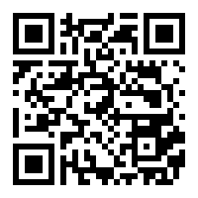
ISeeAI : AI Assistant for Visually Impaired People
Visit ISeeAI : https://iseeai-for-blind-people.netlify.app/
Visit ISeeAI Documentation for more details : https://iseeai-documentation.netlify.app/

