Slide 1


Institute of Advanced Computing and Software Development,
Akurdi, Pune
Project Title:
School Management System
Presented By : Tejas Sanjay Pranjale(223217)
Aniket Vijay Rokade(223021)

Slide 2

INTRODUCTION
School Management System is an application based on java technology which can be used for managing your school’s day to day activities. It allows users to store their school’s information including Students and Teacher’s information. Most importantly, this information can be shared with authorized users, records can be searched and can be manipulated.
School management system is configurable and can be configured to meet certain individual school’s needs. It could make the school staffs work easier than ever. Using this system, finding student’s information’s become a very quick operation which might have cost several hours or even more than a day.

Slide 3
TECHNOLOGY USED
We used Java Spring-Boot as backend and React JS as Frontend in our Project.
• Spring-Boot :–
Spring Boot is an open source Java-based framework used to build stand-alone and production ready spring applications. It is a project that is built on the top of the Spring Framework. The main goal of the Spring Boot framework is that it provides an easier and faster way to set up, configure, and run both simple and web-based applications thereby reduce overall development time and increase efficiency.
• React :–
React allows developers to create large web applications that can change data, without reloading the page. The main purpose of React is to be fast, scalable, and simple. React has become the first choice for frontend because it gives developers the ability to work with a virtual browser (more friendly than the real browser). Also, a JavaScript developer can become a productive developer in a few hours because there is a small API to learn, a few functions, and how to use them.
• MySQL:-
MySQL is a relational database management system based on Structured Query Language. The application is used for a wide range of purposes, including data warehousing, e-commerce, logging applications, etc.

Slide 4



USER CLASSES
Admin
Teacher
Student
In this module, Admin can register, update, delete student, teacher as well as admin and various other features
In this module, Teacher can add marks, add notice, add attendance, and various other things
In this module, Student can view attendance, add fees and view marks various other things

Slide 5
PRODUCT FUNCTIONS
The system provide efficient medium to manage all basic business of school.
It also provide easy interface for admin, teacher and student to perform their related operations.
The system provides better way for keeping huge database of school.
It also allows the student, teacher, admin to get the information faster and easier.
Our system has a encrypted login feature which provide a better security.
It can also distinguish between a normal user or a bot attempting login.

Slide 6
ADMIN MODULE
Update Profile
Add Class
Add Users
Add/Delete Notice
View Attendance
Add/View Subject
Add/View Schedule
View Fees

Slide 7
TEACHER MODULE
Update Profile
Add/Delete Notice
View Attendance
View Subject
Add Marks
View Schedule
View Salary

Slide 8
STUDENT MODULE
Update Profile
View Attendance
View Subject
View Marks
View Schedule
Add Fees

Slide 9
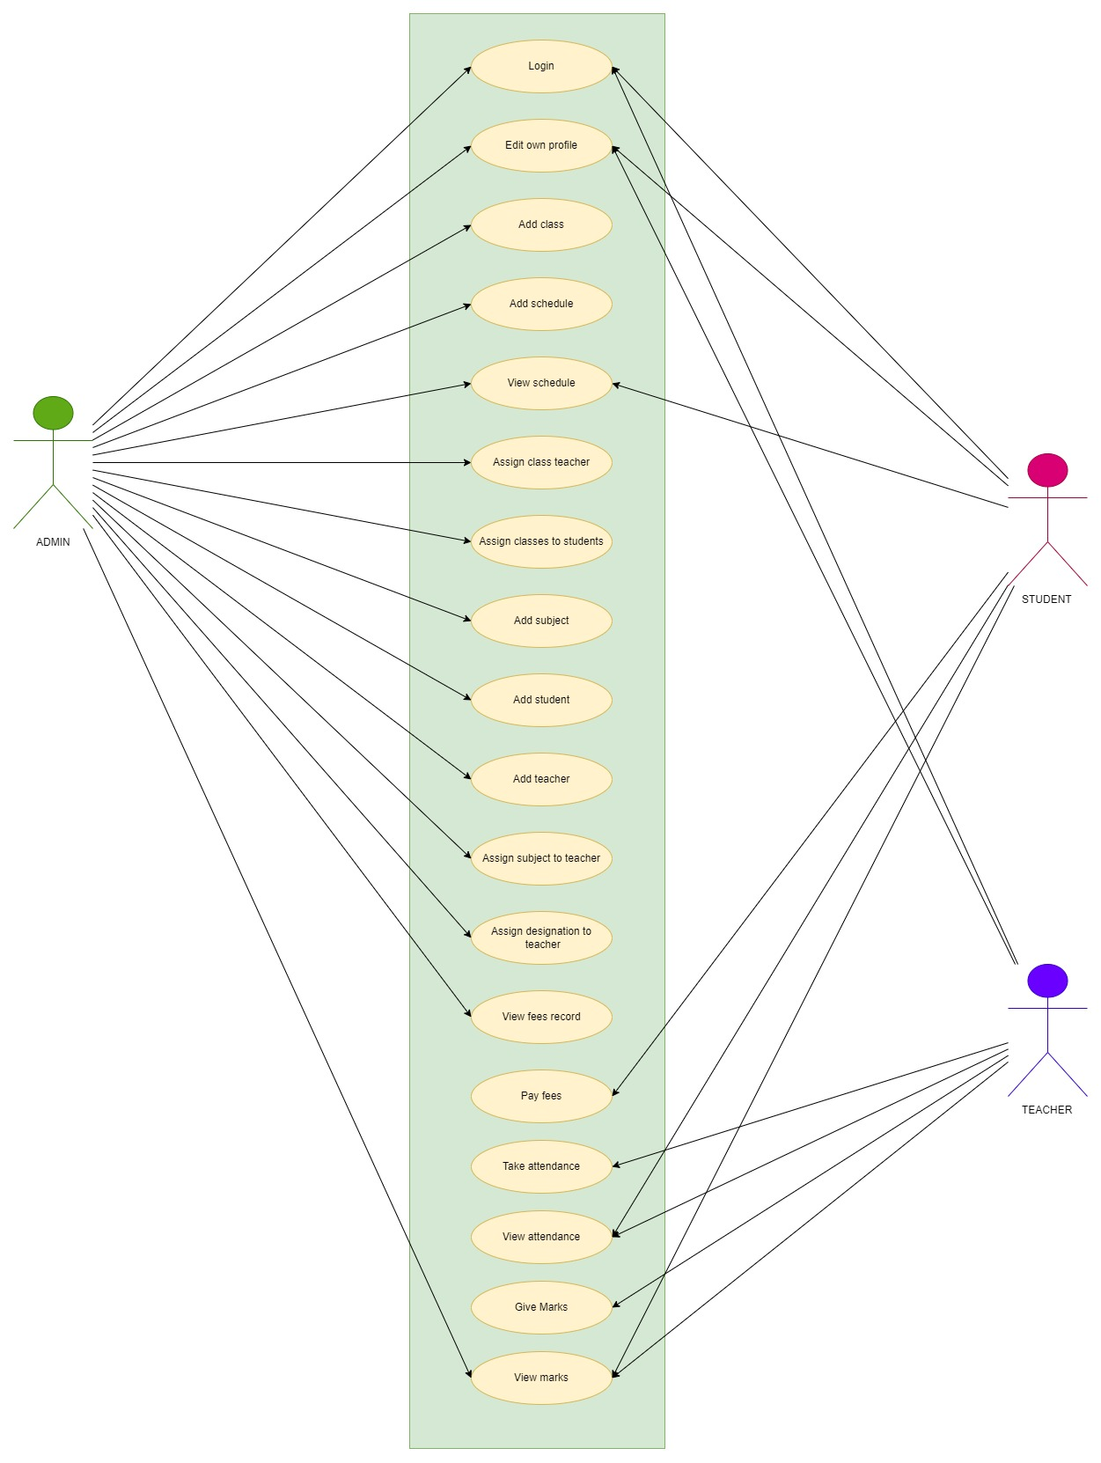
USE CASE
DIAGRAM

Slide 10
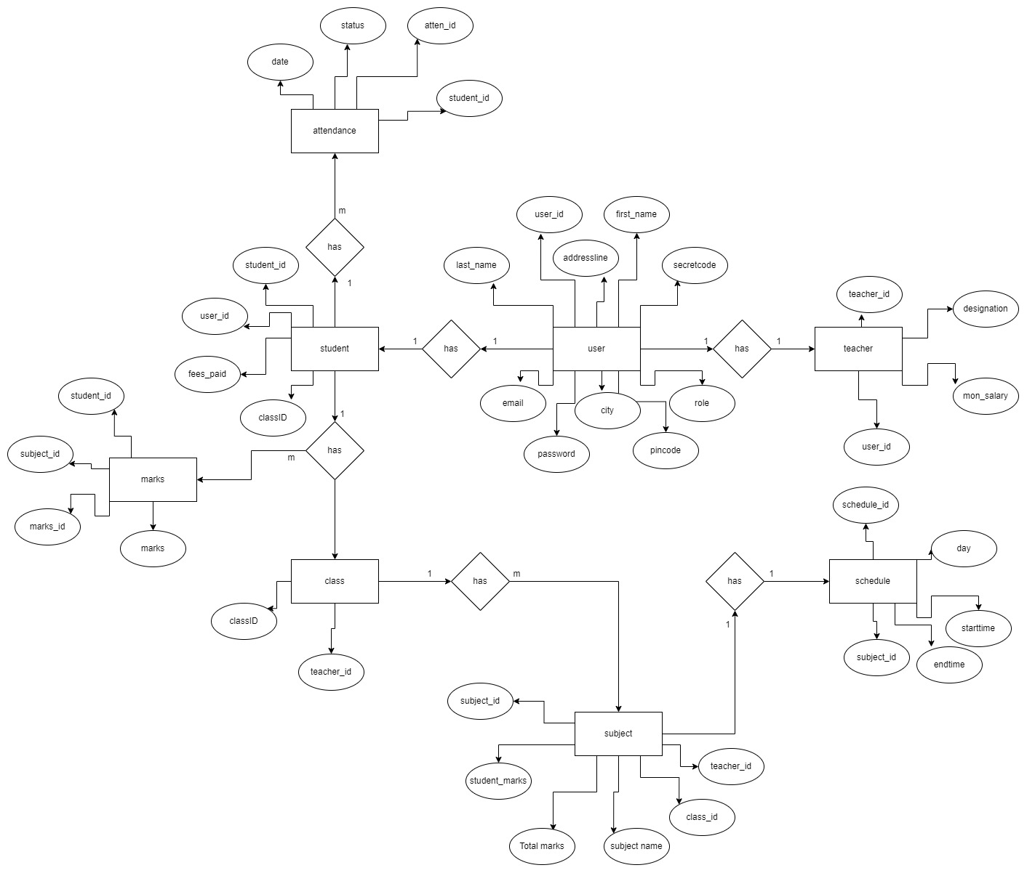
ER DIAGRAM

Slide 11
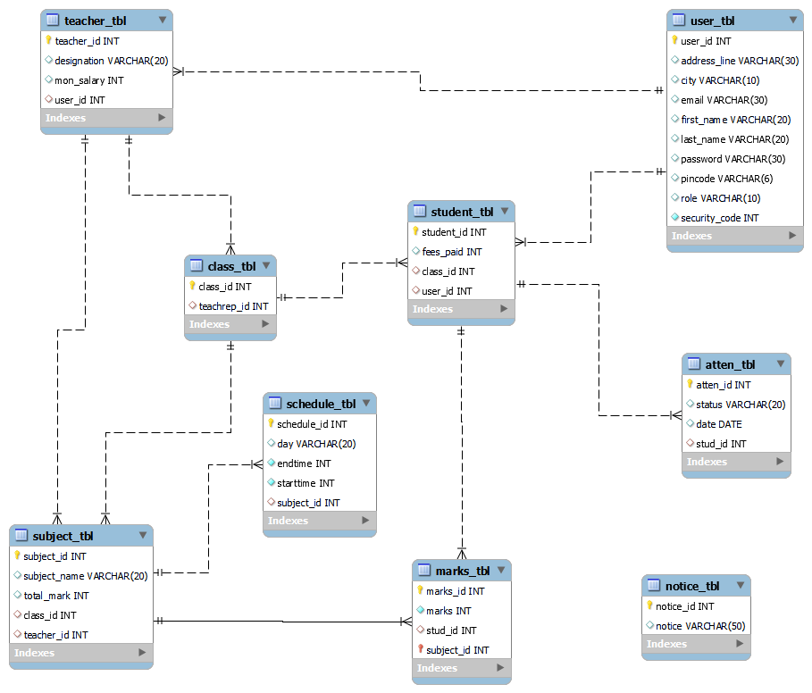

Slide 12
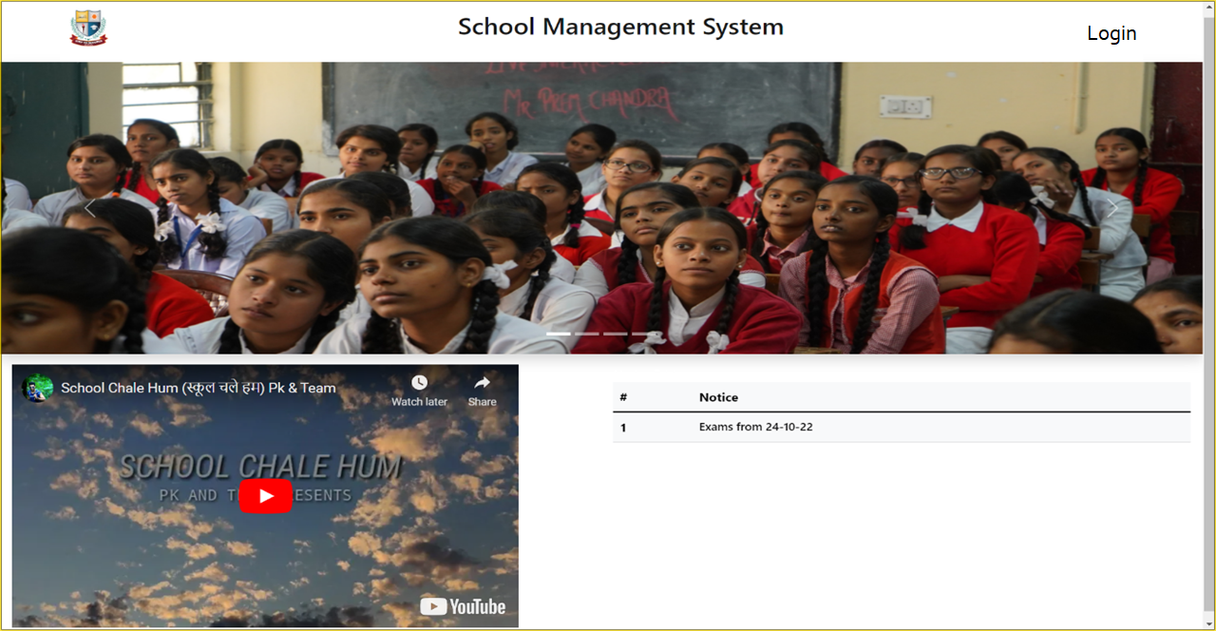
HOMEPAGE

Slide 13
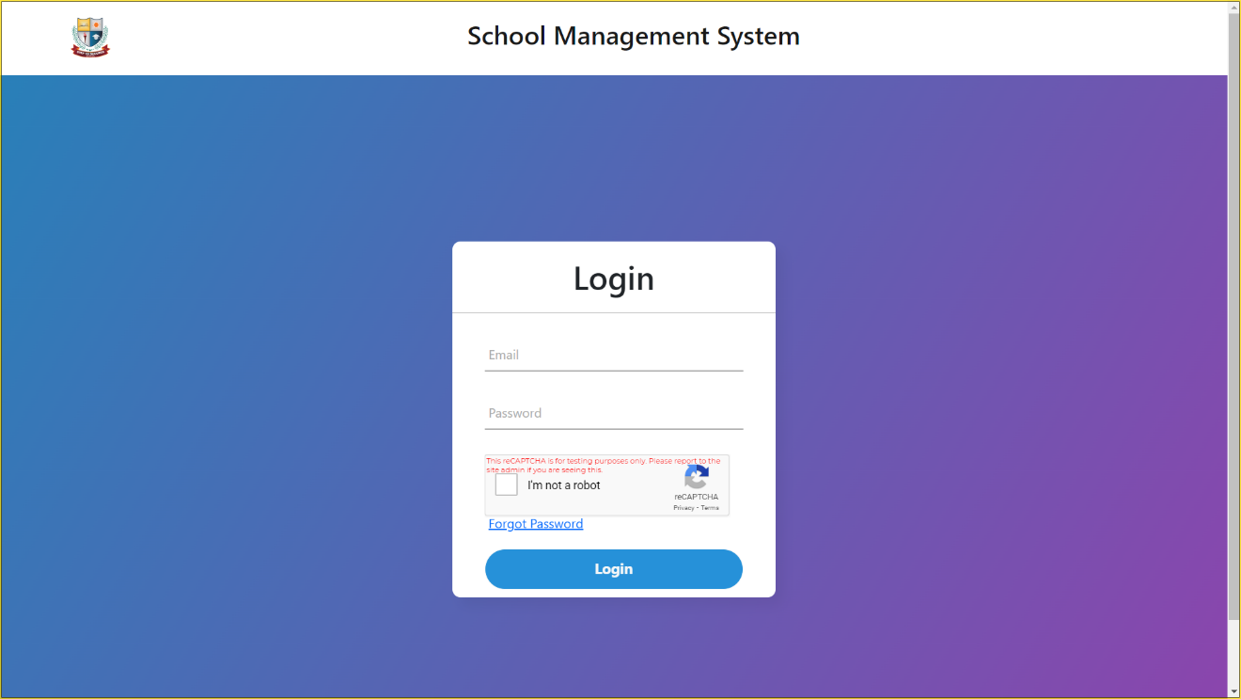
LOGIN

Slide 14
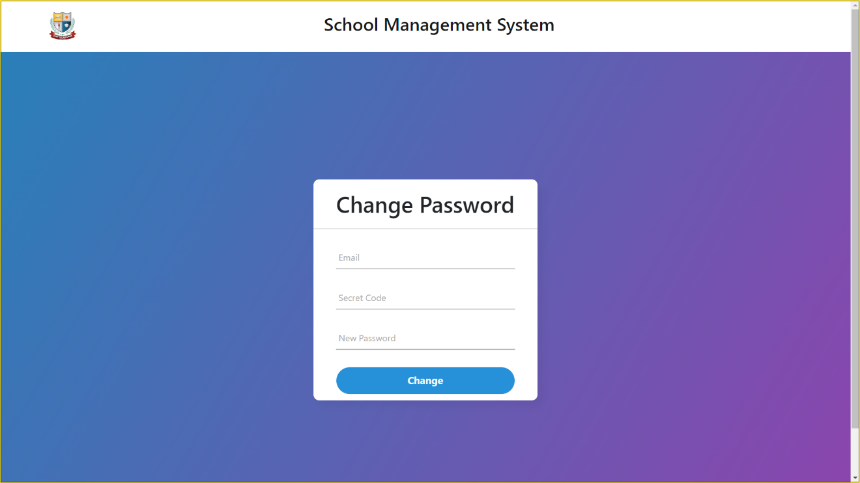
CHANGE PASSWORD

Slide 15
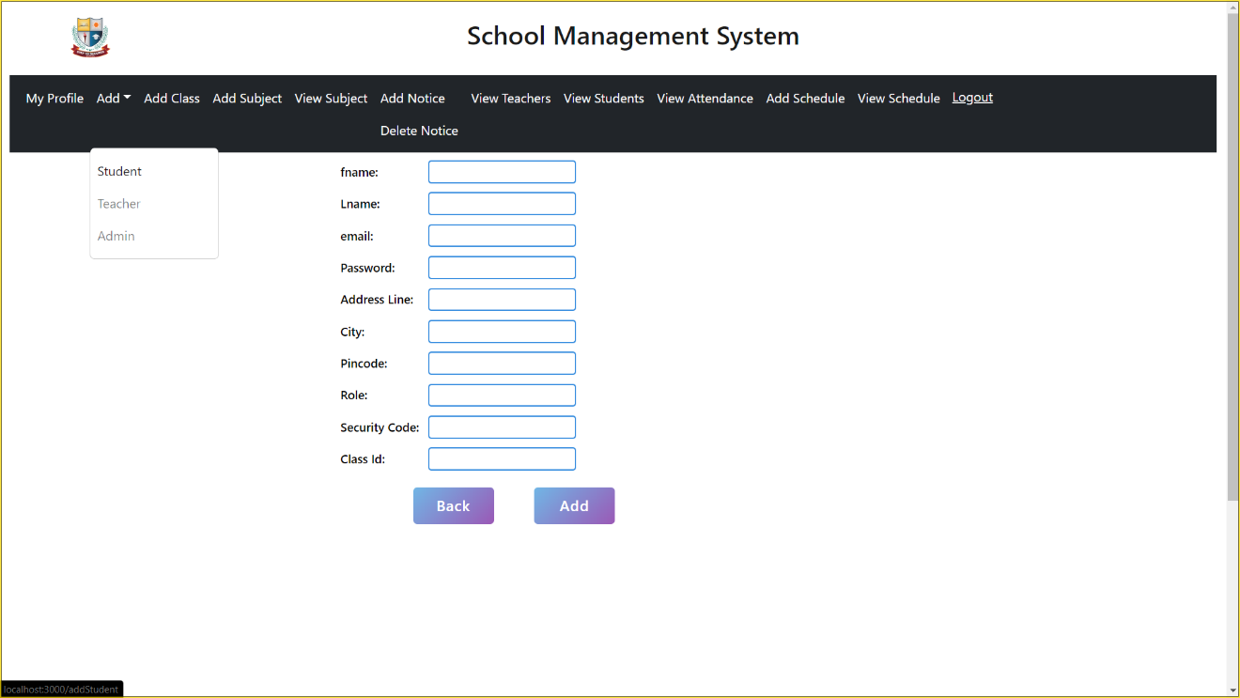
NEW STUDENT REGISTRATION

Slide 16
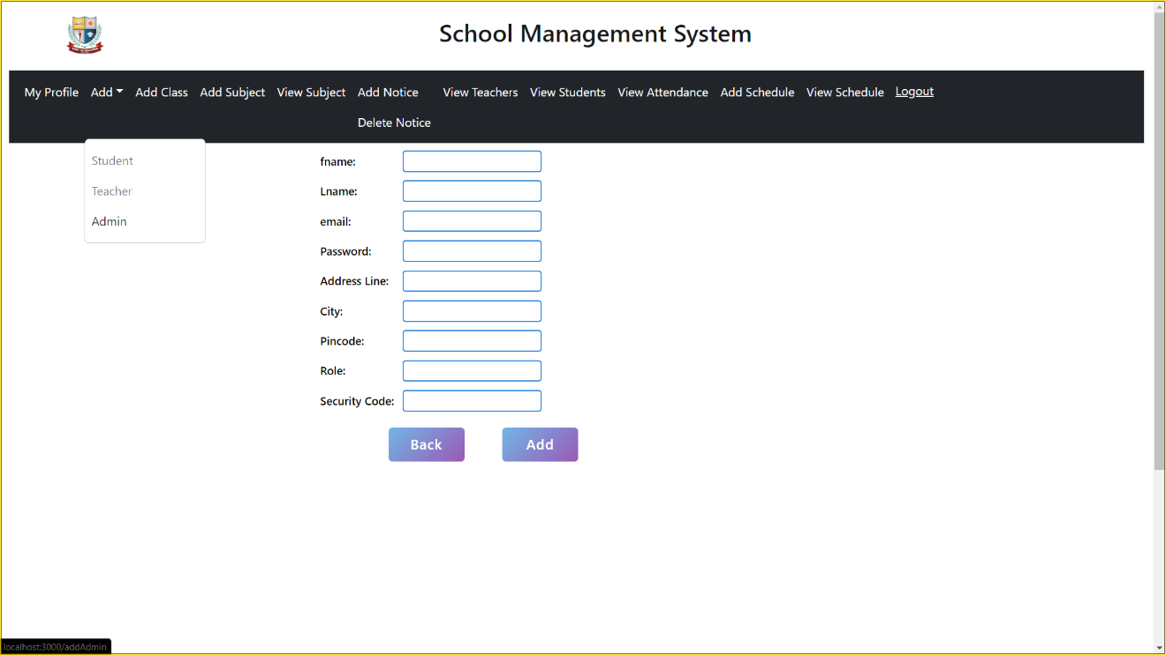
NEW ADMIN REGISTRATION

Slide 17
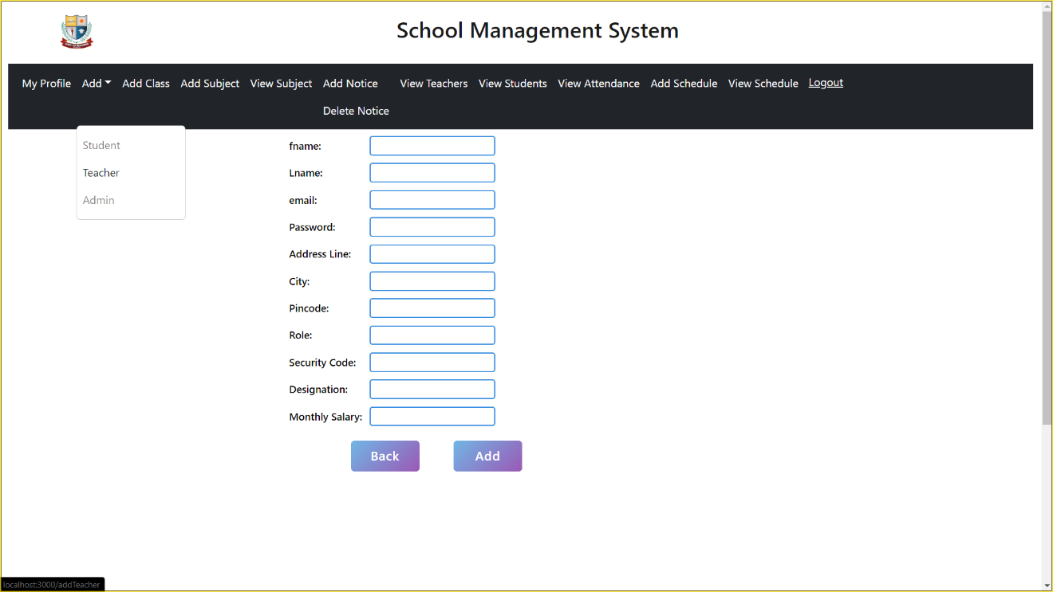
NEW TEACHER REGISTRATION

Slide 18
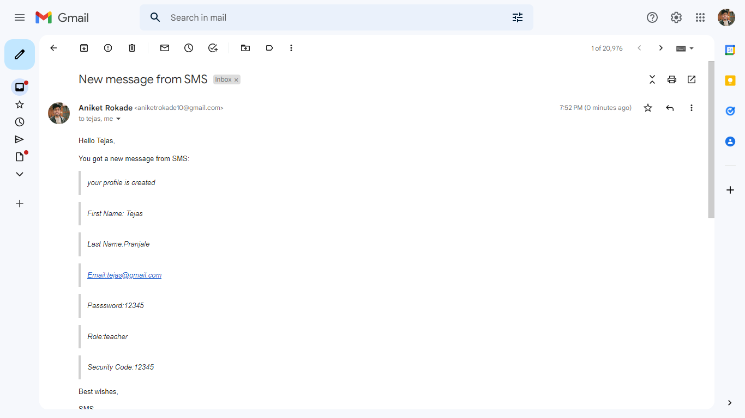
MAIL AFTER REGISTRATION

Slide 19
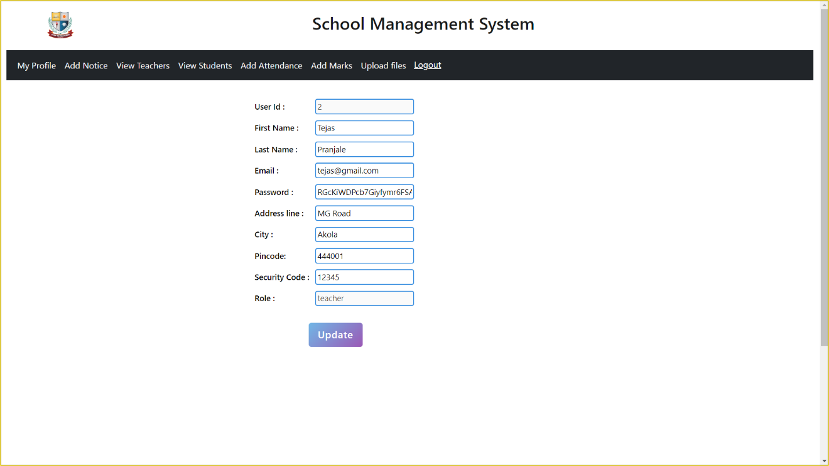
UPDATE PROFILE

Slide 20
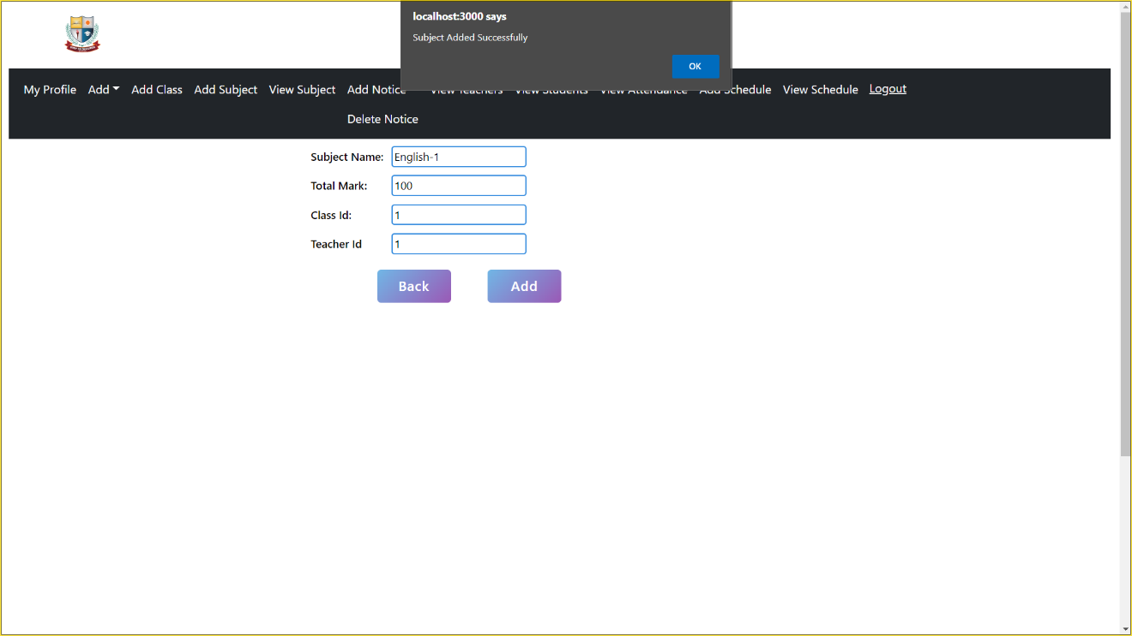
ADD SUBJECT

Slide 21
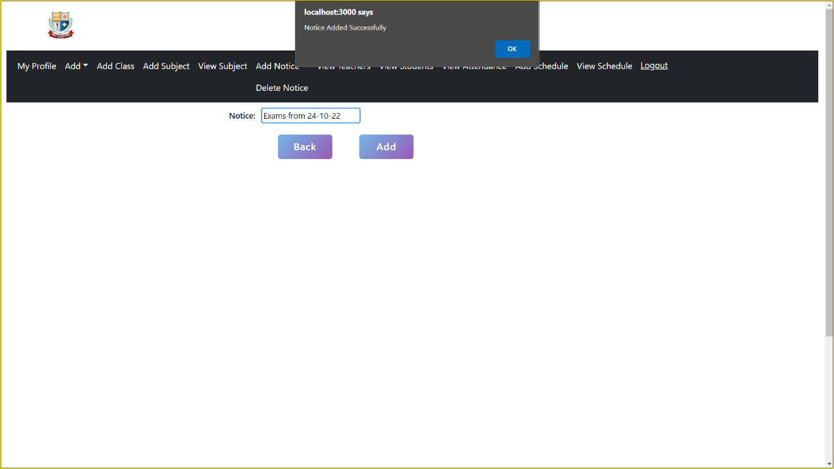
ADD NOTICE

Slide 22
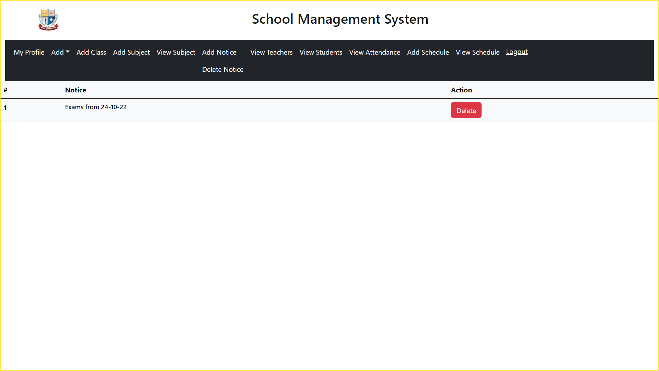
DELETE NOTICE

Slide 23
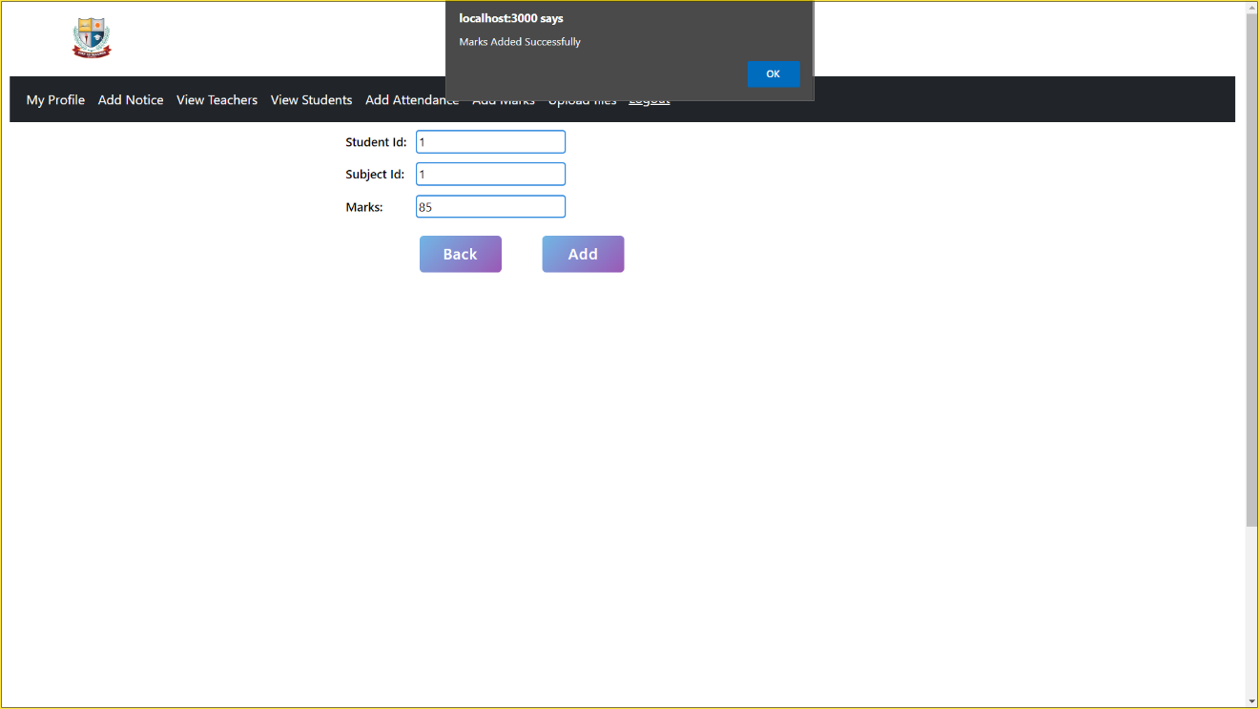
ADD MARKS

Slide 24
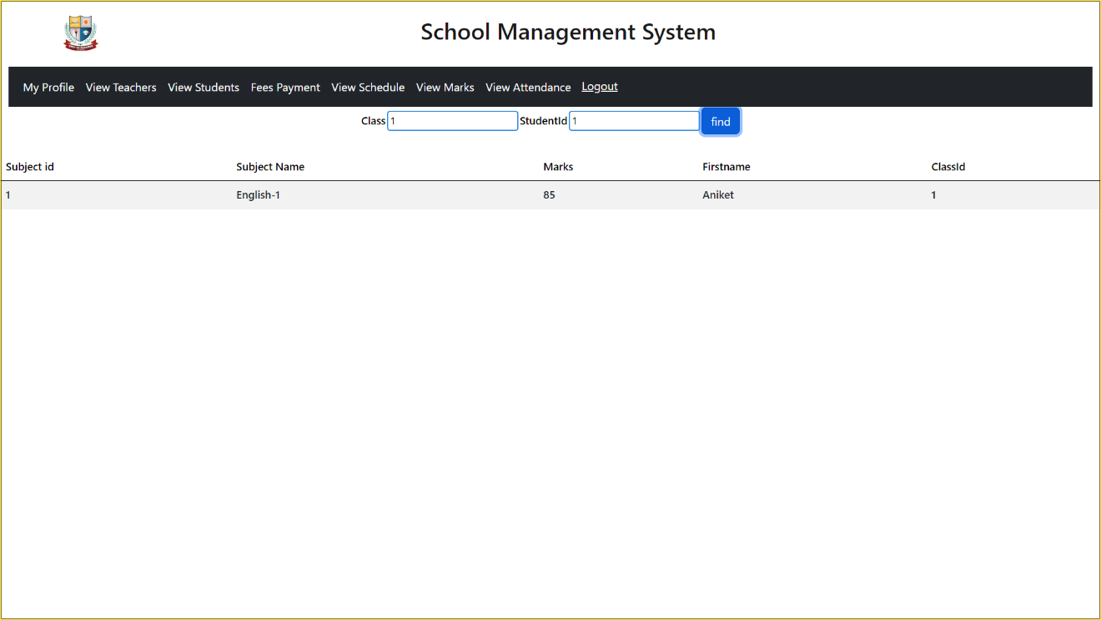
VIEW MARKS

Slide 25
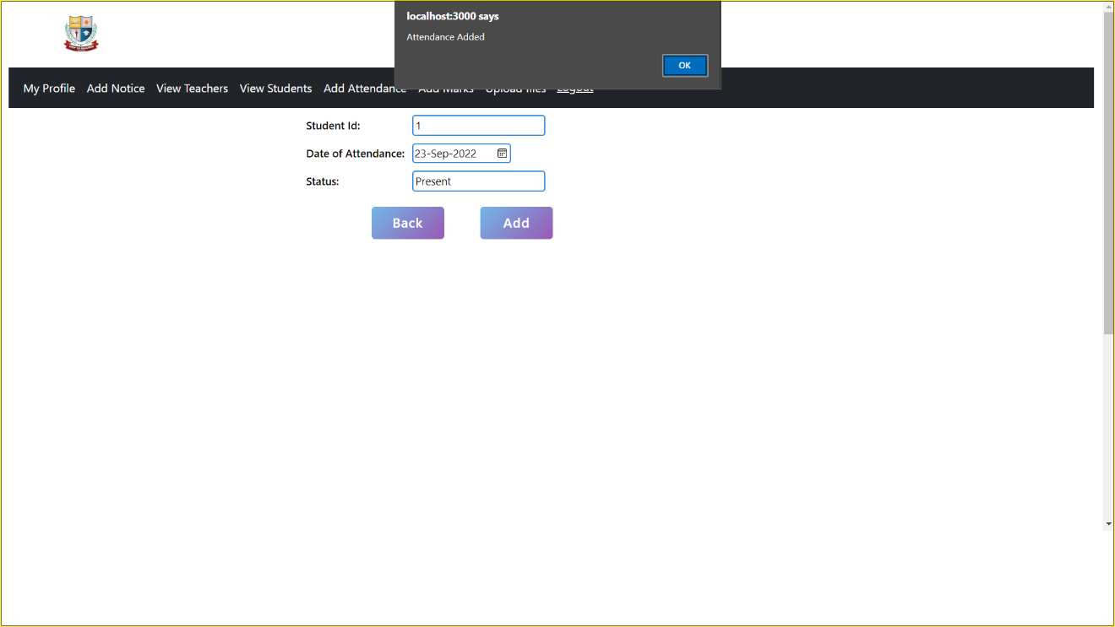

ADD ATTENDANCE

Slide 26
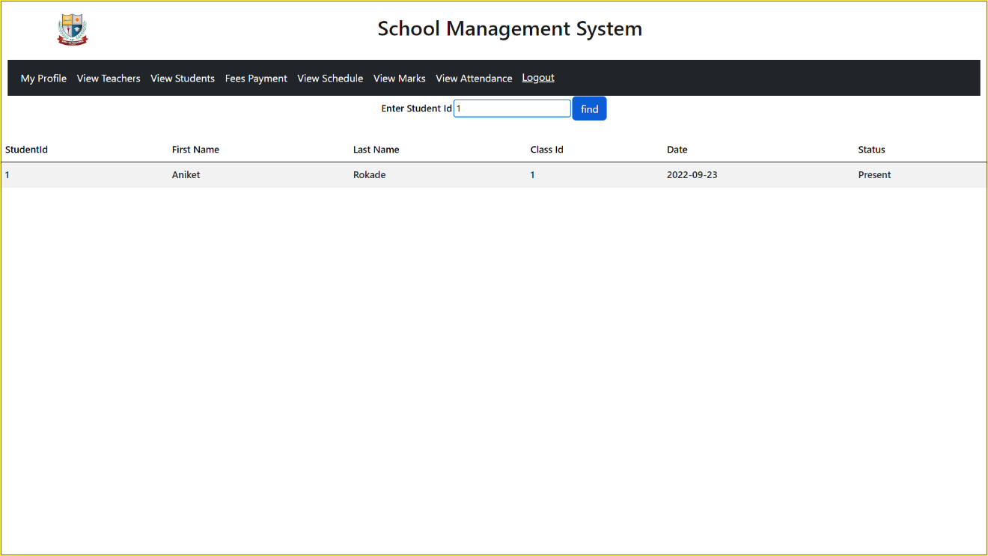
VIEW ATTENDANCE

Slide 27
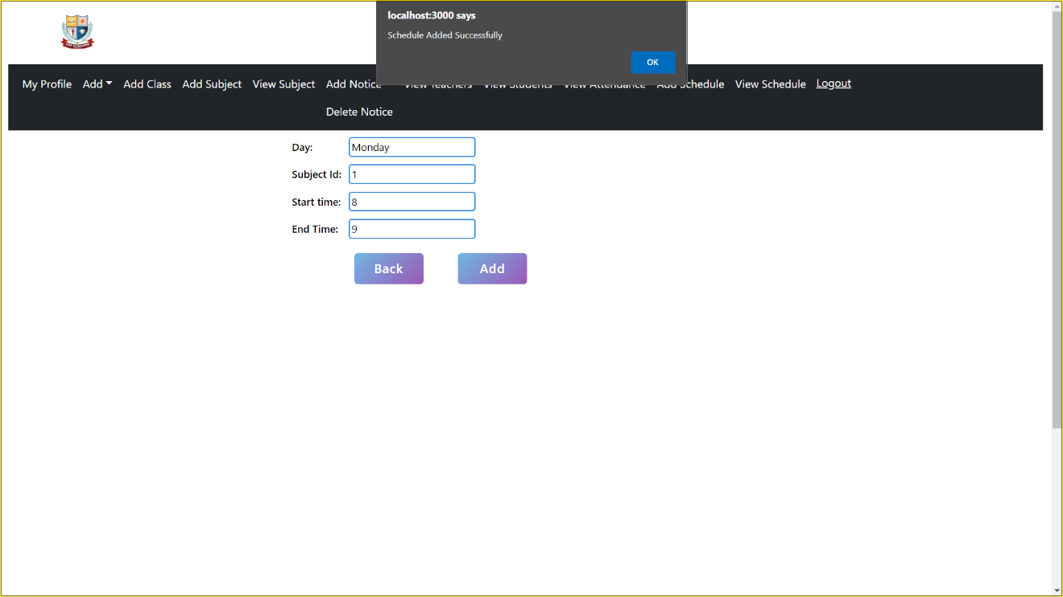
ADD SCHEDULE

Slide 28
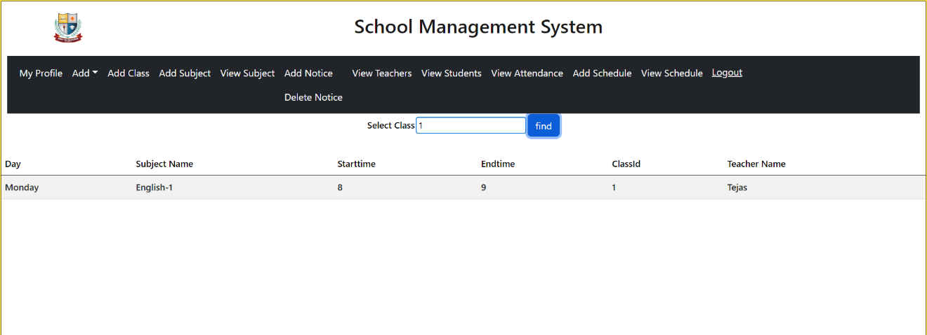
VIEW SCHEDULE

Slide 29
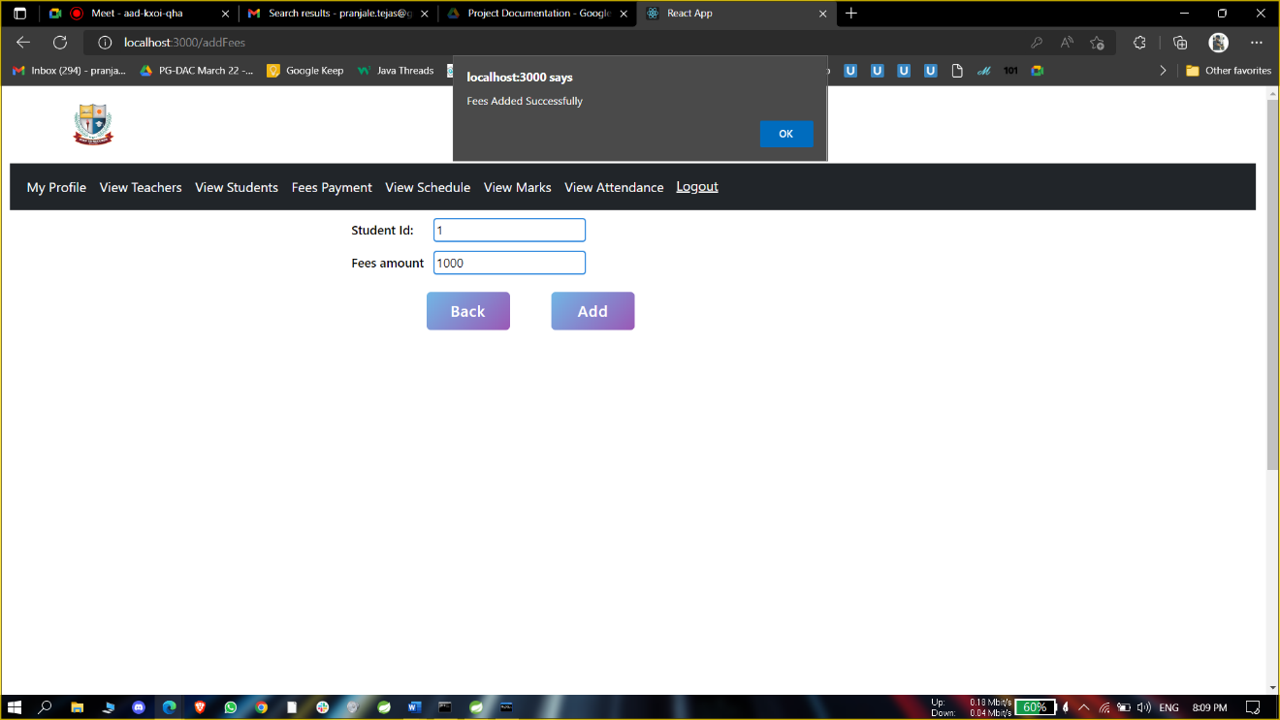
ADD FEES

Slide 30

VIEW FEES

Slide 31
THANK YOU
THANK YOU

