Slide 1
Loan Data Analysis using Lending Club Loan Dataset
By,
Aniket Roy
Srujana N

Slide 2
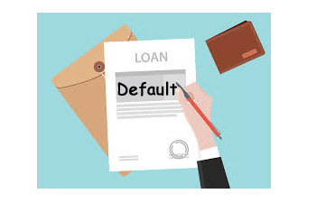
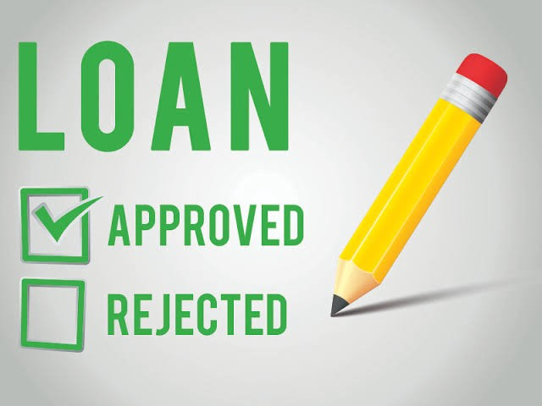
PROBLEM STATEMENT
Lending Club is the largest online loan marketplace, offering products like
Personal Loans
Business Loans
Financing medical procedures
Borrowers can apply and access these products through an online interface
But lending loans to highly risky applicants can cause a very large credit loss
Therefore, we must identify the driving factors that are strong indicators of a loan defaulter

Slide 3




OVERALL APPROACH
Load Data
Missing Value Treatment
Outlier Treatment
Feature Engineering
Exploratory Data Analysis
RECOMMENDATIONS

Slide 4
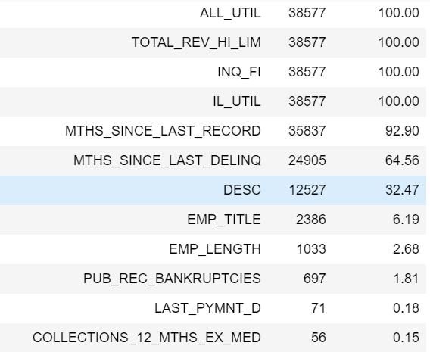
MISSING VALUE TREATMENT
Dropped all the columns that had at least 30% missing values as imputing these will result in bias/de-authentication of data
Dropped all those rows whose respective columns had insignificant number of missing values. Dropping these will not result in data loss as the number is insignificant

Slide 5
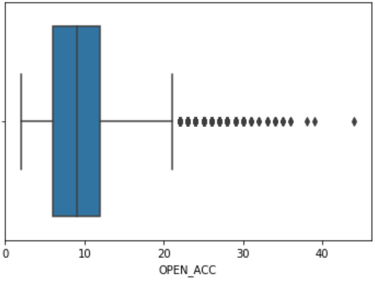
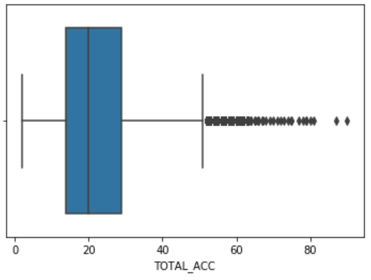
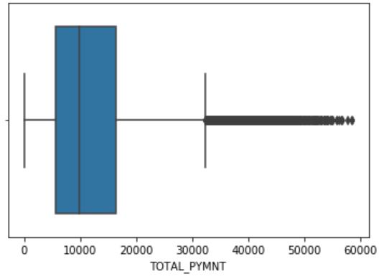
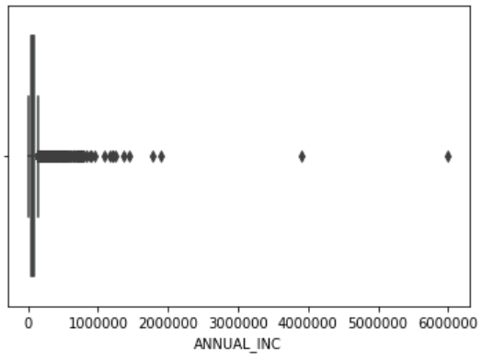
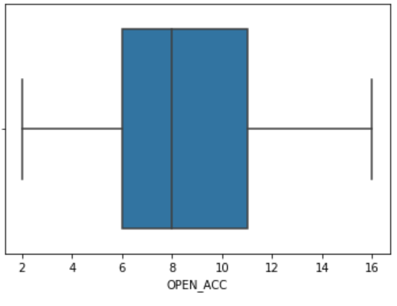
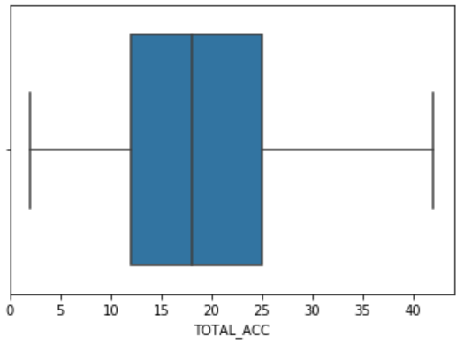
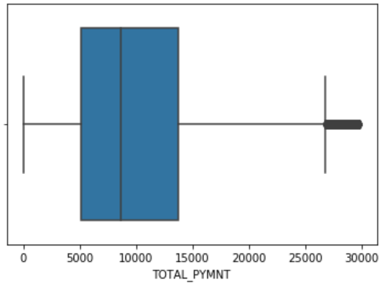
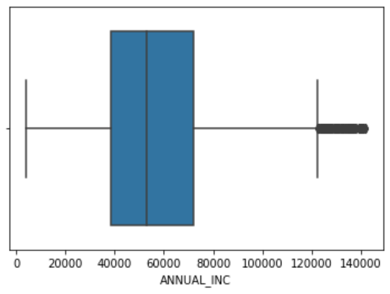
OUTLIER TREATMENT
Removing the outliers by making sure we are not losing a significant amount of data
We may still have some outliers in the data, which is fine. Because, if we drop them, there will be a significant loss of data
Following are some of the features where we performed outlier treatment,
Pre-Outlier Treatment
Post Outlier Treatment

Slide 6
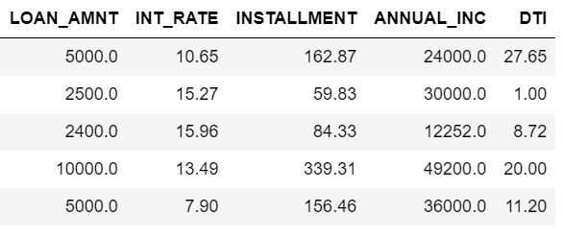
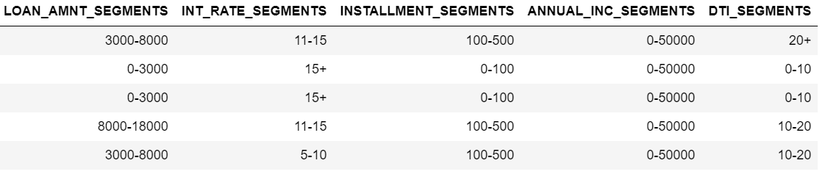
FEATURE ENGINEERING
Continuous features have values that are absolute numbers and trying to compare the absolute numbers with "Defaulters" and "Non-defaulters" will be difficult and make no sense. Hence, we can segment these data-points within features such that each segments have data-points that are homogenous to each other, and the segments are heterogenous amongst each other

Slide 7
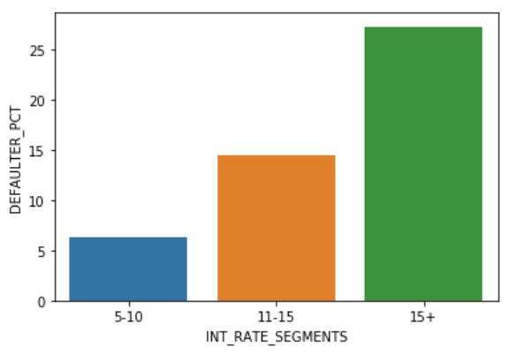
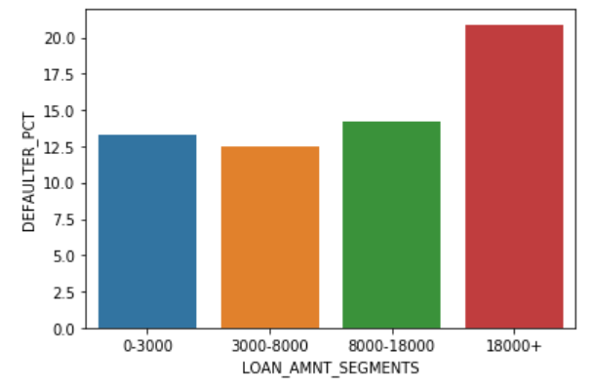
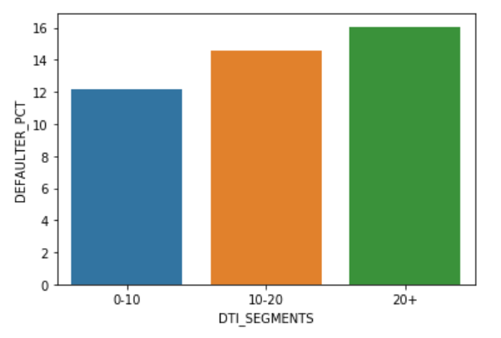
EXPLORATORY DATA ANALYSIS
Following plots depicts the key drivers for loan defaulting,
Higher the interest rates, higher are the chances of defaulting
Higher the loan amount, higher are the chances of defaulting
Higher the debt to salary ratio, higher are the chances of defaulting

Slide 8
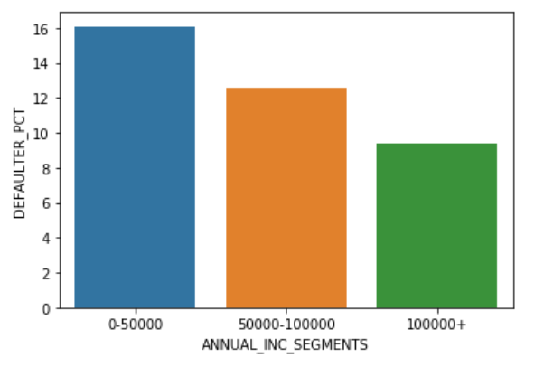
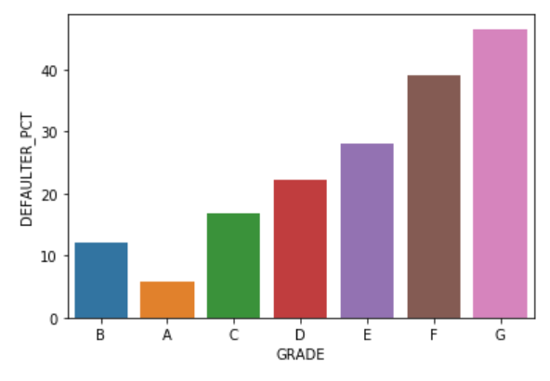
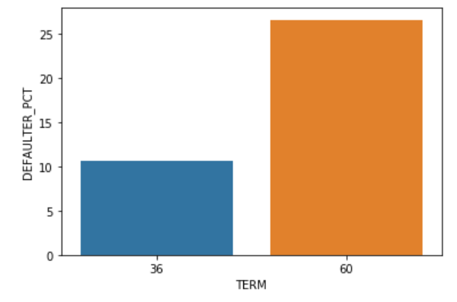
EXPLORATORY DATA ANALYSIS
Lower the salary, higher are the chances of defaulting
Higher the grade of debt, higher are the chances of defaulting
Higher the debt term, higher are the chances of defaulting

Slide 9
RECOMMENDATIONS
As observed in the EDA, interest rates, loan amount, debt to salary ratio, salary, grade of debt and term of debt are the key drivers of loan defaulting
Following are our recommendations,
To the applicants with low salary, high loan amount requirement, high debt to salary ratio, higher grade of debt and higher term requirement, we can approve a loan of an amount not to high but with a high interest as they are very high risky applicants
To the applicants with medium salary, medium loan amount requirement, medium debt to salary ratio, medium grade of debt and medium to low term requirement, we can lend a slightly higher loan amount and a slightly lower interest rate than the highly risky applicants
To the applicants with high salary, low loan requirement, low debt to salary ratio, low grade of debt and with a low term requirement, we can lend a higher amount as required with a standard or low interest rates as they are the least risky applicants

