Slide 1

A Project on "Seasonal Crop Price Prediction Using AI ML”
Presented By
Aniket Sawant
Tejas Jadhav
Sarthak Kakade
Harsh Dudhal
Under the Guidance of
T.S.Dhage
Mrs. Dhage T.S.
Department of Computer Engineering
DKFOE, Pune

Slide 2

Contents
Abstract
Project objective
Scope of project
Literature survey
Project planning
Project Results
Project Conclusion
Future Scope
References

Slide 3
Abstract
The Indian agricultural sector continues to face major inefficiencies due to the persistent mismatch between crop production and localized market demand.
Farmers often cultivate crops without accurate insights into city-level requirements, resulting in oversupply, wastage, reduced profits, or undersupply leading to scarcity and inflation.
To address this issue, the proposed system “Seasonal Crop Supply Chain Planner with Local Demand Forecasting” integrates artificial intelligence and web technologies to provide actionable demand forecasts for farmers

Slide 4
Project Objectives
To design a web-based platform that allows farmers to register and access local demand forecasts.
To implement forecasting using LSTM for predicting future demand of seasonal crops in a given city.
To provide a user-friendly dashboard that displays forecasted demand, historical trends, and seasonal variations.
To support data-driven decision making in the agricultural supply chain, thereby reducing waste, stabilizing farmer incomes, and improving food availability.
To evaluate the performance of the forecasting model using statistical metrics such as RMSE.

Slide 5
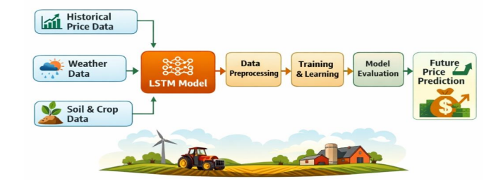
Project Objectives

Slide 6

Scope of Project
“The proposed system will focus on providing city-specific local demand forecasts for major crops using AI techniques, primarily Long Short-Term Memory (LSTM) networks for time-series prediction. The system will be developed as a web application with functionalities for managing farmer profiles and demand data. Key stakeholders include”
Farmers: who will log in to the system, view demand forecasts for their respective city, and plan their cultivation and supply accordingly.
Researchers and Policymakers: who may use aggregated demand insights to plan procurement and distribution policies

Slide 7
Literature survey
Title | Authors / Year | Methods Used | Key Findings | Publisher
Crop recommendation and forecasting system for Maharashtra using machine learning with LSTM: a novel expectation-maximization technique | 2024 | ML + LSTM + EM | Forecasted crop demand and suitability in Maharashtra using weather and historical crop data. LSTM effectively captured temporal variations. | Springer – Discover Sustainability
Classification and Estimation of Crop Yield Prediction in Karnataka using LSTM with Attention Mechanism | 2023 | LSTM + Attention + Feature Selection | Applied LSTM with attention for crop yield prediction; high accuracy (~98%). Demonstrates handling of seasonal and city-level variation. | IJISAE
Crop Yield Prediction using Deep Learning Algorithm based on CNN-LSTM with Attention Layer and Skip Connection | 2024 | CNN-LSTM + Attention | Hybrid CNN-LSTM architecture for wheat and rice; useful reference for combining temporal and spatial patterns. | Indian Journal of Agricultural Research
ARIMA models to forecast demand in fresh supply chains | 2011 | ARIMA | Applied ARIMA to onion sales in Ahmedabad market; achieved MAPE of 43.14%. Shows volatility in perishable goods demand. | Int. Journal of Operational Research, Inderscience Publishers
Forecasting wheat prices in India | 2018 | ARIMA | Modeled monthly wheat price trends (2006–2017). Useful for understanding seasonal price variations. | Journal of Wheat Research, ICAR
Hybrid linear time series approach for long term forecasting of crop yield | 2018 | ARIMA + ANN | Hybrid model outperforms ARIMA alone for long-term forecasts of rice yield in Uttar Pradesh. | Indian Journal of Agricultural Sciences, ICAR
ARIMA model for forecasting of area, production and productivity of oilseeds in India | 2024 | ARIMA | Forecasted area, production, and yield for oilseeds up to 2031-32; demonstrates handling multi-year forecasts. | The Journal of Research, BANGRAU
Agmarknet Market Data | Government of India | Time-series analysis | Daily crop arrivals and prices across markets; essential for local demand forecasting. | Ministry of Agriculture & Farmers’ Welfare
Agricultural Statistics at a Glance | Government of India | Data compilation | Provides historical agricultural statistics for India; foundational dataset for LSTM-based forecasting. | Directorate of Economics & Statistics (DES)

Slide 8
Literature survey
Data-driven stochastic programming for sustainable agricultural supply chains | 2014 | Time-series analysis | Daily crop arrivals and prices across markets; essential for local demand forecasting. | H. Darouni et
Crop Yield Prediction using Deep Learning Algorithm based on CNN-LSTM with Attention Layer and Skip Connection | 2018 | CNN-LSTM | Hybrid model outperforms CNN-LSTM alone for long-term forecasts of rice yield in india | The Journal of Research, BANGRAU
A stochastic micro-periodic age-based inventory replenishment policy for perishable goods | 2018 | ARIMA model forecasting | ARIMA model forecasting essential for local demand forecasting. | L. Janssen et
E-Agribusiness with special reference to Agricultural Marketing Information Network (AGMARKNET),” | 2022 | ARIMA | Forecasted area, production, and yield for oilseeds up to 2031-32; demonstrates handling multi-year forecasts. | Research Gate
A stacking ensemble model for food demand forecasting | 2025 | ML | Representative modern ML ensemble approach for food demand forecasting | ] A. Seyam et
Real Time Cold Chain Monitoring System Using | 2021 | ARIMA + ANN | Hybrid model outperforms ARIMA alone for long-term forecasts of rice yield in USA | S. M. Shawon

Slide 9
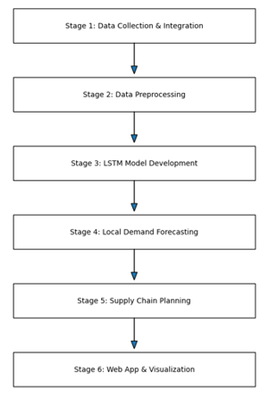
Methodologies/tools/techniques used
.

Slide 10
Project Planning
Phase 1: Requirement Analysis
Collect datasets.
Define system objectives and constraints.
Identify input/output variables for LSTM.
Phase 2: System Design
Design database schema.
UML diagrams and data flow diagrams.
LSTM model design architecture.

Slide 11
Project Planning
Phase 3: System Development
Backend: Python with SQLite integration.
Frontend: HTML, CSS, Bootstrap for UI.
LSTM model development in Python (Tensor Flow/ Keras).
Evaluate accuracy with test datasets.
Phase 4: Model Training & Testing
Preprocess datasets (normalization, feature engineering).
Train LSTM model with historical data.
Generate prediction reports.

Slide 12
Project Planning
Phase 5: Integration
Integrate LSTM predictions into web system.
Create farmer profile module.
Generate prediction reports.
Phase 6: Validation & Deployment
Test GUI with real users (farmers).
Debugging and error handling.
Deployment on localhost/server.
Phase 7: Documentation & Reporting
Prepare project report.
Final presentation.

Slide 13
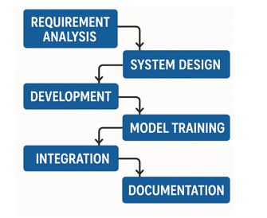
Project Planning (Task Network)

Slide 14
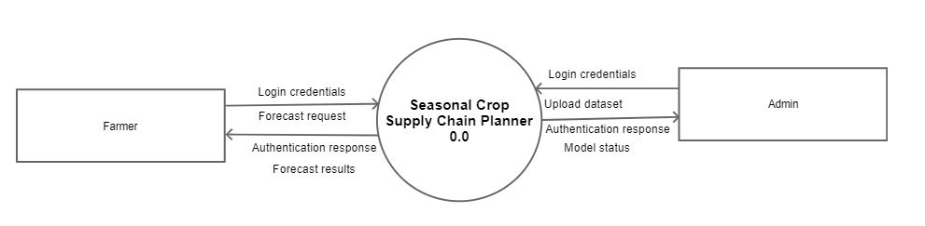
Project Planning (Task Network)

Slide 15
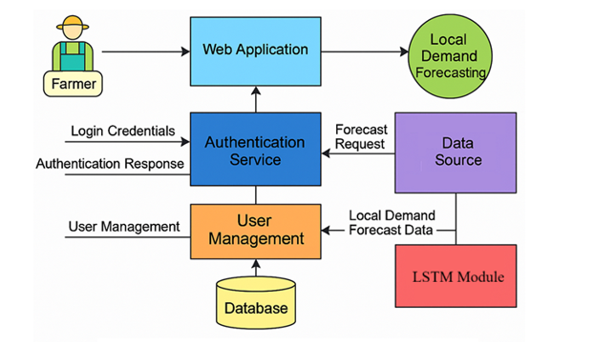
Systems Architecture

Slide 16
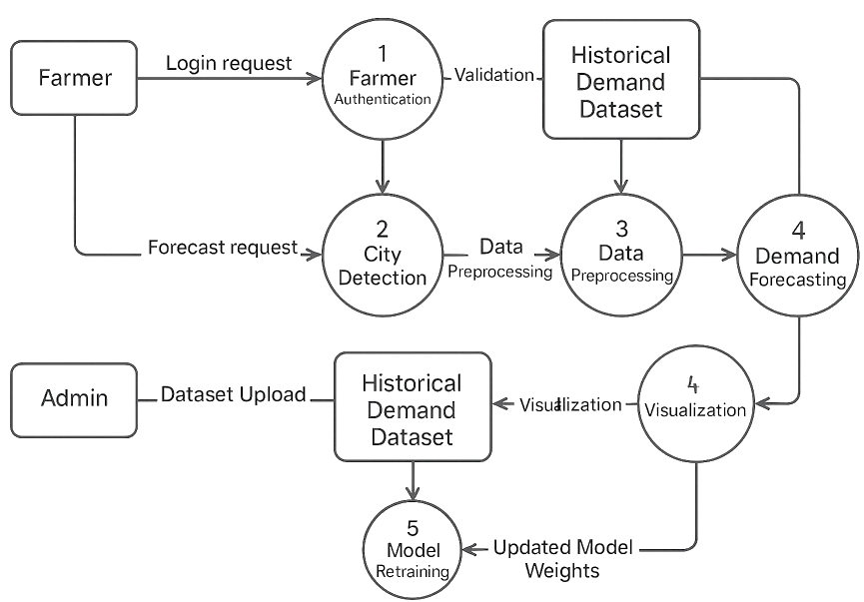
Data Flow Diagram

Slide 17
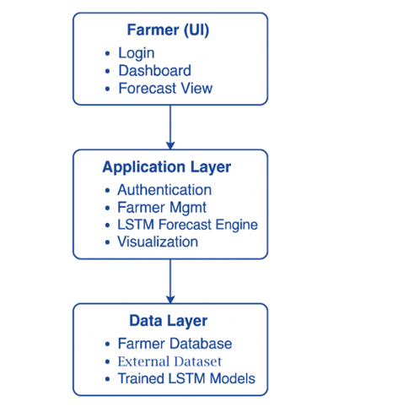
Systems Layer Diagram

Slide 18
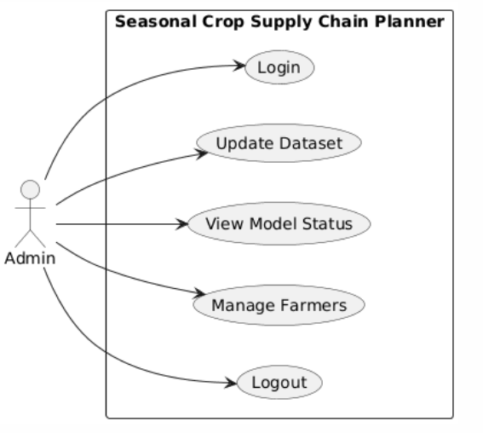
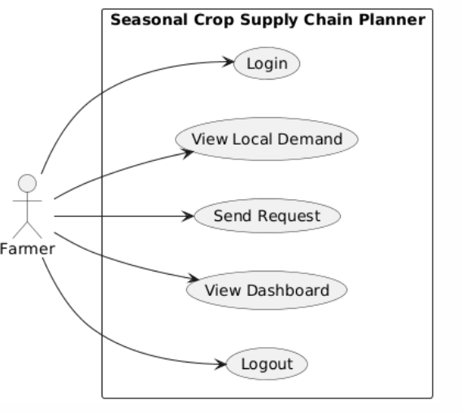
Use Case

Slide 19
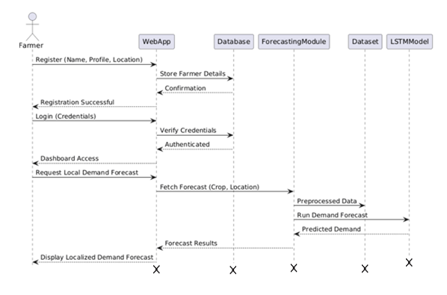
Sequence Diagram Farmer

Slide 20
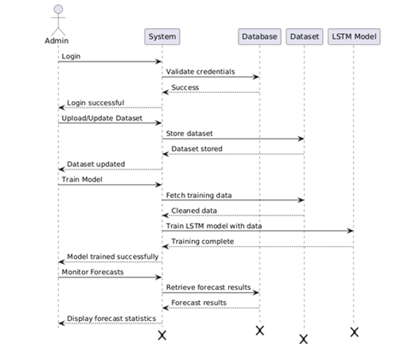
Sequence Diagram Admin

Slide 21
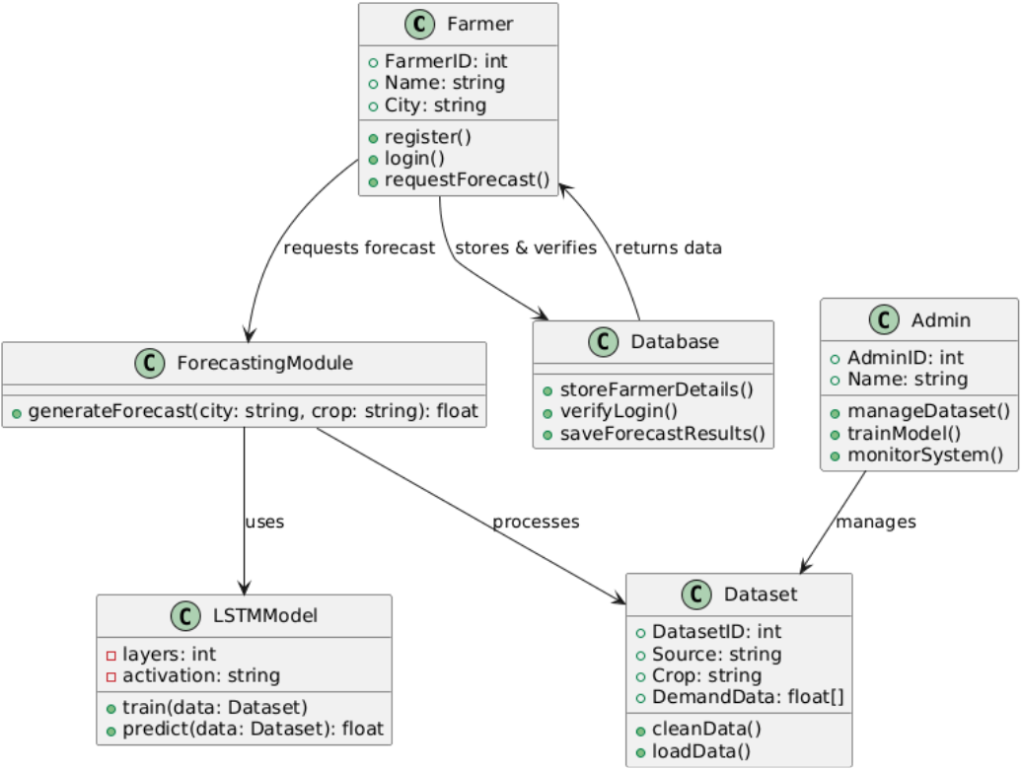
Class Diagram

Slide 22
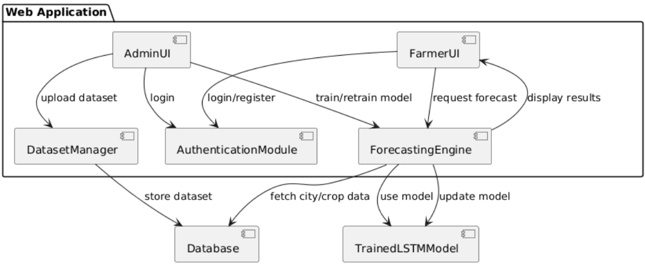
Component Diagram

Slide 23
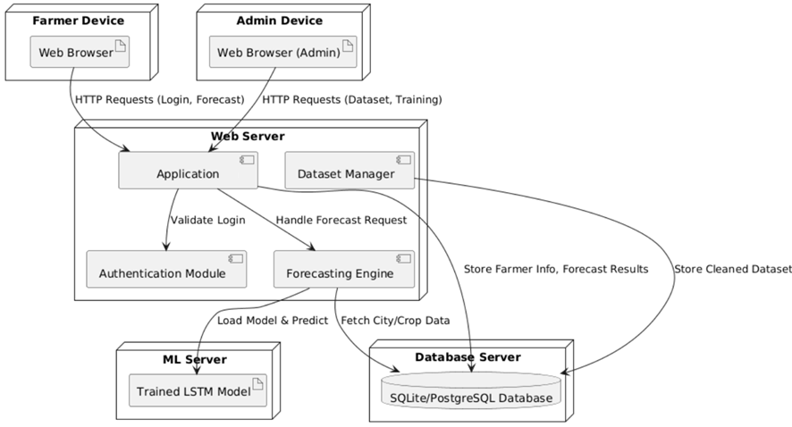
Deployment Diagram

Slide 24
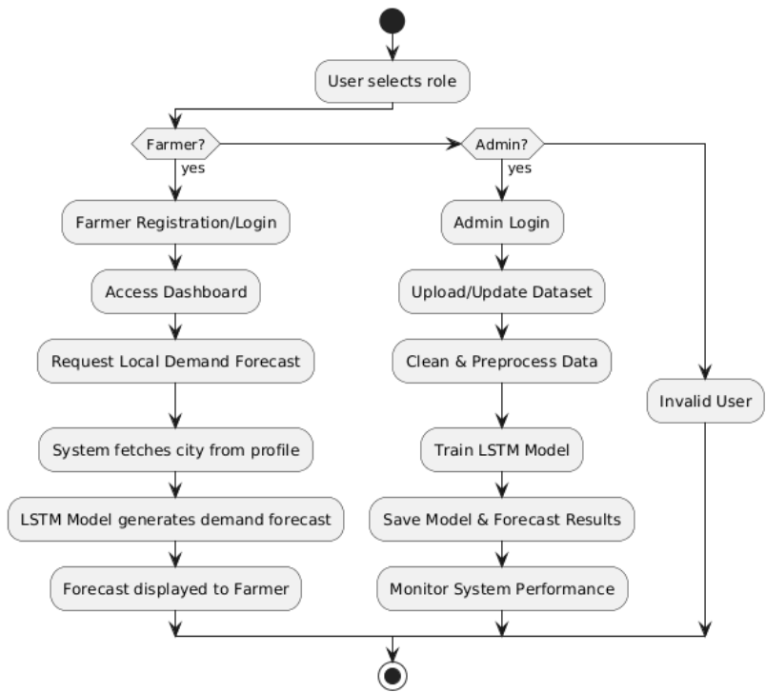
Activity Diagram

Slide 25
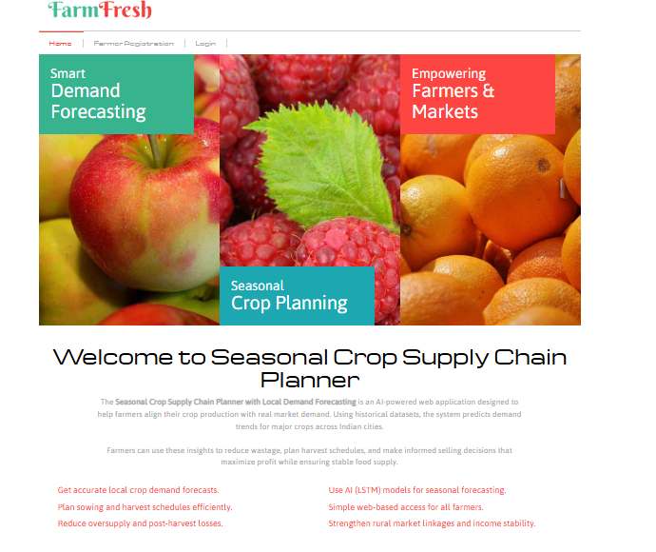
Web Platform Details

Slide 26
Project Result
Metric | LSTM
RMSE | 5.85
MAE | 3.95
MAPE | 7.05
Accuracy (%) | 92.95%

Slide 27
Project Result
The Seasonal Crop Supply Chain Planner with Local Demand Forecasting successfully demonstrates the application of AI for city-level crop demand prediction in India. By integrating historical data with a web-based farmer interface, the system provides actionable insights to optimize crop supply and minimize economic losses.
Key outcomes:
Accurate Local Demand Forecasts
Farmer-Centric Platform
Reduced Wastage & Market Inefficiency
Economic Impact

Slide 28
Project Conclusion
The project highlights the significant role of Artificial Intelligence and predictive analytics in transforming agricultural supply chain management.
The Seasonal Crop Supply Chain Management System provides a practical and scalable solution for improving crop planning, demand forecasting, market coordination, and overall supply chain efficiency.
By supporting data-driven decision-making, the system contributes to sustainable agricultural development and enhances the economic well-being of farmers and other stakeholders in the agricultural ecosystem.

Slide 29
Project Future Scope
Integration of Real-Time Weather Data to improve crop planning and forecasting accuracy.
IoT-Based Crop Monitoring for tracking soil moisture, temperature, and crop health.
Mobile Application Development to farmers with easy access to market and crop information.
Advanced AI Models for more accurate crop price and demand prediction.
Block chain Integration to ensure transparency and traceability in the supply chain.
Market Demand Forecasting for different regions and cities.
Automated Crop Recommendation System based on market trends and environmental
Real-Time Supply Chain Tracking for monitoring transportation and inventory status.
Integration with Government Agricultural Portals for subsidies and support schemes.
Multi-Crop and Multi-Region Support to expand the system's applicability.

Slide 30
References
[1] M. Shukla, “ARIMA models to forecast demand in fresh supply chains,” Int. J. Oper. Res., vol. 11, pp. 1–18, 2011. Available: https://doi.org/10.1504/IJOR.2011.040325
[2] Government of India, Directorate of Marketing & Inspection (DMI), “Agmarknet — Price Trends / Market Arrivals,” Agmarknet, 2024. [Online]. Available: https://agmarknet.gov.in
[3] G. Dobson, “An EOQ model for perishable goods with age-dependent deterioration,” Eur. J. Oper. Res., vol. (article), 2017. Available: https://www.sciencedirect.com
[4] E. Tekin, “Age-based vs. stock-level control policies for a perishable inventory system,” Eur. J. Oper. Res., vol. 132, no. 3, pp. 596–606, 2001. Available: https://www.sciencedirect.com
[5] S. Poormoaied, “An exact analysis on age-based control policies for perishable inventories,” J. (article), 2020. [Online]. Available: https://www.tandfonline.com/doi/full/10.1080/24725854.2020.1785649

Slide 31
References
[6] Q. Li, “Managing perishable inventories in retailing: Replenishment and clearance,” Oper. Res. (INFORMS), 2016. Available: https://pubsonline.informs.org/doi/10.1287/opre.2016.1523
[7] S. A. d. Reis, J. E. Leal, and A. M. T. Thomé, “A two-stage stochastic linear programming model for tactical planning in the soybean supply chain,” Logistics, vol. 7, no. 3, Art. no. 49, 2023, doi: 10.3390/logistics7030049.
[8] H. Flores, “A stochastic planning framework for the discovery of agri-food supply chains,” Eur. J. Oper. Res., 2020. Available: https://www.sciencedirect.com
[9] S. M. M. Nejad, “Capsular attention Conv-LSTM network (CACN): A deep learning approach to crop yield forecasting,” Comput. Electron. Agric., 2024. Available: https://www.sciencedirect.com
[10] S. M. Shawon, “Crop yield prediction using machine learning: An extensive systematic literature review,” Comput. Electron. Agric. (review), 2024. Available: https://www.sciencedirect.com

Slide 32
References
[11] M. A. Jabed et al., “Crop yield prediction in agriculture: A review of AI applications,” Agronomy / Comput. Electron. Agric., 2024. Available: https://www.sciencedirect.com
[12] “Crop Yield Prediction using Deep Learning Algorithm based on CNN-LSTM with Attention Layer and Skip Connection,” Indian Journal of Agricultural Research (ARCC Journals), 2024. [Online]. Available: https://arccjournals.com/journal/indian-journal-of-agricultural-research/A-6300
[13] H. Darouni et al., “Data-driven stochastic programming for sustainable agricultural supply chains,” J. (article), 2025. Available: https://www.sciencedirect.com
[14] “Smart Cold Chain Logistics Using IoT for Perishable Agricultural Products,” Research Gate publication (IoT cold-chain survey/implementation), 2021–2025. [Online]. Available: https://www.researchgate.net/publication/389490304_Smart_Cold_Chain_Logistics_Using_IoT_for_Perishable_Agricultural_Products
[15] “Real Time Cold Chain Monitoring System Using IoT,” Research Gate / conference article (system prototype), 2021. [Online]. Available: https://www.researchgate.net/publication/373366064_Real_Time_Cold_Chain_Monitoring_System_Using_IoT

Slide 33
References
[16] L. Janssen et al., “A stochastic micro-periodic age-based inventory replenishment policy for perishable goods,” Eur. J. Oper. Res. (representative), 2018. [Online]. Available: https://www.sciencedirect.com
[17] A. Birkmaier et al., “Improving supply chain planning for perishable food: Data-driven forecasting expectations,” Supply Chain / Practitioner Report, 2024. [Online]. (industry/practitioner literature on forecast-to-plan for perishables)
.

Slide 34


