Slide 1

Artificial Intelligence and data science Title of Project – Smart Study Assistant with RAG Chatbot
Project Group ID-
Team Member – 1) Aniket Sinha
2) Tanishqa Sevalkar
3) Arush Hate
4) Sayali Kurale
Guide Name – Miss Vaishnavi Bhong
Date:01-09-2026

Slide 2
Content:
Introduction
Problem Statement
Objectives
Base Paper Details
Literature Survey
Research Gap
References

Slide 3
Introduction
iSmartRAG is a web application that lets students build a personal knowledge base from their own study material — PDFs, Word documents, PowerPoint slides, and websites — and chat with it through a Retrieval-Augmented Generation (RAG) chatbot. Every answer is grounded in the student’s own uploaded content, with citations showing exactly where it came from. Beyond chat, students can auto-generate MCQ quizzes from their material and receive graded, explained feedback, turning it into an active study tool rather than just a search engine.

Slide 4
Problem Statement
Students study from scattered sources — textbooks, lecture slides, handwritten notes, reference websites — with no unified way to query across all of them. General-purpose tools like ChatGPT answer from broad training data, not from a student’s specific syllabus or uploaded material, so answers are often generic, unverifiable, or off-topic.

Slide 5
Objectives
Build a unified ingestion pipeline for documents (PDF/DOCX/PPT) and live websites.
Develop a multi-turn RAG chatbot that answers strictly from retrieved, cited content.
Provide auto-generated quizzes with graded, explained feedback for active recall.
Evaluate RAG quality quantitatively using RAGAS (faithfulness, relevancy, recall).
Deploy a real, production-grade system with CI/CD and cloud hosting.

Slide 6





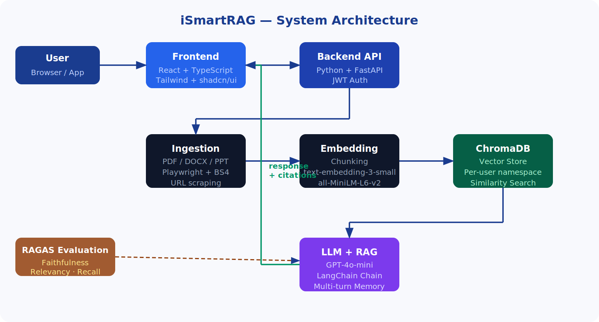
Proposed System Architecture
→
→
→
→
Ingest
Chunk
Embed
Store
Retrieve & Answer
PDF / DOCX / PPT
+ Website URLs
Text split into
overlapping chunks
Chunks embedded
(text-embedding-3-small)
Per-user vectors
in ChromaDB
Top-k retrieval →
GPT-4o-mini + citations
9

Slide 7
SECTION 07
Technology Stack
BACKEND
FRONTEND
SCRAPING
Python + FastAPI
React + TypeScript + Tailwind
Playwright + BeautifulSoup
VECTOR DB
LLM
EVALUATION
ChromaDB
GPT-4o-mini
RAGAS (faithfulness, relevancy, recall)
AUTH
CONTAINERS
CLOUD
JWT
Docker + docker-compose
Oracle Cloud Always Free (ARM VM)
iSmartRAG — Major Project Review 1
10

Slide 8
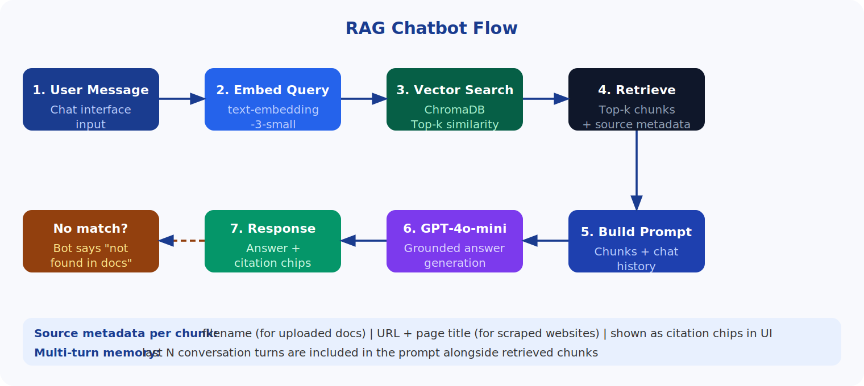
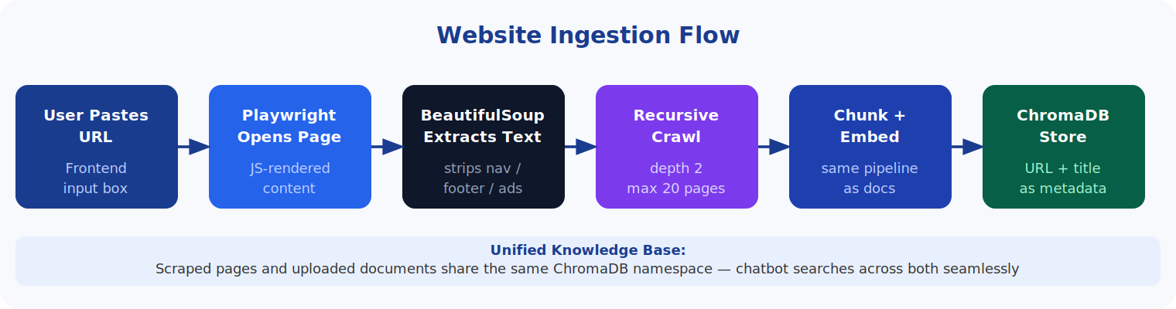

Slide 9
Base Paper Details
Paper 1 — RAG for Knowledge-Intensive NLP Tasks (2020)- This is the original paper that invented RAG. The idea: instead of an AI trying to remember everything on its own, let it look up information from a document store before answering — like an open-book exam instead of relying on memory. It worked better than AI models that only used their own memory.
Paper 2 — Chatbots in Academia (2024) - Built a chatbot for a college/university that looks up relevant documents before answering, and also remembers what was said earlier in the chat so it can handle follow-up questions.
Paper 3 — Benchmarking RAG Frameworks (2025) - Made a chatbot to help students prepare for the GATE exam. The main point of this paper is that they tested many different combinations of tools (which "search" method + which AI model) to find out which combo gives the best answers without being too slow.
Paper 4 — RAG Chatbots for Education: A Survey (2025) - Not a new chatbot — just a big review of 47 other papers about education chatbots. It sums up patterns: who these chatbots help (students/teachers), what they're built with, and confirms that this look-up-before-answering approach is the standard way to stop chatbots from making things up.
Paper 5 — Smart Web Scraping with Crawl4AI (2025) - Instead of using fixed documents, this system pulls information directly from live web pages. It scrapes a webpage, breaks the text into small chunks, and uses those chunks to answer question
Paper 6 — RAG for E-Commerce Customer Support (2024) - Applied the same look-up-before-answering idea to an online store's chatbot — it checks product info, FAQs, and reviews before replying, so it gives correct, up-to-date answers instead of generic ones
Paper 7 — Multi-Document Question Answering (2026) - Proposes a chatbot that can pull answers from several documents at once (not just one file) to answer a single question. Very new paper — not fully verified, so double-check before quoting numbers from it.
Paper 8 — RAGAS: Automated Evaluation (2024) - This paper isn't about building a chatbot — it's about grading one. It gives three simple tests to check chatbot quality: (1) Did it stick to facts from the source? (2) Did it actually answer the question? (3) Did it look up the right information in the first place?

Slide 10
Literature Survey
Paper / Year | Approach | Key Findings
Lewis et al. (2020) – Retrieval-Augmented Generation for Knowledge-Intensive NLP Tasks | Introduced RAG by combining retrieval with text generation | Retrieval improves factuality and performance on knowledge-intensive tasks
Maryamah et al. (2024) – Chatbots in Academia: A RAG Approach | RAG-based academic chatbot with conversational memory | Enables context-aware question answering from academic documents
Towards Efficient Educational Chatbots (2025) | Benchmarked different RAG frameworks and model combinations | Shows that retrieval strategy and model selection affect answer quality and efficiency
RAG Chatbots for Education: A Survey (2025) | Survey of RAG-based educational chatbots | Identifies RAG as an effective approach for reducing hallucination in educational applications
RAG Based Smart Web Scraping using Crawl4AI (2025) | Extracts and chunks information from live websites for RAG | Demonstrates that web content can be incorporated into retrieval-based QA
RAGAS: Automated Evaluation (2024) | Framework for evaluating RAG systems | Provides metrics such as faithfulness, answer relevancy and context recall

Slide 11
Research Gap
Existing Systems
Most RAG-based educational chatbots focus primarily on question answering from a limited document set.
Existing approaches generally handle documents or web content separately, rather than providing a unified knowledge base.
Limited support for ingesting multiple study-material formats such as PDF, DOCX, PPT, and websites in one system.
Many systems focus on answering questions but do not integrate active-learning features such as automatic quiz generation and feedback.
RAG evaluation is not consistently integrated into the application using quantitative metrics such as faithfulness, relevancy, and recall.
Identified Research Gap
There is a need for a unified, student-centric RAG system that can combine multi-format study materials and web sources, provide citation-grounded conversational answers, generate quizzes for active learning, and quantitatively evaluate response quality.

Slide 12
References
Lewis, P. et al. (2020). Retrieval-Augmented Generation for Knowledge-Intensive NLP Tasks. arXiv:2005.11401.
Maryamah et al. (2024). Chatbots in Academia: A RAG Approach for Improved Efficient Information Access. IEEE KST 2024.
(2025). Towards Efficient Educational Chatbots: Benchmarking RAG Frameworks. arXiv:2503.00781.
(2025). Retrieval-Augmented Generation (RAG) Chatbots for Education: A Survey of Applications. ResearchGate.
(2025). RAG Based Implementation for Smart Web Scraping using Crawl4AI. ResearchGate.
(2025). RAG Based Implementation for Smart Web Scraping using Crawl4AI. ResearchGate.
(2026). Enhanced RAG Framework for Intelligent Multi-Document Question Answering. RSIS International.
Es, S. et al. (2024). RAGAS: Automated Evaluation of Retrieval Augmented Generation. EACL 2024. arXiv:2309.15217.

Slide 13
Base Paper Details
Paper Title
Authors
Journal/Conference Name
Publisher (IEEE/Elsevier/Springer, etc.)
Year of Publication
Indexing (Scopus, WoS, etc.)
DOI (if available)

Slide 14
Presentation Tips
Keep the presentation within 10–12 slides.
Use bullet points instead of long paragraphs.
Include diagrams, flowcharts, and tables where appropriate.
Ensure all references are from reputed sources such as Scopus, IEEE Xplore, ScienceDirect, Web of Science (WoS), Springer, or ACM etc.
Be prepared to explain:
Why you selected the topic.
Why you chose the base paper.
What research gap you identified.
How your proposed work differs from existing approaches.

