Slide 1
Price is right: Home edition
Housing prices prediction model
Jeroen Hak & Aniket Tikotkar

Slide 2
Contents
Motivation
Problem definition
Data
Key issues
Approach
Validation
Conclusions
Future work

Slide 3
Motivation
Reduced time to select house by prospective home buyers
Improved efficiency when buying houses (Can be used by brokers as well)
Find suitable houses according to a person’s need
To find which features of the house such as number of bedrooms, condition, square feet etc. affect the price
Find which features are primarily looked at and what quantity of specified feature is most common (example: no. of rooms)

Slide 4
Problem definition (1)
Predict prices of the houses based on the features given
Dataset used comprises of prices and features of houses between the years 2014-2015
The dataset has 21 features and 21613 rows
Problem is a regression problem
Regression algorithms will be tested and performance will be evaluated, best one will be chosen thereafter

Slide 5
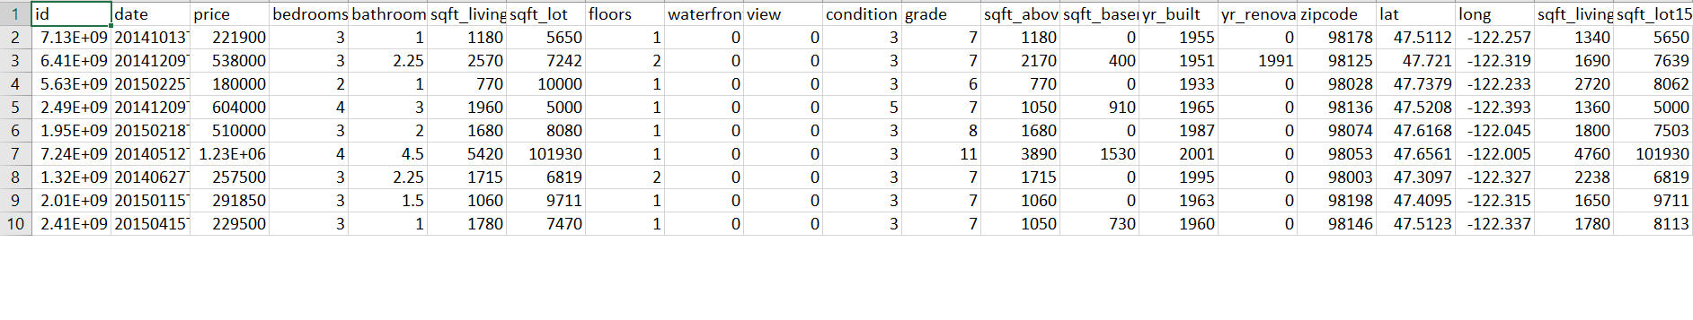
Data (1)
Given below are the first 10 instances of houses in the dataset:

Slide 6
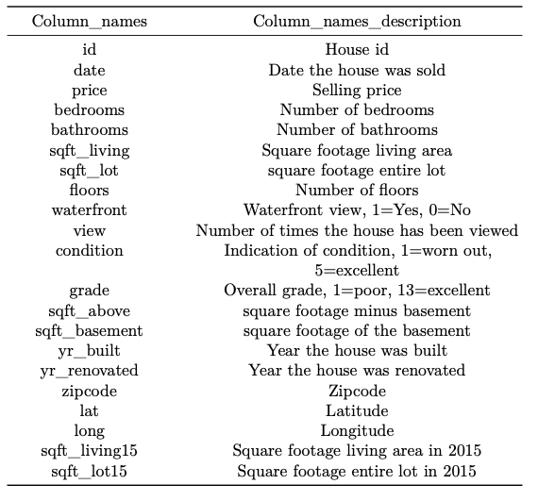
Data(2)
The variables are described in the table on the right
The variable names are under “Column_names” and the description is next to it

Slide 7
Key issues (1)
One anomaly detected in the form of a instance of a house with 33 bedrooms and only 1609 square-feet
Apart from that no particular issues found with the dataset
As for the algorithms we found most of them to have a very high MSE
GAM did not produce MSE hence it was hard to compare it to the other candidate algorithms

Slide 8
Key issues (2)
The variable sqft_lot and sqft_lot15 have a small weight in the ridge model, but if they are taken out the MSE increases slightly to 45495122746
In Generalized Additive Model (GAM) the variables yr_built and grade had the least the area of confidence compared to other predictors
Other predictors which can be considered are sqft_above, sqft_living15, view

Slide 9
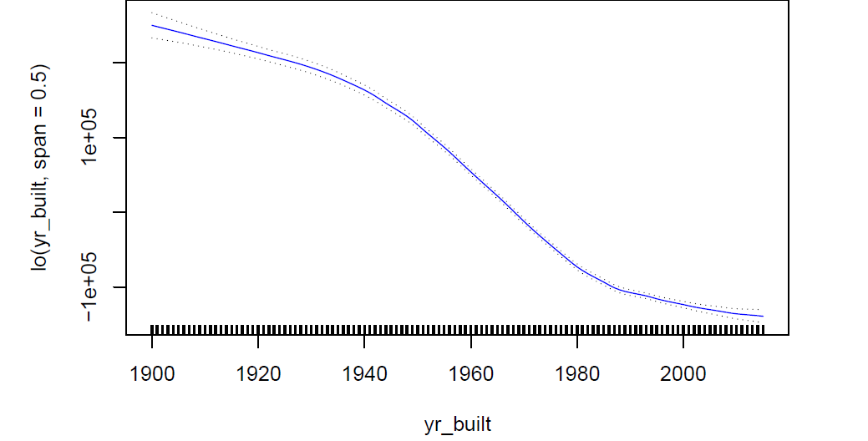
Key issues (3)
Area of confidence for yr_built:

Slide 10
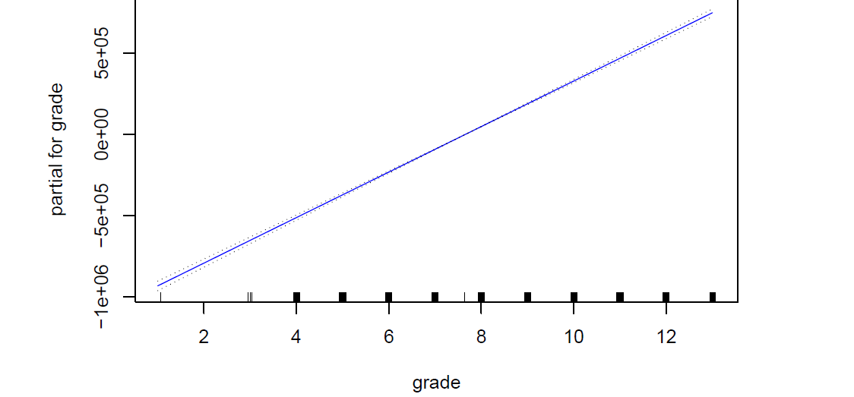
Key issues (4)
Area of confidence for variable grade:

Slide 11
Approach
The problem was a regression problem
Candidate algorithms selected are Linear Regression, Polynomial Regression, Ridge Regression, Lasso Regression and Generalized Additive Model
Ridge regression performed the best with the lowest mean square error and its fit was the best in the test set
Lasso regression can also be considered as it has low MSE of 45555184264

Slide 12
Validation (1)
We compared the five different models on:
MSE
R squared

Slide 13
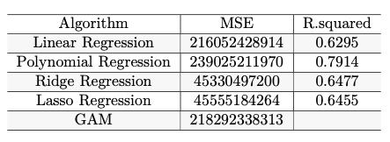
Validation (2)
Comparison of:
MSE
R squared

Slide 14
Validation (3)
Ridge regression produced the lowest MSE
Polynomial regression produced the highest R squared value

Slide 15
Validation (4)
For Ridge regression the best lambda was obtained by using a grid from 10^-3 to 10^10
Both a plot of MSE vs log(lambda) and the function lambda.min were used to validate the best lambda

Slide 16
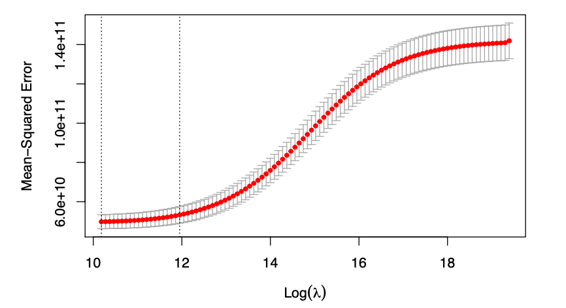
Validation (5)
Ridge regression lambda-MSE plot:

Slide 17
Validation (6)
Polynomial regression showed that the variables sqft_lot, floors, yr_built and condition do not contribute to the model and can be taken out

Slide 18
Conclusions
We chose Ridge regression as the best fit because of the lowest MSE
The model has:
MSE = 45275234661
Lambda = 26456.57

Slide 19
Future work (1)
All of the MSE that the models produced were very high and further research should be performed in order to try to lower this
The R squared value of the Lasso model was a bit low and further research should be performed in order to try to increase it

Slide 20
Future work (2)
The next step is creating an app that uses the model to predict housing prices given certain inputs
After that the model should be improved so that fewer features have to be put in to get a prediction
Brokers can make use of this application to get in touch with prospective buyers

