Slide 1
Secure Data Hiding in Image Using Steganography
CAPSTONE PROJECT
Presented By:
Student Name : Aniket Ankush Tikudave
College Name & Department : AGCE Satara, E&TC.

Slide 2
OUTLINE
Problem Statement
Technology used
Wow factor
End users
Result
Conclusion
Git-hub Link
Future scope

Slide 3
Problem Statement
To develop a robust and efficient method to embed sensitive data within a digital image, ensuring that the hidden information remains undetectable to the naked eye while providing strong security measures to prevent unauthorized extraction of the data.

Slide 4
Technology used
1) OpenCV (cv2) :
>> Reading image Manipulating pixel values to encode and decode dataHandling image channels for embedding the data.
>> Key Functions: cv2.imread() – Reads image files. cv2.imwrite() – Saves the image after data encoding or decoding. cv2.cvtColor() – Converts between different color spaces, useful for analyzing image channels.
2) OS Library:
>> Navigating the file system to load and save images.Checking file existence and manipulating file paths.
>> Key Functions: os.path.exists() – Verifies if a file exists. os.remove() – Removes
3) String Library:
>> Converting the secret message into binary format ,Splitting and embedding the message within the image pixels.
>> Key Functions: string.ascii_lowercase – Can be used to work with alphabets or predefined characters.String manipulations such as join(), split(), and others are helpful in encoding data into the image.

Slide 5
Wow factors
Seamless Concealment
High Capacity for Storing Data
Low Complexity and Efficiency
Real-time Application in Security
Data Integrity and Authenticity
Integration with Other Security Techniques
Cross-Platform Communication

Slide 6
End users
Military and Defense
Cloud Storage Services
Government Agencies and Intelligence Services
Cybersecurity Professionals
Digital Forensics Investigators
Legal and Regulatory Bodies
Journalists and Activists
Individuals and Privacy Advocates
Software Developers

Slide 7
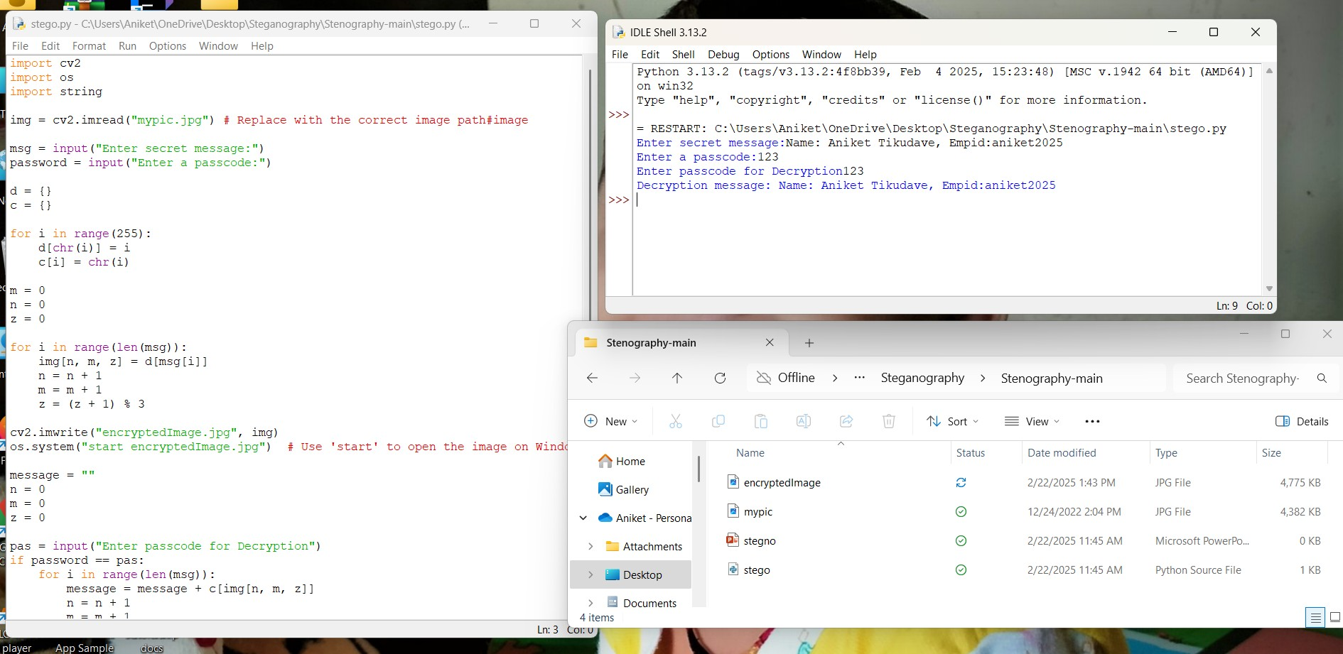
Results

Slide 8
Conclusion
In conclusion, the problem of securely transmitting sensitive data over potentially insecure channels is effectively addressed by data hiding in images using steganography. By embedding secret information within an image, steganography ensures that the data remains hidden from unauthorized access, providing a covert communication method that is hard to detect. This technique solves the challenge of maintaining data confidentiality while preventing interception or tampering. With the help of libraries like OpenCV and Python tools, this approach offers a practical, efficient solution to safeguarding sensitive information in digital formats.

Slide 9
GitHub Link
https://github.com/anikettikudave187/Steganography-Internship-Project.git

Slide 10
Future scope
Improved Security Algorithms
AI and Machine Learning Integration
Use in Blockchain for Secure Transactions
Real-Time Data Hiding in Videos and Streaming
Enhanced Detection Methods for Forensics
Embedded Systems and IoT
Cross-Platform Communication

Slide 11
THANK YOU

