Slide 1
💎
Fine Jewellery's
E-COMMERCE PLATFORM — PROJECT PRESENTATION
15
7+
Full
Live
SLIDES
PAGES
STACK
DEMO
Presented by Aniket · Fine Jewellery's E-Commerce Project · 2026

Slide 2
02 — OVERVIEW
Project Overview
Fine Jewellery's is a full-stack luxury e-commerce platform built to showcase and sell premium handcrafted jewellery. The platform offers a seamless shopping experience with a modern, elegant UI inspired by high-end jewellery brands.
PROJECT TYPE
Full-Stack Web Application
✦ Complete e-commerce flow from browsing to checkout
DOMAIN
✦ User authentication with JWT tokens
Luxury E-Commerce / Jewellery
✦ Persistent wishlist synced to MongoDB
✦ Shopping cart with quantity management
TARGET USERS
✦ Responsive design for all screen sizes
Jewellery shoppers across India
✦ BIS Hallmarked jewellery catalogue
DEPLOYMENT
Local Dev · Cloud-ready

Slide 3
03 — TECHNOLOGY
Tech Stack
⚛️ React 18 + TypeScript
⚡ Vite
🎨 Tailwind CSS
Component-based UI with full type safety and modern hooks
Lightning-fast build tool and dev server with HMR
Utility-first CSS framework for rapid, consistent styling
🟢 Node.js + Express
🍃 MongoDB + Mongoose
🔐 JWT Authentication
RESTful API backend with middleware-based architecture
NoSQL database with schema validation and Atlas cloud hosting
Stateless auth with bcrypt password hashing
🔀 React Router v6
🧩 Radix UI + shadcn
🔔 Sonner Toasts
Client-side routing with protected routes and navigation
Accessible component primitives with custom theming
Beautiful animated toast notifications for user feedback

Slide 4
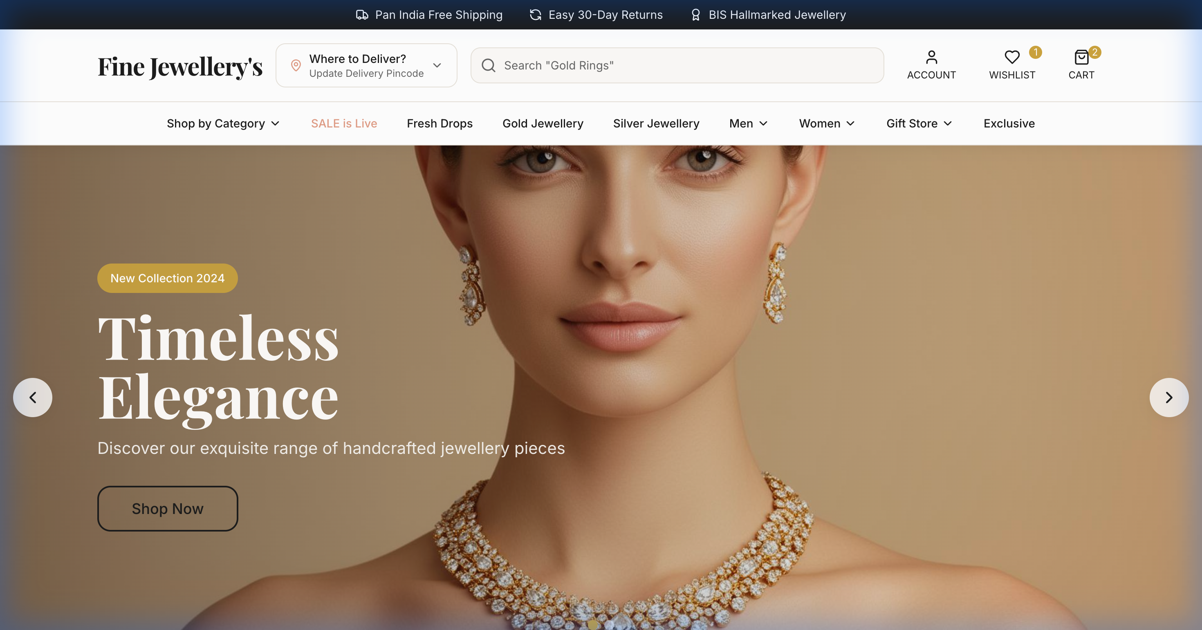
04 — HOMEPAGE
Homepage
◆ Auto-rotating hero carousel with 3 banners
◆ Top announcement bar with offers
◆ Smart search bar with placeholder hints
◆ Category navigation: Gold, Silver, Men, Women
◆ Wishlist & Cart count badges in header
◆ Delivery pincode selector

Slide 5
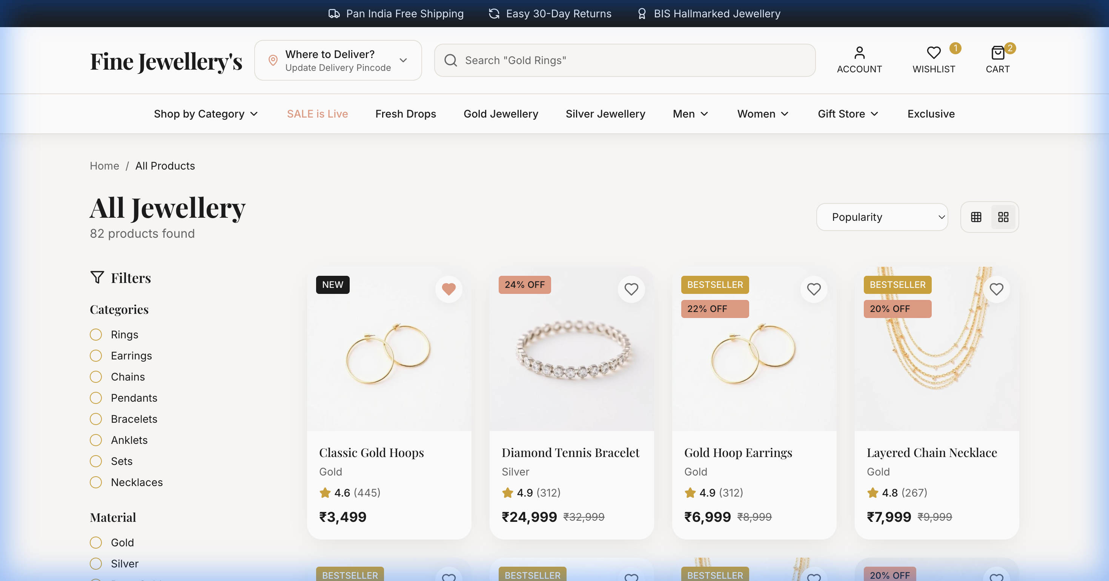
05 — PRODUCT LISTING
Product Listing
◆ Grid layout with hover animations
◆ Filter by category, material, price range
◆ NEW & BESTSELLER badges on cards
◆ Quick 'Add to Cart' on hover
◆ Heart icon for instant wishlist toggle
◆ Star ratings and review counts

Slide 6
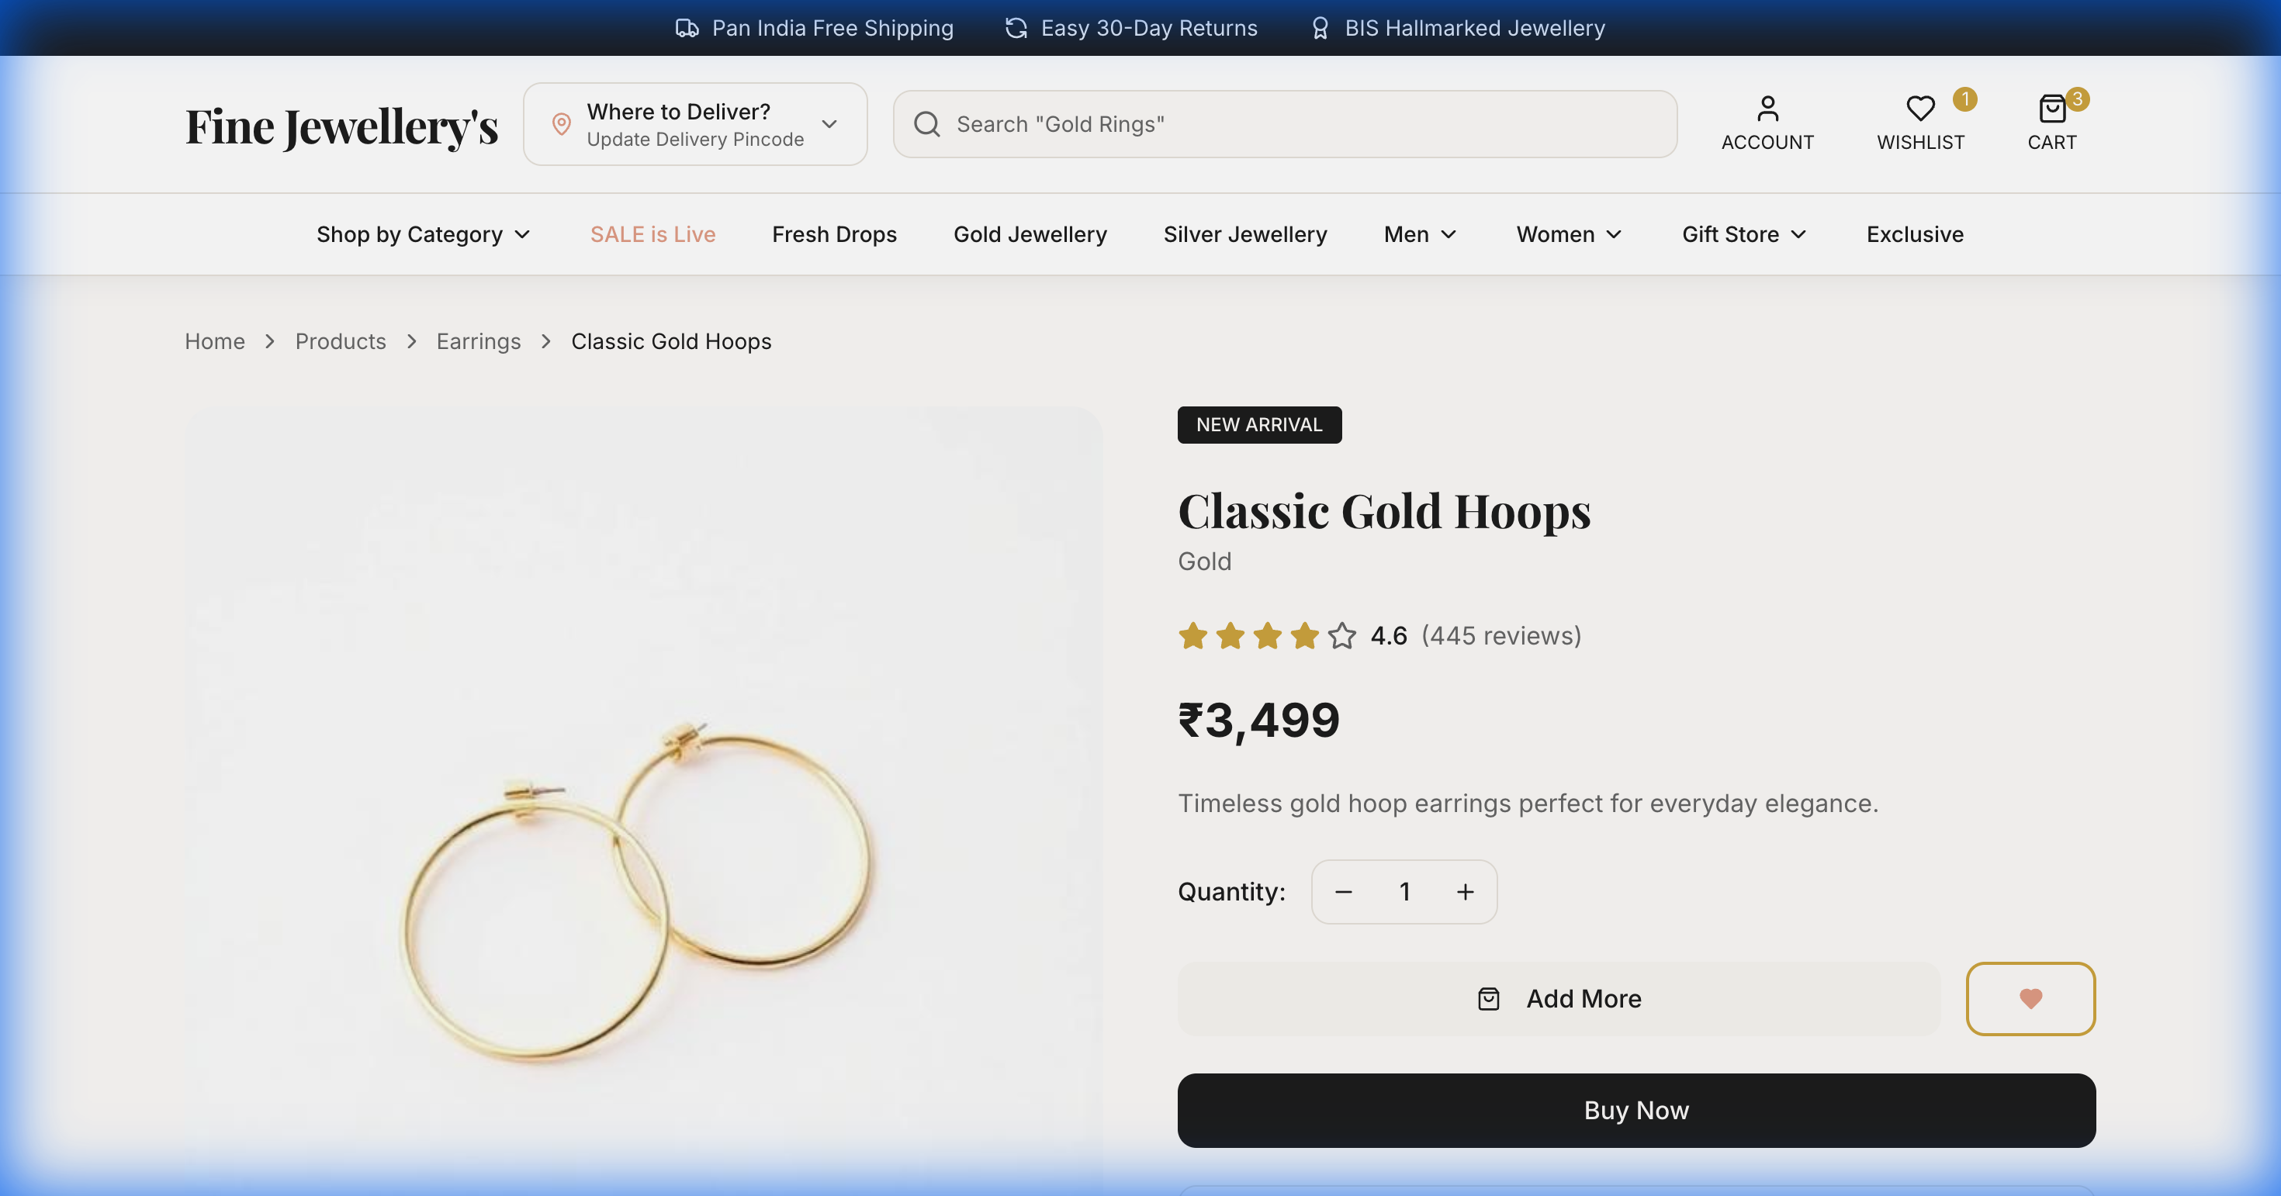
06 — PRODUCT DETAIL
Product Detail
◆ High-res product image gallery (4 views)
◆ Breadcrumb navigation
◆ Quantity selector with +/- controls
◆ Add to Cart & Wishlist buttons
◆ Buy Now → direct checkout
◆ Related products section

Slide 7
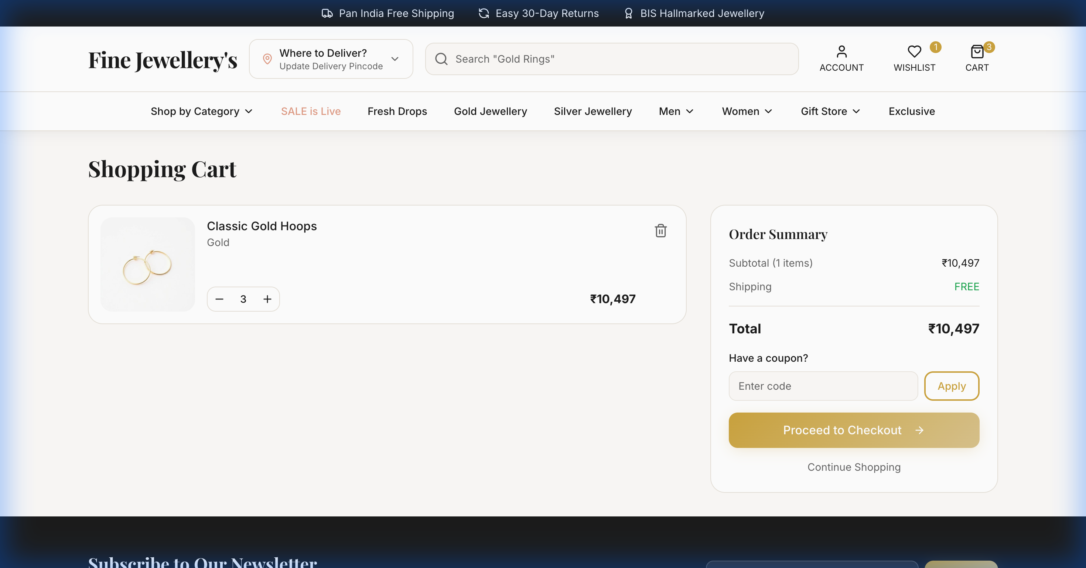
07 — SHOPPING CART
Shopping Cart
◆ Persistent cart saved in localStorage
◆ Quantity update with +/- controls
◆ Remove individual items
◆ Real-time price calculation
◆ Order summary with subtotal
◆ Proceed to Checkout CTA

Slide 8
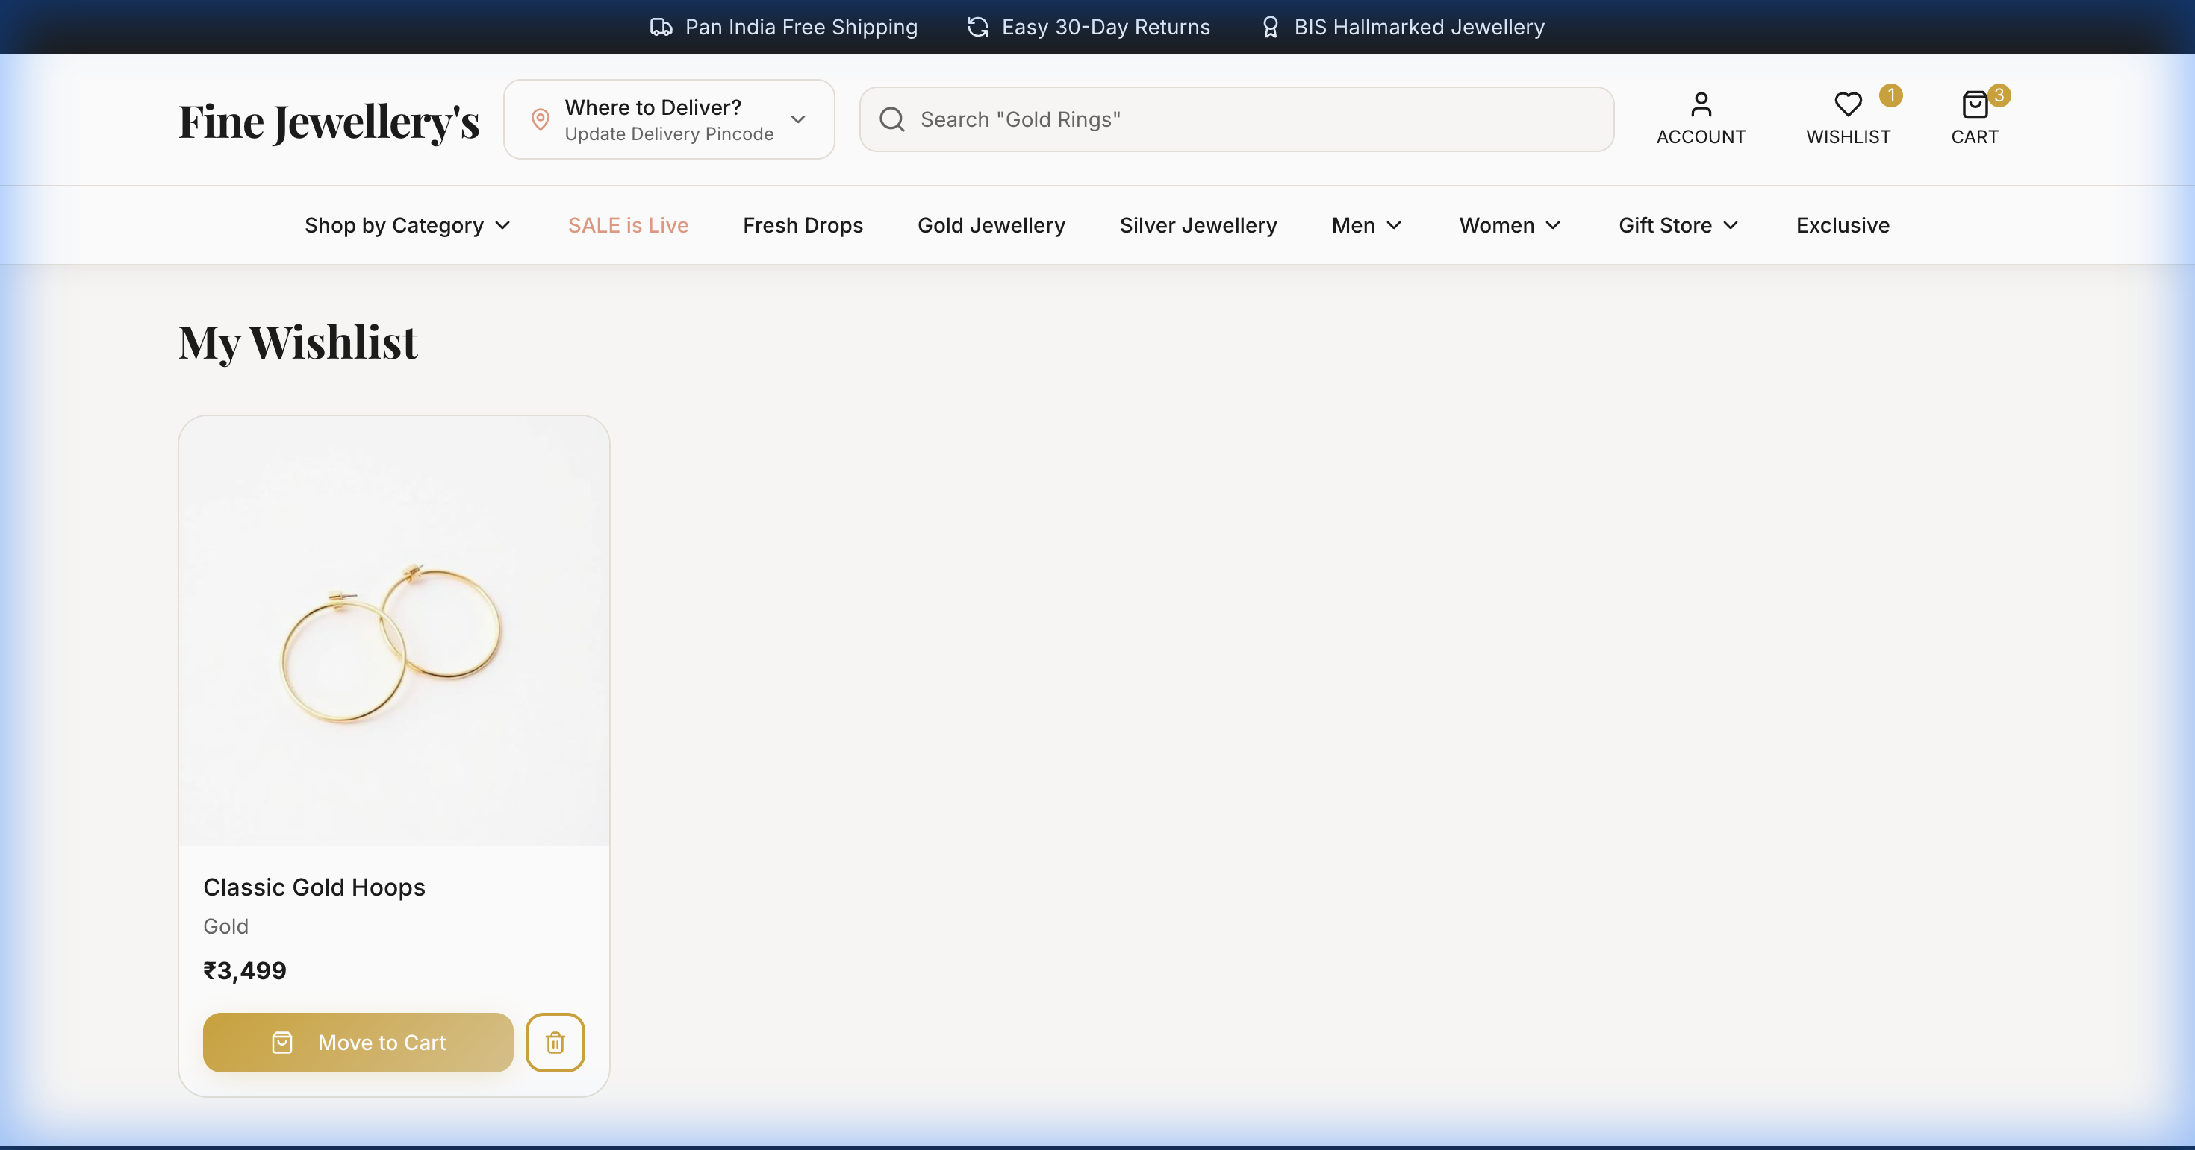
08 — WISHLIST FEATURE
Wishlist Feature
◆ Synced to MongoDB when logged in
◆ localStorage fallback when not logged in
◆ Optimistic UI — instant heart toggle
◆ Move to Cart with one click
◆ Wishlist count badge in header
◆ Persists across sessions

Slide 9
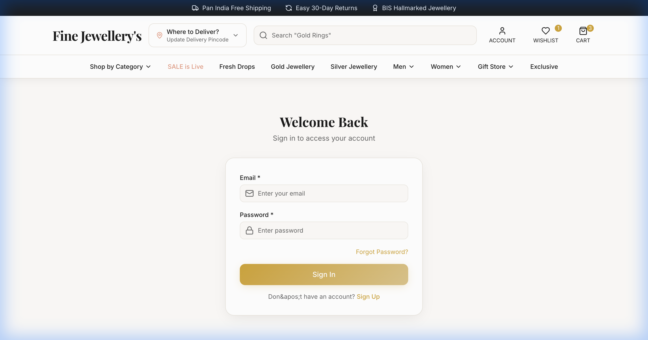
09 — LOGIN & SIGN UP
Login & Sign Up
◆ JWT-based stateless authentication
◆ bcrypt password hashing (12 rounds)
◆ Token stored in localStorage
◆ Auto-login on page refresh
◆ Form validation with error messages
◆ Protected routes for authenticated users

Slide 10
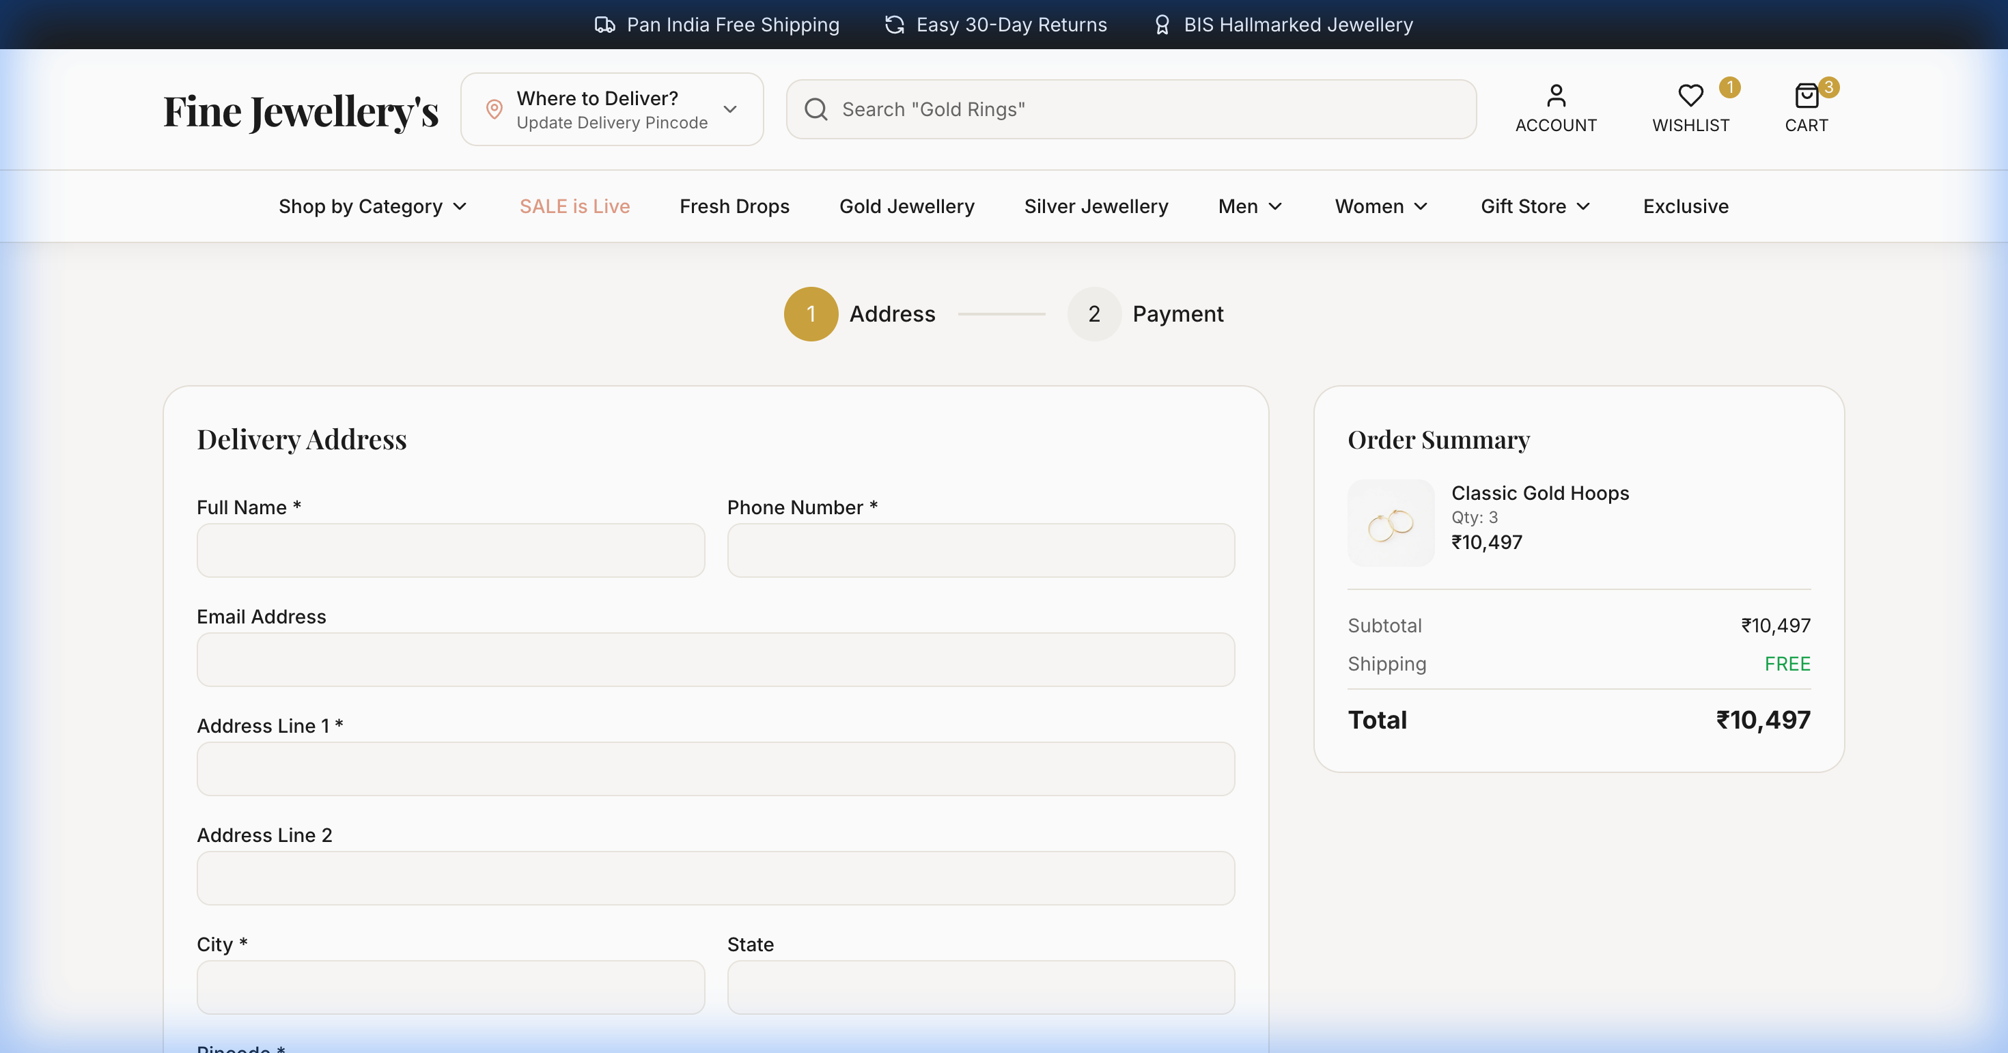
10 — CHECKOUT PAGE
Checkout Page
◆ Shipping address form
◆ Order summary with item list
◆ Price breakdown (subtotal, shipping, total)
◆ Payment method selection
◆ Free shipping on all orders
◆ Order confirmation flow

Slide 11
11 — ARCHITECTURE
Backend Architecture
🖥️ Frontend (React)
⚙️ Backend (Node.js)
▸ React 18 + TypeScript + Vite
▸ Express.js REST API server
▸ AuthContext — JWT token management
▸ JWT middleware — route protection
REST API
──────────
HTTP / JSON
Bearer Token
▸ CartContext — cart & wishlist state
▸ bcryptjs — password hashing
▸ React Router v6 — client routing
▸ Mongoose ODM — MongoDB models
▸ Tailwind CSS + Radix UI
▸ CORS configured for port 8080
▸ Sonner toast notifications
▸ Routes: /auth, /wishlist, /orders
▸ localStorage for cart persistence
▸ MongoDB Atlas — cloud database
Frontend Port
Backend Port
Database
Auth
:8080
:5000
MongoDB Atlas
JWT + bcrypt

Slide 12
12 — DATABASE
MongoDB Schema Design
👤 User Model
❤️ Wishlist Model
📦 Order Model
_id
ObjectId
_id
ObjectId
_id
ObjectId
name
String *
user
→ User ref
user
→ User ref
email
String * unique
items[]
Array
items[]
Array
phone
String *
productId
String *
productId
String
password
String * hashed
name
String *
quantity
Number
role
user | admin
image
String *
totalAmount
Number *
isActive
Boolean
price
Number *
status
pending|confirmed
createdAt
Date
material
String
shippingAddress
Object

Slide 13
13 — FEATURES
Key Features Summary
🔐
🛒
❤️
🔍
Secure Auth
Smart Cart
Wishlist Sync
Smart Search
JWT tokens, bcrypt hashing, protected routes, auto-login
Persistent localStorage cart with quantity management
MongoDB-backed wishlist with optimistic UI updates
Search across products by name, category, material
📱
🏷️
🌙
🔔
Responsive
Filters
Dark Mode
Notifications
Fully responsive design for mobile, tablet, desktop
Filter by category, material, price range, new arrivals
Elegant dark theme with gold accents throughout
Animated toast notifications for all user actions

Slide 14
14 — CHALLENGES
Challenges & Solutions
CHALLENGE
SOLUTION
MongoDB Atlas DNS SRV records couldn't be resolved by local ISP DNS, causing backend connection failure
→
Replaced mongodb+srv:// URI with direct shard hostnames discovered via Google DNS (8.8.8.8)
CHALLENGE
SOLUTION
Wishlist adding silently failed — async API calls were fired without await, so UI state never updated
→
Added optimistic UI updates, proper async/await in all handlers, boolean returns, and state revert on failure
CHALLENGE
SOLUTION
Rollup native module @rollup/rollup-darwin-arm64 missing due to npm optional dependency bug on Apple Silicon
→
Deleted node_modules and package-lock.json, then ran a clean npm install to resolve platform-specific binaries

Slide 15
💎
Thank You
Questions & Discussion
Fine Jewellery's — A Full-Stack Luxury E-Commerce Platform
🌐
⚙️
🍃
👤
LIVE URL
API SERVER
DATABASE
DEVELOPER
localhost:8080
localhost:5000
MongoDB Atlas
Aniket

