Slide 1

Department of Information Technology
Yeshwantrao Chavan College of Engineering, Nagpur
TOPIC NAME :- Heart Disease Prediction (Using Logistic Regression)
Presented By Name :- Atharva Bhedodkar
Roll No :- 38
Section :-A
Reg No :- 20011077
Session 2022-23

Slide 2
USAGE
Logistic Regression is a popular machine learning algorithm used for classification problems, where the output variable is a categorical variable, and the goal is to predict the probability of the input variables belonging to one of the possible categories. Some common usages of logistic regression include:
Binary Classification: Logistic Regression is used extensively for binary classification problems, where the output variable can take only two values (0 or 1). For example, predicting whether a customer will churn or not, based on their previous behavior and demographics.
Multiclass Classification: Logistic Regression can be extended to solve multiclass classification problems, where the output variable can take more than two values. One common approach is to use a variant of logistic regression called "softmax regression," which assigns probabilities to each class and selects the class with the highest probability.
Probabilistic Modeling: Logistic Regression can be used as a probabilistic model to estimate the probability of an event occurring based on input features. For example, predicting the probability of a patient having a particular disease based on their symptoms and medical history.
Risk Assessment: Logistic Regression can be used to assess risk in various domains, such as finance, insurance, and healthcare. For example, predicting the probability of a borrower defaulting on a loan based on their credit score and financial history.
Marketing: Logistic Regression can be used to identify the factors that influence customer behavior, such as buying patterns and product preferences. This can help businesses target their marketing efforts more effectively and optimize their advertising campaigns.
Overall, Logistic Regression is a versatile machine learning algorithm that can be used for a wide range of applications where classification and probabilistic modeling are required.
Session 2022-23

Slide 3
Dataset Availability
The dataset has been taken from Kaggle. In dataset there are 14 attributes of a human body like age ,sex ,cp trestbps, chol, fbs, restecg, thalach, exang, oldpeak, slope, ca, thal, target . On the basis of these 14 attributes we have predicted the heart disease.
Sr no. | age | sex | cp | trestbps | chol | fbs | restecg | thalach | exang | oldpeak | slope | ca | thal | target
0 | 52 | 1 | 0 | 125 | 212 | 0 | 1 | 168 | 0 | 1.0 | 2 | 2 | 3 | 0
1 | 53 | 1 | 0 | 140 | 203 | 1 | 0 | 155 | 1 | 3.1 | 0 | 0 | 3 | 0
2 | 70 | 1 | 0 | 145 | 174 | 0 | 1 | 125 | 1 | 2.6 | 0 | 0 | 3 | 0
3 | 61 | 1 | 0 | 148 | 203 | 0 | 1 | 161 | 0 | 0.0 | 2 | 1 | 3 | 0
4 | 62 | 0 | 0 | 138 | 294 | 1 | 1 | 106 | 0 | 1.9 | 1 | 3 | 2 | 0
Session 2022-23

Slide 4
Future Scope For Research & Project
.
Feature Selection and Dimensionality Reduction: The Heart Disease dataset contains 14 attributes, but not all of them may be relevant for predicting heart disease. Further research could be conducted to identify the most important features and reduce the dimensionality of the dataset to improve the accuracy and efficiency of the model.
Comparison with other Machine Learning Models: Logistic Regression is a popular algorithm for classification problems, but there are many other machine learning models that can be used for heart disease prediction. Future research could be conducted to compare the performance of Logistic Regression with other models, such as Decision Trees, Random Forests, Neural Networks, and Support Vector Machines.
Multi-Center Studies: The Heart Disease dataset used in this experiment is relatively small and contains data from only one center. Future research could be conducted to collect larger datasets from multiple centers to improve the generalizability and reliability of the model.
Incorporating New Data Sources: The Heart Disease dataset used in this experiment contains only clinical and demographic data. Future research could be conducted to incorporate other data sources, such as genetic and lifestyle factors, to improve the accuracy and completeness of the model.
Clinical Applications: The Heart Disease prediction model could be integrated into clinical decision-making tools to assist healthcare professionals in diagnosing and treating patients with heart disease. Future research could focus on developing and validating such tools in clinical settings.
Overall, there is still much room for research and development in the field of Heart Disease Prediction using Logistic Regression. By addressing some of these future scopes, we can improve the accuracy, efficiency, and clinical utility of the models for predicting heart disease.
Session 2022-23

Slide 5
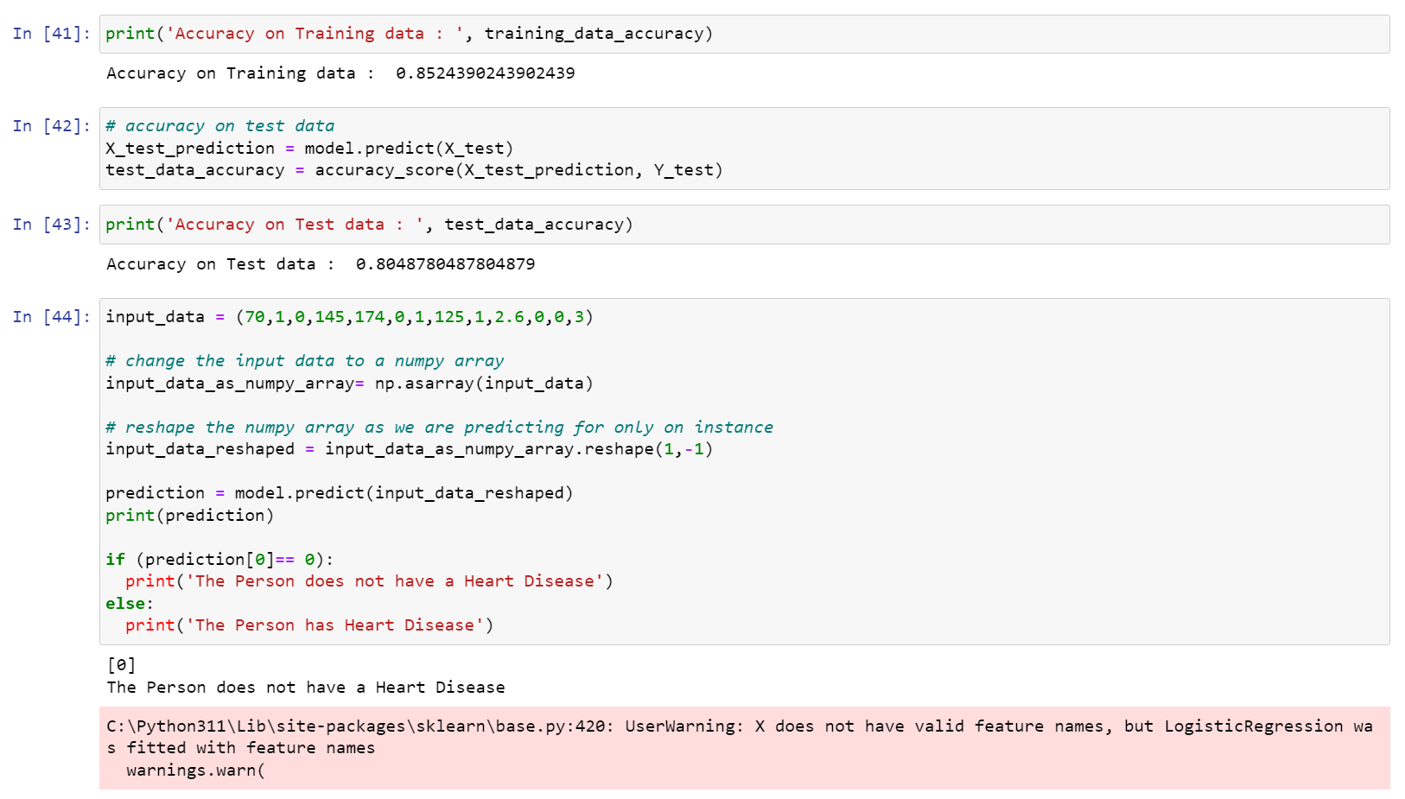
Code
Session 2022-23

Slide 6
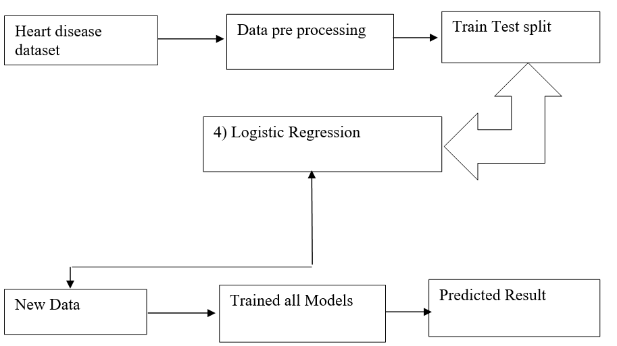
Flow Diagram
.
Session 2022-23

Slide 7
Conclusion
The heart disease prediction model is developed using machine learning. This model predicts the people with heart disease by taking patient’s medical history from dataset that includes various attributes of patient’s body like age, gender, blood pressure, cholesterol, chest pain, sugar level, etc. The algorithm that is used to build the given model is logistic regression . The accuracy of our model is 85% . If we give some more attributes to the model and train it there are higher chances of getting a better accuracy and it will be able to predict the heart disease more accurately
Therefore, in conclusion this model helps us predict that if the person is having the heart disease or not by using the dataset and applying algorithm of Logistic regression. Systems based on machine learning algorithms and techniques have been very accurate in predicting the heart related diseases but still there is a lot scope of research to be done on how to handle high dimensional data and over fitting. A lot of research can also be done on the correct implementation of algorithms to use for a particular type of data.
Session 2022-23

Slide 8
References
Heart Disease Dataset: https://archive.ics.uci.edu/ml/datasets/heart+disease
Scikit-learn library for Python: https://scikit-learn.org/stable/
Logistic Regression for Heart Disease Prediction: A Systematic Review and Future Directions (Research Paper): https://www.ncbi.nlm.nih.gov/pmc/articles/PMC7472798/
Machine Learning in Healthcare: A Systematic Review of Recent Research (Research Paper): https://www.ncbi.nlm.nih.gov/pmc/articles/PMC7267457/
Predicting Cardiovascular Risk Factors Using Machine Learning Algorithms: A Systematic Review (Research Paper): https://www.ncbi.nlm.nih.gov/pmc/articles/PMC7901396/
The Role of Machine Learning in Cardiovascular Disease Risk Prediction and Stratification (Review Article): https://www.frontiersin.org/articles/10.3389/fcvm.2020.596238/full
Logistic Regression for Medical Machine Learning (Tutorial): https://towardsdatascience.com/logistic-regression-for-medical-machine-learning-887c133b1ba1
Machine Learning in Cardiovascular Medicine (Book): https://www.springer.com/gp/book/9783030162497
Session 2022-23

