Slide 1
Functions
Introduction to functions
Types of functions
Elements of user defined functions
Types on the basis of arguments and return values
Methods of calling a function

Slide 2
Introduction to Function
Block of statements that perform the particular task.
Enables modular programming.
Main() is the driver function.
Has pre defined prototype.
Same function can be accessed from different places within a program.
Once a function execution is completed , control return to the place from where the function was called.

Slide 3
Advantages
Modular Programming
Length of source program can be reduced
Easy to locate and isolate faulty function
Functions can be used by other program’s

Slide 4
Types of Functions
Library (Built In) Functions:
They are written in the header files.
To use them appropriate header files should be included.
Header Files | Functions Defined
stdio.h | printf(), scanf(), getchar(), putchar(), gets(), puts(), fopen(), fclose()
conio.h | Clrscr(), getch()
ctype.h | toupper(), tolower(), isalpha()
math.h | Pow(), sqrt(), cos(), log()
stdlib.h | Rand(), exit()
string.h | strlen(), strcpy(), strupr()

Slide 5
User Defined Functions
Written by the user at the time of programming.

Slide 6
Elements of User defined functions
Function Prototype
Function Call
Function arguments and parameters
Function Definitions

Slide 7
Function prototype
It specify the type of value that is to be return from the function and that is to be passed to the function.
It is defined in the beginning before the function call is made.
Syntax:
return-type name-of-function(list of arguments);
Example
void Sum(int, int);

Slide 8
Function Call
A function can be called by specifying name and list of arguments enclosed in parenthesis and separated by comma.
If there is no arguments empty parenthesis are place after function name.
If function return a value, function call is written as assignment statement as:
A=Sum(x,y);

Slide 9
Function arguments and parameters
Arguments are also called actual parameters.
Arguments are written within parenthesis at the time of function call.
Parameters are also called formal parameters.
These are written within parenthesis at the time of function definition.

Slide 10
Function Definition
It is the independent program module.
It is written to specify the particular task that is to be performed by the function.
The first line of the function is called function declaration and rest line inside { } is called function body

Slide 11
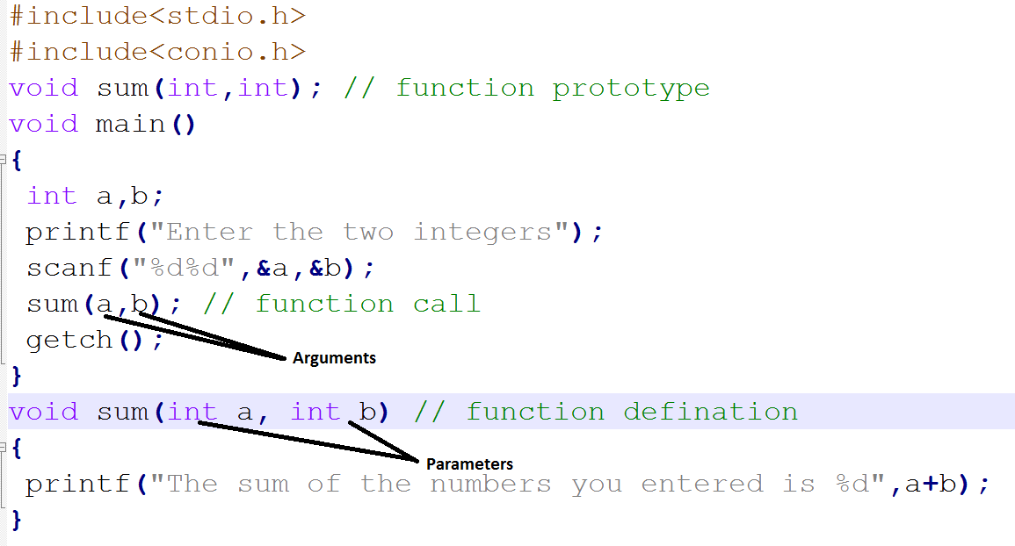

Slide 12
Return statement
When a return statement is executed, program control is immediately passed back to the calling environment.
If an expression follows the keyword return, the value of the expression is returned to the calling environment as well.
return;
return expression;
It return certain types of values to the place from where the function was invoked.
Syntax:
return(variable-name or constant);

Slide 13
Categories of function
Function with no arguments and no return
Function with arguments but no return
Function with no arguments and return
Function with arguments and return

Slide 14
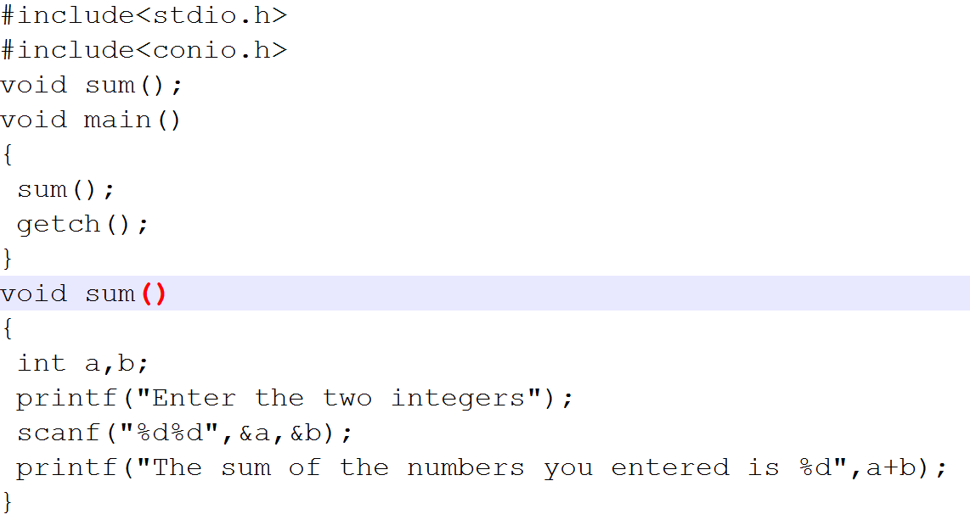
Function with no argument and no return

Slide 15
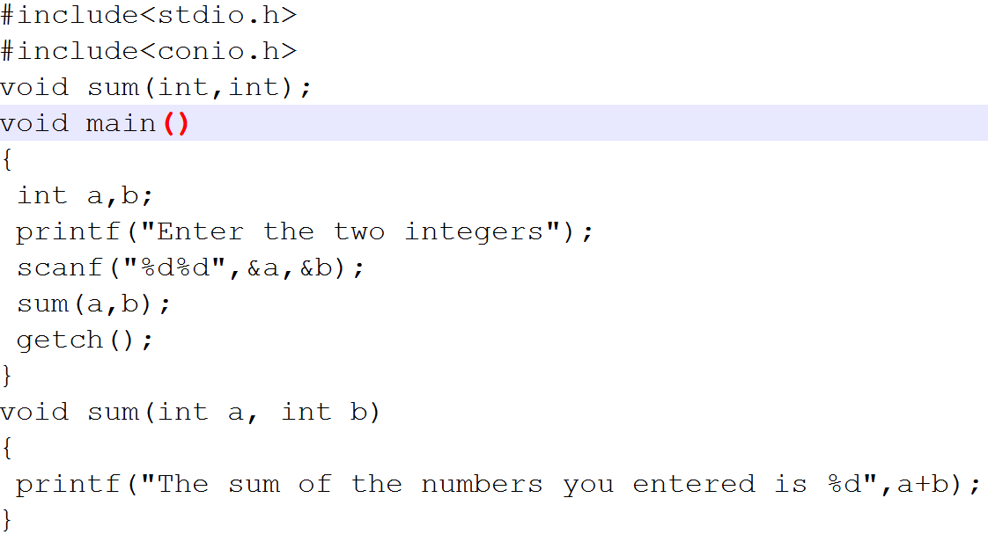
Function with argument and no return

Slide 16
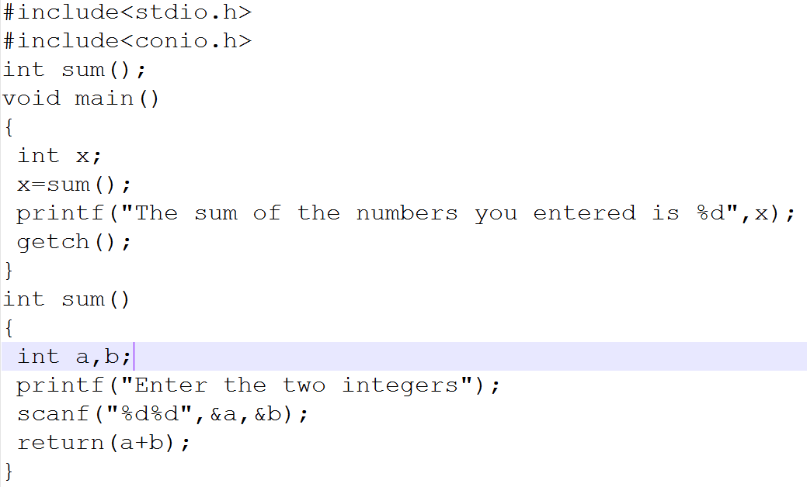
Function with no argument and return

Slide 17
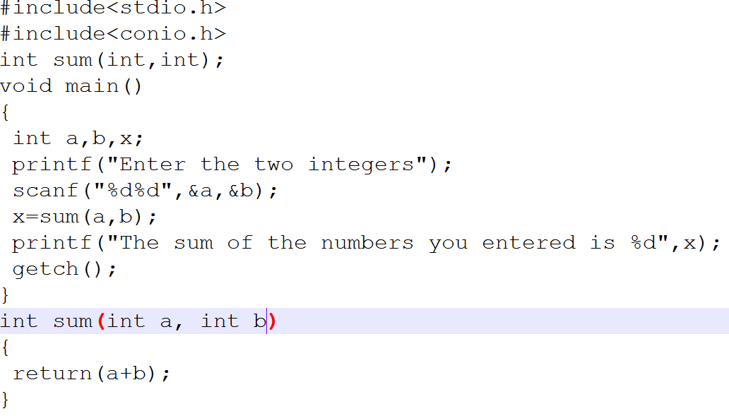
Function with argument and return

Slide 18
Methods of calling function
Call by value
Call by reference

Slide 19
Call by value
Copies the value of actual parameters into formal parameters.
During execution whatever changes are made in the formal parameters are not reflected back in the actual parameters.

Slide 20
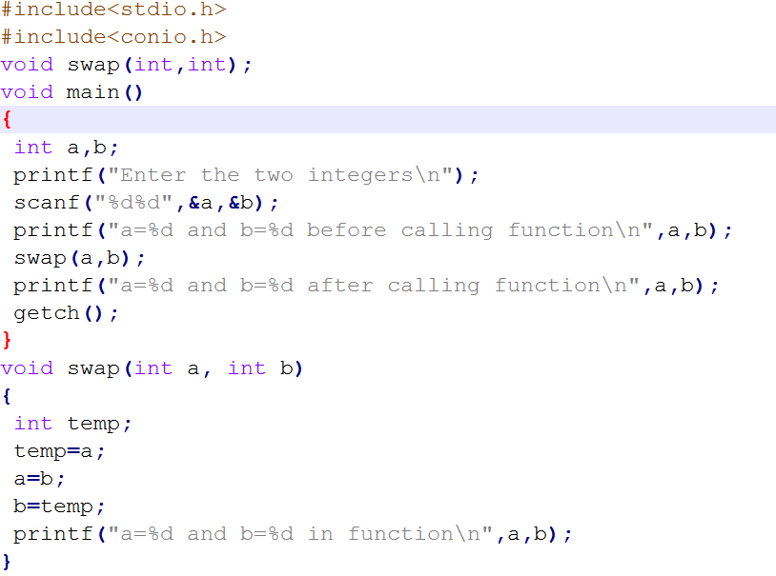

Slide 21
Call by Reference
Reference(address) of the original variable is passed.
Function does not create its own copy, it refers to the original values by reference.
Functions works with the original data and changes are made in the original data.

Slide 22
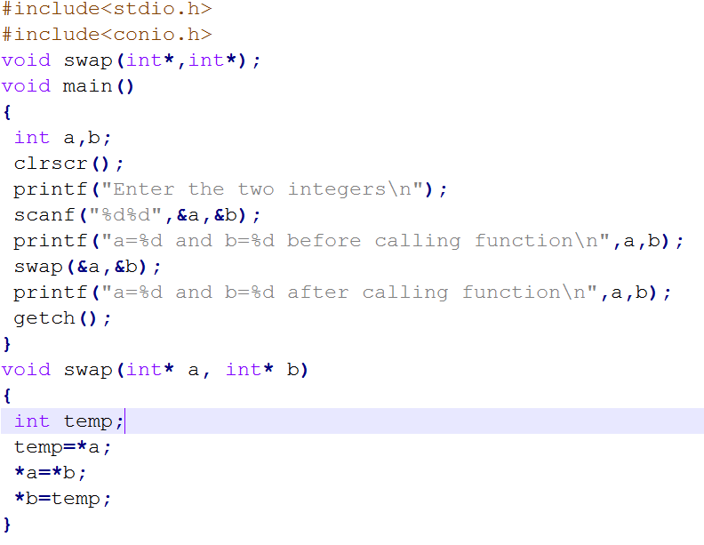

Slide 23
Factorial program in c using function
#include <stdio.h>
#include<conio.h>
long factorial(int);
void main()
{
int number;
long fact = 1;
printf("Enter a number to calculate it's factorial\n");
scanf("%d", &number);
printf("%d! = %ld\n", number, factorial(number));
getch();
}
long factorial(int n)
{
int c;
long result = 1;
for (c = 1; c <= n; c++)
result = result * c;
return result;
}

Slide 24
Factorial program in c using recursion
#include<stdio.h>
#include<conio.h>
long factorial(int);
void main()
{
int n;
long f;
printf("Enter an integer to find factorial\n");
scanf("%d", &n);
if (n < 0)
printf("Negative integers are not allowed.\n");
else
{
f = factorial(n);
printf("%d! = %ld\n", n, f);
}
getch();
}
long factorial(int n)
{
if (n == 0)
return 1;
else
return(n * factorial(n-1));
}

Slide 25
Format of recursive Functions
Recursive functions generally involve an if statement with the following form:
if this is a simple case
solve it
else
redefine the problem using recursion
The if branch is the base case, while the else branch is the recursive case.
The recursive step provides the repetition needed for the solution and the base step provides the termination
Note: For the recursion to terminate, the recursive case must be moving closer to the base case with each recursive call.

Slide 26
The complete recursive multiply example
/* Computes the factorial of a number */
#include <stdio.h>
int factorial(int n);
/* shows how to call a user-define function */
int main(void) {
int num, fact;
printf("Enter an integer between 0 and 7> ");
scanf("%d", &num);
if (num < 0) {
printf("Factorial not defined for negative numbers\n");
} else if (num <= 7) {
fact = factorial(num);
printf("The factorial of %d is %d\n", num, fact);
} else {
printf("Number out of range: %d\n", num);
}
system("pause");
return (0);
}
/* Computes n! for n greater than or equal to zero */
int factorial (int n)
{
if (n == 0) //base case
return 1;
else
return n * factorial (n-1); //recursive case
}

Slide 27
Example 1: Recursive Factorial
Recursive version
int factorial (int n)
{
if (n == 0)
return 1;
else
return n * factorial (n-1);
}
Iterative version
int factorial (int n)
{
int i, product=1;
for (i=n; i>1; --i)
product=product * i;
return product;
}

Slide 28
Tracing Recursive Functions
Executing recursive algorithms goes through two phases:
Expansion in which the recursive step is applied until hitting the base step
“Substitution” in which the solution is constructed backwards starting with the base step
factorial(4) = 4 * factorial (3) = 4 * (3 * factorial (2)) = 4 * (3 * (2 * factorial (1))) = 4 * (3 * (2 * (1 * factorial (0))))
= 4 * (3 * (2 * (1 * 1))) = 4 * (3 * (2 * 1)) = 4 * (3 * 2) = 4 * 6 = 24
Expansion phase
Substitution phase

Slide 29
Example : Fibonacci Function
Suppose we wish to define a function to compute the nth term of the Fibonacci sequence.
Fibonacci is a sequence of number that begins with the term 0 and 1 and has the property that each succeeding term is the sum of the two preceding terms:
Thus, the sequence is: 0, 1, 1,2,3,5,8,13,21,34 …
Mathematically, the sequence can be defined as:
n, n = 0, 1
fib(n)
fib(n-1) + fib(n-2) n>1

Slide 30
Example Fibonacci Function …
int fib(int n);
int main(void) {
int n;
printf("Enter an integer n to find the nth fibonacci term: ");
scanf("%d", &n);
printf("fibonacci(%d) = %d\n", n, fib(n));
return 0;
}
int fib(int n) {
if (n == 0 || n== 1)
return n; /* simple case */
else
return fib(n-1) + fib(n-2); /* recursive step */
}

