Slide 1
Predictive text
Type one key per letter for most words
It will guess your word, and give you options for completing it

Slide 2
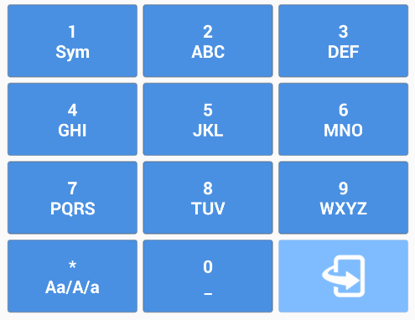
Example
To type “actor”:
- with predictive text: 22867
- without it: 22228666777

Slide 3
1st Attempt – SQLite FTS3
Using SQL "LIKE" queries was not an option as the dictionary data set was pretty big
SQLite FTS3 supports creating virtual tables which maintain an index for full-text searches
Proved to be quite slow but was working on large dictionaries

Slide 4
2nd Attempt – Modified trie data structure
2
2
8
act, bat, cat
4
6
6
8
7
actor
6
action
3
active

Slide 5
Statistics
Dictionary size: 4400 words
Device: Nexus 6
SQLite FTS3: less than 1ms / word
Modified trie: instant

