Slide 1
Engineering Economy
Chapter 2: Cost Concepts and Design Economics
R. M. SHAHBAB
Lecturer, Department of IPE, BUET
Email: sshahbab@ipe.buet.ac.bd

Slide 2
The objective of Chapter 2 is to analyze short-term alternatives when the time value of money is not a factor.

Slide 3
Costs can be categorized in different ways:
Fixed cost: unaffected by changes in activity level (ex: insurance, license fees, administrative salaries)
Variable cost: vary in total with the quantity of output or similar measure of activity (ex: cost of material, cost of labor used)

Slide 4
More ways to categorize costs
Direct: can be measured and allocated to a specific work activity (ingredients to make a certain product)
Indirect: difficult to attribute or allocate to a specific output or work activity; also called overhead or burden (costs of common tools, utility bills, equipment maintenance)
Standard cost: cost per unit of output, established in advance of production or service delivery

Slide 5
Some useful cost terminology
Cash cost: a cost that involves a payment of cash (buying supplies).
Book cost: a cost that does not involve a cash transaction but is reflected in the accounting system (ex: depreciation).
Sunk cost: a cost that has occurred in the past and has no relevance to estimates of future costs and revenues related to an alternative course of action (down payment on a bike then you changed your mind)

Slide 6
More useful cost terminology
Opportunity cost: the monetary advantage foregone due to limited resources. The cost of the best rejected opportunity. (Ex: employee leaves his $20,000/year job for a year to study and pays $5000 for his studies. The opportunity cost of going to university is $25000).
Life-cycle cost: the summation of all costs related to a product, structure, system, or service during its life span.

Slide 7
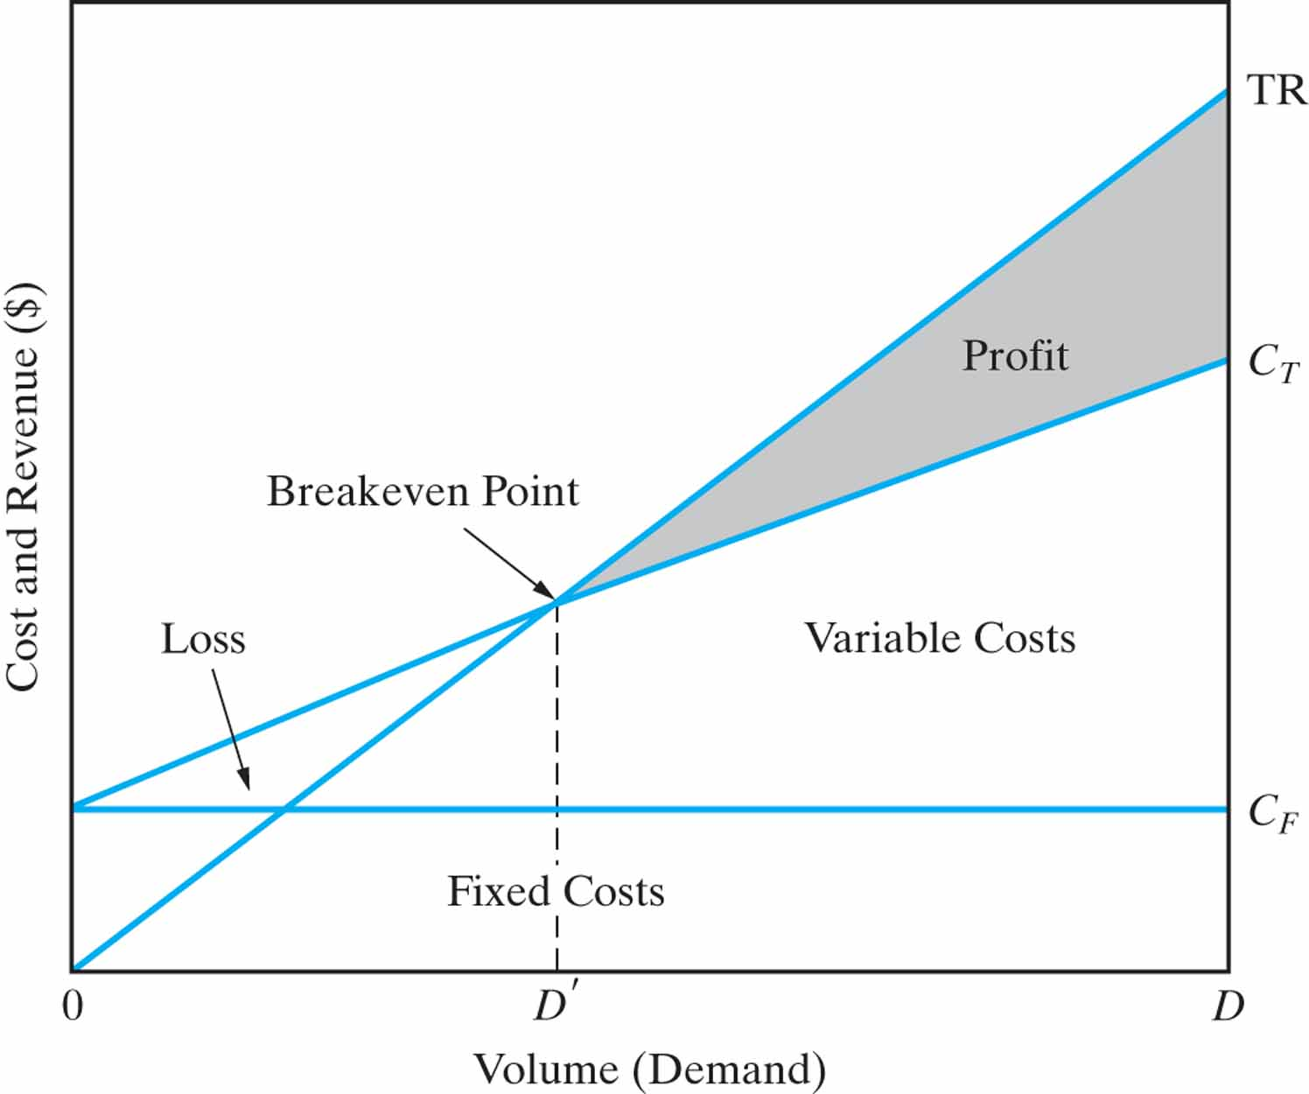
If Price is Constant (independent of demand)
→ Single Breakeven Point

Slide 8
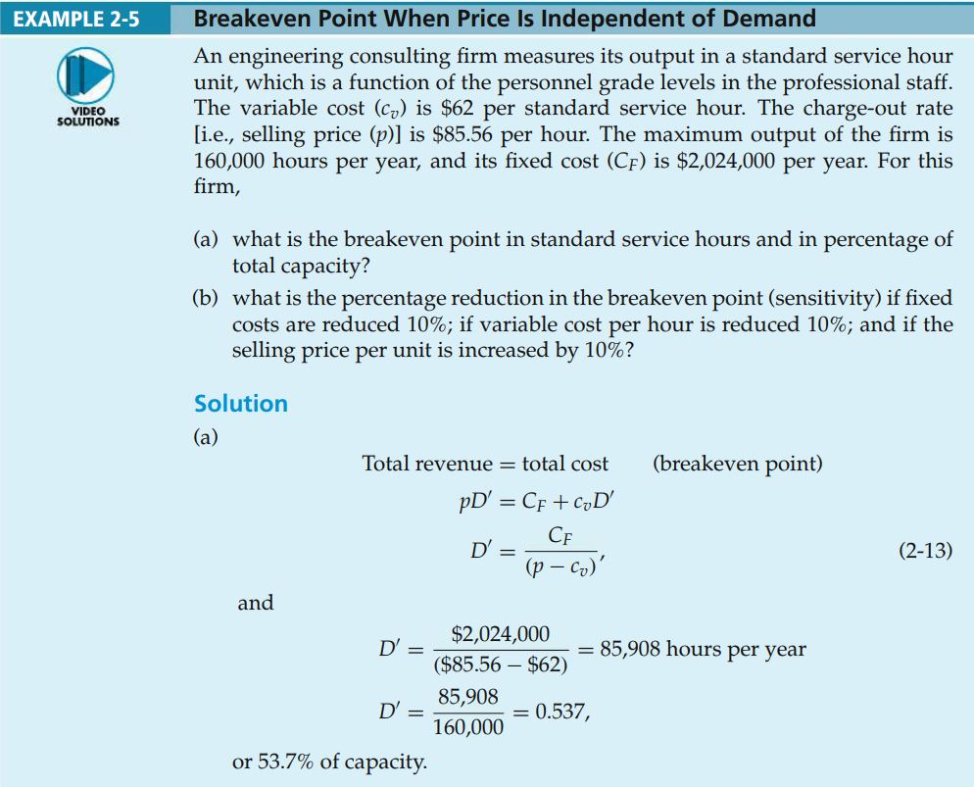

Slide 10
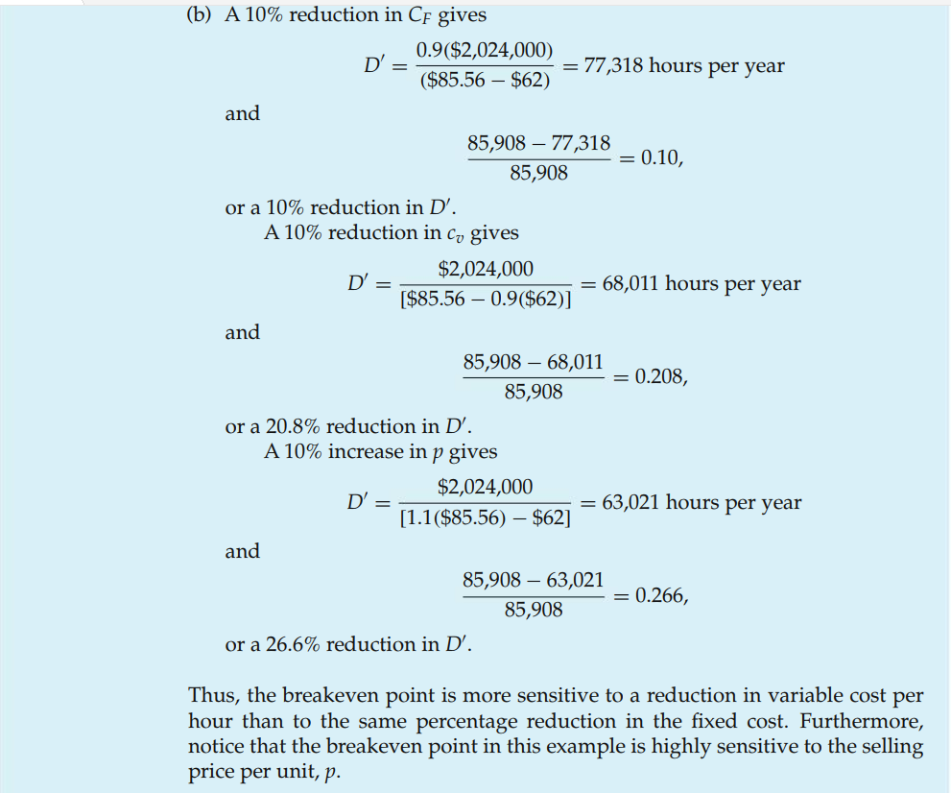

Slide 11
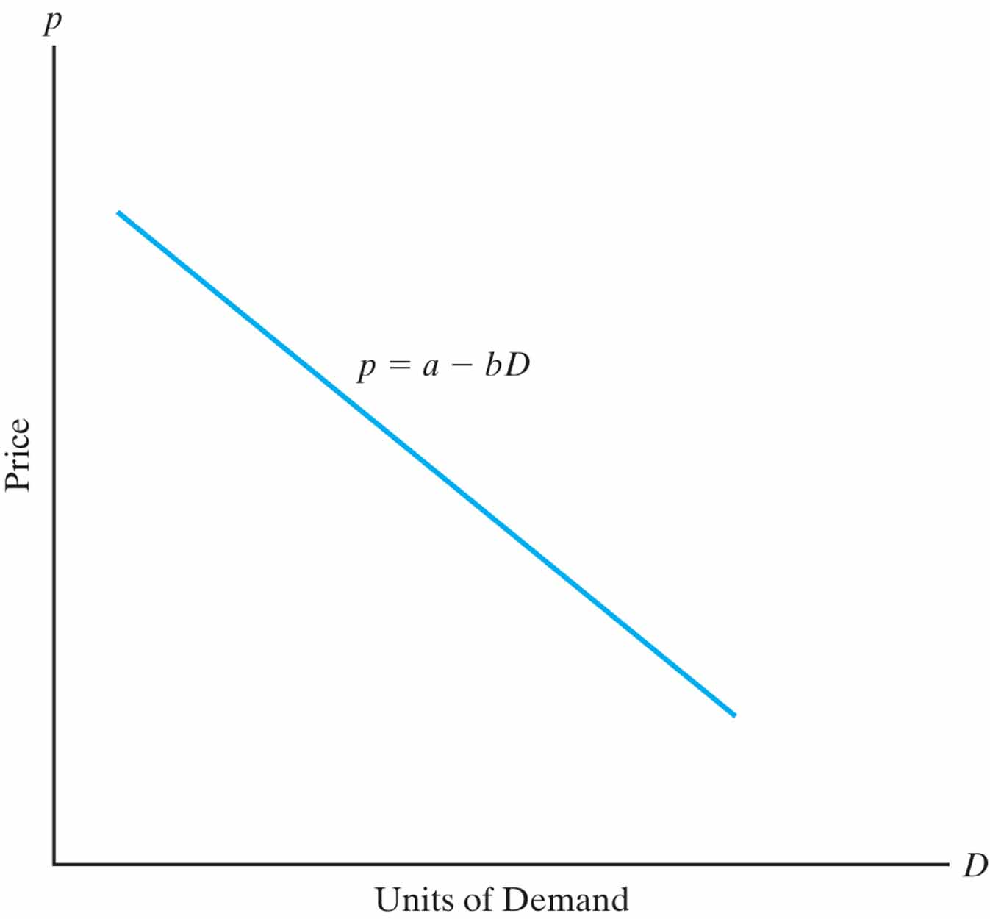
The general price-demand relationship
The demand for a product or service is directly related to its price according to p = a - bD where p is price, D is demand, and a and b are constants that depend on the particular product or service.
Necessities or Luxuries?
Perfect Competition or Monopoly?

Slide 12
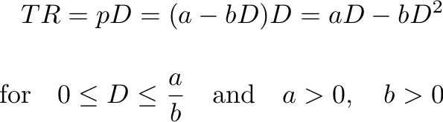
Total revenue depends on price and demand.
Total Revenue (TR) is the product of the selling price per unit, p, and the number of units sold, D.

Slide 13
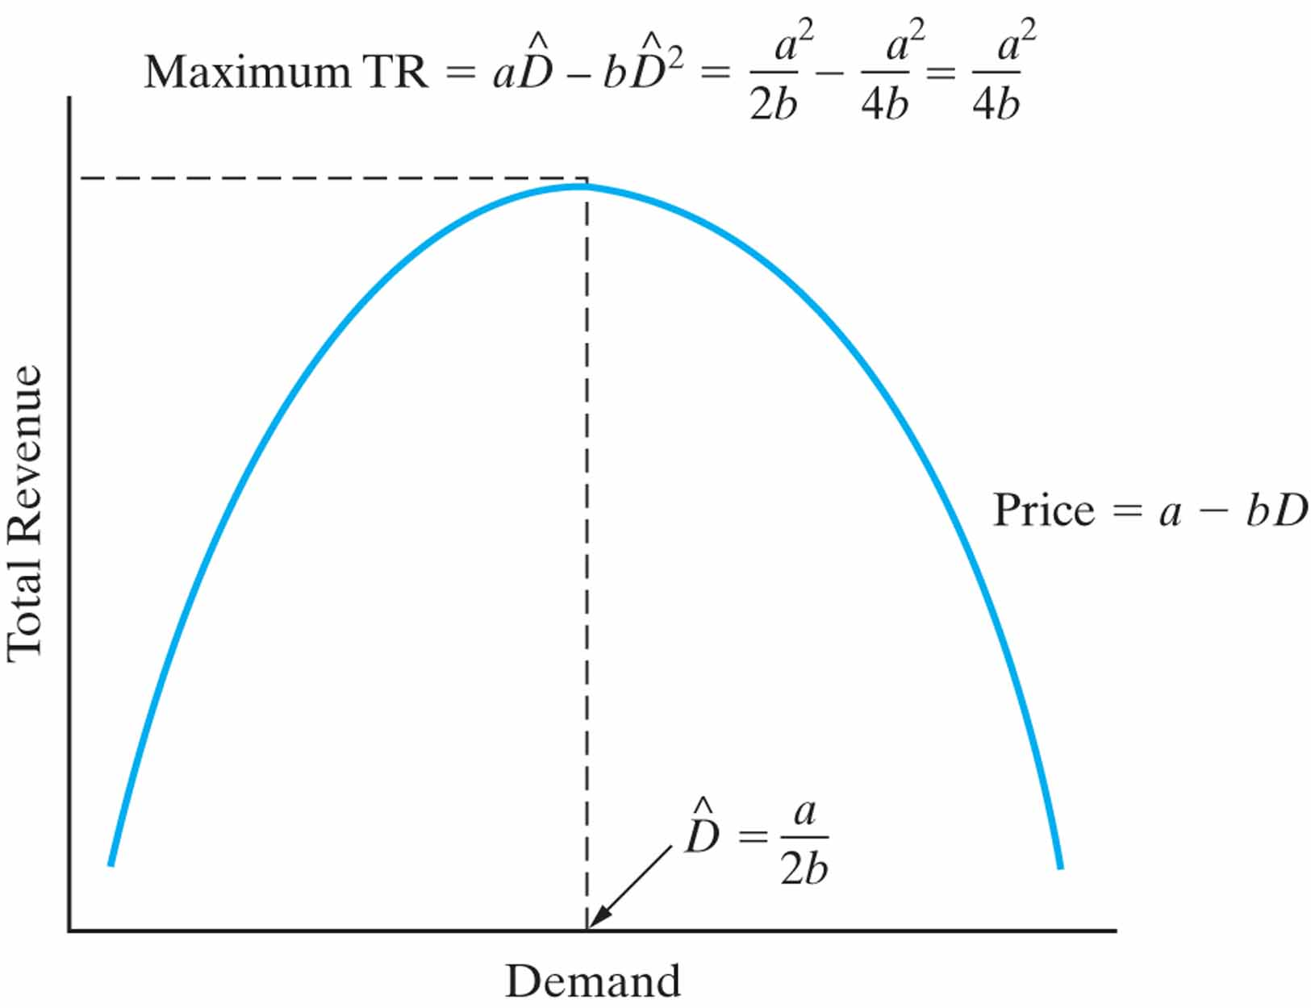


Calculus can help determine the demand that maximizes revenue.
Solving, the optimal demand is

Slide 14


We can also find maximum profit…
Profit is revenue minus cost
Total Cost = Fixed Costs + Variable Costs
C_{T} = C_{F} + C_{V}
At any Demand D: C_{V} = c_{v}. D
for
Differentiating, we can find the value of D that maximizes profit:
; second derivative of profit must be negative (-2b)

Slide 15

And we can find revenue/cost breakeven.
Breakeven is found when total revenue = total cost. Solving, we find the demand at which this occurs.
There are two roots of the equation; so there are two breakeven points (D'₁ and D'₂)

Slide 16
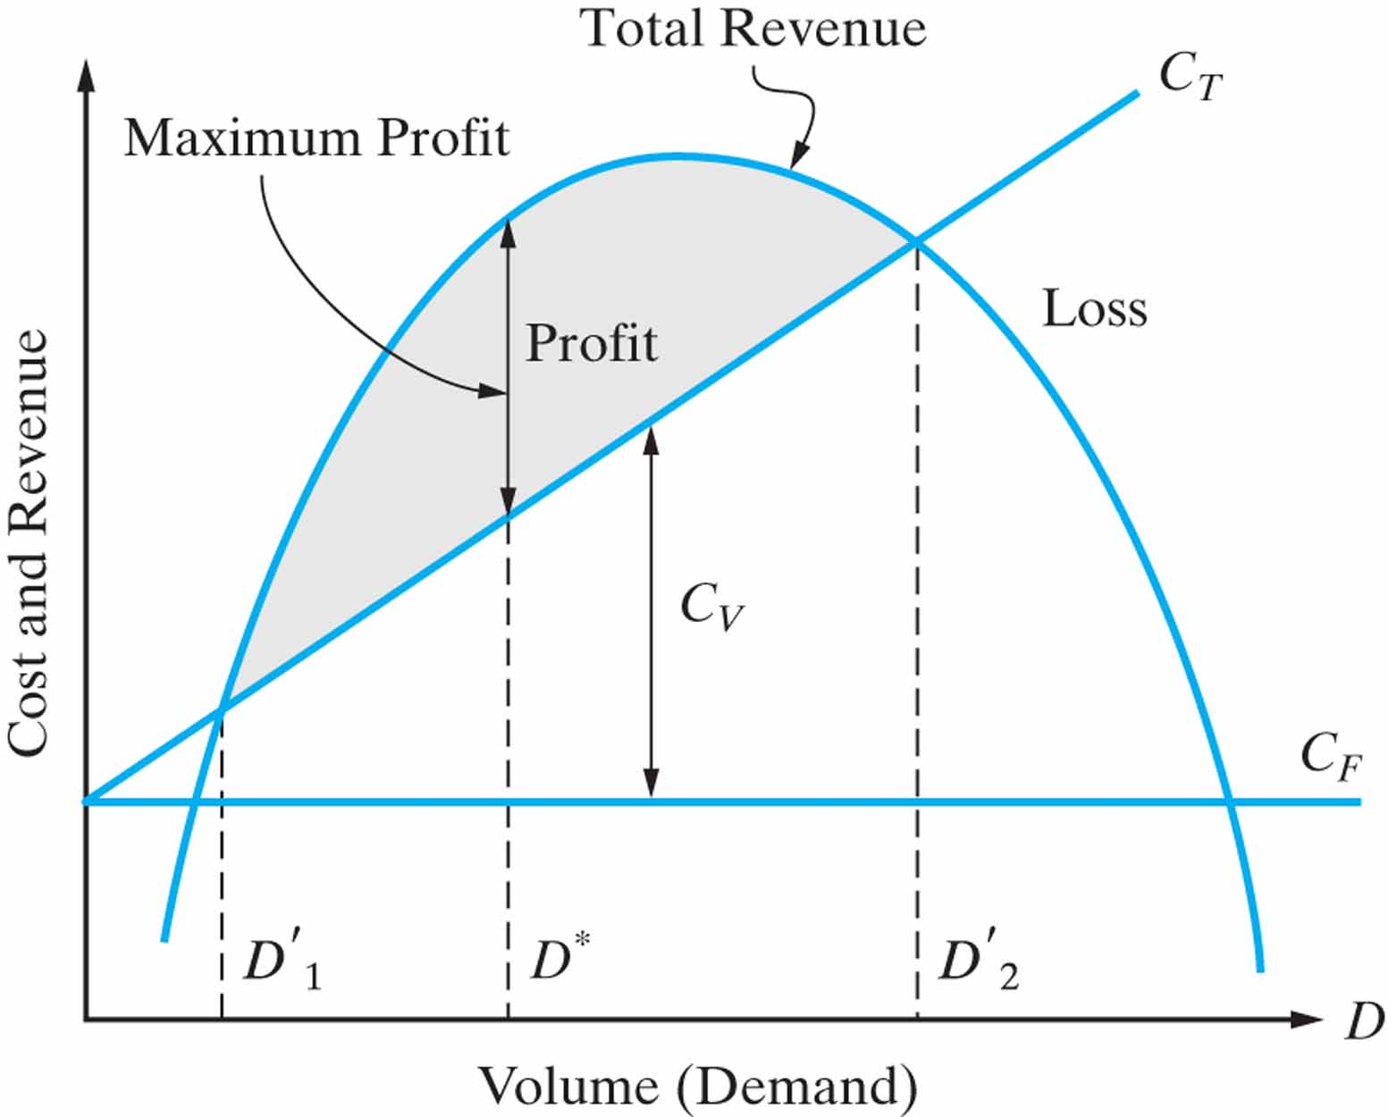
Combined Cost and Revenue Functions, and Breakeven Points as Functions of Volume, and Their Effect on Typical Profit

Slide 17
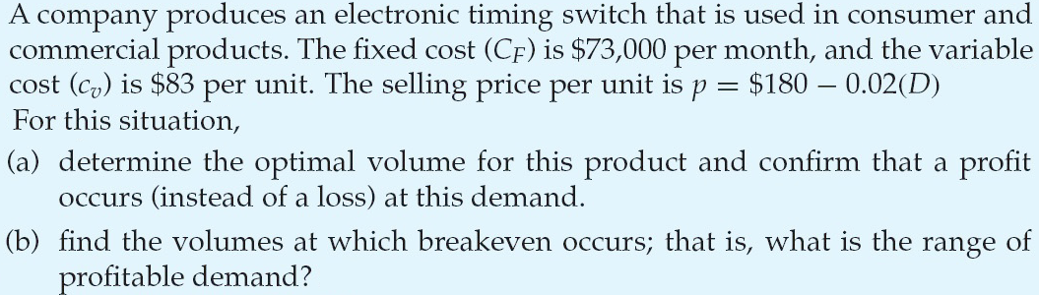
Example 3:

Slide 18
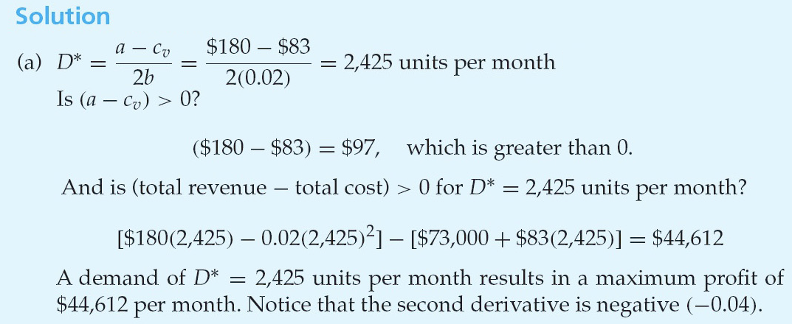
Example 3:

Slide 19
