Slide 1
Engineering Economy
Chapter 4: The Time Value of Money
R. M. SHAHBAB
Lecturer, Department of IPE, BUET
Email: sshahbab@ipe.buet.ac.bd

Slide 2
Money has a time value.
Capital refers to wealth in the form of money or property that can be used to produce more wealth.
Engineering economy studies involve the commitment of capital for extended periods of time.
A dollar today is worth more than a dollar one or more years from now (for several reasons).

Slide 3
Simple Interest: infrequently used
When the total interest earned or charged is linearly proportional to the initial amount of the loan (principal), the interest rate, and the number of interest periods, the interest and interest rate are said to be simple.
Compound Interest: commonly used
Compound interest reflects both the remaining principal and any accumulated interest.

Slide 4
Computation of simple interest
The total interest, I, earned or paid may be computed using the formula below.
P = principal amount lent or borrowed
N = number of interest periods (e.g., years)
i = interest rate per interest period
The total amount repaid at the end of N interest periods is P + I.

Slide 5

If $1,000 were loaned for three years at a simple interest rate of 10% per year, the interest earned would be
Computation of simple interest
So, the total amount repaid at the end of five years would be –
the original amount ($1,000) plus the interest ($300), or $1,300.

Slide 6
For $1,000 at 10%…
Compound interest
Period | (1) Amount owed at beginning of period | (2)=(1)x10% Interest amount for period | (3)=(1)+(2) Amount owed at end of period
1 | $1,000 | $100 | $1,100
2 | $1,100 | $110 | $1,210
3 | $1,210 | $121 | $1,331

Slide 7
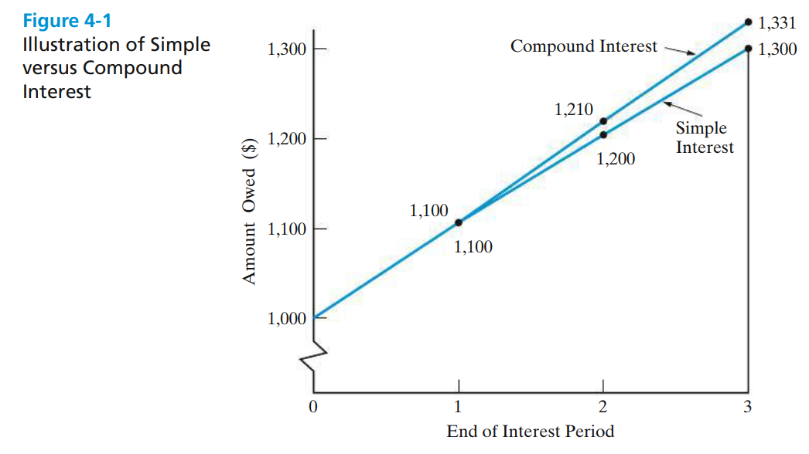
Simple vs. Compound interest

Slide 8
Economic equivalence allows us to compare alternatives on a common basis.
Each alternative can be reduced to an equivalent basis dependent on
  interest rate,
  amount of money involved, and
  timing of monetary receipts or expenses.
Using these elements we can “move” cash flows so that we can compare them at particular points in time.

Slide 9
We need some tools to find economic equivalence.
Notation used in formulas for compound interest calculations.
  i = effective interest rate per interest period
  N = number of compounding (interest) periods
  P = present sum of money; equivalent value of one or more cash flows at a reference point in time; the present
  F = future sum of money; equivalent value of one or more cash flows at a reference point in time; the future
  A = end-of-period cash flows in a uniform series continuing for a certain number of periods, starting at the end of the first period and continuing through the last

Slide 10
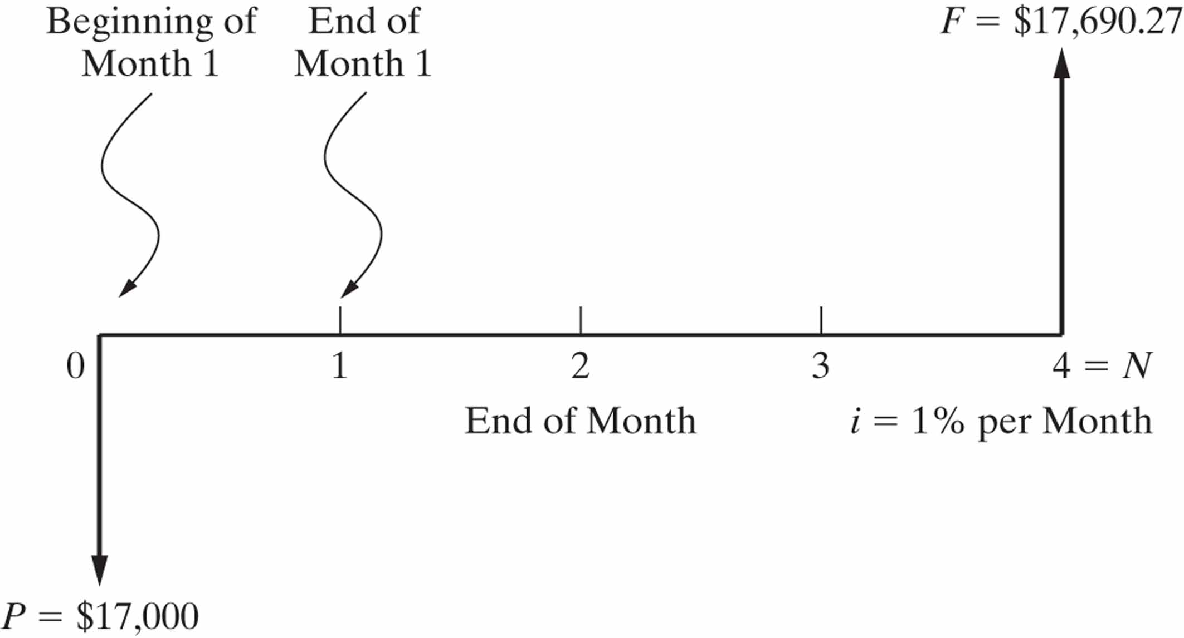
A cash flow diagram is an indispensable tool for clarifying and visualizing a series of cash flows.
Cash-Flow Diagrams

Slide 11
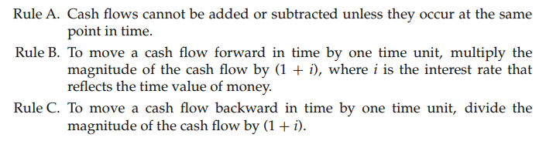
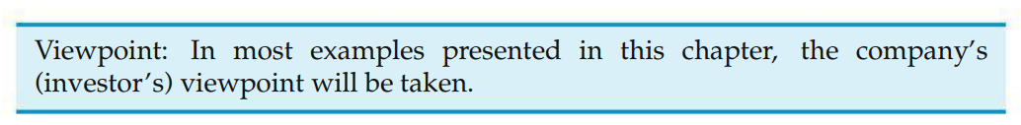
Cash-Flow Diagrams

Slide 12
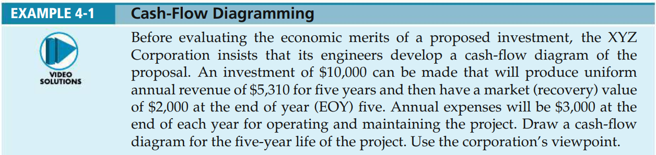
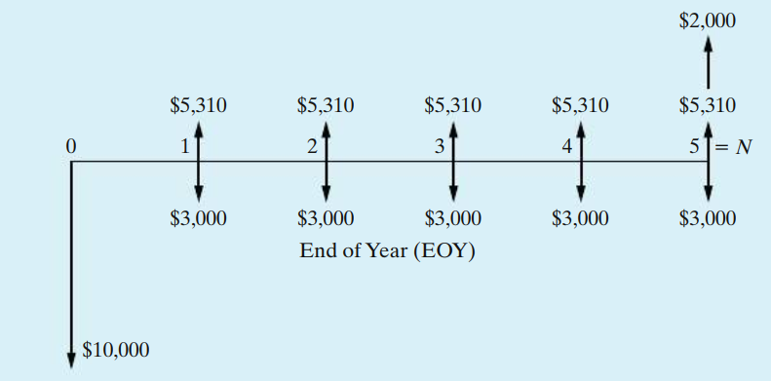
Cash-Flow Diagrams

Slide 13


Present and Future Equivalent
Using the standard notation, we find that a present amount, P, can grow into a future amount, F, in N time periods at interest rate i according to the formula below.
In a similar way we can find P given F by

Slide 14


It is common to use standard notation for interest factors.
Present and Future Equivalent
This is also known as the single payment compound amount factor. The term on the right is read “F given P at i% interest per period for N interest periods.”
is called the single payment present worth factor.

Slide 15
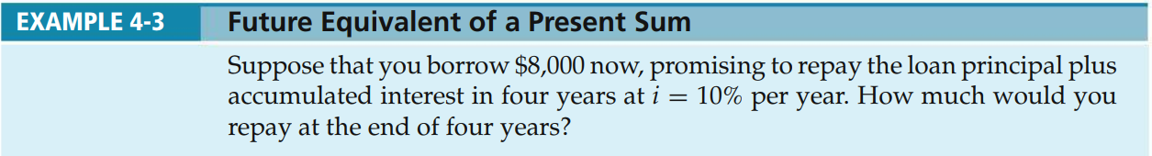
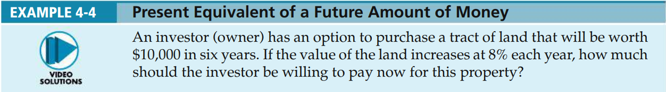
Present and Future Equivalent

Slide 16

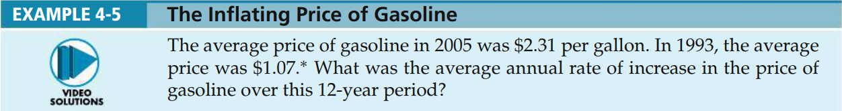
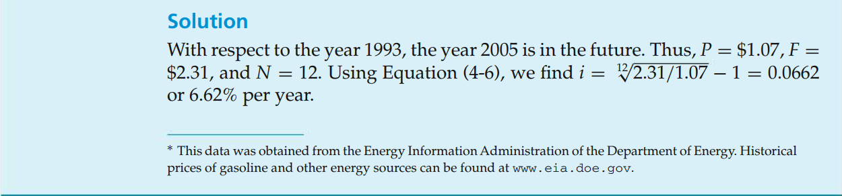
Finding the Interest Rate Given P, F, and N -
Present and Future Equivalent

Slide 17
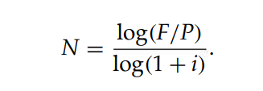
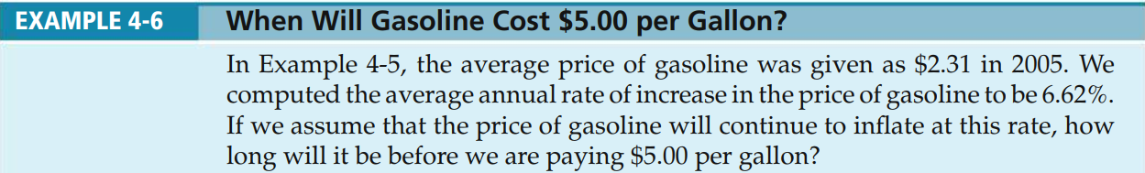
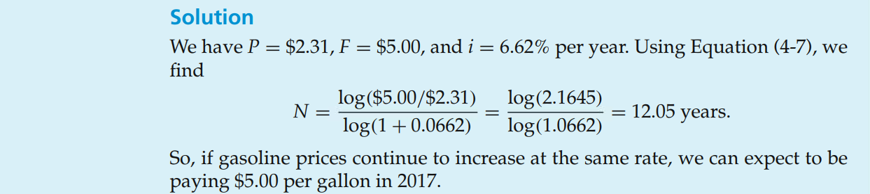
Finding N when Given P, F, and i
Present and Future Equivalent

Slide 18
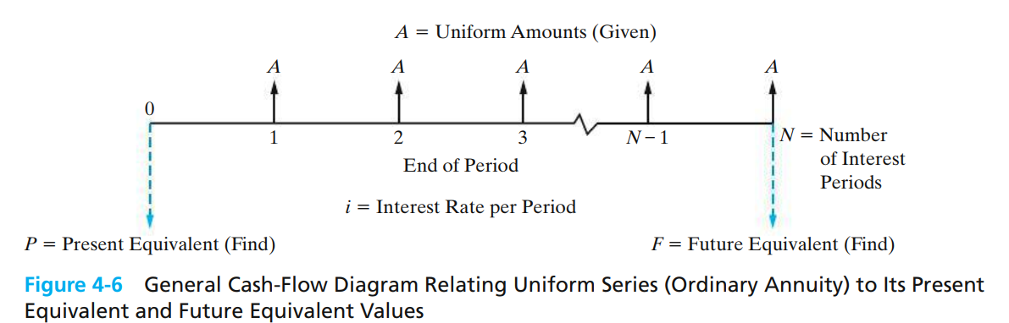
Annual equivalent value, A

Slide 19

Annual equivalent value, A
Finding F when Given A-
How much will you have in 40 years if you save $3,000 each year and your account earns 8% interest each year?

Slide 20

Annual equivalent value, A
Finding P when Given A-
How much would be needed today to provide an annual amount of $50,000 each year for 20 years, at 9% interest each year?

Slide 21

Finding A when given F.
How much would you need to set aside each year for 25 years, at 10% interest, to have accumulated $1,000,000 at the end of the 25 years?

Slide 22

Finding A when given P.
If you had $500,000 today in an account earning 10% each year, how much could you withdraw each year for 25 years?

Slide 23
Homework
The manager of a canned food processing plant must decide between two different labeling machines. Machine A will have a first cost of $42,000, an annual operating cost of $28,000, and a service life of 4 years. Machine B will cost $51,000 to buy and will have an annual operating cost of $17,000 during its 4-year life. At an interest rate of 10% per year, which should be selected on the basis of a present worth analysis?

Slide 24
It can be challenging to solve for N or i.
We may know P, A, and i and want to find N.
We may know P, A, and N and want to find i.

Slide 25
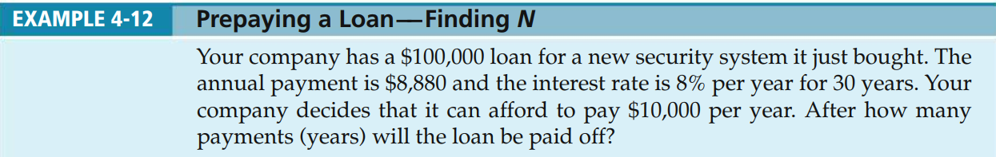
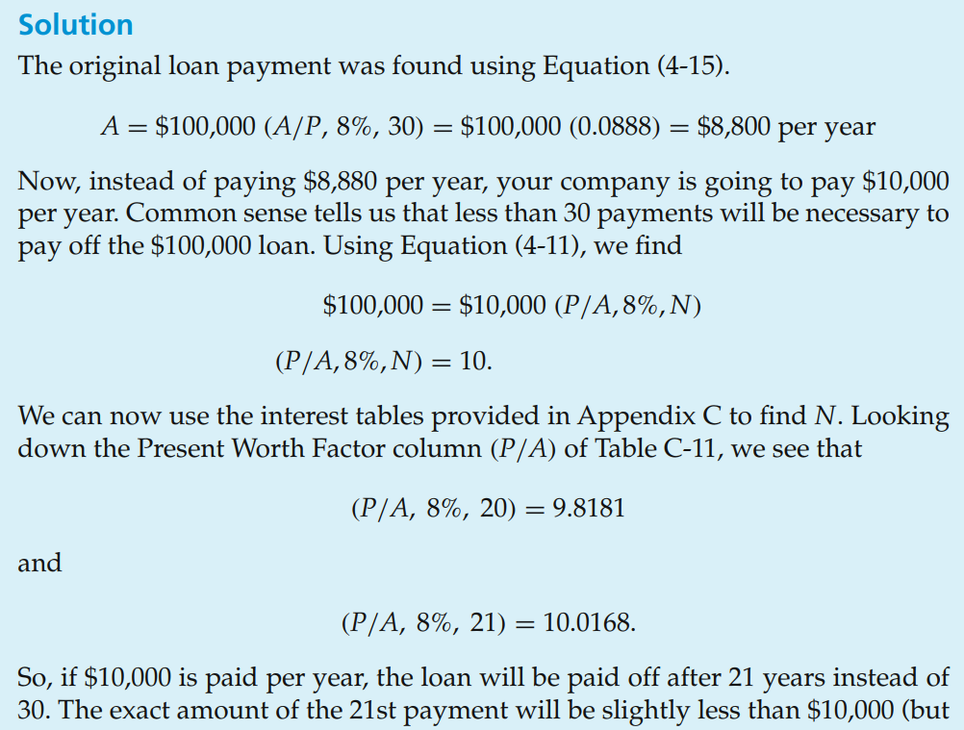
Finding N, Given A, P, and i

Slide 26
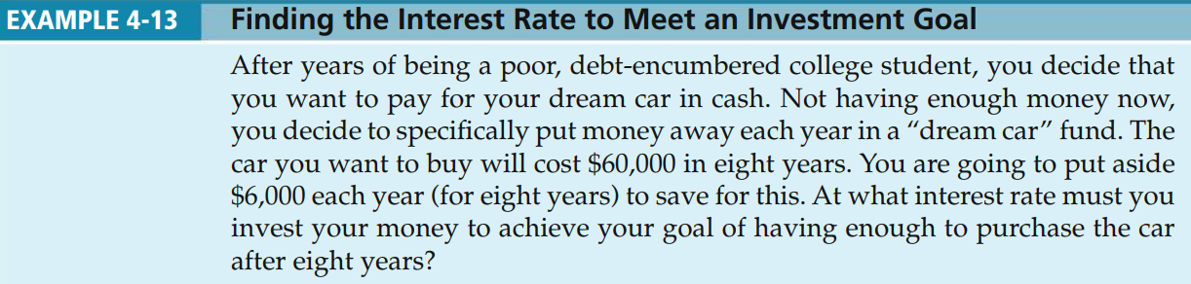
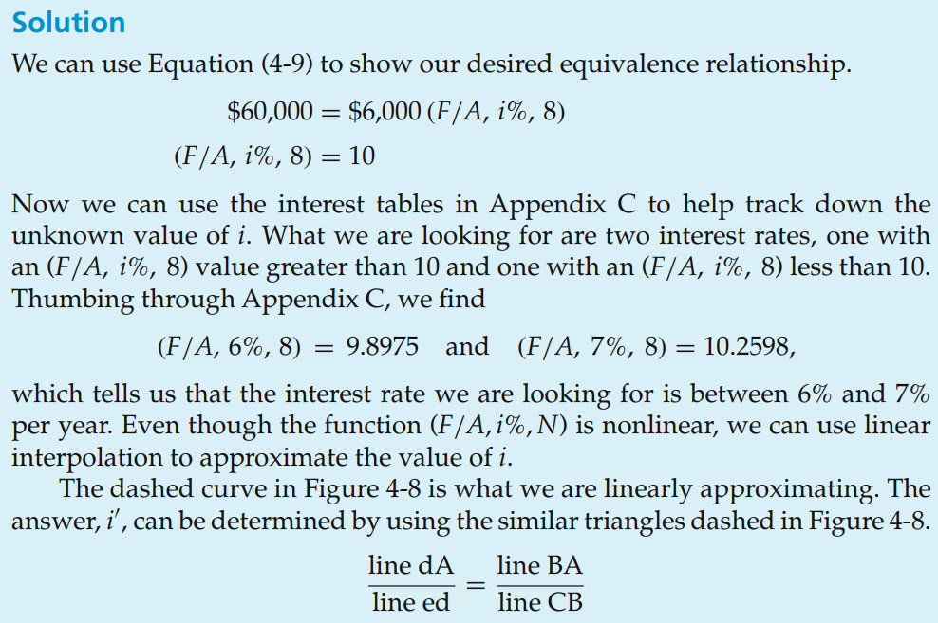
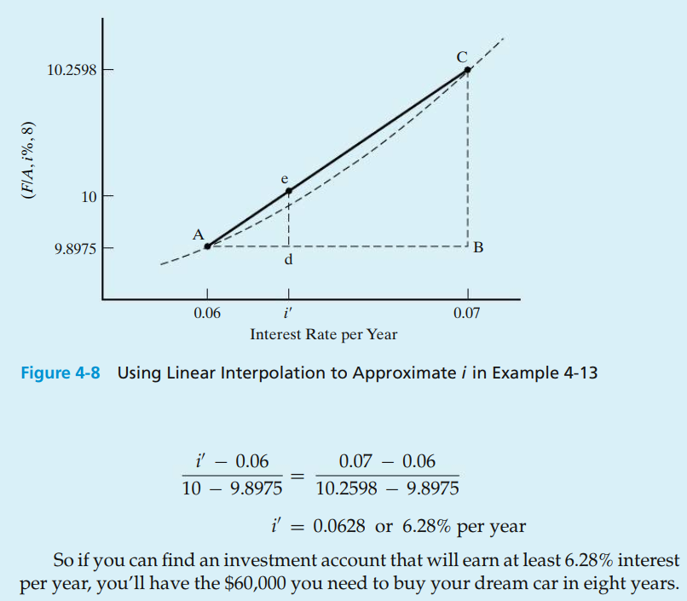
Finding i, Given A, F, and N

Slide 27
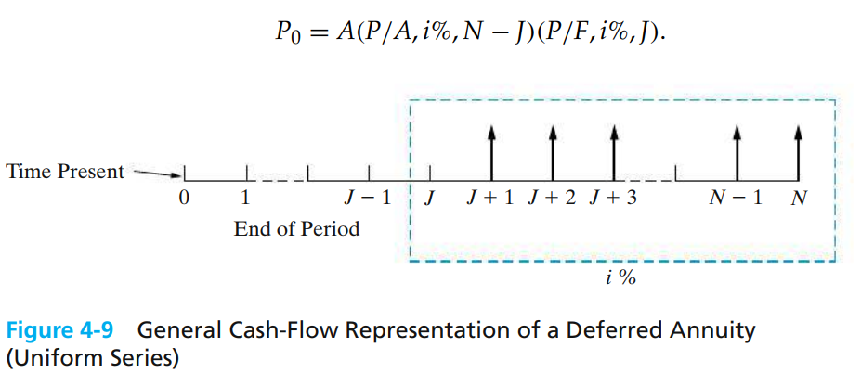
Deferred Annuities (Uniform Series)
If the annuity is deferred J periods then the first payment (cash flow) begins at the end of period J+1.

Slide 28
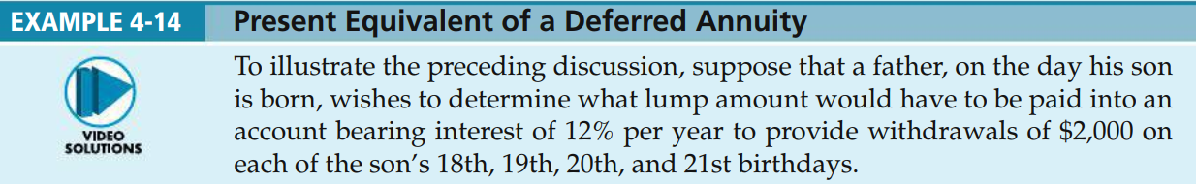
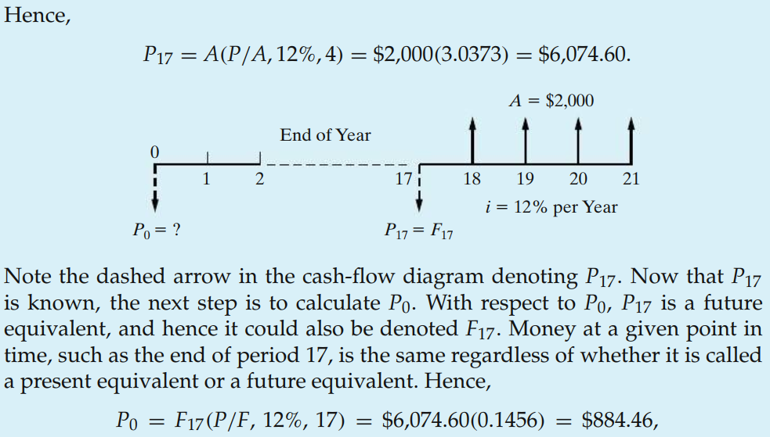
Deferred Annuities (Uniform Series)

Slide 29
Nominal and effective interest rates.
Often, the time between successive compounding, or the interest period, is less than one year (e.g., daily, monthly, quarterly).
The annual rate is known as a nominal rate.
A nominal rate of 12%, compounded monthly, means an interest of 1% (12%/12) each month, and the annual rate would be effectively somewhat greater than 12%.
The more frequent the compounding the greater the effective interest.

Slide 30

Nominal and effective interest rates.
Let r be the nominal, annual interest rate and M the number of compounding periods per year. We can find, i, the effective interest by using the formula below.

Slide 31


Nominal and effective interest rates.
For an 18% nominal rate, compounded quarterly, the effective interest is.
For a 7% nominal rate, compounded monthly, the effective interest is.

Slide 32
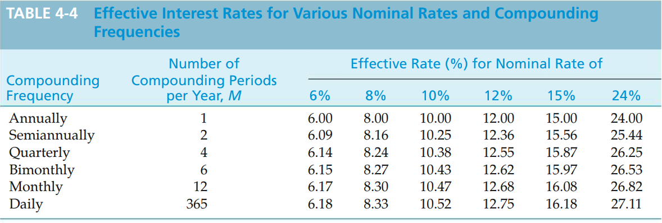
Nominal and effective interest rates.

Slide 33
Interest can be compounded continuously.
Interest is typically compounded at the end of discrete periods.
In some companies, cash is always flowing, and should be immediately put to use.
We can allow compounding to occur continuously throughout the period.
The effect of this compared to discrete compounding is small in most cases.

Slide 34
We can use the effective interest formula to derive the interest factors.
As the number of compounding periods gets larger (M gets larger), we find that

Slide 35



Continuous compounding interest factors.
The other factors can be found from these.

Slide 36
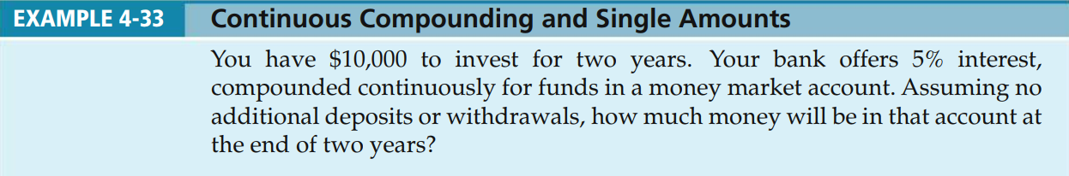
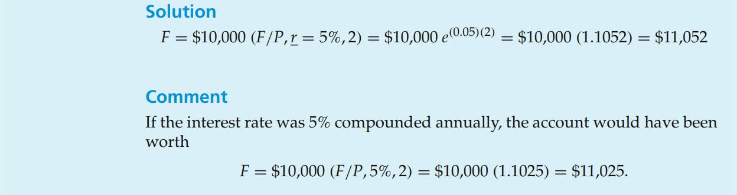
Continuous compounding interest factors.

