Slide 1

Spacey Class and ER Diagram
1705096-Kazim Abrar Mahi
1705097-Mohammad Shamim Ahsan
1705104-Anik Islam

Slide 2
Registration-Class Diagram

Slide 3
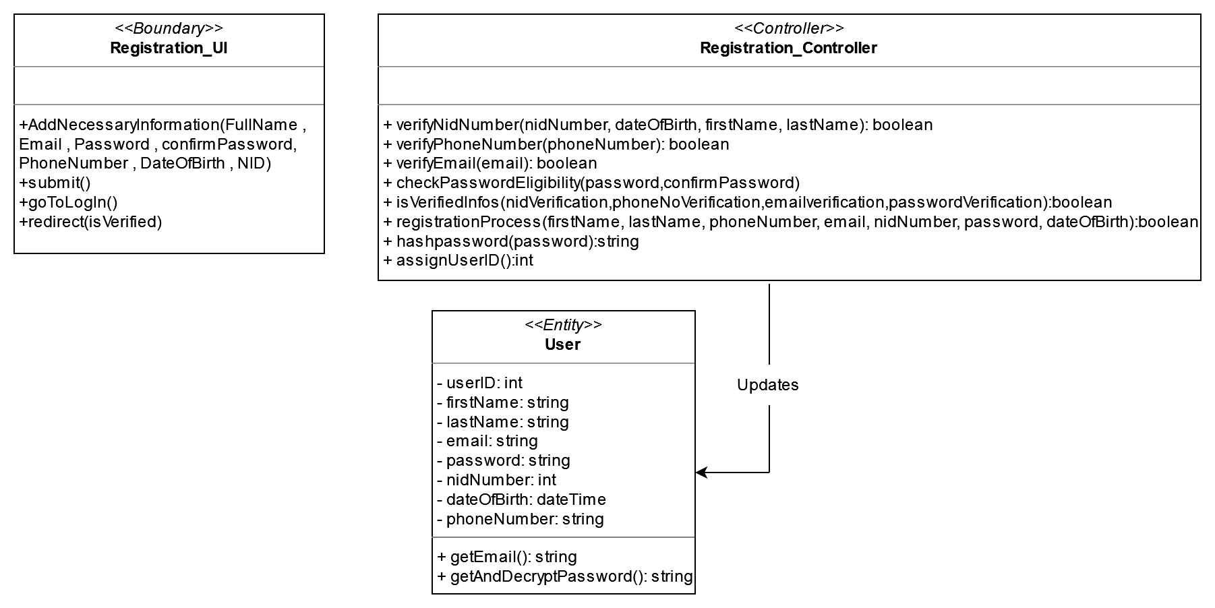

Slide 4
User Entity

Slide 5
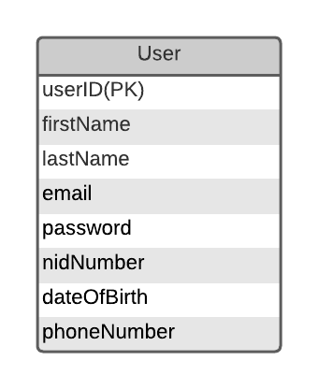

Slide 6
LogIn-Class Diagram

Slide 7
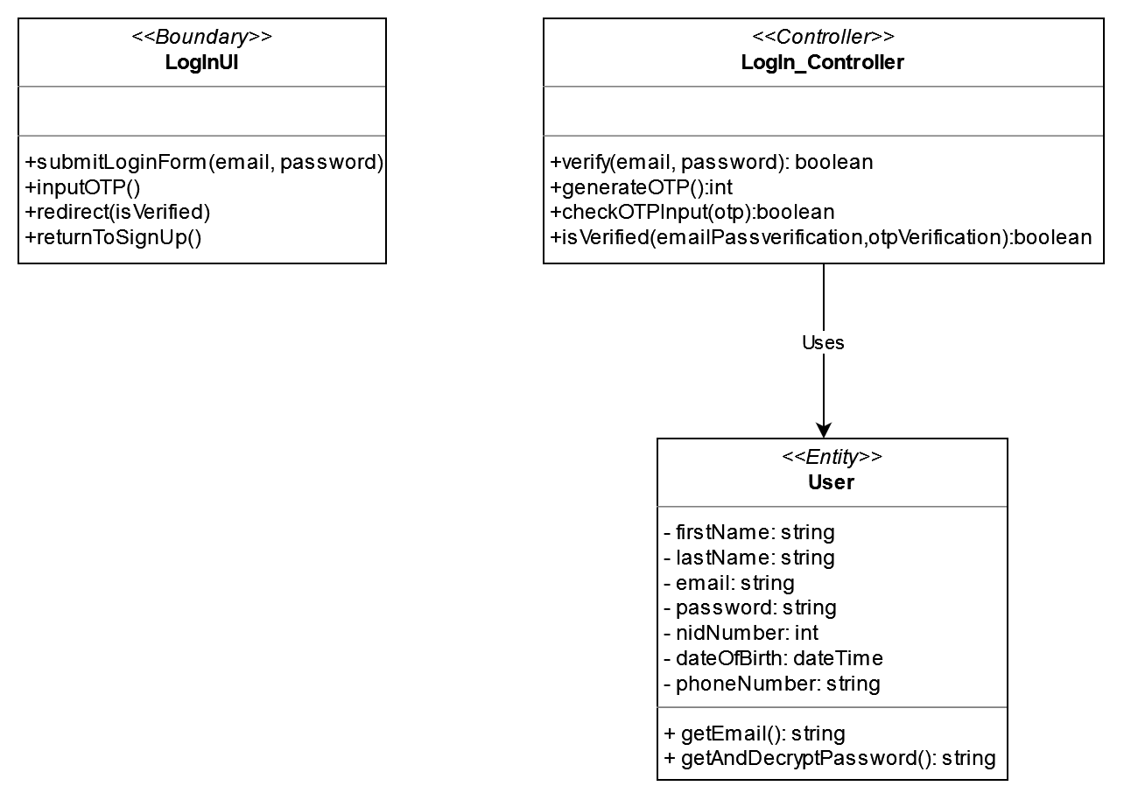

Slide 8
Hosting-Class Diagram

Slide 9
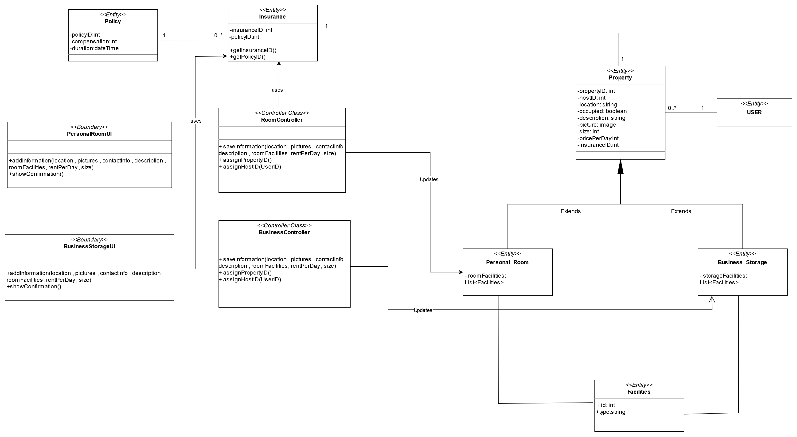

Slide 11
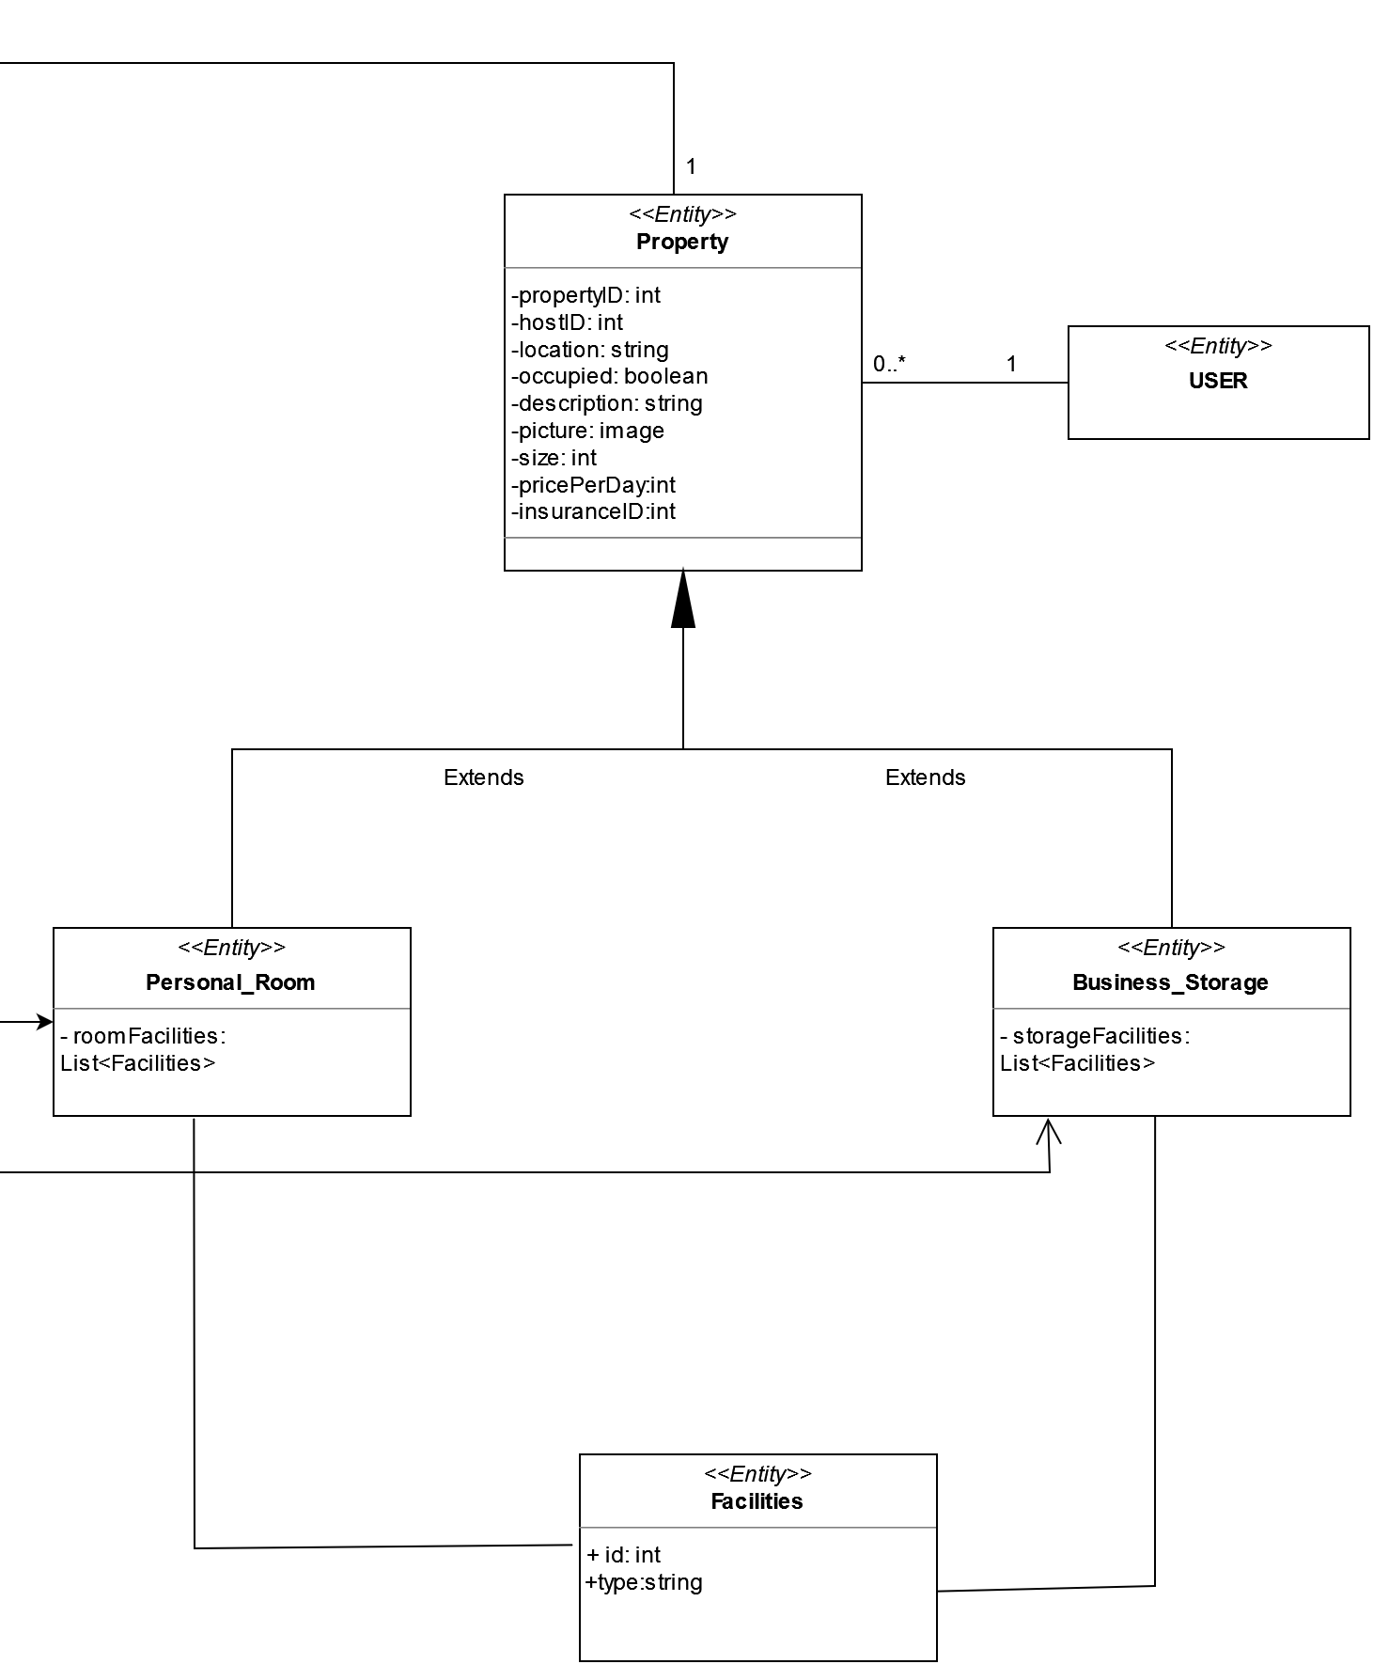

Slide 12
Property, Facilities-ERD

Slide 13
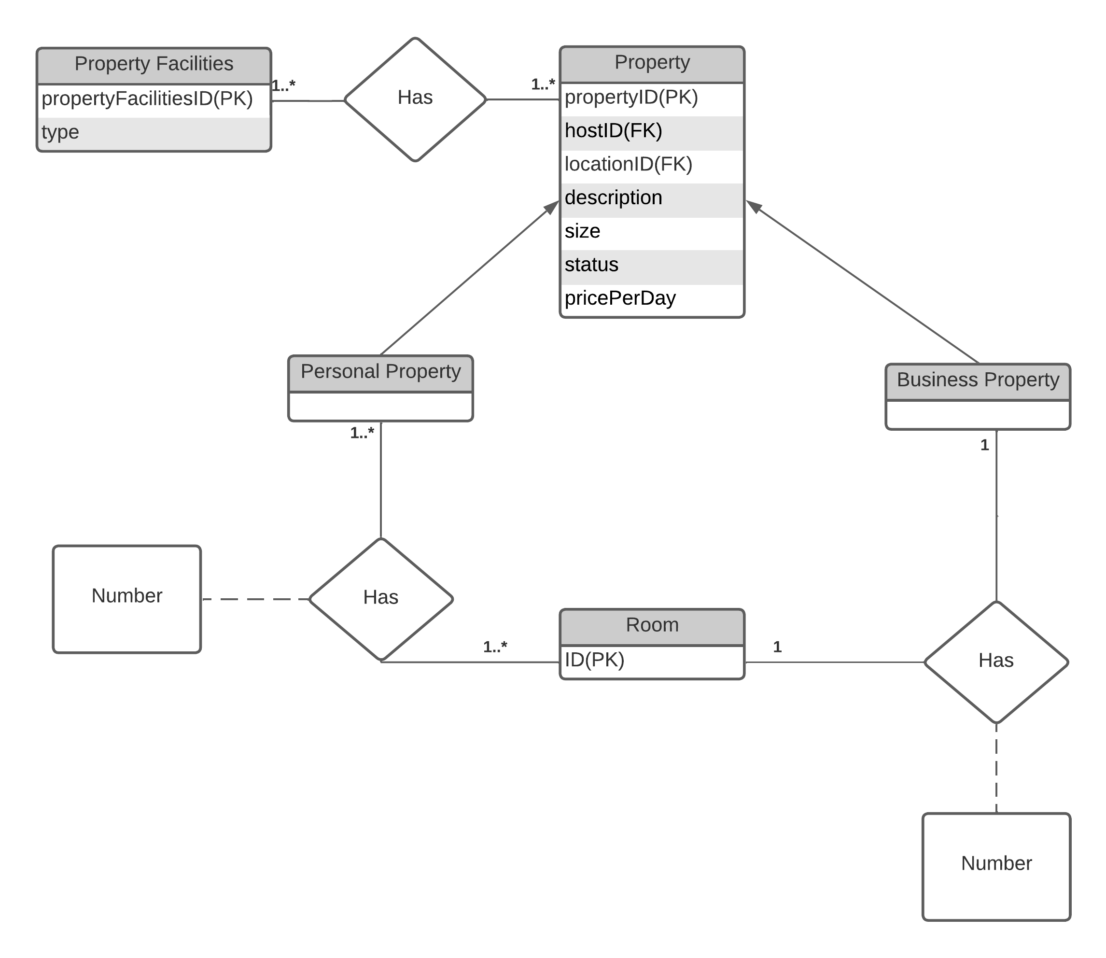

Slide 14
Address, Picture-ERD

Slide 15
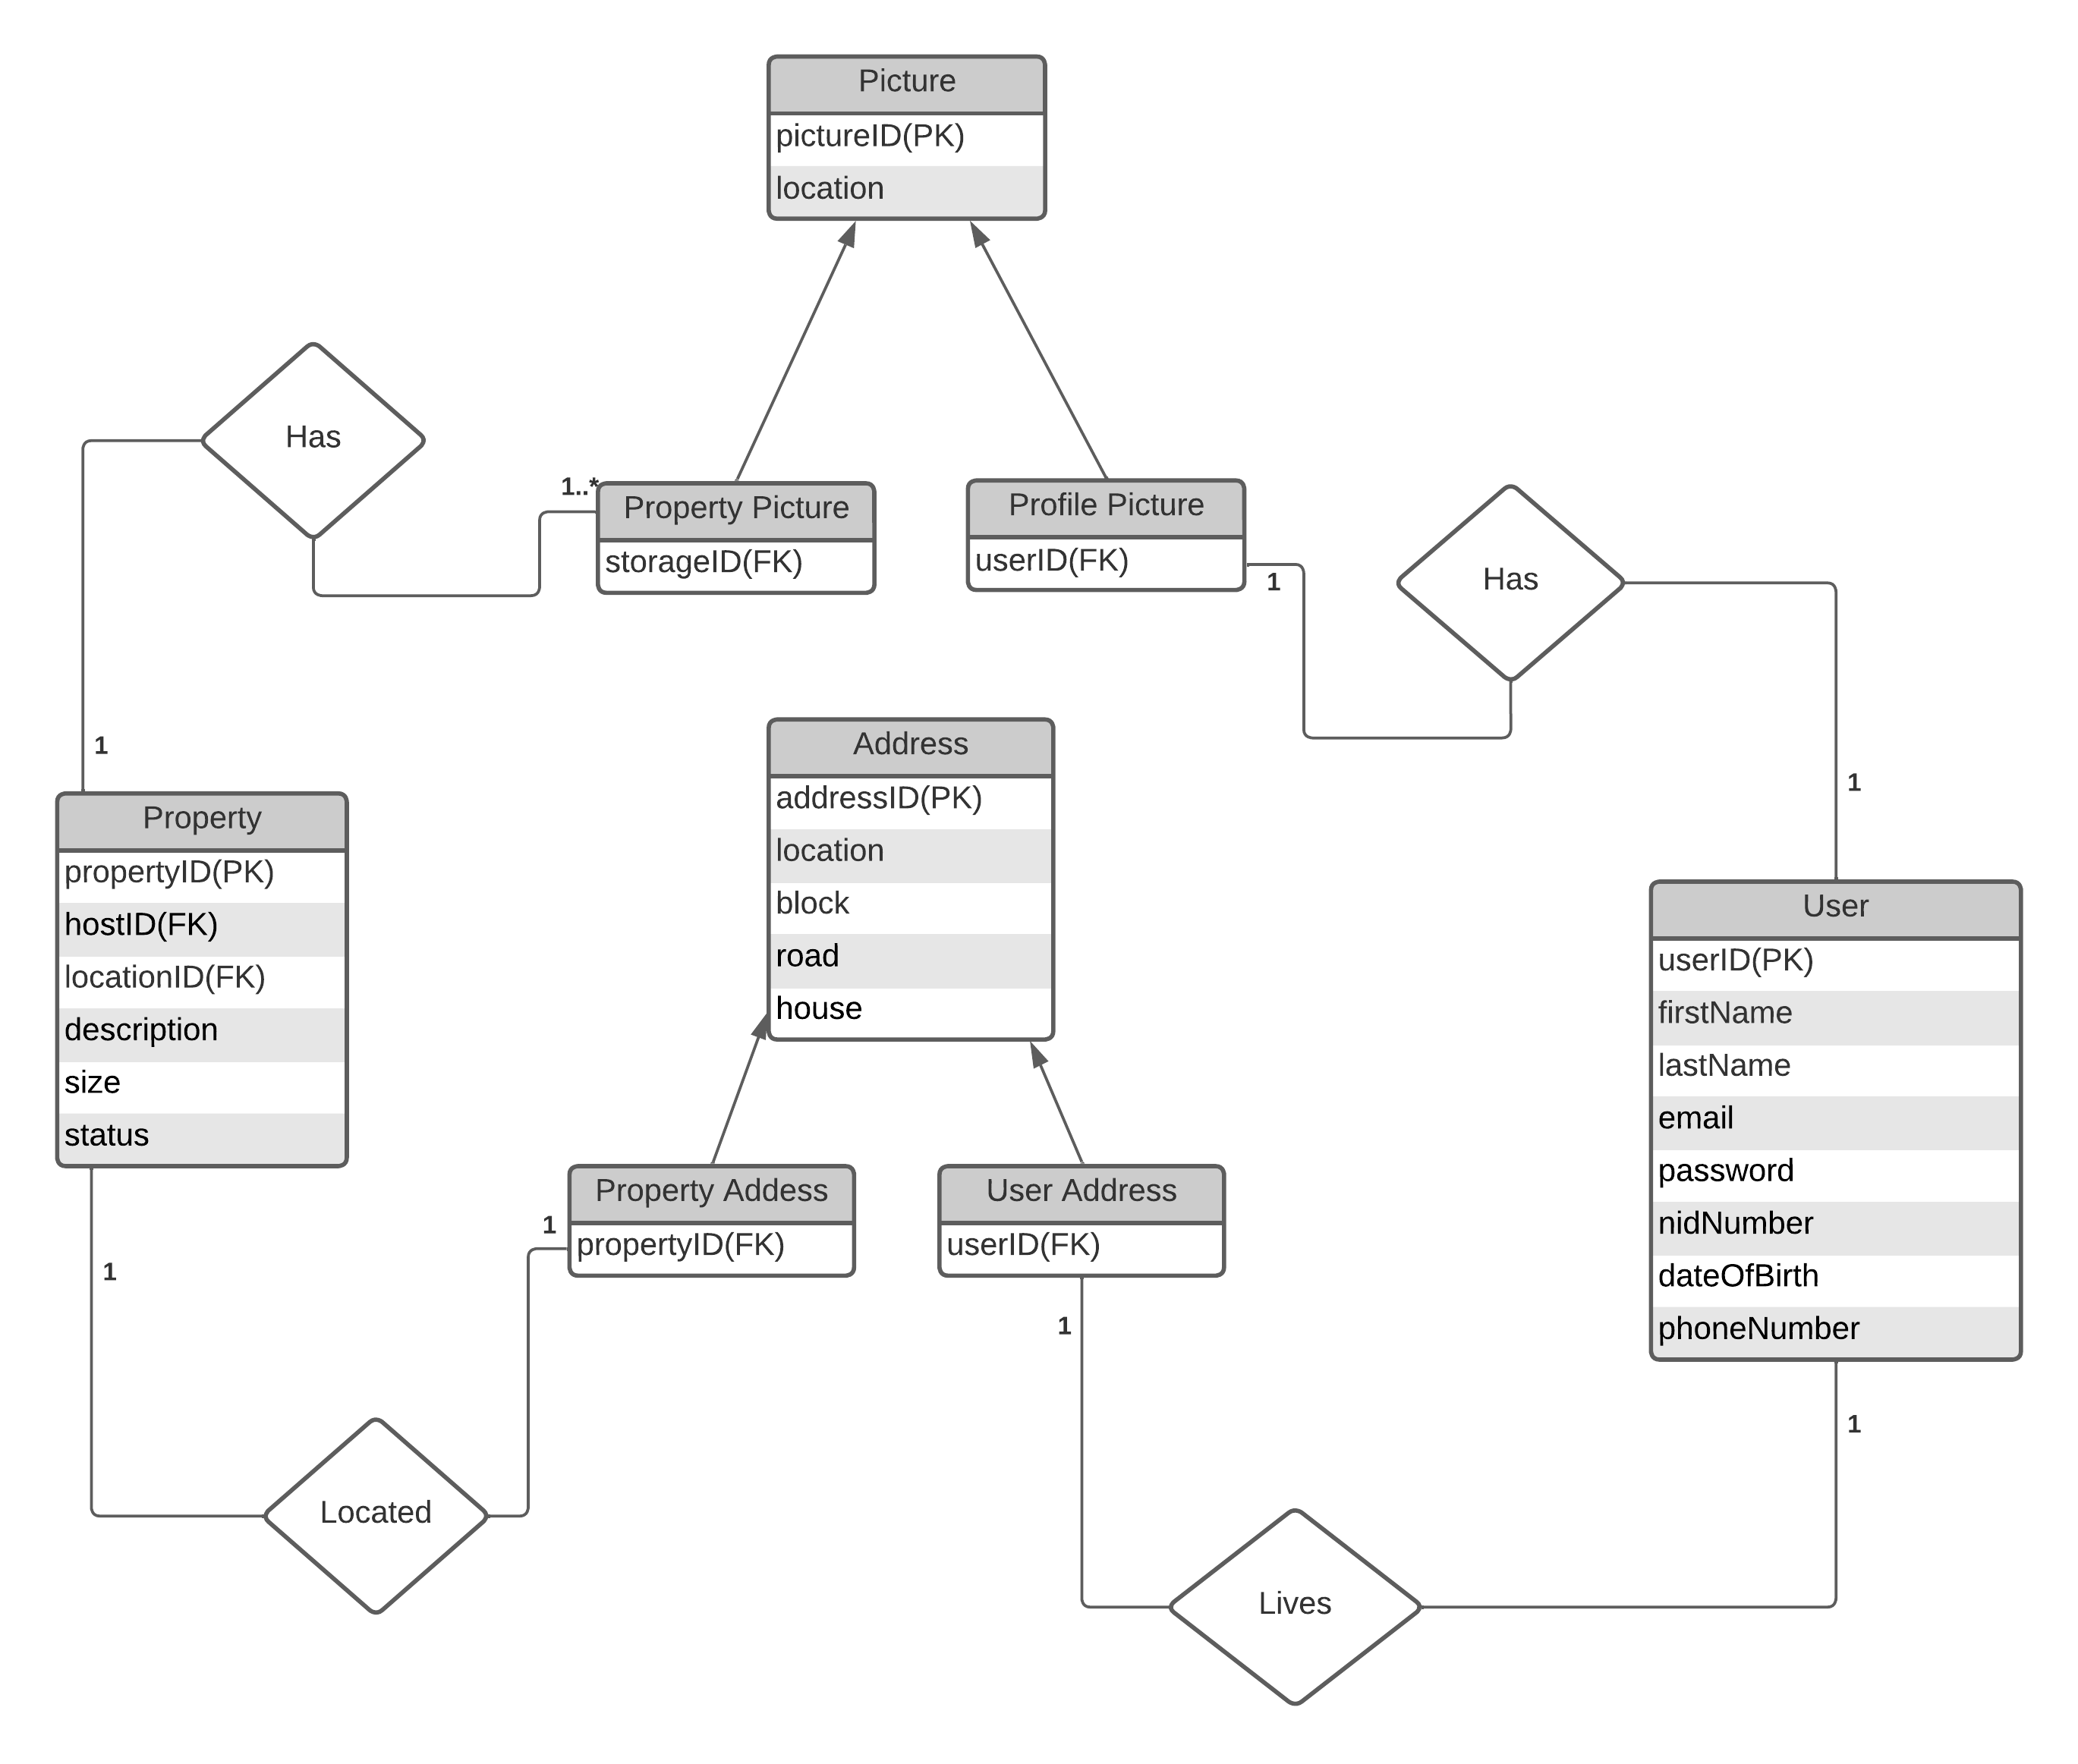

Slide 16
Renting-Class Diagram

Slide 17
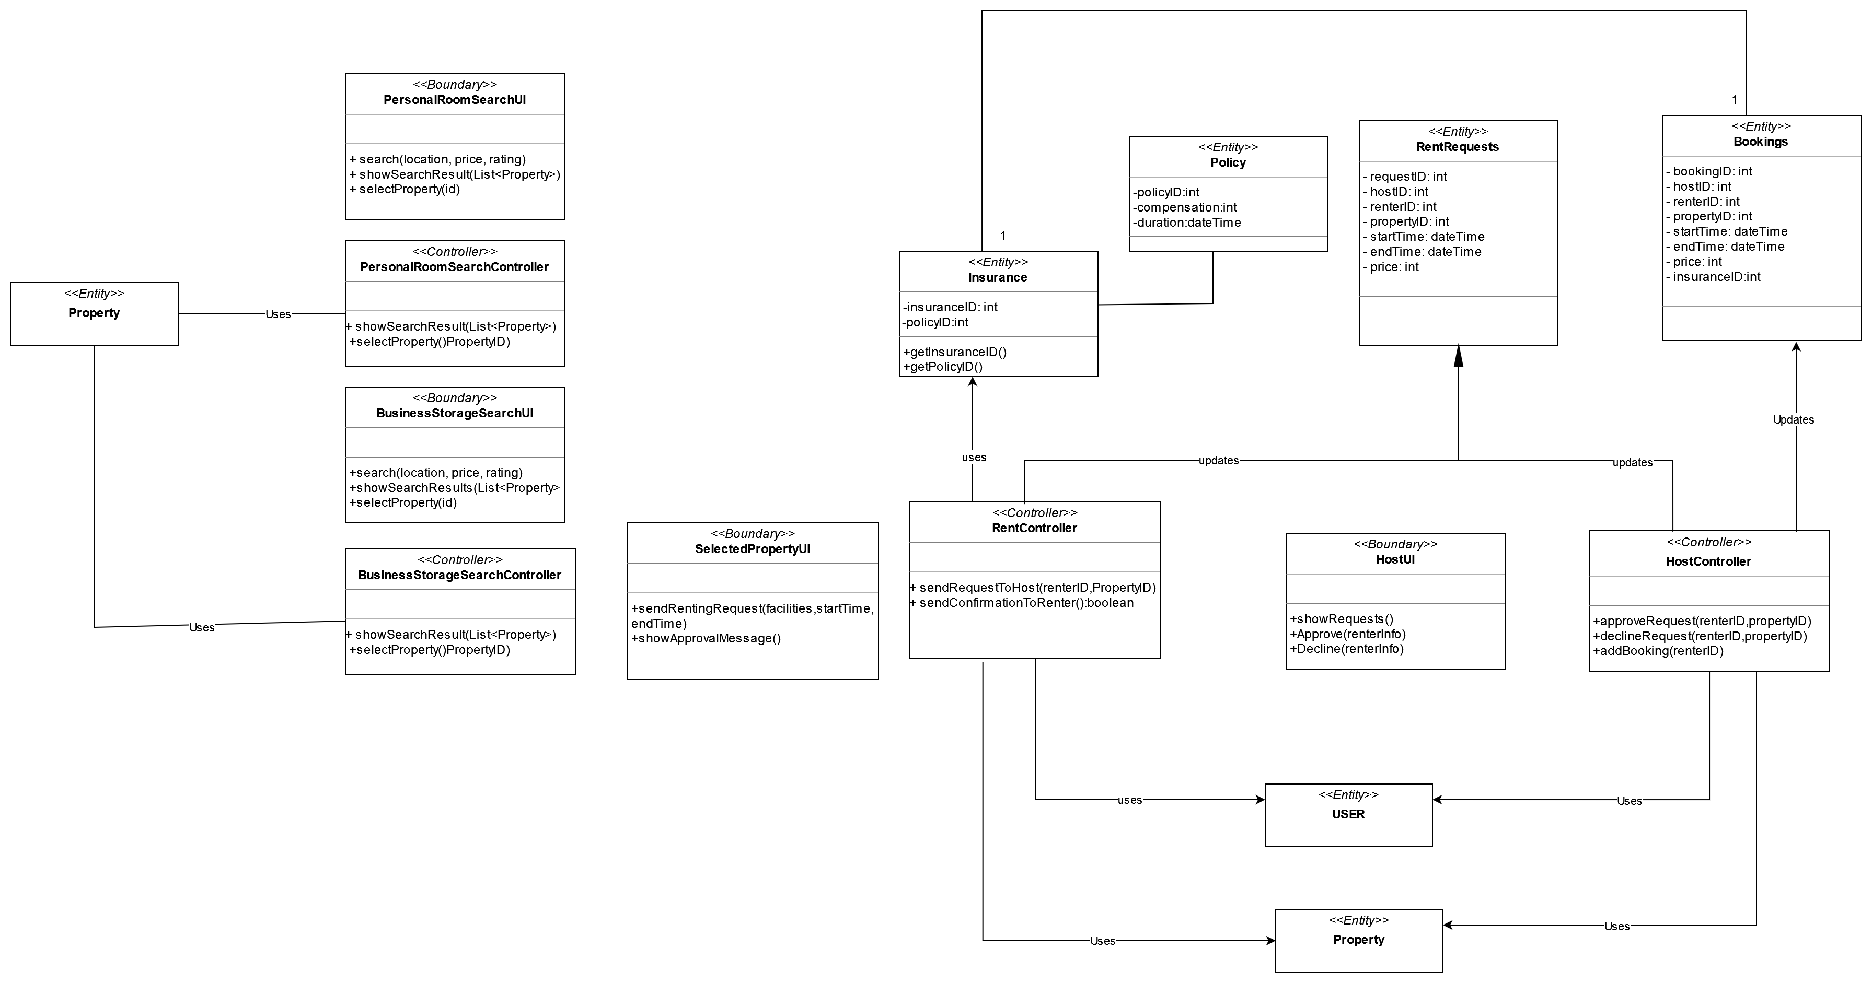

Slide 18
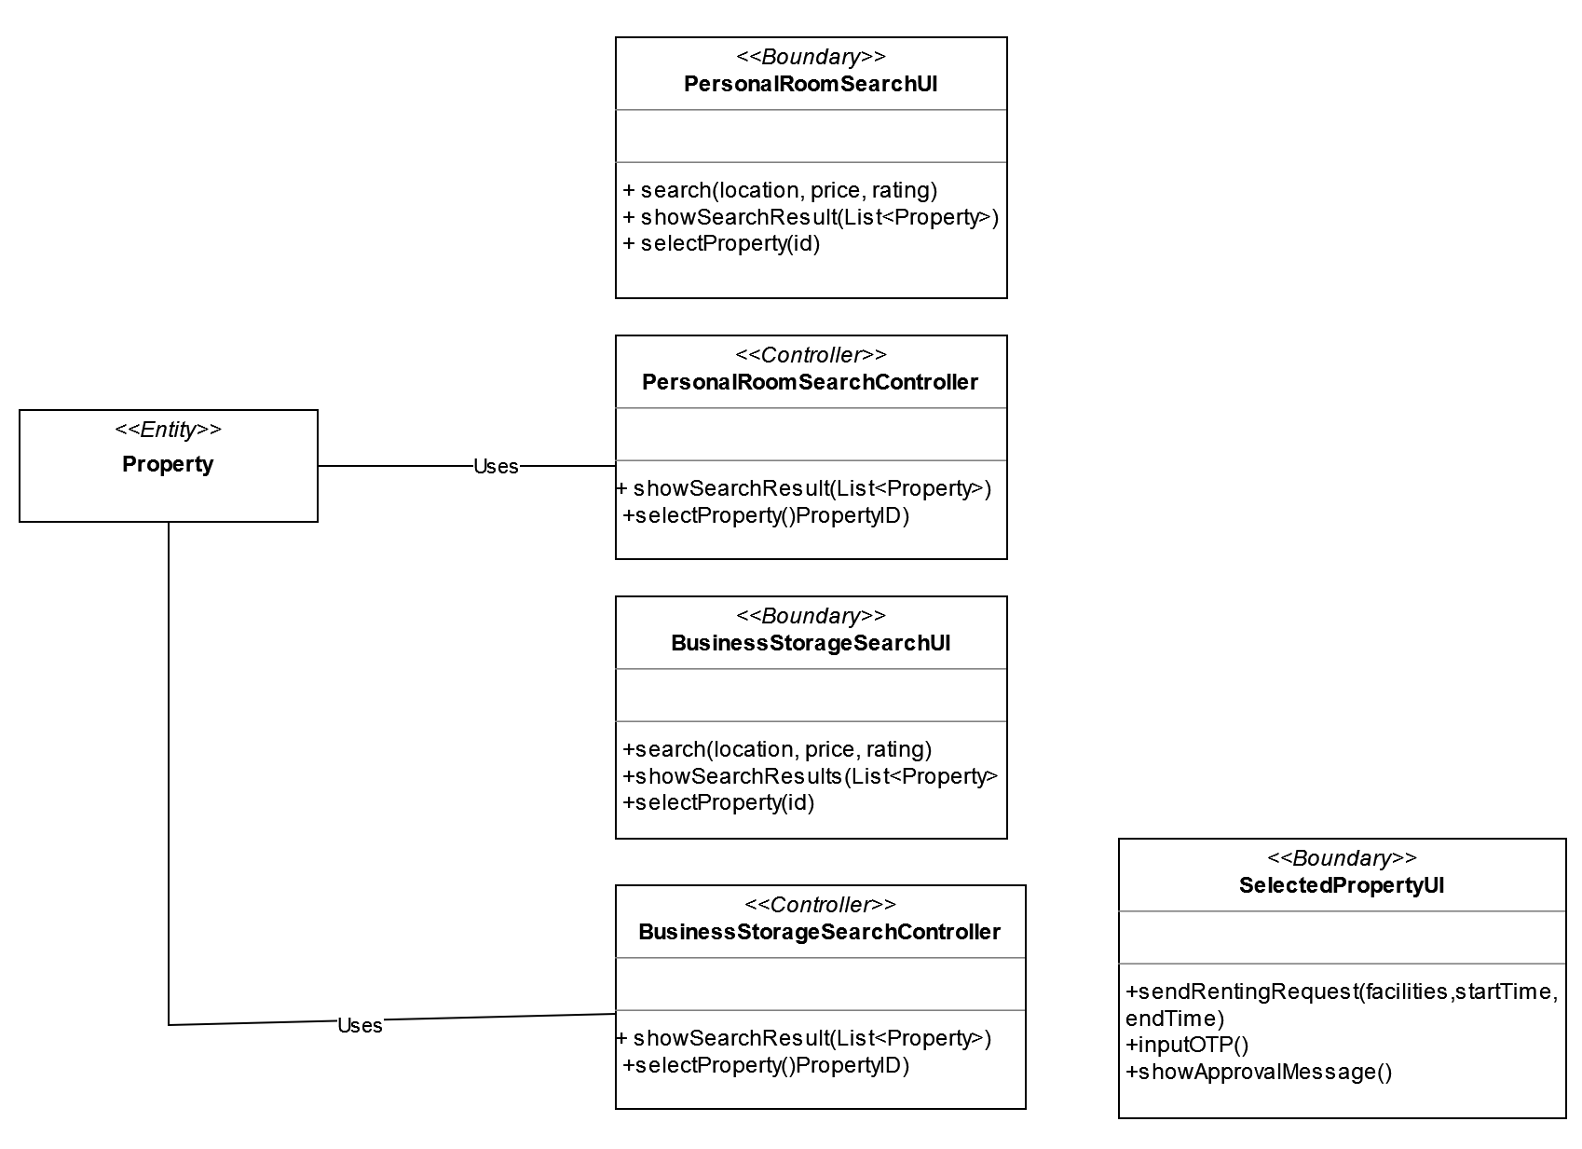

Slide 20
Renting-ERD

Slide 21
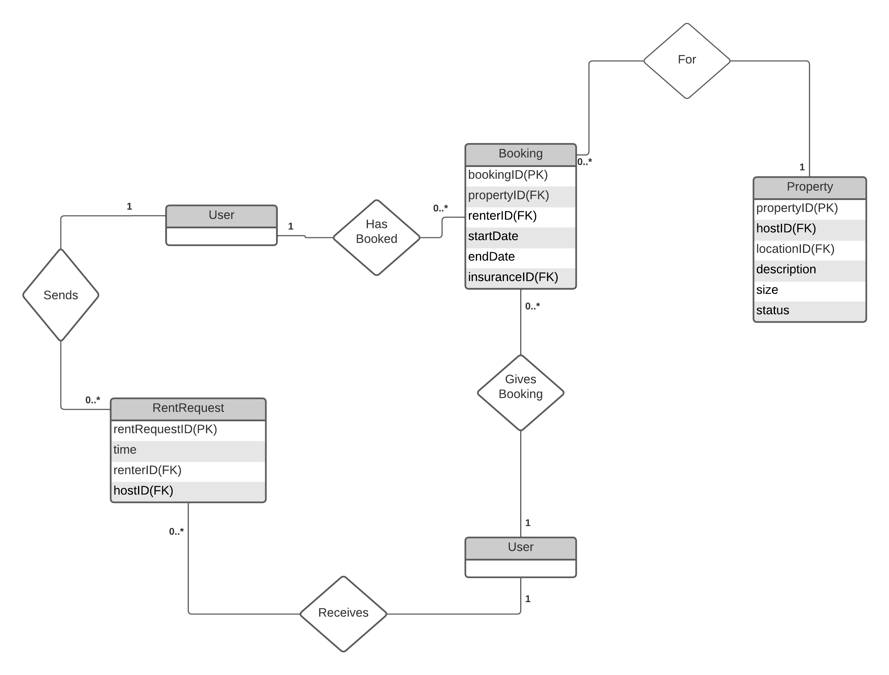

Slide 22
Insurance-ERD

Slide 23
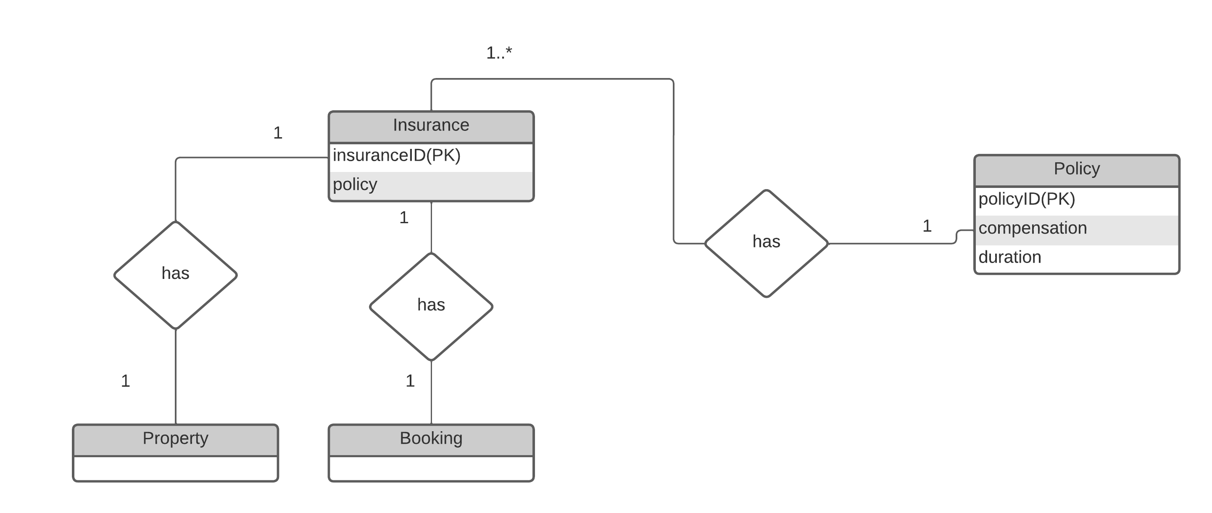

Slide 24
Payment – Class Diagram

Slide 25
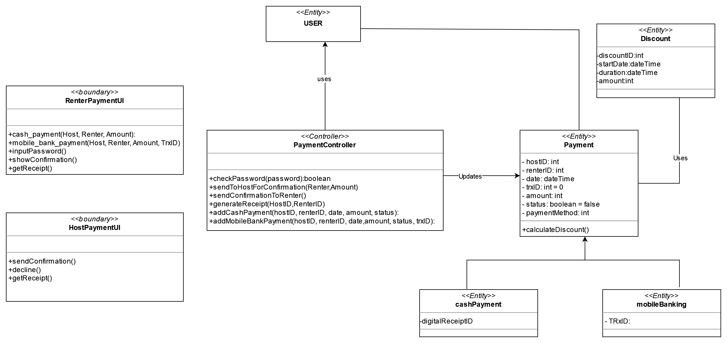

Slide 26
Payment-ERD

Slide 27
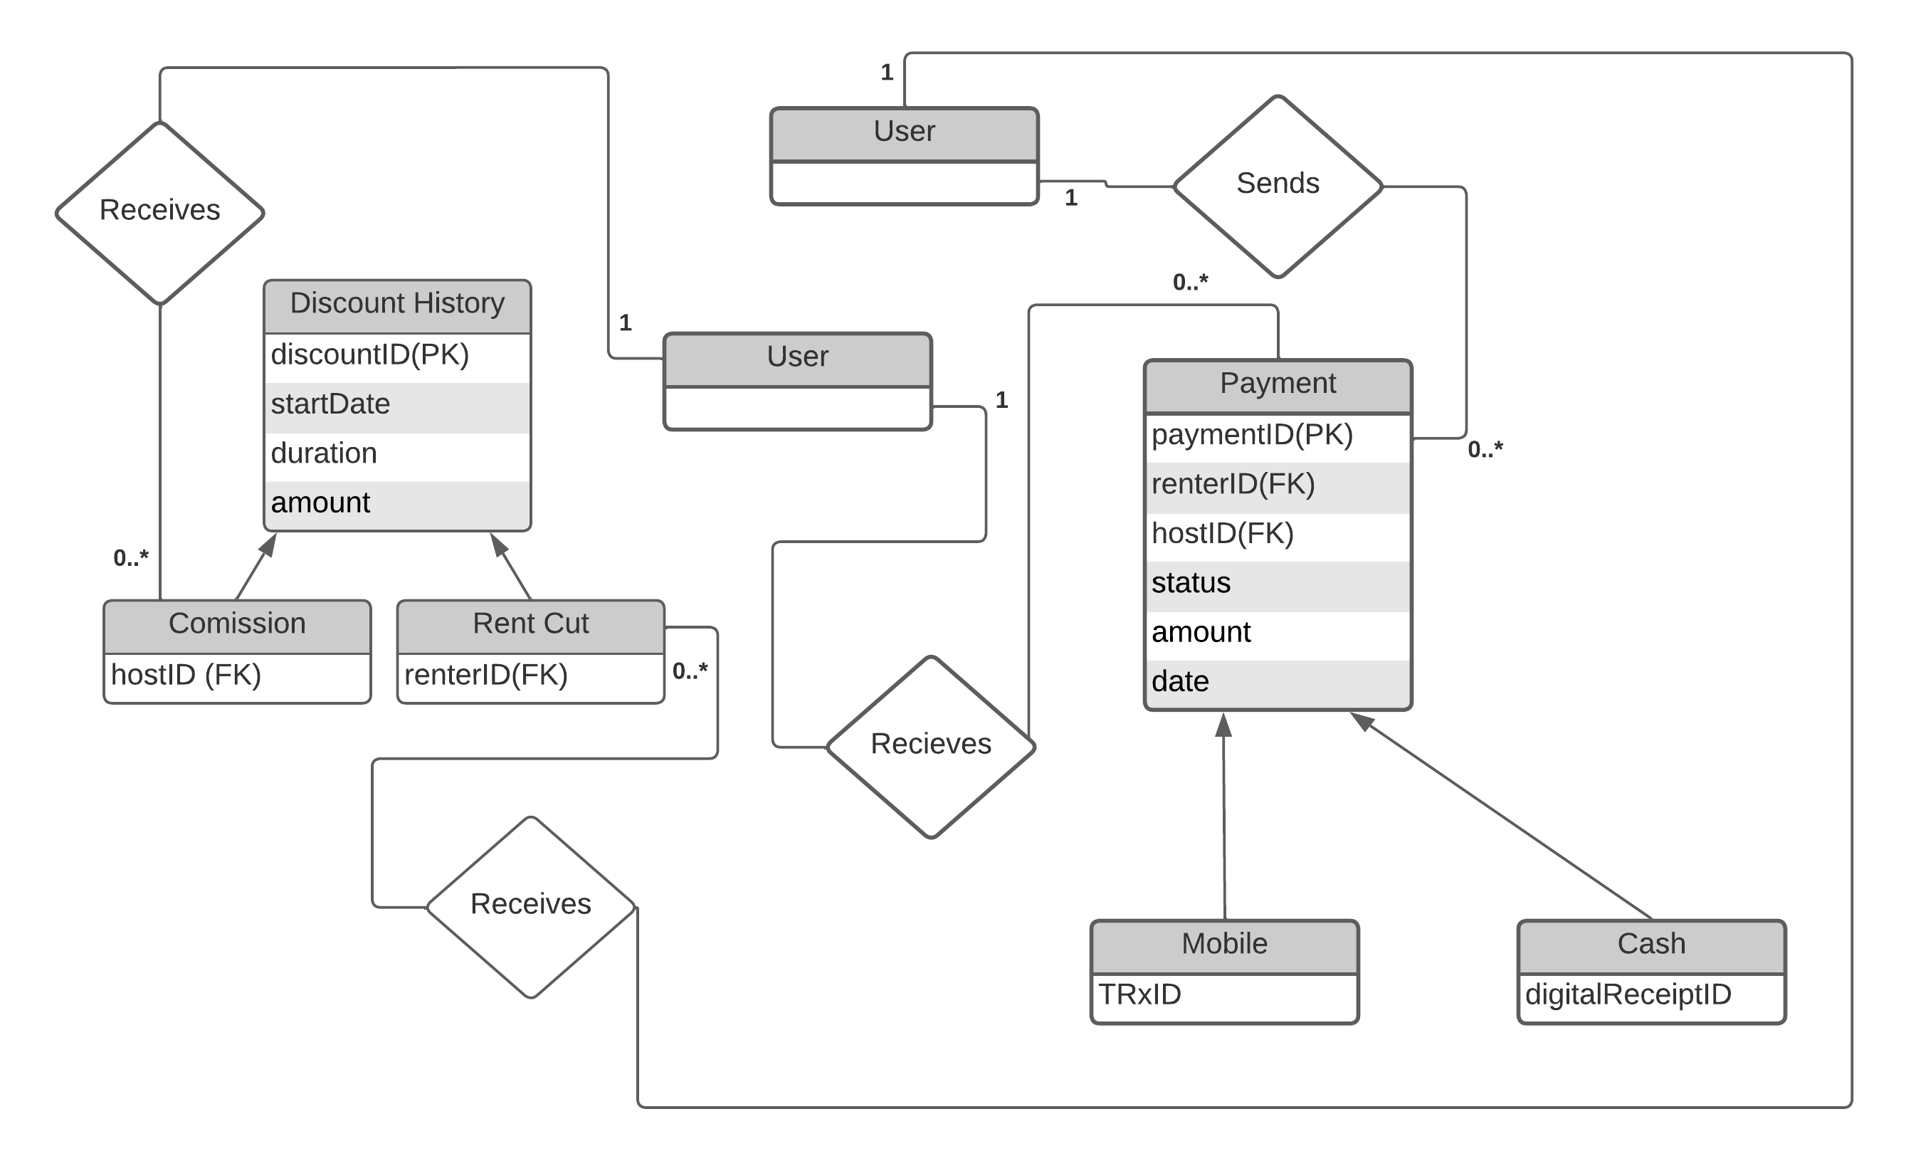

Slide 28
Review/Complain-Class Diagram

Slide 29
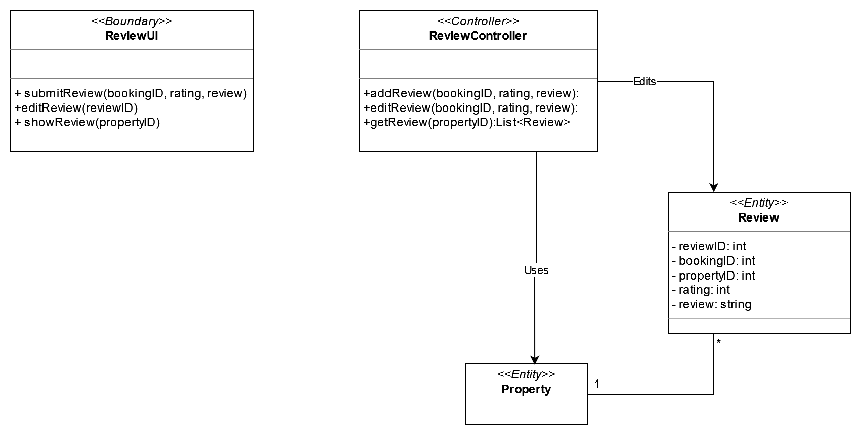

Slide 30
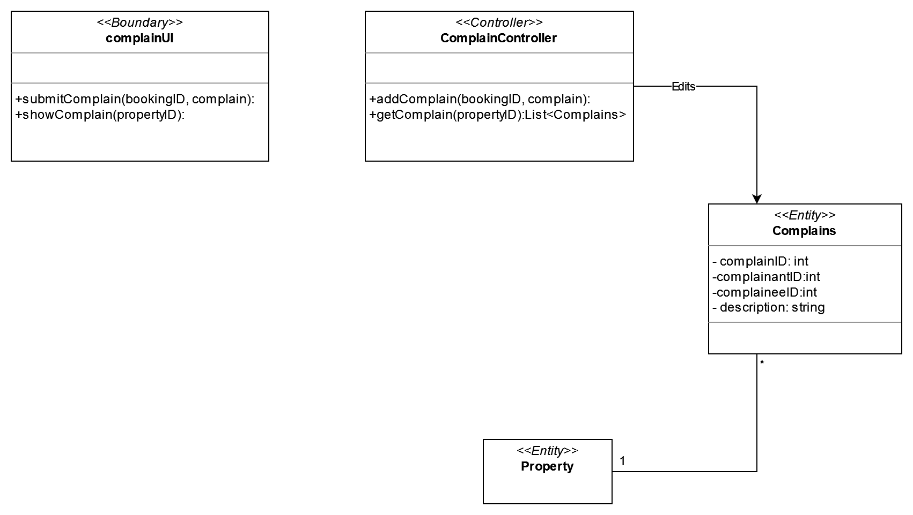

Slide 31
Review-ERD

Slide 32
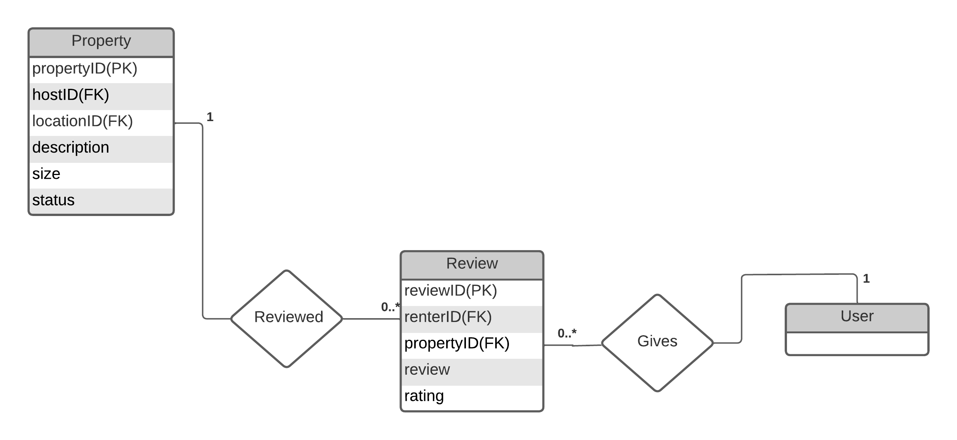

Slide 33
In-site Messaging – Class Diagram

Slide 34
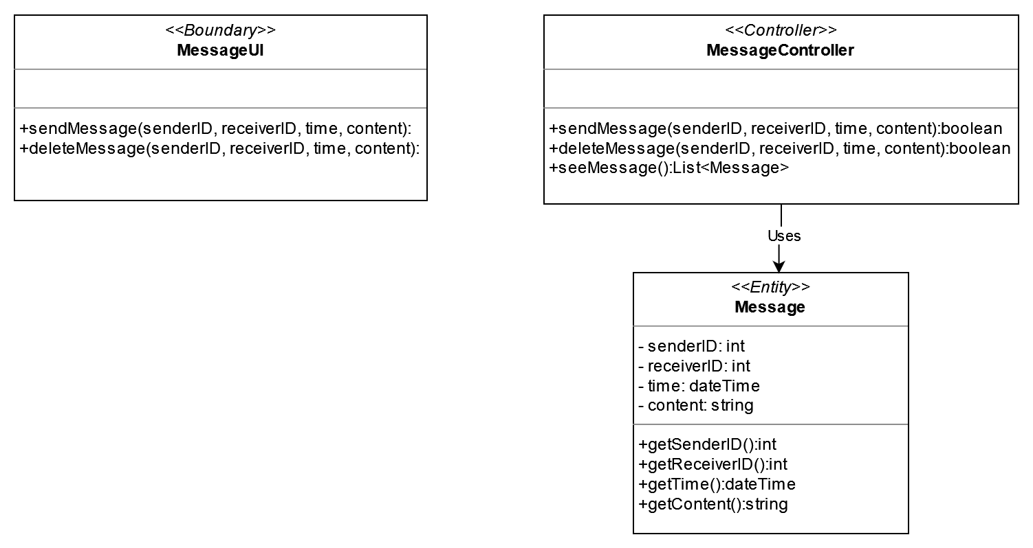

Slide 35
Recommender –Class Diagram

Slide 36
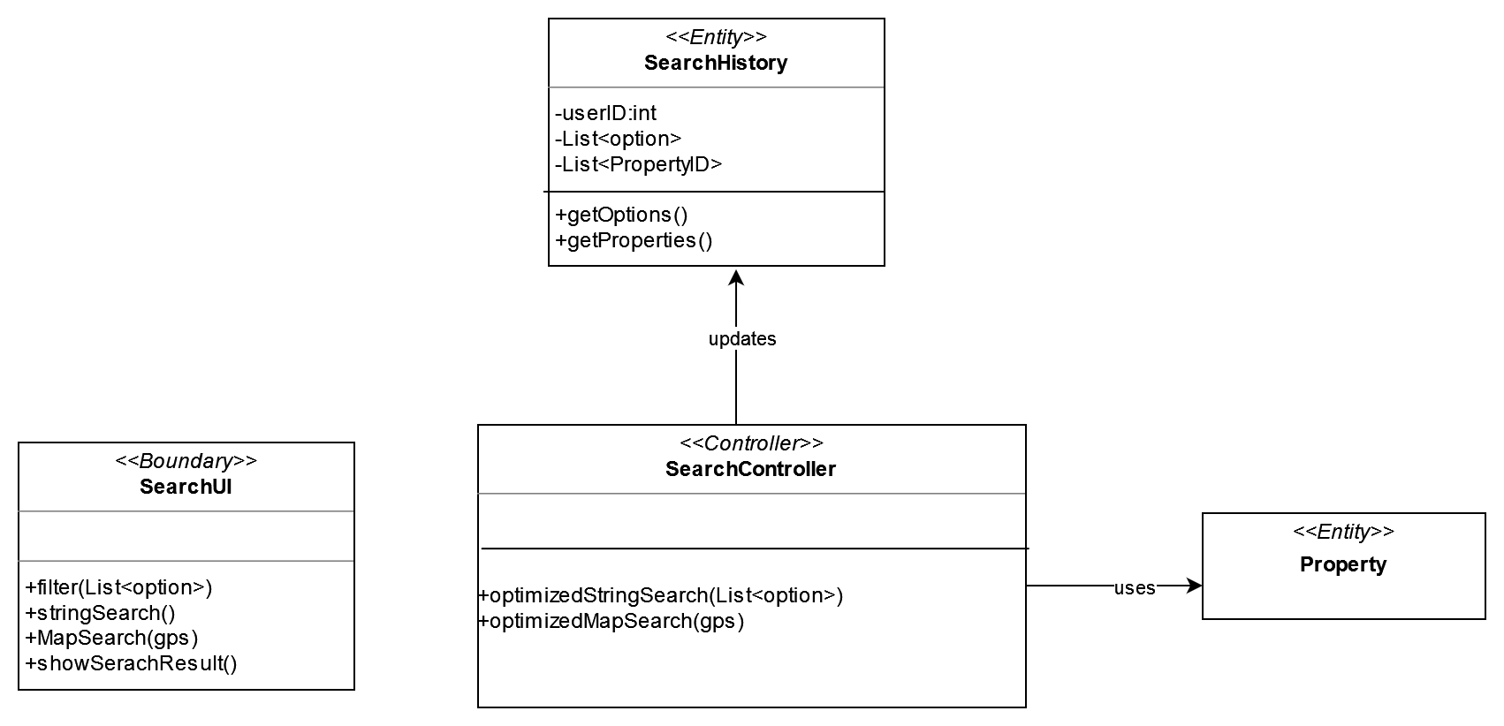

Slide 37
Complain,Messaging,Search History -ERD

Slide 38
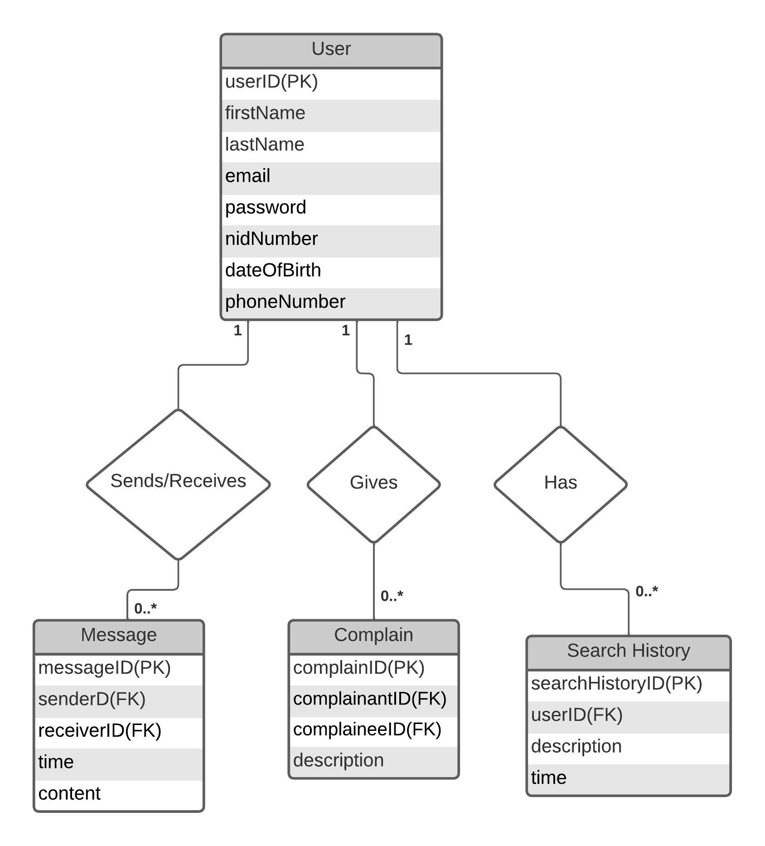

Slide 39
Blog – Class Diagram

Slide 40
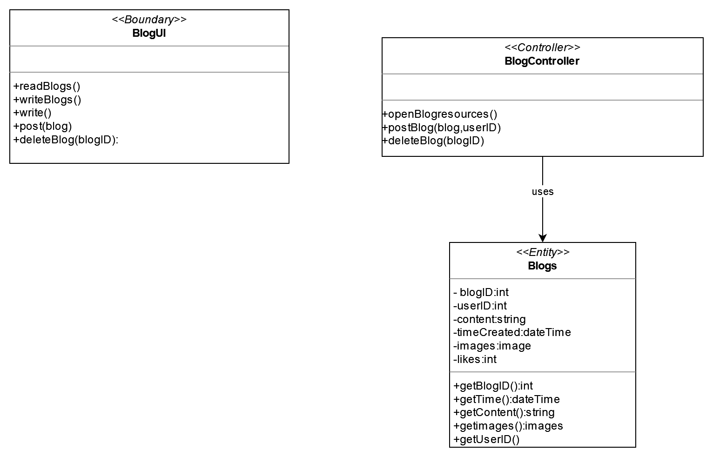

Slide 41
Blog-ERD

Slide 42
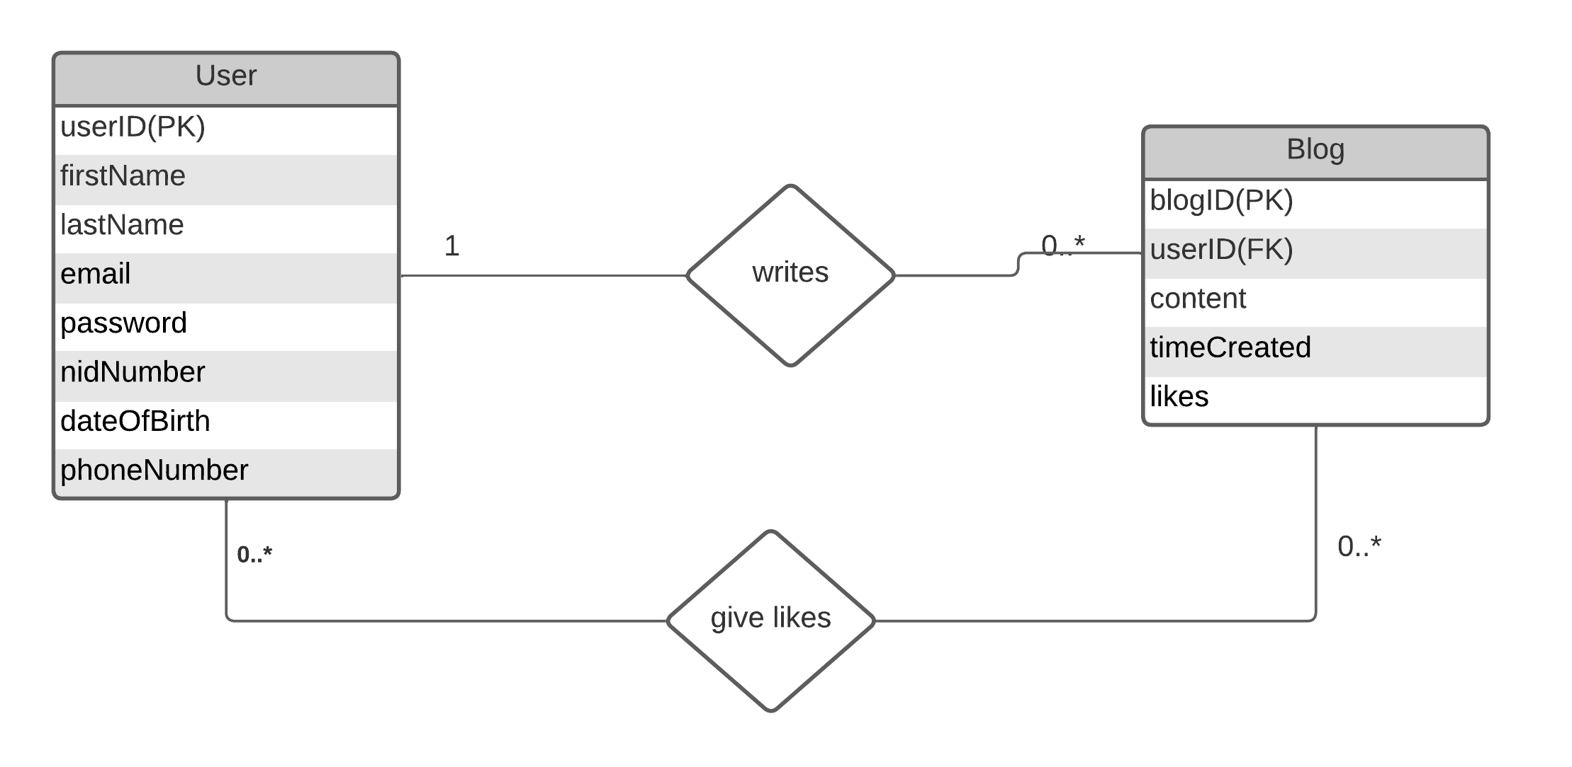

Slide 43
Thank you

