Slide 1
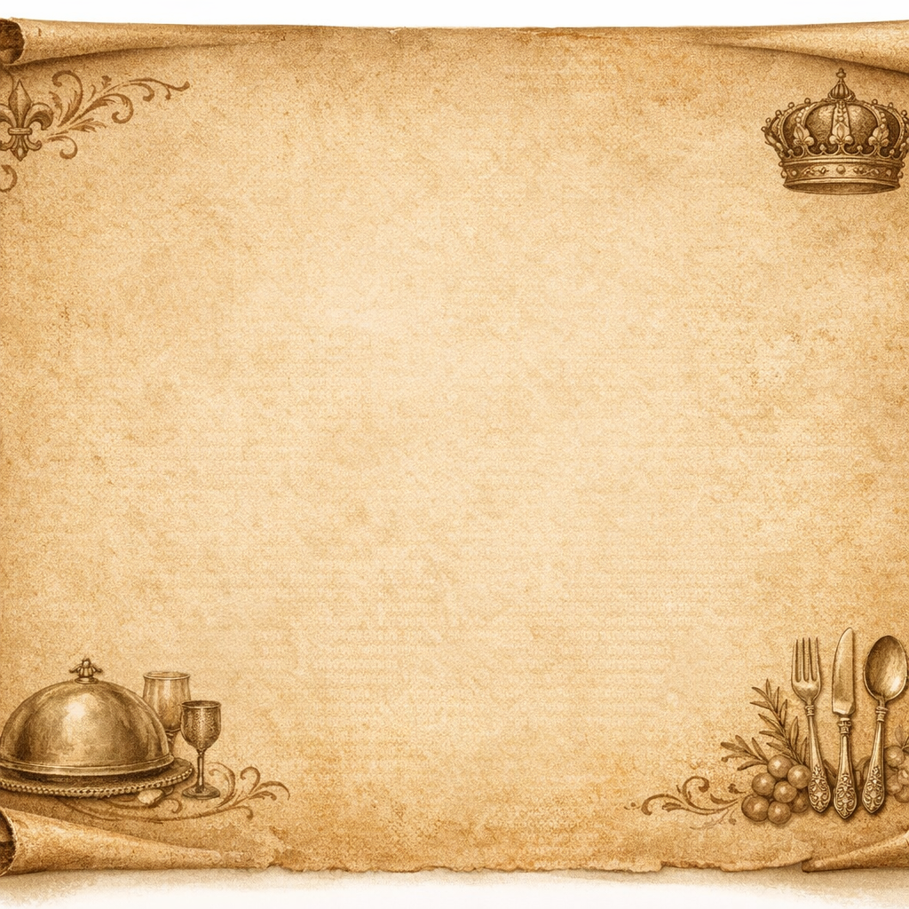

The Royal Banquet of Image Formats
Join me on a culinary tour!

Slide 2
The Appetizer-JPEG slider
A compressed bite designed for quick eats. It does lose some size ( or data) through DCT compression. It’s the perfect snack for any digital occasion.
Be carful of crusty edges also know as artifacts if you reheat to many times!

Slide 3
The Palate Cleanser: PNG Punch
This punch is magical! A refreshing drink that uses LZ compression to savor every bit of flavor(Lossless).
Severed in a clear glass that supports full transparency .

Slide 4
The Main Course: The BMP Brisket
This dish is only for the brave. Pure unprocessed sensor data straight from the source. Providing the ultimate flavor for workflows.
Massive in size this requires a professional chef to prepare properly before it is ready to serve.

Slide 5
The Grand Dessert: The TIFF Treats
A rich, heavy dessert that supports layered images and stacks.
Favored by the royals for using RGB/CMYK color models to ensure it looks immaculate.

Slide 6
The Royal Decree
Dish (Format) | Special Ingredient
JPEG Slider | DCT Compression
PNG Punch | LZ Compression(Lossless)
BMP Brisket | Unprocessed (Giant file size)
TIFF Treats | CMYK/RGB & Image Stacks

