Slide 1
Fraud Detection

Slide 2
Problem
Fraud in online transactions:
Loss of revenue
Decreased customer satisfaction

Slide 3
Solution
Fraud detection system:
Accurate fraud prediction
Less false alarms

Slide 4
Data
IEEE Computational Intelligence Society Fraud Detection
Vesta Corporation’s real-world e-commerce transactions

Slide 5
Data Overview
Two datasets: transaction and identity data
590540 observations, 434 variables

Slide 6
Workflow
I. Data Preparation:
Data Cleaning
Exploratory Data Analysis
Feature Engineering
II. Modeling:
Class Imbalance
Model Optimization
Model Evaluation

Slide 7
Data Preparation
Address missing data
Limit values of outliers
Transform variables
Reduce dimensionality

Slide 8
Data Preparation
Continuous variables:
Transaction time deltas
Transaction amount
Distance
Vesta engineered features
Categorical variables:
Product codes
Payment card information
Address
Email domains
Identity information

Slide 9
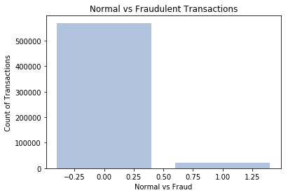
Data Preparation
Target: isFraud
3.6%
Class Imbalance

Slide 10
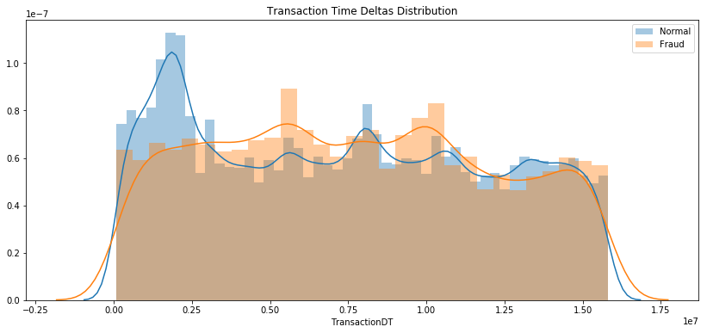
Data Preparation
Transaction Time Deltas

Slide 11
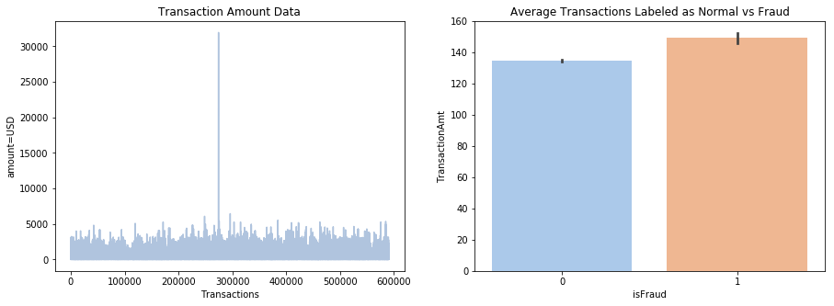
Data Preparation
Transaction Amount

Slide 12
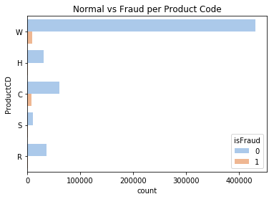
Data Preparation: Product Code
Product Codes

Slide 13
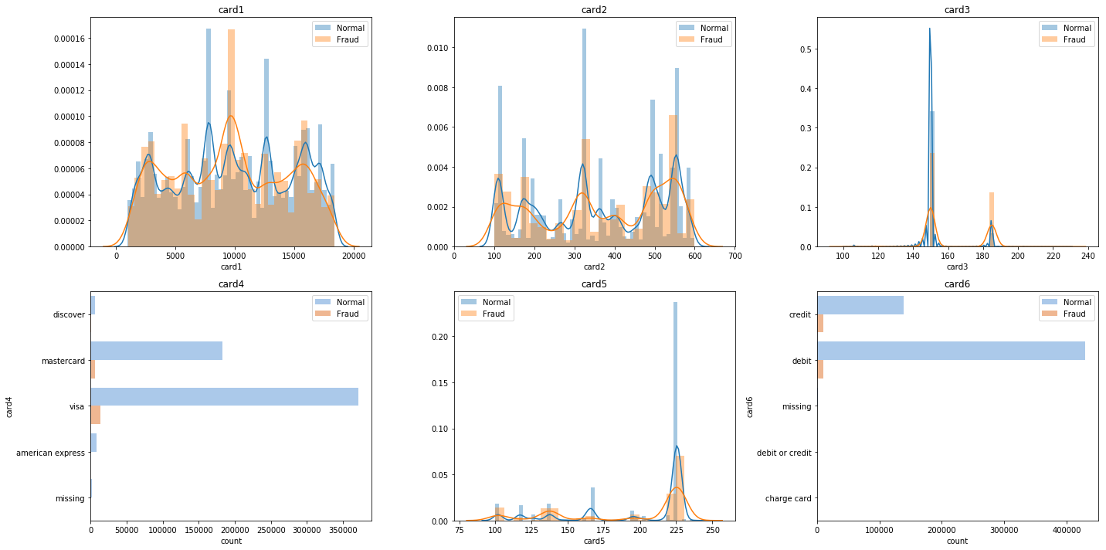
Data Preparation
Payment Card Information

Slide 14
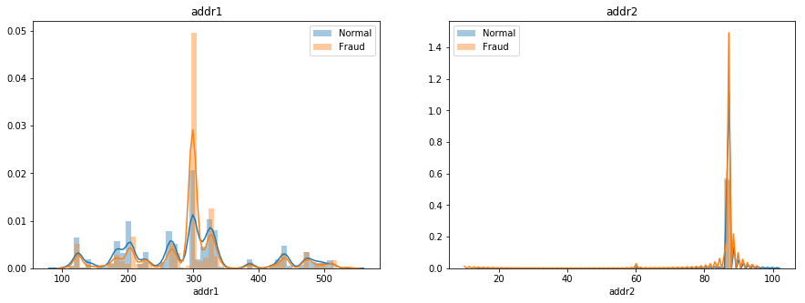
Data Preparation
Address

Slide 15
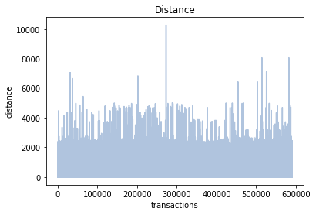
Data Preparation
Distance

Slide 16
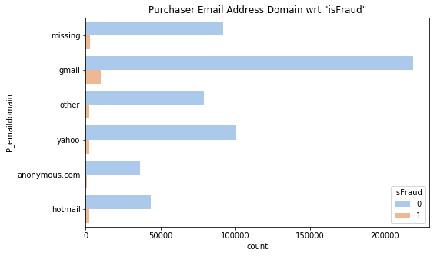
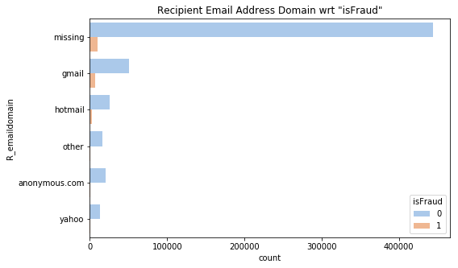
Data Preparation
Email domains

Slide 17
Data Preparation
Vesta-engineered features:
C variables
D variables
M variables
V variables

Slide 18
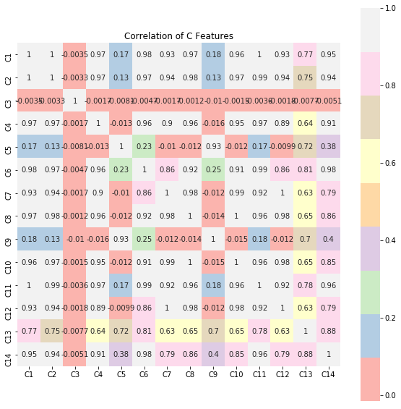
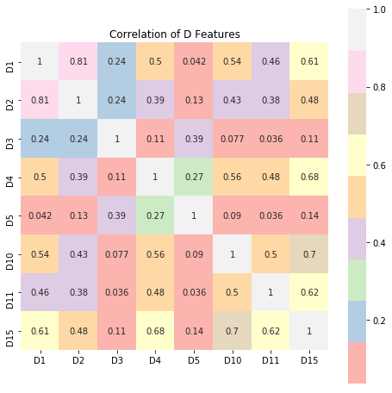
Data Preparation
Correlation of C Features
Correlation of D Features

Slide 19
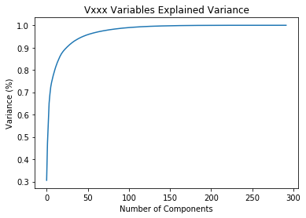
Data Preparation
Principal Component Analysis
292 variables
reduced to 25 features

Slide 20
Data Preparation
Identity/Device Information:
Over 75% of missing values

Slide 21
Data Preparation Summary
Data is numeric
91 features
Some features are highly correlated
Some variables had a lot of missing values

Slide 22
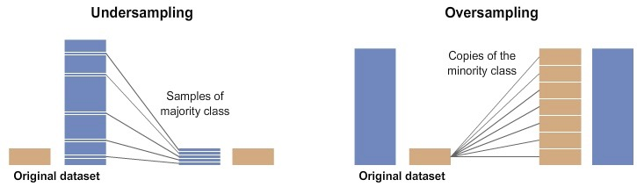
Modeling
Class Imbalance:
Random Undersampling
Synthetic Majority Oversampling Technique (SMOTE)

Slide 23
Modeling
Evaluation Metrics:
Area under Receiver Operating Characteristic curve
Precision
Recall

Slide 24
Modeling
Model Selection and Tuning:
Logistic Regression
Decision Tree
Gradient Boosting Classifier
Random Forest Classifier

Slide 25
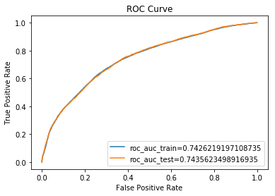
Modeling
Logistic Regression
AUC: 0.7597
Precision: 0.08
Recall: 0.67

Slide 26
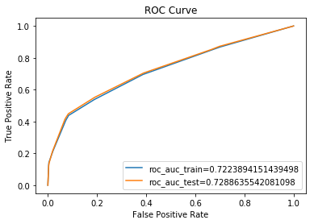
Modeling
Decision Tree
AUC: 0.7288
Precision: 0.17
Recall: 0.45

Slide 27
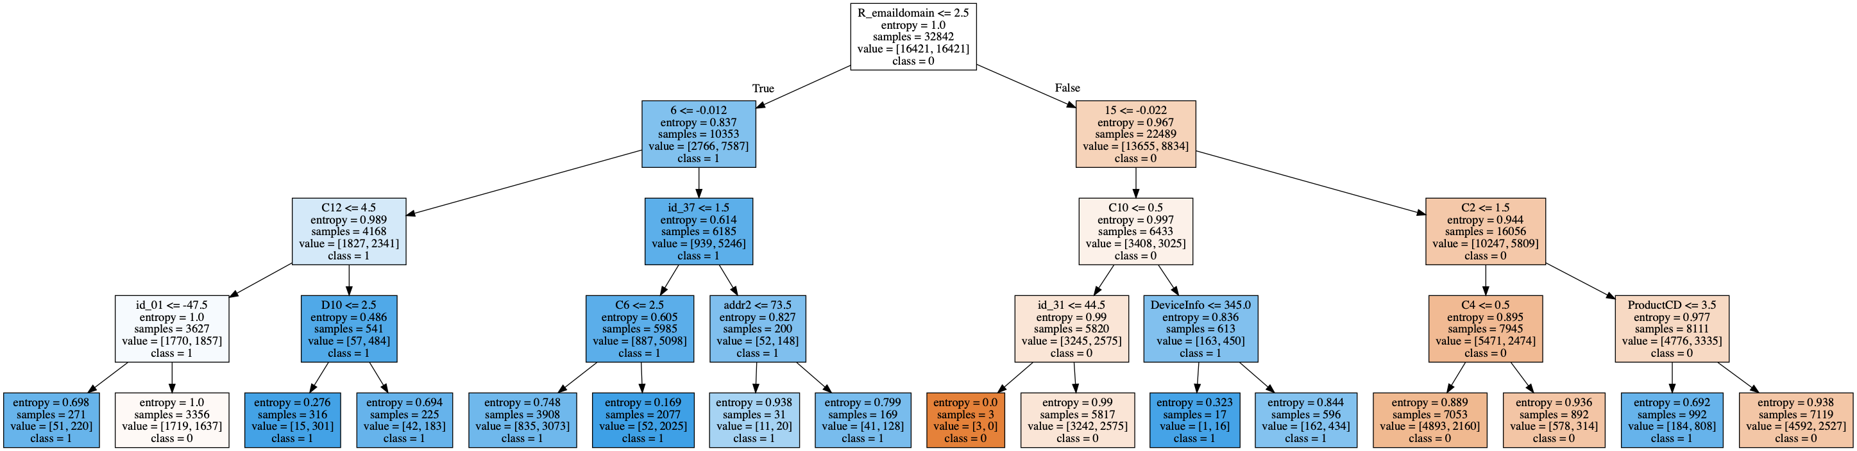
Modeling

Slide 28
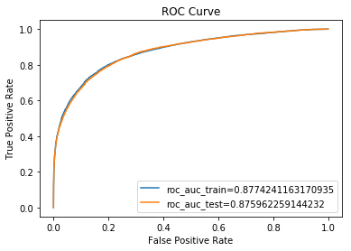
Modeling
Gradient Boosting Classifier
AUC: 0.8759
Precision: 0.14
Recall: 0.77

Slide 29
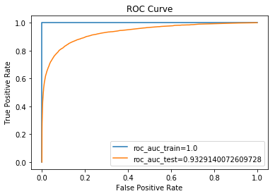
Modeling
Random Forest (300 trees)
AUC: 0.9329
Precision: 0.21
Recall: 0.84

Slide 30
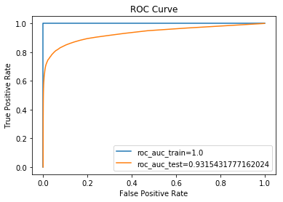
Modeling
Random Forest (SMOTE)
AUC: 0.9315
Precision: 0.92
Recall: 0.55

Slide 31
Modeling
Important Features (>= 0.03):
1 (V-feature)
Transaction Time Deltas
Transaction Amount
Card1
C13
C14
10 (V-feature)

Slide 32
Modeling
Model | AUC | Precision | Recall
Random Forest (300) | 0.9327 | 0.21 | 0.84
Random Forest (SMOTE) | 0.9315 | 0.92 | 0.55

Slide 33
Q&A

