Slide 1

Exploring Solar Eclipses
Aniko Szabo
5 July 2024

Slide 2
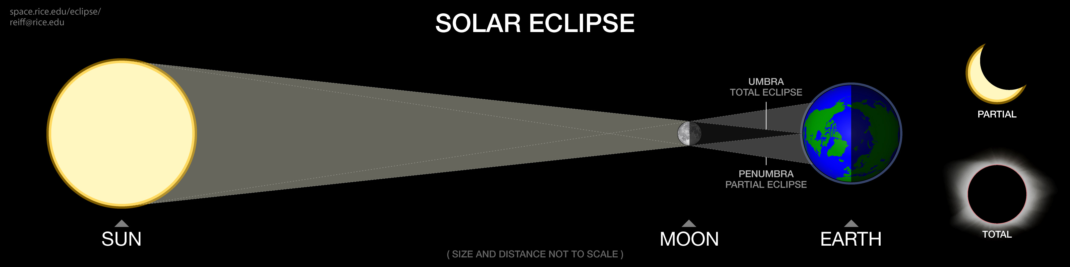
What is a solar eclipse?
A solar eclipse occurs when the Moon passes between the Earth and the Sun, blocking all or part of the Sun’s light.
There are different types of solar eclipses based on the alignment and distance of the Moon and Sun.

Slide 3
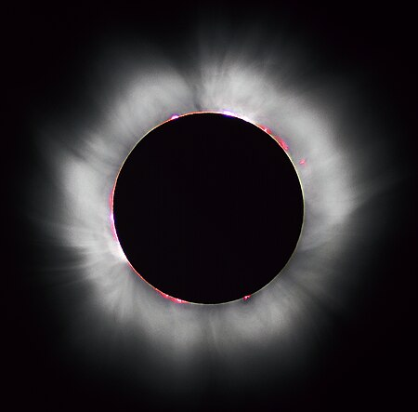
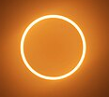
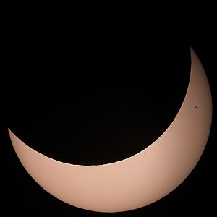
Types of solar eclipses
Total eclipse: The Moon completely covers the Sun, as seen from Earth. This happens when the Moon is close enough to Earth to cover the Sun’s entire disc.
Annular eclipse: The Moon covers the centre of the Sun, leaving a ring-like appearance (a “ring of fire”). This occurs when the Moon is farther from Earth.
Partial eclipse: Only part of the Sun is obscured by the Moon.
Hybrid eclipse: Shifts between a total and annular eclipse along different sections of its path.
Images from: https://en.wikipedia.org/wiki/Solar_eclipse

Slide 4
Why are solar eclipses important?
The Sun’s corona: solar wind, coronal mass ejections, the Sun’s magnetic field.
Effects of the Moon’s shadow: temperature drop, animal behaviour, atmospheric dynamics.
Gravitational effects: tides, general relativity (1919).

Slide 5
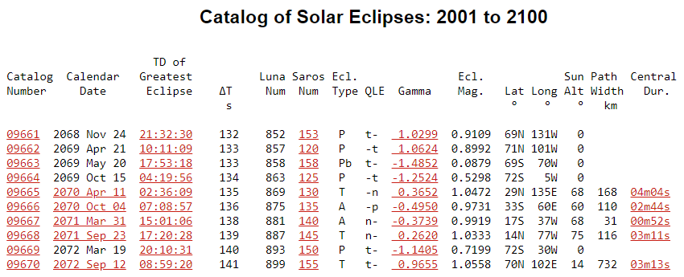
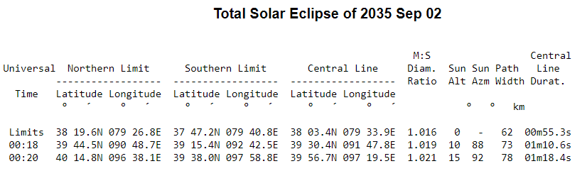
Solar eclipse data overview
5000 years of eclipse data (from 2000 BC to 3000 AD).
Additional data on the paths of the total, annular and hybrid eclipses for the next 30 years.
Source: https://eclipse.gsfc.nasa.gov/SEcat5/SEcatalog.html

Slide 6
The solar eclipse explorer dashboard
Visualise and interact with solar eclipse data
Plan trips
Explore eclipse occurrences

