Slide 1
LOOP in C
Md. Shafqat Talukder Rakin
Lecturer, Dept. of CSE
United International University
Email: shafqat@cse.uiu.ac.bd
Courtesy: Tasmin Sanjida Mam

Slide 2
Outline
The for Statement
Relational Operators
Nested for Loops
Increment Operator
Program Input
for Loop Variants
The while Statement
The do Statement
The break Statement
The continue Statement

Slide 3
What is loop?
Loop is repeating the same process multiple times until a specific condition satisfies.

Slide 4
Why you need loop?
Display a message 100 times:
printf(“hello !\n”);
printf(“hello !\n”);
printf(“hello !\n”);
… Repeat 100 times printf(“hello !\n”); printf(“hello !\n”);
Printf(“hello !\n”);
Is it feasiable?

Slide 5
Why Loop?
It provides code reusability.
Using loops, we do not need to write the same code again and again.
Using loops, we can traverse over the elements of data structures (array or linked lists).

Slide 6
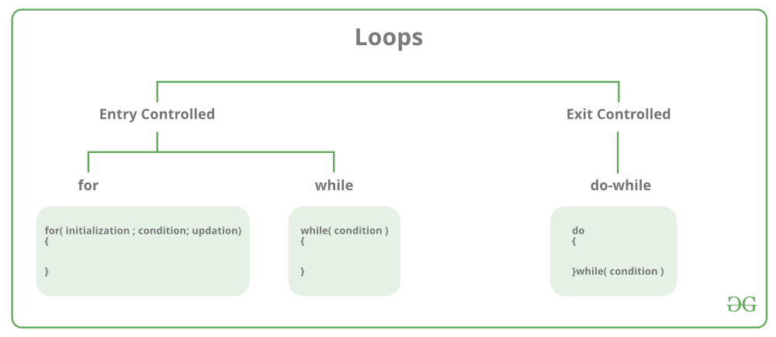
Types of Loop in C

Slide 7
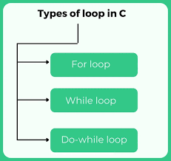

Slide 8
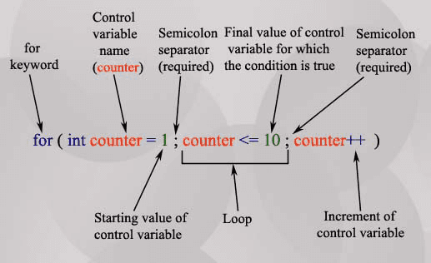
for loop in C
for(initialization; condition; operation)
{
//statement;
//statement;
}

Slide 9
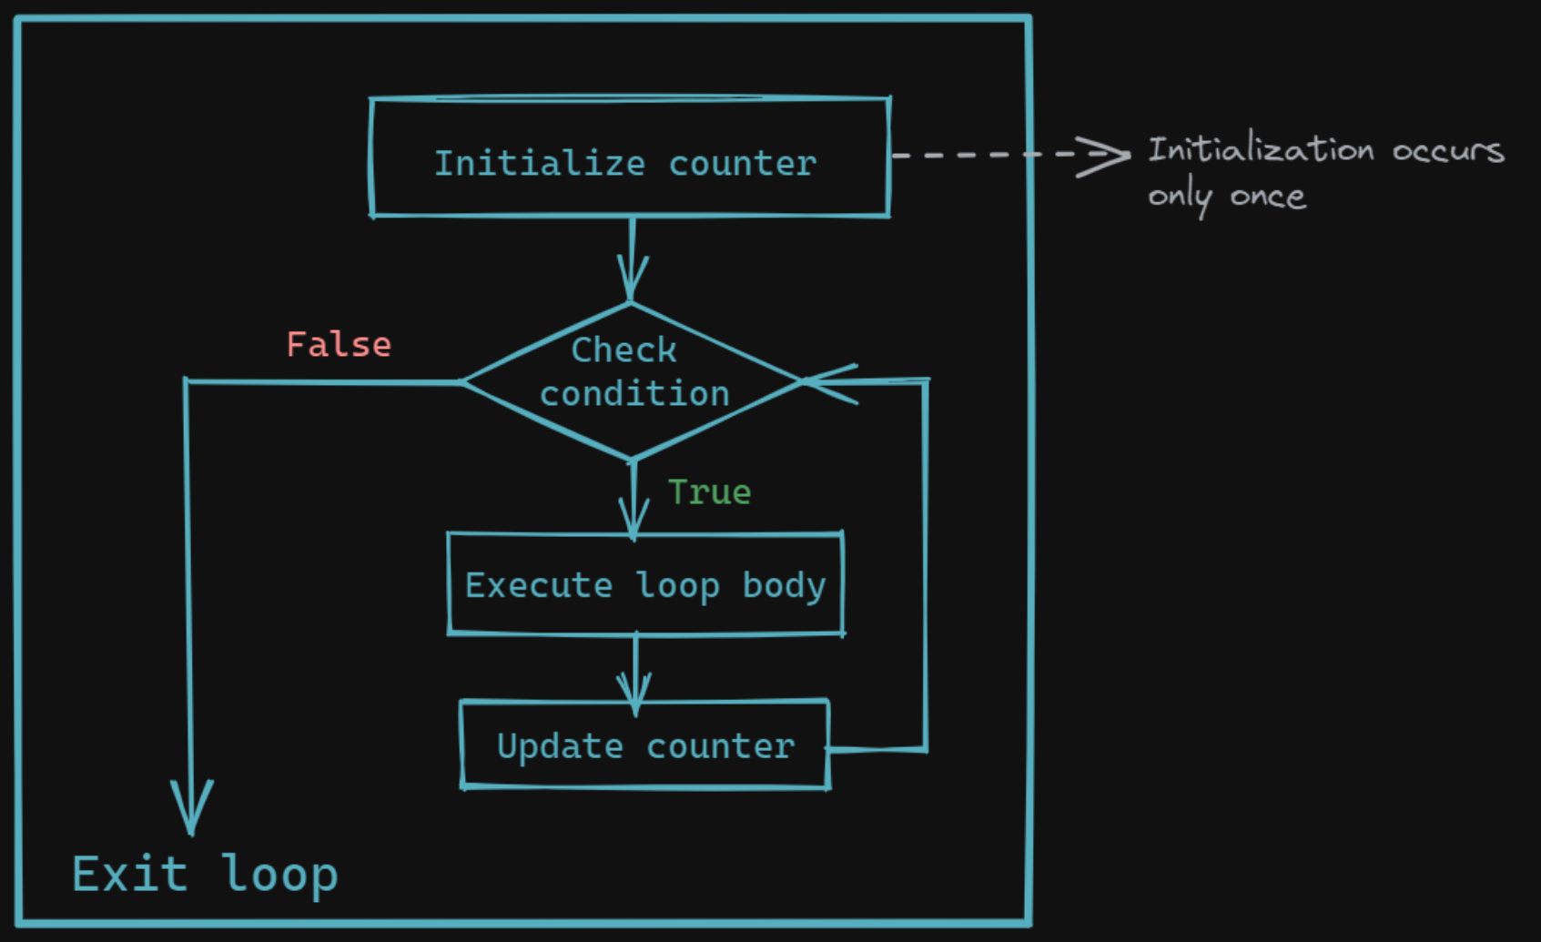
Loop in C

Slide 10
How for works
The execution of a for statement proceeds as follows:
The initial expression is evaluated first. This expression usually sets a variable that will be used inside the loop, generally referred to as an index variable, to some initial value.
The looping condition is evaluated. If the condition is not satisfied (the expression is false – has value 0), the loop is immediately terminated. Execution continues with the program statement that immediately follows the loop.
The program statement that constitutes the body of the loop is executed.
The looping expression is evaluated. This expression is generally used to change the value of the index variable
Return to step 2.

Slide 11
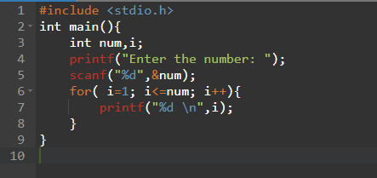
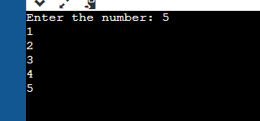
Example
Problem: Write a program (WAP) that will print following series upto Nth terms. 1, 2, 3, 4, 5, 6, 7, 8, 9, 10, 11, 12, 13, 14, …….

Slide 12
Example
Problem: Write a program (WAP) that will print following series upto Nth terms. 1, 3, 5, 7, 9, 11, 13, 15, 17, 19, 21, 23, 25, 27, 29, 31 …….

Slide 13
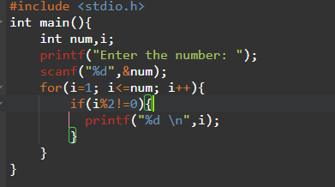
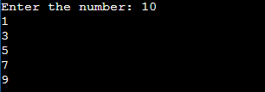
Example
Problem: Write a program (WAP) that will print following series upto Nth terms. 1, 3, 5, 7, 9, 11, 13, 15, 17, 19, 21, 23, 25, 27, 29, 31 …….

Slide 14
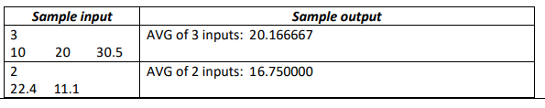
Example
Problem: Write a program (WAP) that will take N numbers as inputs and compute their average.

Slide 15
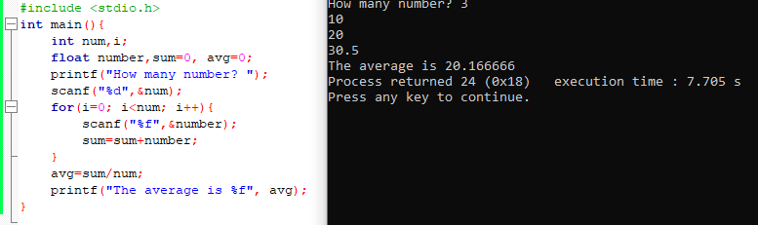
Example

Slide 16
Example
Write a program (WAP) that will print following series upto Nth terms.
1, 0, 1, 0, 1, 0, 1, 0, 1, 0, 1, 0, 1, 0, 1, 0, 1, …….

Slide 17
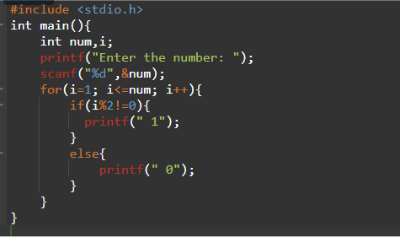
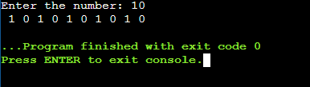
Example

Slide 18
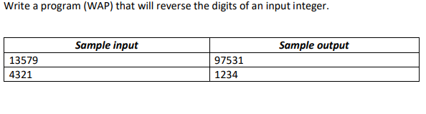
Example

Slide 19
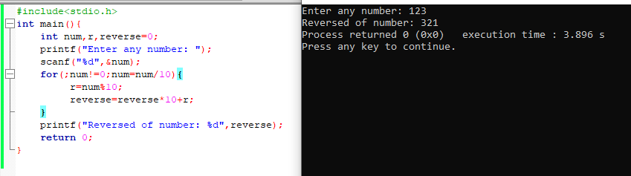
Example

Slide 20
While loop
while(condition){
//statement;
//statement;
}

Slide 21
Print till nth number
#include <stdio.h>
int main(){
int num;
printf("Enter the number: ");
scanf("%d\n",&num);
while(num>0){
printf("%d",num);
num--;
}
}

Slide 22
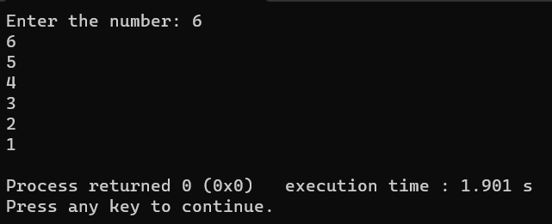
Print till nth number
#include <stdio.h>
int main(){
int num;
printf("Enter the number: ");
scanf("%d\n",&num);
while(num>0){
printf("%d",num);
num--;
}
}

Slide 23
Write a program (WAP) that will find X^{Y} (x to the power y) where x, y are positive integers.
#include <stdio.h>
int main(){
int num,pow,result=1;
printf("Enter the number: ");
scanf("%d",&num);
printf("Enter the power: ");
scanf("%d",&pow);
while(pow>0){
result=num*result;
pow--;
}
printf("The result is : %d", result);
}

Slide 24
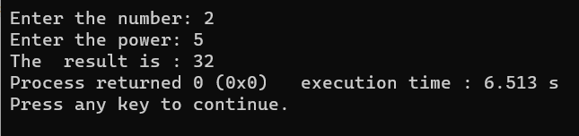
Write a program (WAP) that will find X^{Y} (x to the power y) where x, y are positive integers.
#include <stdio.h>
int main(){
int num,pow,result=1;
printf("Enter the number: ");
scanf("%d",&num);
printf("Enter the power: ");
scanf("%d",&pow);
while(pow>0){
result=num*result;
pow--;
}
printf("The result is : %d", result);
}

Slide 25
do-while loop
do{
//statement;
//statement;
}while(condition)

Slide 26
do-while loop
#include<stdio.h>
int main(){
int i=10;
do{
printf("%d\n",i);
i--;
}
while(i>0);
}

Slide 27
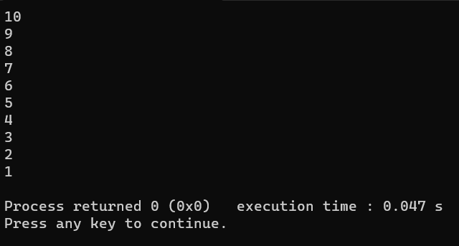
do-while loop
#include<stdio.h>
int main(){
int i=10;
do{
printf("%d\n",i);
i--;
}
while(i>0);
}

Slide 28
break
Can be used in order to immediately exiting from a loop
After a break, following statements in the loop body are skipped and execution continues with the first statement after the loop
If a break is executed from within nested loops, only the innermost loop is terminated

Slide 29
Example of break
#include <stdio.h>
int main(){
int i=0, sum=0, num=0, decision;
while(i==0){
sum=sum+num;
printf("Want to add more number? Enter 1 for 'YES' or 0 for 'NO' : ");
scanf("%d",&decision);
if(decision==0){
break;
}
else{
printf("Enter the number: ");
scanf("%d",&num);
}
}
printf("The sum is : %d",sum);
}

Slide 30
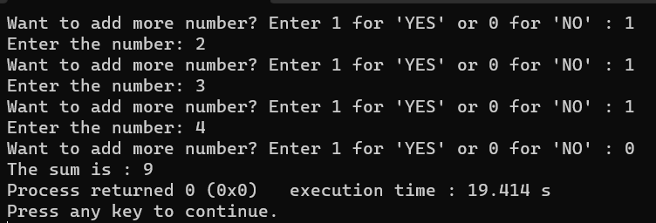
Example of break
#include <stdio.h>
int main(){
int i=0, sum=0, num=0, decision;
while(i==0){
sum=sum+num;
printf("Want to add more number? Enter 1 for 'YES' or 0 for 'NO' : ");
scanf("%d",&decision);
if(decision==0){
break;
}
else{
printf("Enter the number: ");
scanf("%d",&num);
}
}
printf("The sum is : %d",sum);
}

Slide 31
continue
Similar to the break statement, but it does not make the loop terminate, just skips to the next iteration

Slide 32
continue
#include <stdio.h>
int main(){
int i=0, sum=0, num=0, decision;
while(i==0){
printf("Want to add more number? Enter 1 for 'YES' or 0 for 'NO' : ");
scanf("%d",&decision);
if(decision==1){
printf("Enter the number: ");
scanf("%d",&num);
sum=sum+num;
continue;
}
else{
printf("You don't want to continue\n");
break;
}
}
printf("The sum is : %d",sum);
}

Slide 33
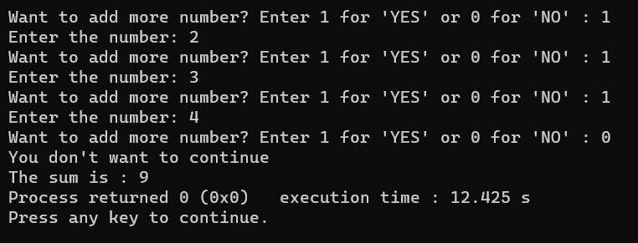
continue
#include <stdio.h>
int main(){
int i=0, sum=0, num=0, decision;
while(i==0){
printf("Want to add more number? Enter 1 for 'YES' or 0 for 'NO' : ");
scanf("%d",&decision);
if(decision==1){
printf("Enter the number: ");
scanf("%d",&num);
sum=sum+num;
continue;
}
else{
printf("You don't want to continue\n");
break;
}
}
printf("The sum is : %d",sum);
}

Slide 34
Thank You

