Slide 1
Sketchy Decisions: Convex Low-Rank Matrix Optimization with Optimal Storage
Alp Yurtsever | Madeleine Udell | Joel A. Tropp | Volkan Cevher EPFL | Cornell | Caltech | EPFL
Presented by:
Anik Saha

Slide 2
Introduction
Yurtsever et el. published this method in AISTATS 2017
Convex low rank matrix optimization problem
Computes a low rank approximation of a solution
Stores a small randomized sketch of the matrix variable
After convergence, extracts the solution from the sketch

Slide 3
Theory

Slide 4


Matrix Completion
A rank-r approximation to a solution X* of this problem requires ϴ(r(m+n)) parameters but we need mn parameters for X
Goal is to compute an approximate solution using optimal storage Õ(r(m+n))

Slide 5

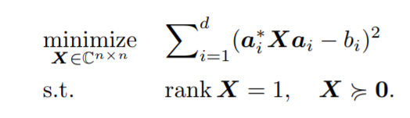

Phase Retrieval
Here, b_{i} are noisy measurements of the the complex vector x
a_{i} are complex measurement vectors
ξ_{i} are real measurement noise
This problem can be formulated as

Slide 6
Phase Retrieval
The solution to this problem uses storage ϴ(n) but the matrix variable requires storage ϴ(n²)
The goal is to find the solution using optimal storage ϴ(n)

Slide 7


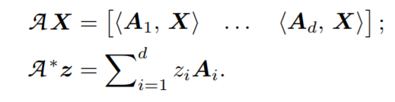

Matrix Completion Problem
Here is a linear operator
is the adjoint operator

Slide 8
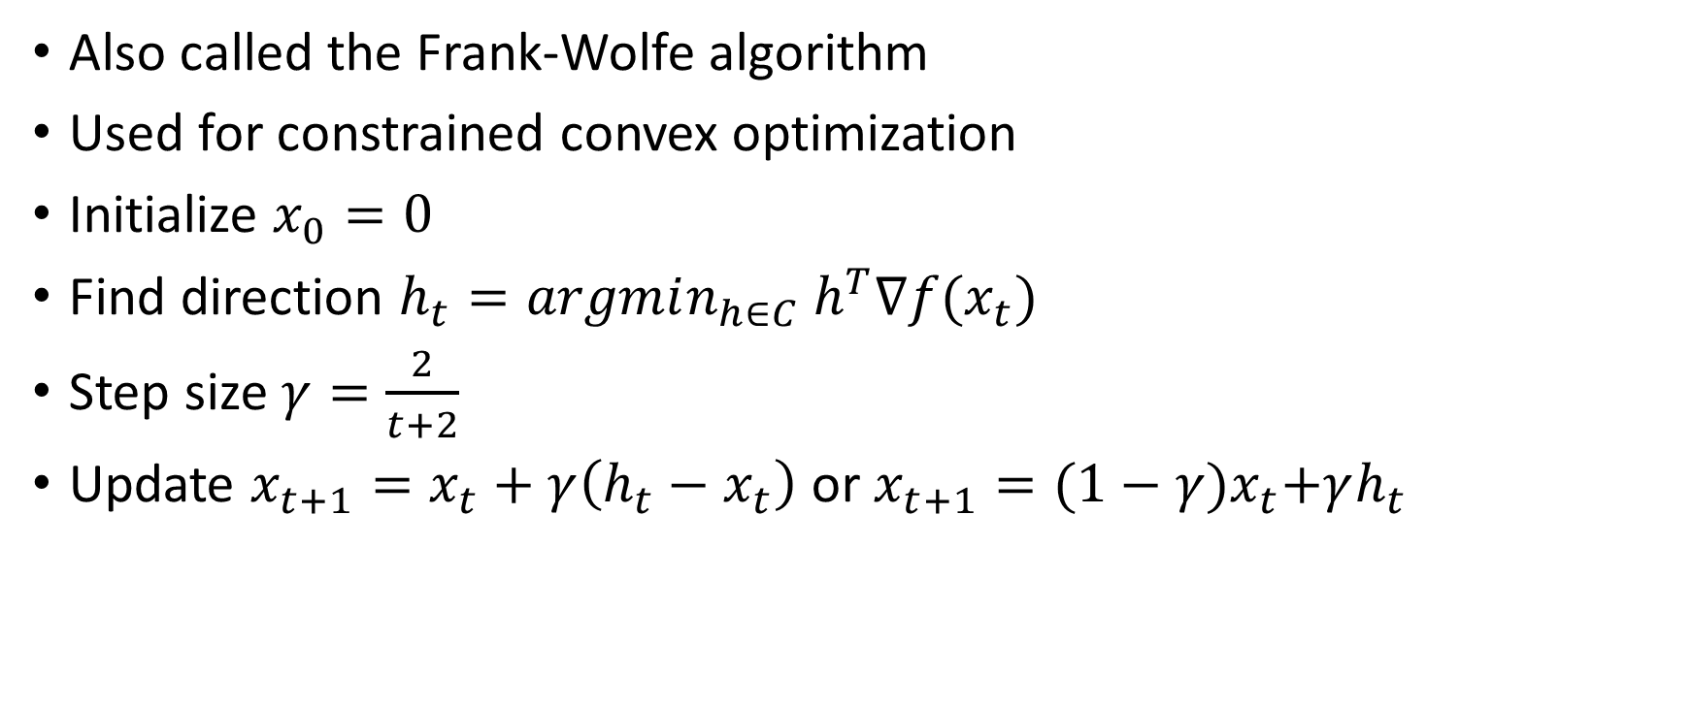
Conditional Gradients
Also called the Frank-Wolfe algorithm
Used for constrained convex optimization
Initialize $x_{0}=0$
Find direction $h_{t}=argmin_{h∈C} h^{T}∇f(x_{t})$
Step size $γ=\frac{2}{t+2}$
Update $x_{t+1}=x_{t}+γ\left(h_{t}−x_{t}\right)$ or $x_{t+1}={(1−γ)x}_{t}+γh_{t}$

Slide 9
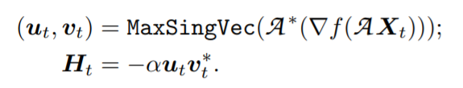


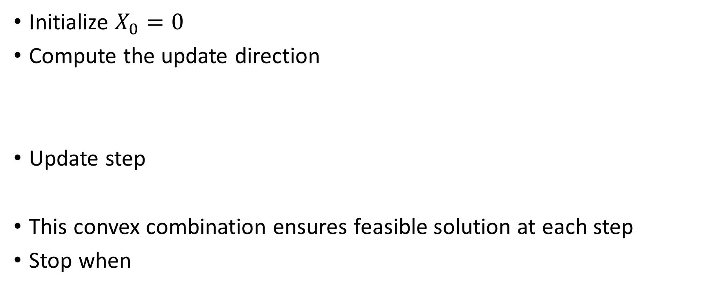
CGM for Matrix Optimization
Initialize $X_{0}=0$
Compute the update direction
Update step
This convex combination ensures feasible solution at each step
Stop when

Slide 10



Matrix Sketching
Draw two independent standard normal matrices Ω and Ψ where
The sketch consists of two matrices Y and W that capture the range and co-range of X
The rank-r approximation of X can be obtained from the following procedure

Slide 11

Reconstruction
If $Q$ is an orthonormal matrix $X=QQ^{+}X$ $≈QQ^{+}Ψ^{+}W$ $≈Q{\left(ΨQ\right)}^{+}W$ $≈Q{\left[B\right]}_{r}$
Where $B= {\left(ΨQ\right)}^{+}W$

Slide 12
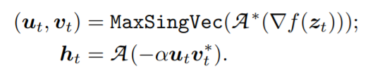
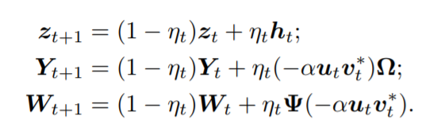

Sketch + CGM
Update
Convergence

Slide 13
Paper Experiments

Slide 14
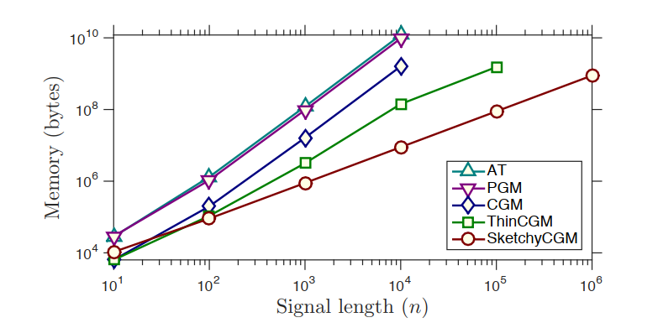
Synthetic Phase Retrieval
Memory usage of five algorithms with the size of the signal vector x
The memory usage increases linearly for SketchyCGM but higher with other methods

Slide 15
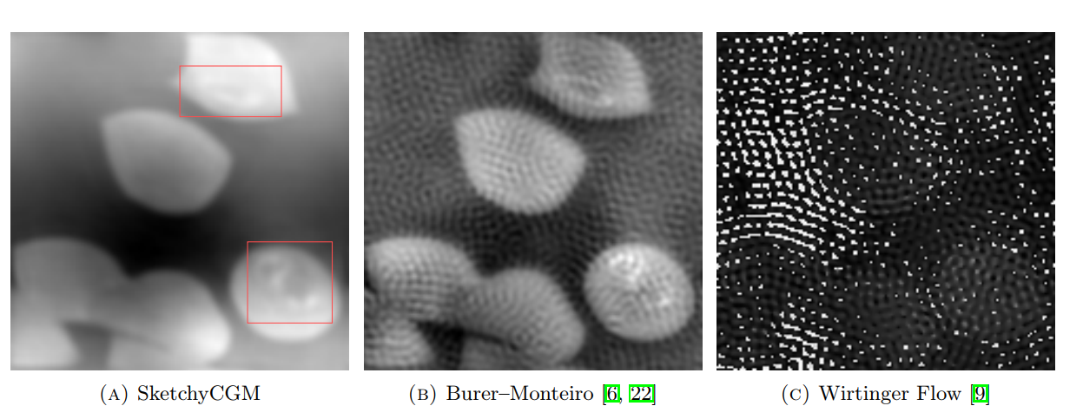
Fourier Ptychography
Obtained clearer images of blood cells compared to other methods

Slide 16
Implementation

Slide 17
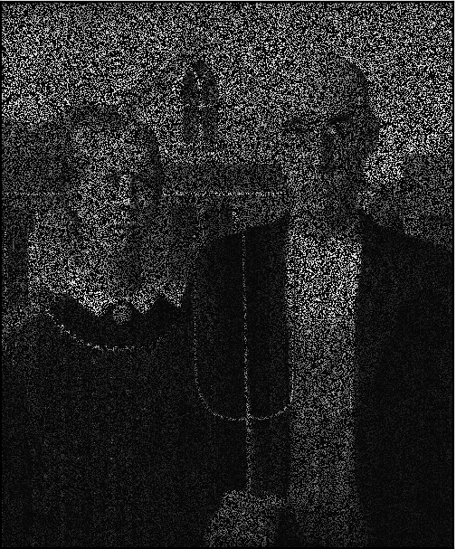
Input Image

Slide 18
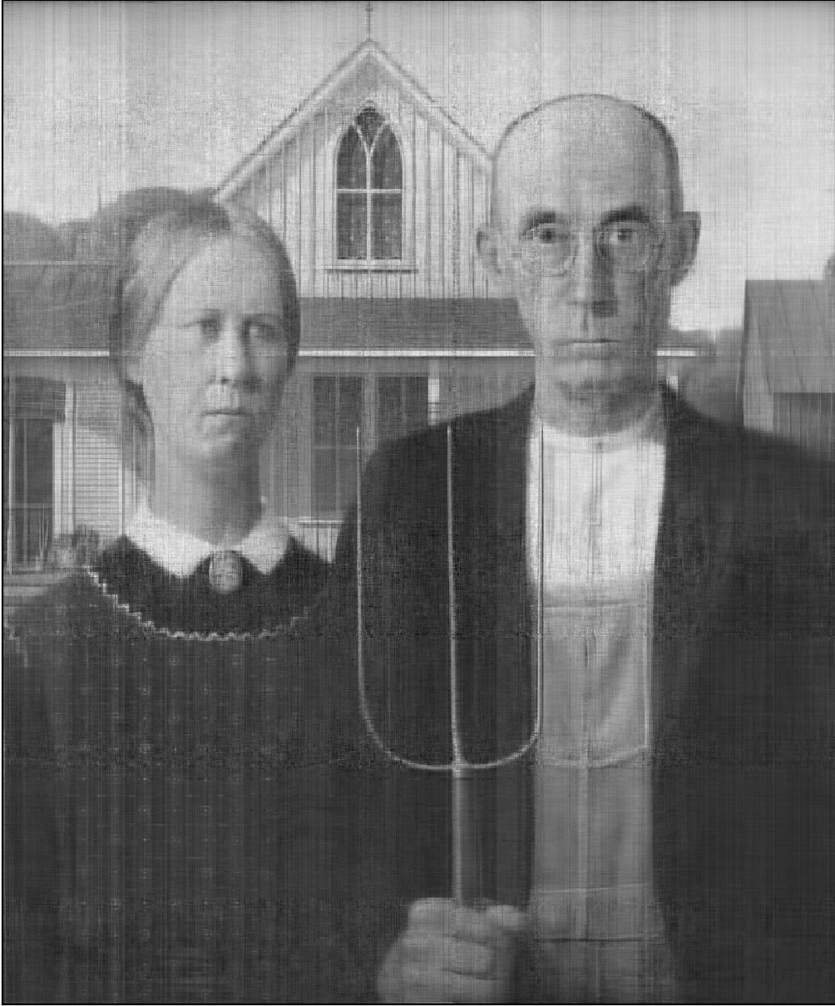
CGM Result

Slide 19

SCGM Result

Slide 20
MovieLens Dataset
943 users, 1682 movies
Ratings from 1 to 5
The ratings are preprocessed to be binary (1 and -1)
Rating > 3.5 (4, 5) → 1
Rating < 3.5 (1, 2, 3) → -1

Slide 21
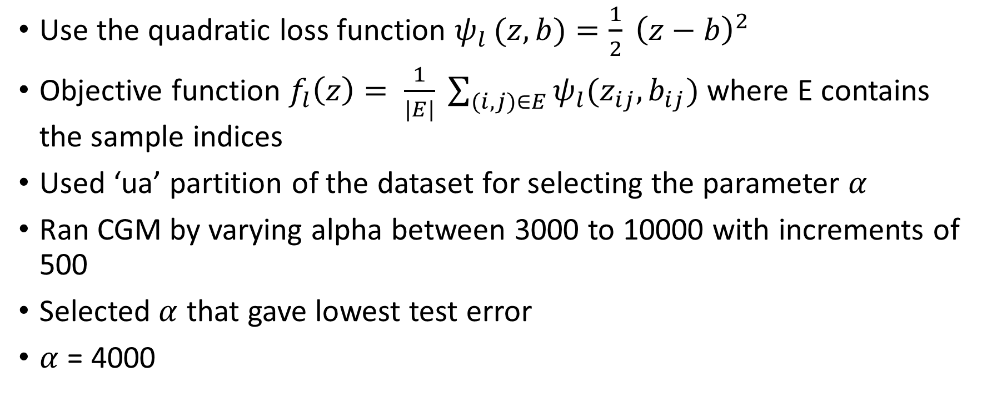
Experiment Details
Use the quadratic loss function $ψ_{l }(z, b)=\frac{1}{2} {\left(z−b\right)}^{2}$
Objective function $f_{l}\left(z\right)= \frac{1}{|E|} \sum_{(i,j)∈E}{ψ_{l}(z_{ij},b_{ij})}$ where E contains the sample indices
Used ‘ua’ partition of the dataset for selecting the parameter $α$
Ran CGM by varying alpha between 3000 to 10000 with increments of 500
Selected $α$ that gave lowest test error
$α$ = 4000

Slide 22
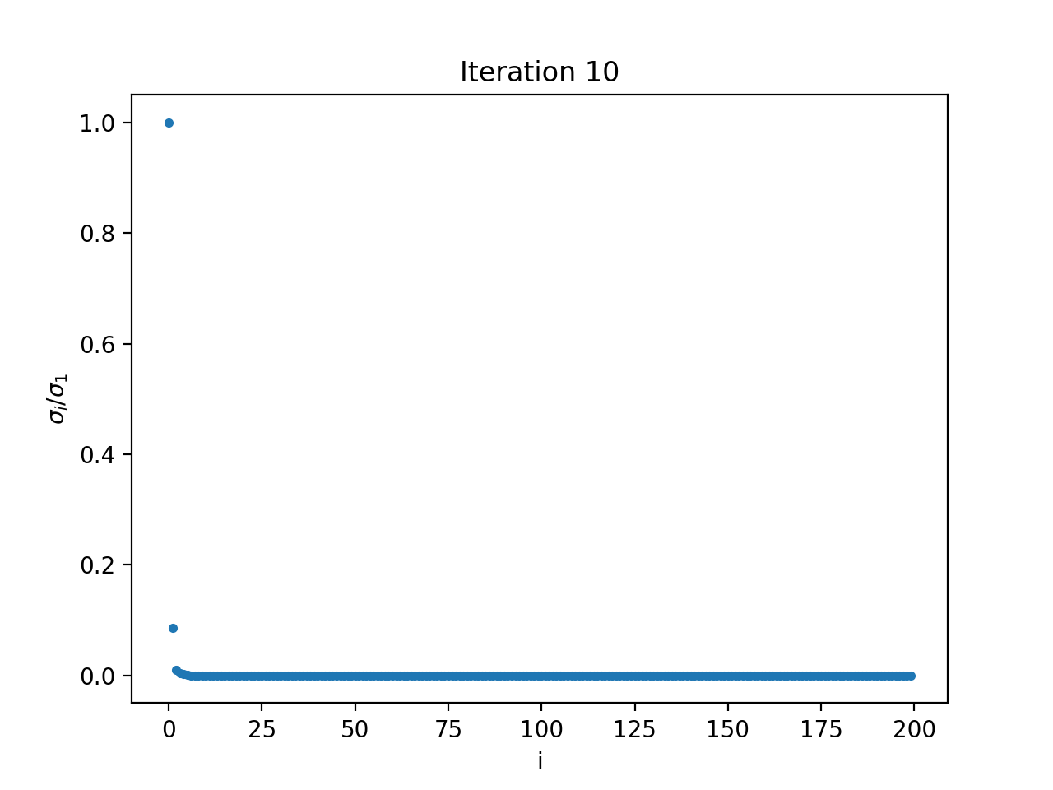
Rank of SketchyCGM
Used the ‘ub’ partition of the datset for final experiments
Looked at the spectrum of the CGM iterates to find rank

Slide 23
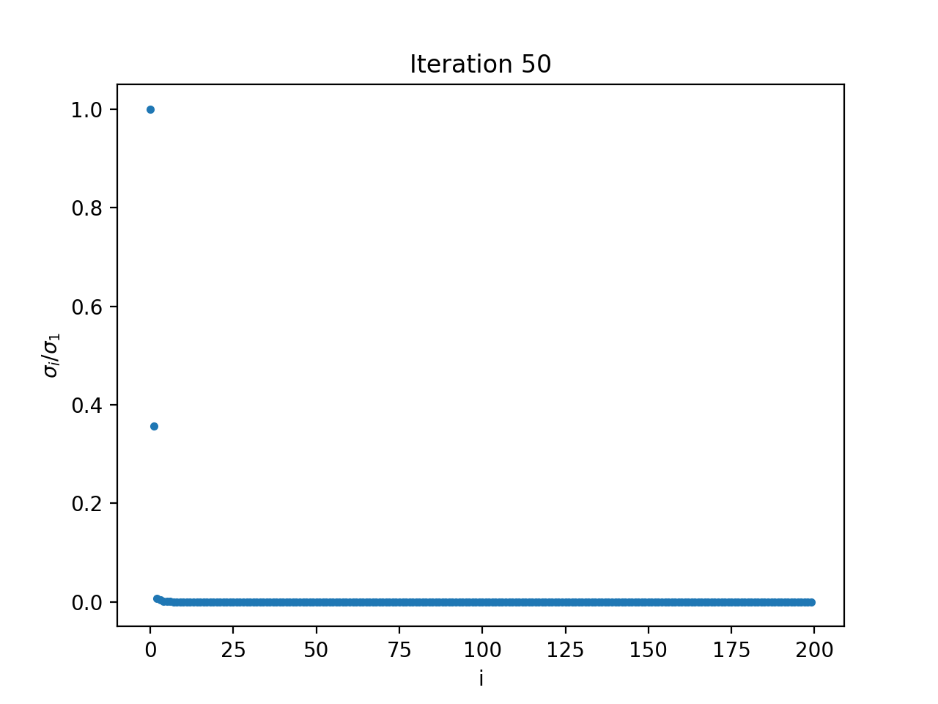
Rank of SketchyCGM

Slide 24
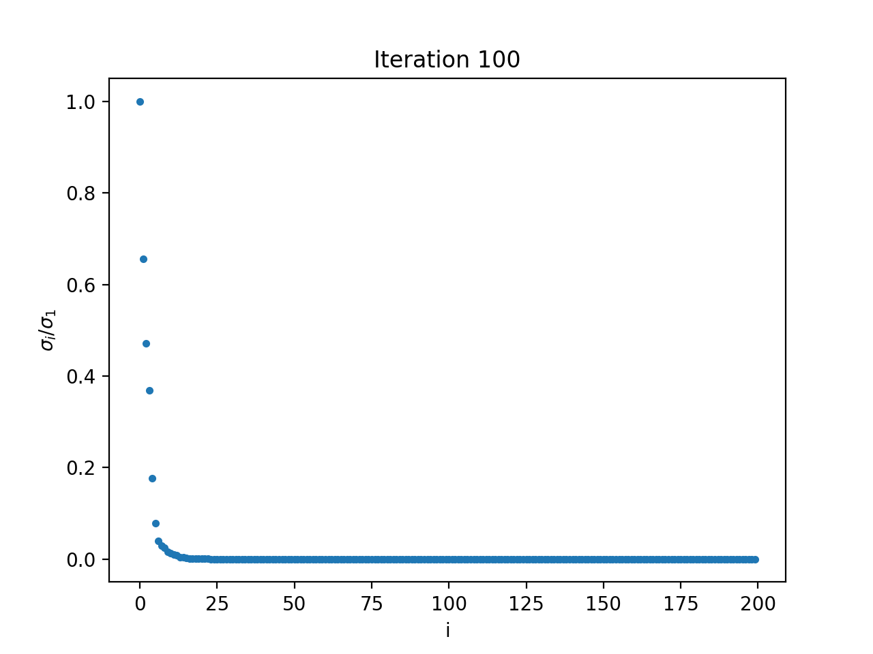
Rank of SketchyCGM

Slide 25
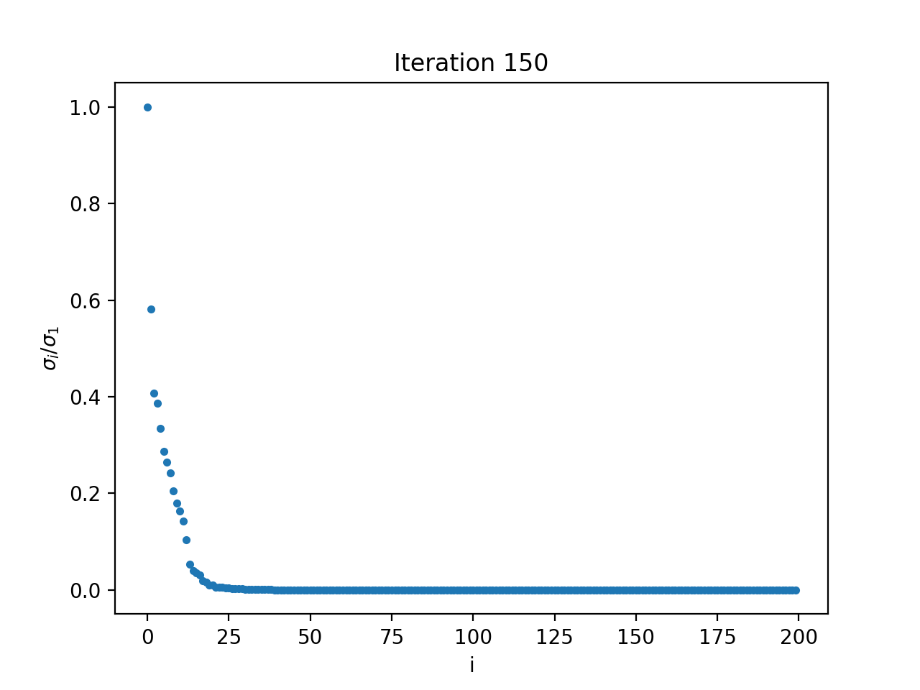
Rank of SketchyCGM

Slide 26
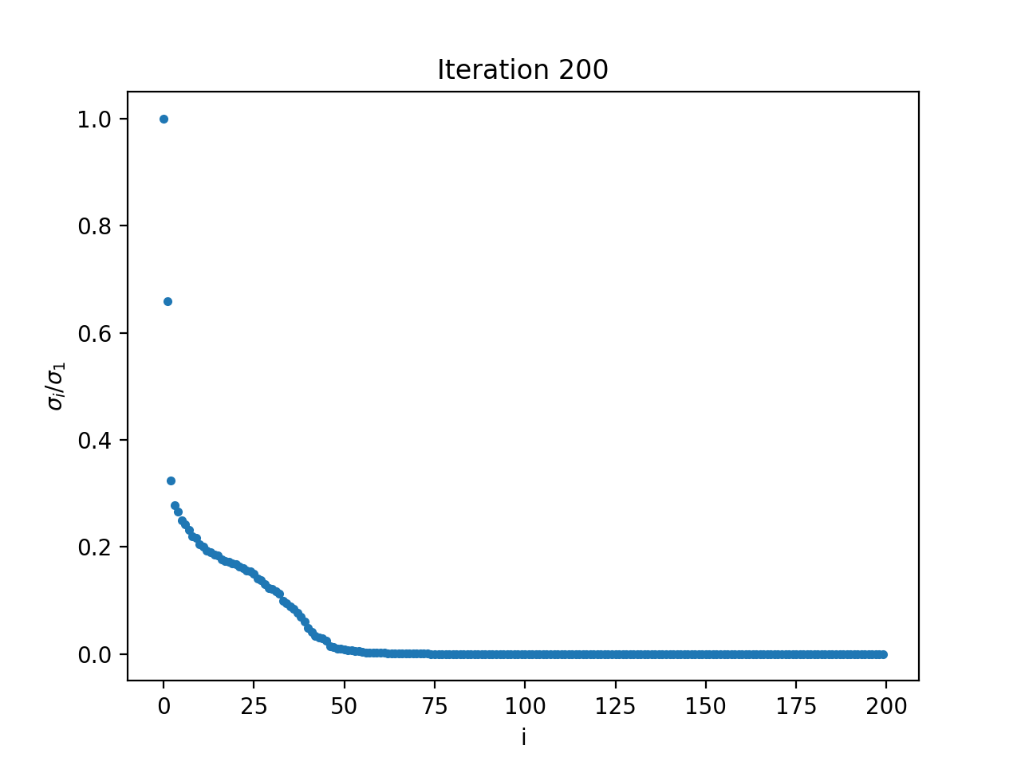
Rank of SketchyCGM

Slide 27
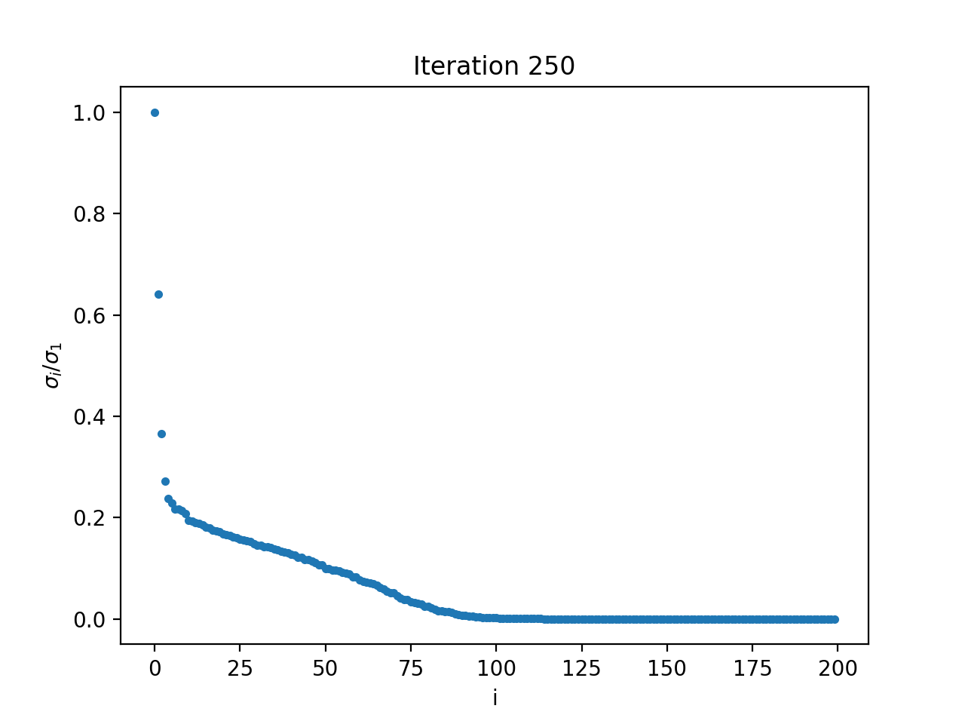
Rank of SketchyCGM

Slide 28
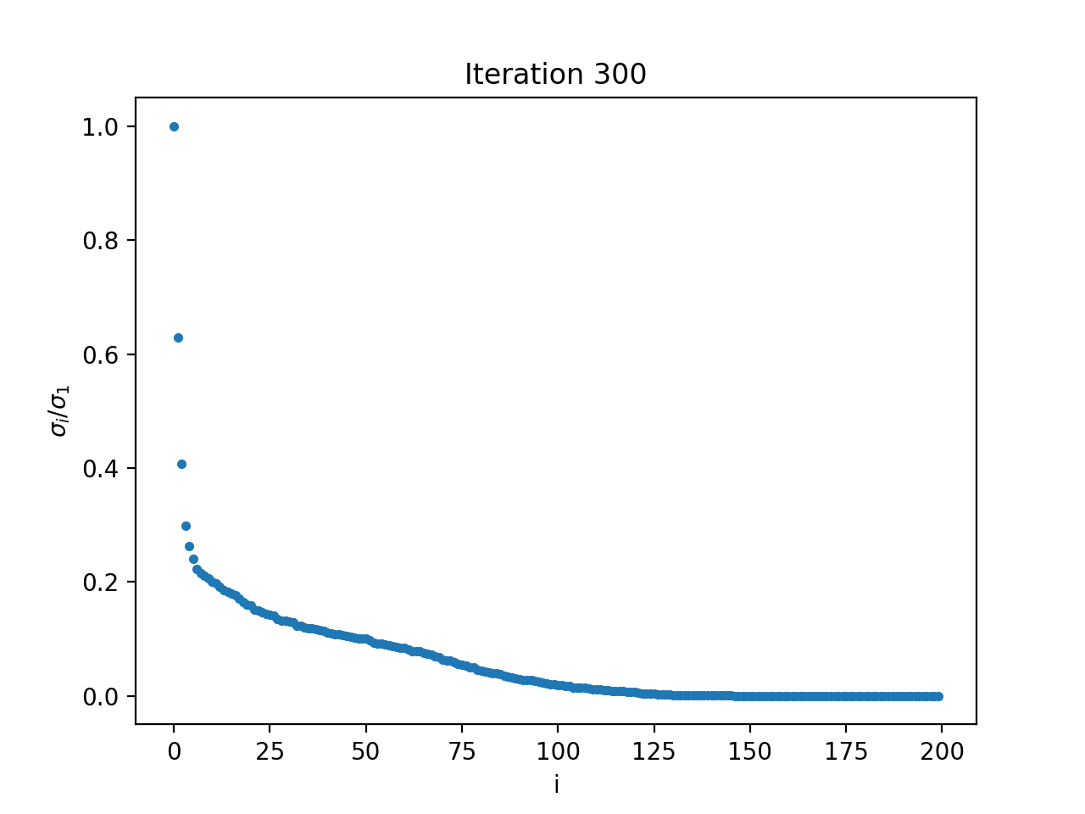
Rank of SketchyCGM

Slide 29
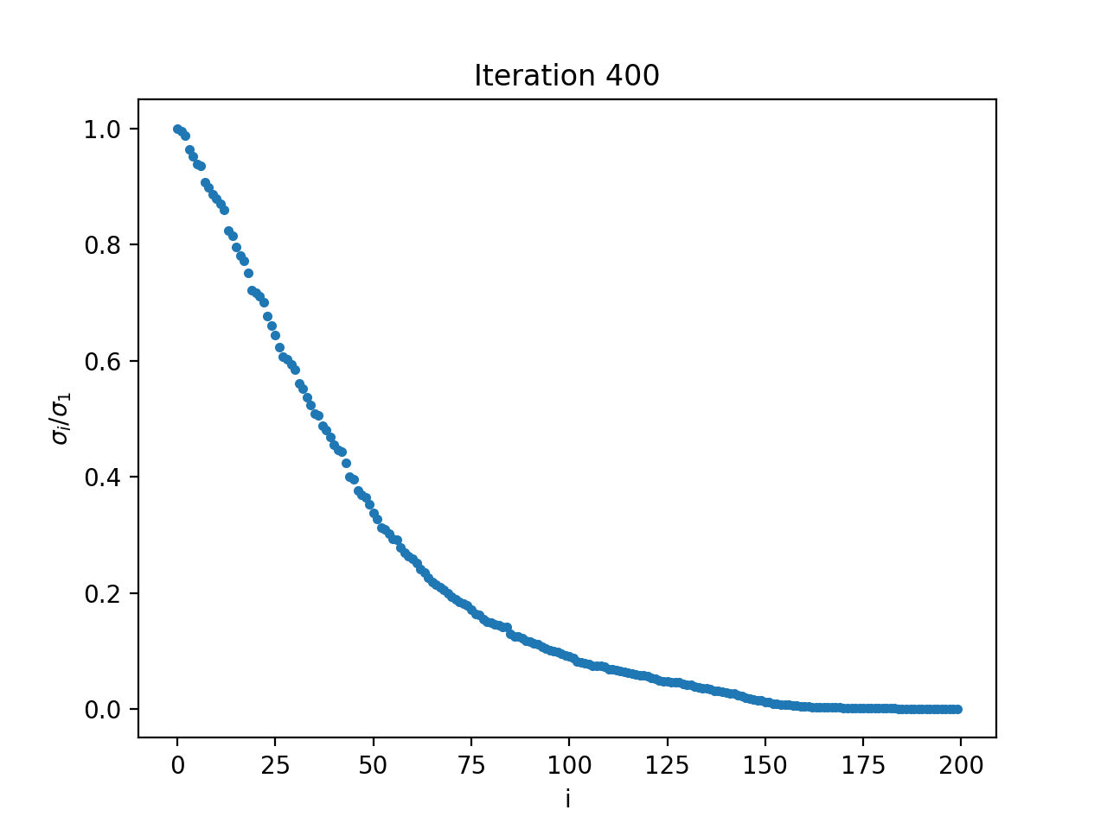
Rank of SketchyCGM

Slide 30

Rank of SketchyCGM

Slide 31
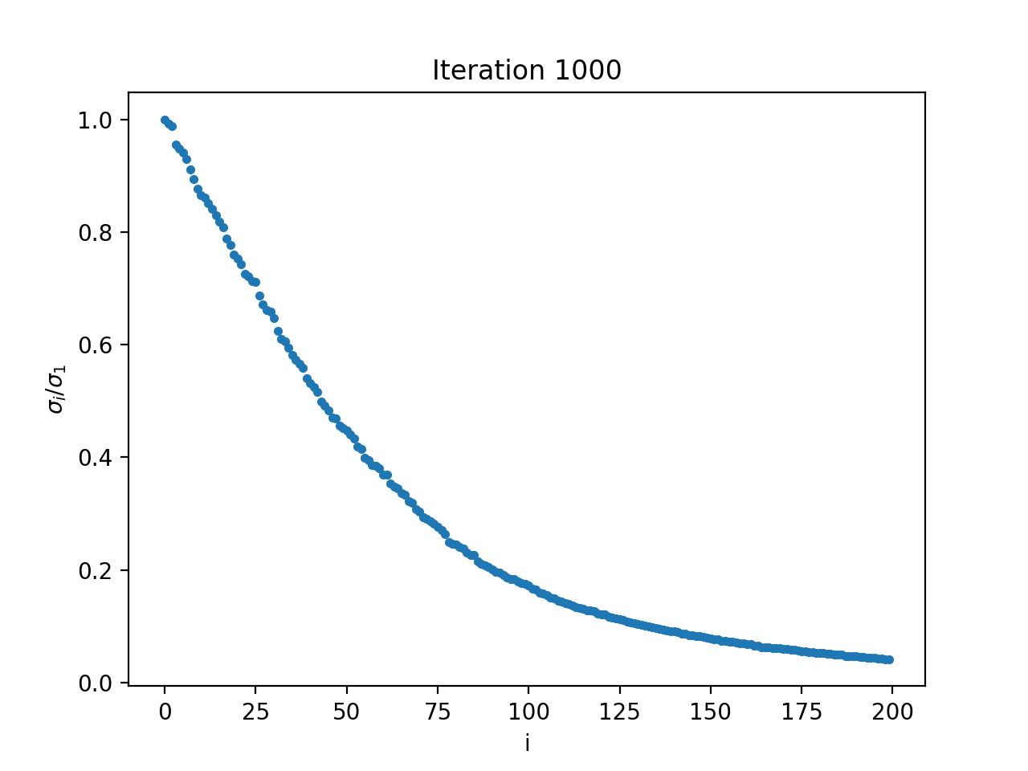
Rank of SketchyCGM

Slide 32
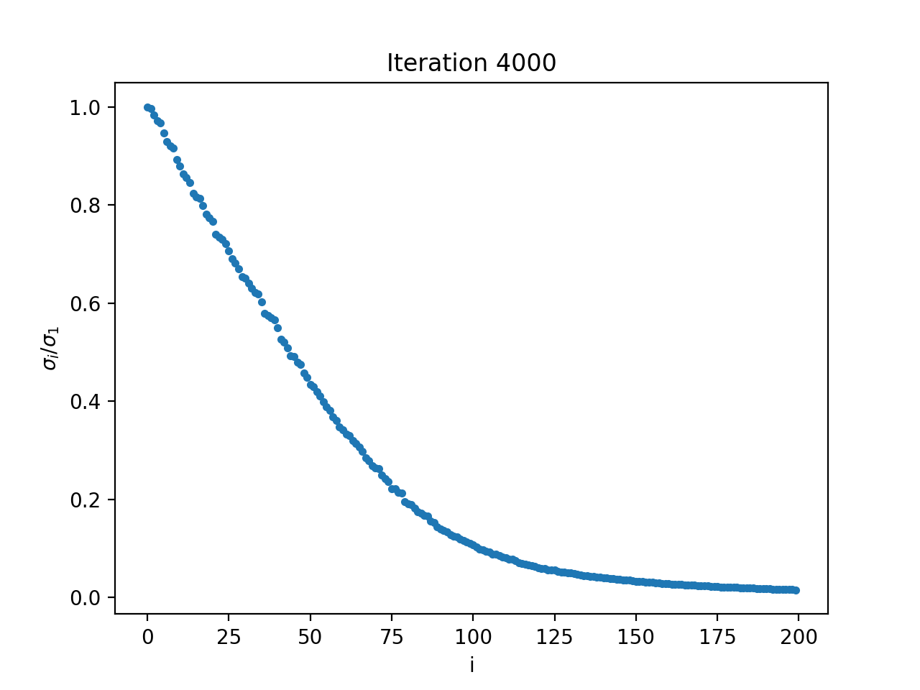
Rank of SketchyCGM

Slide 33
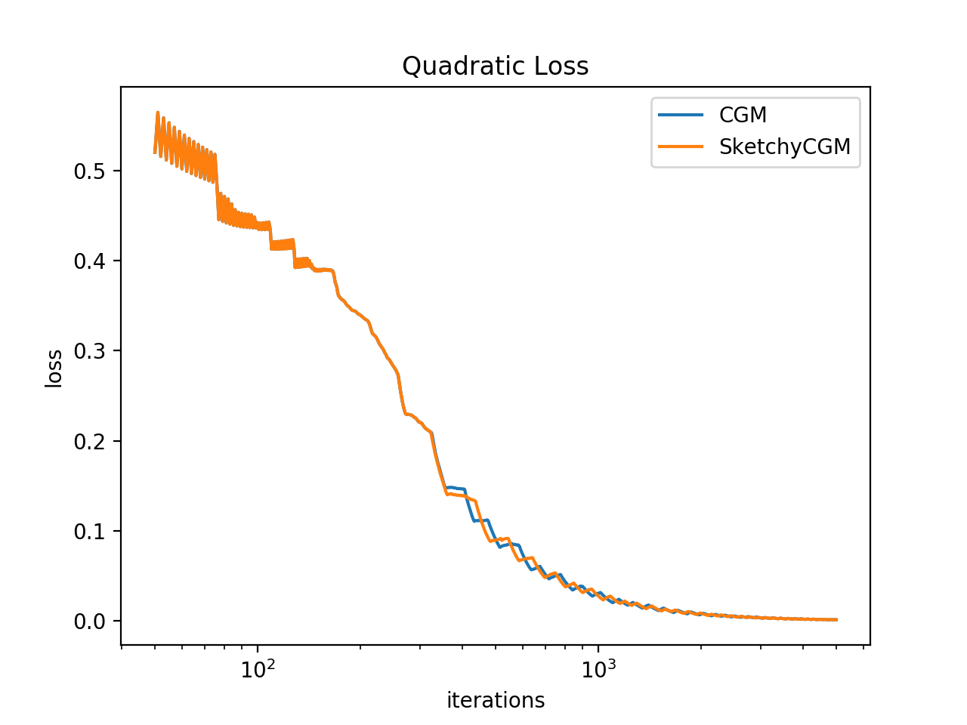
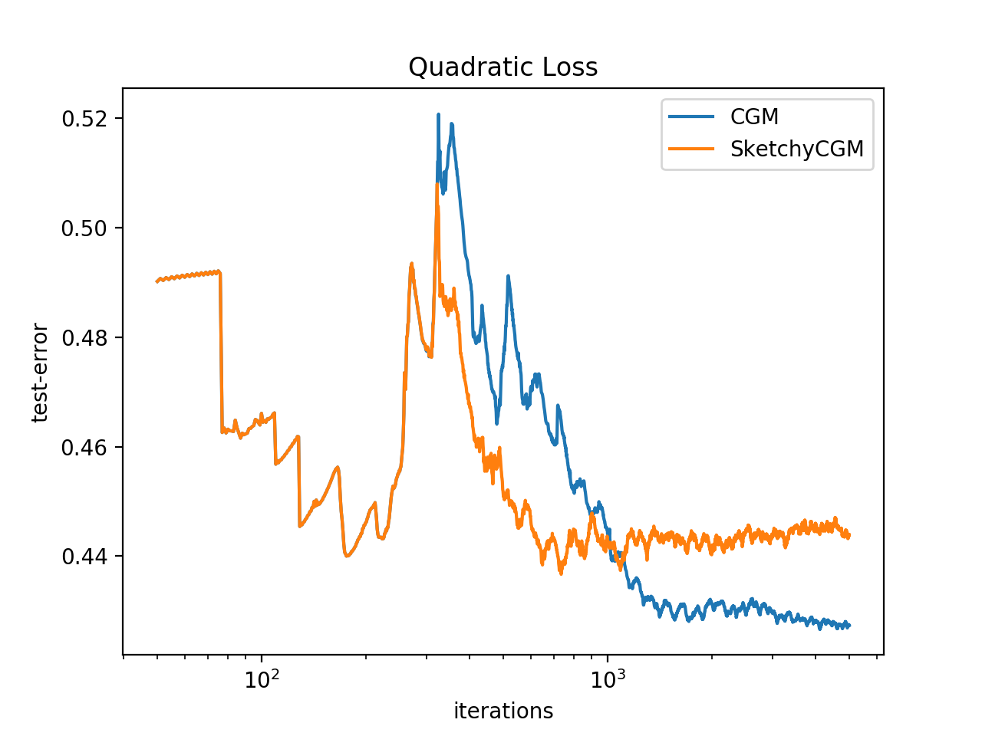
Error Plot
Compared rank of 50 and 100 for SketchyCGM

Slide 34
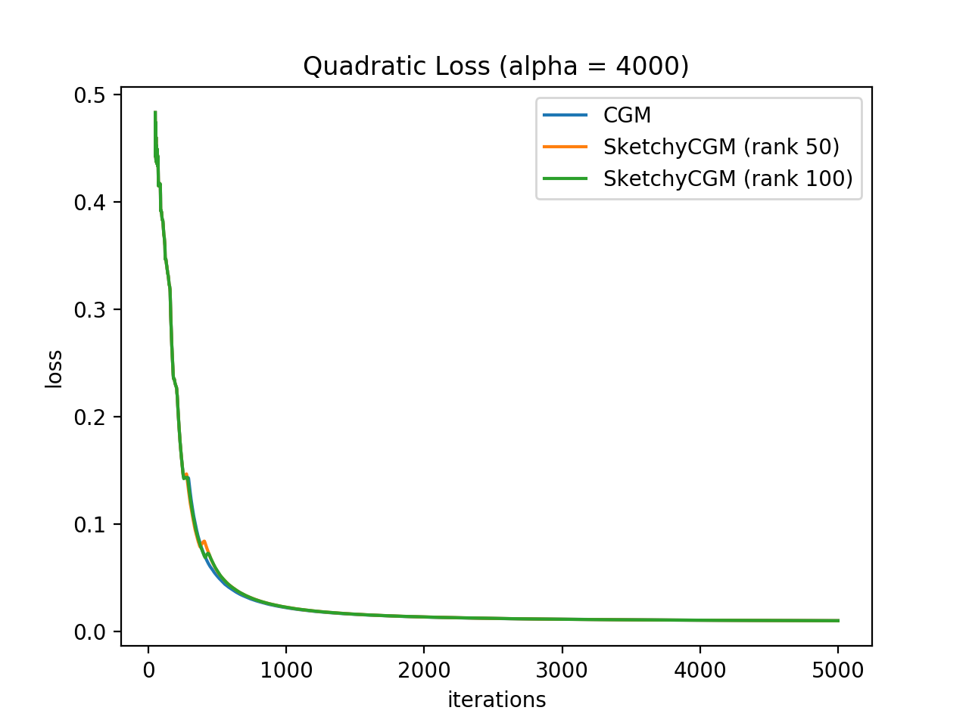
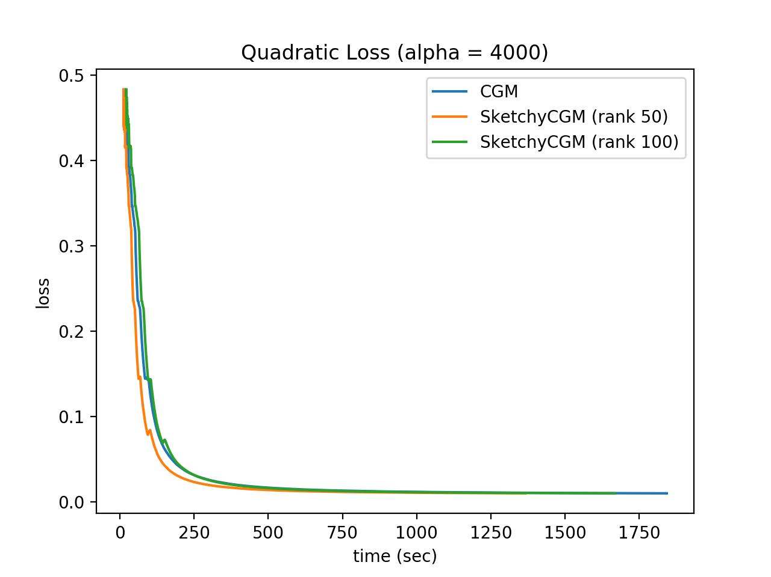
Loss Plot
Compared rank of 50 and 100 for SketchyCGM

Slide 35
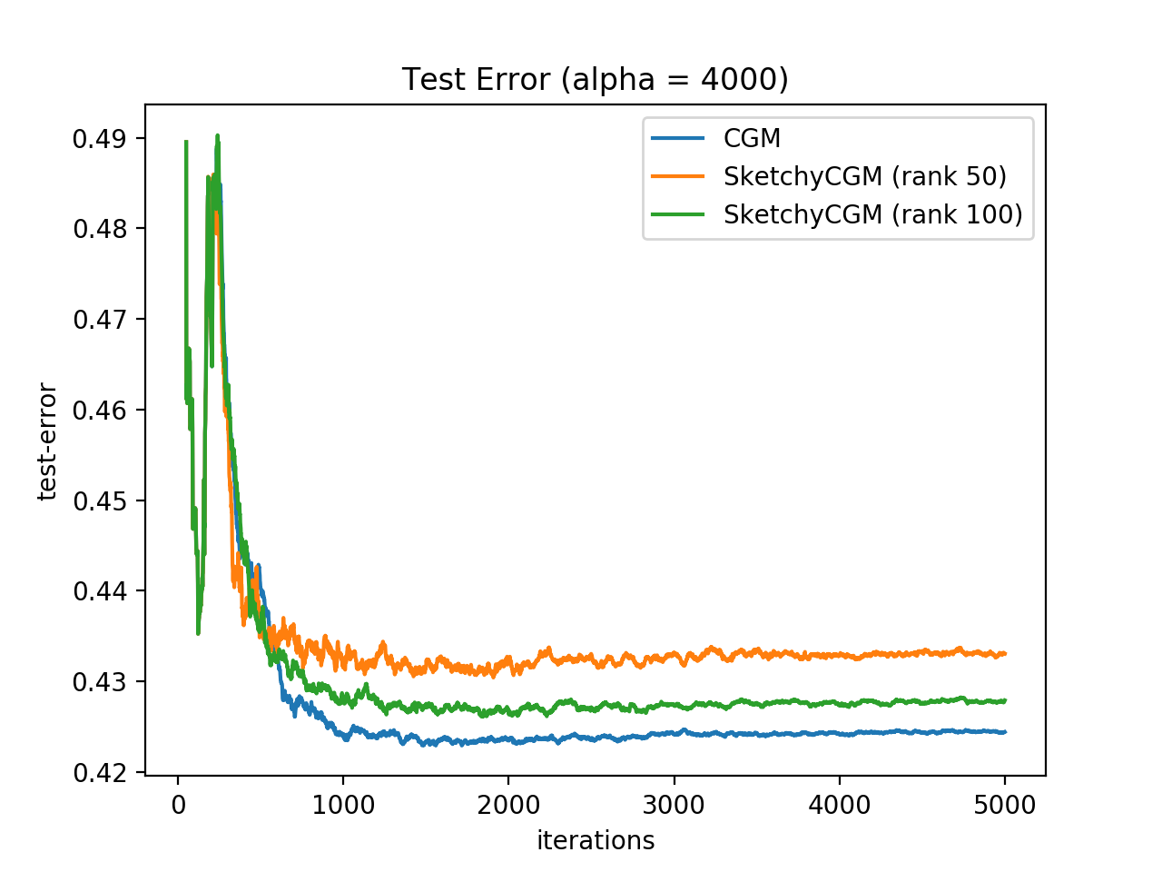
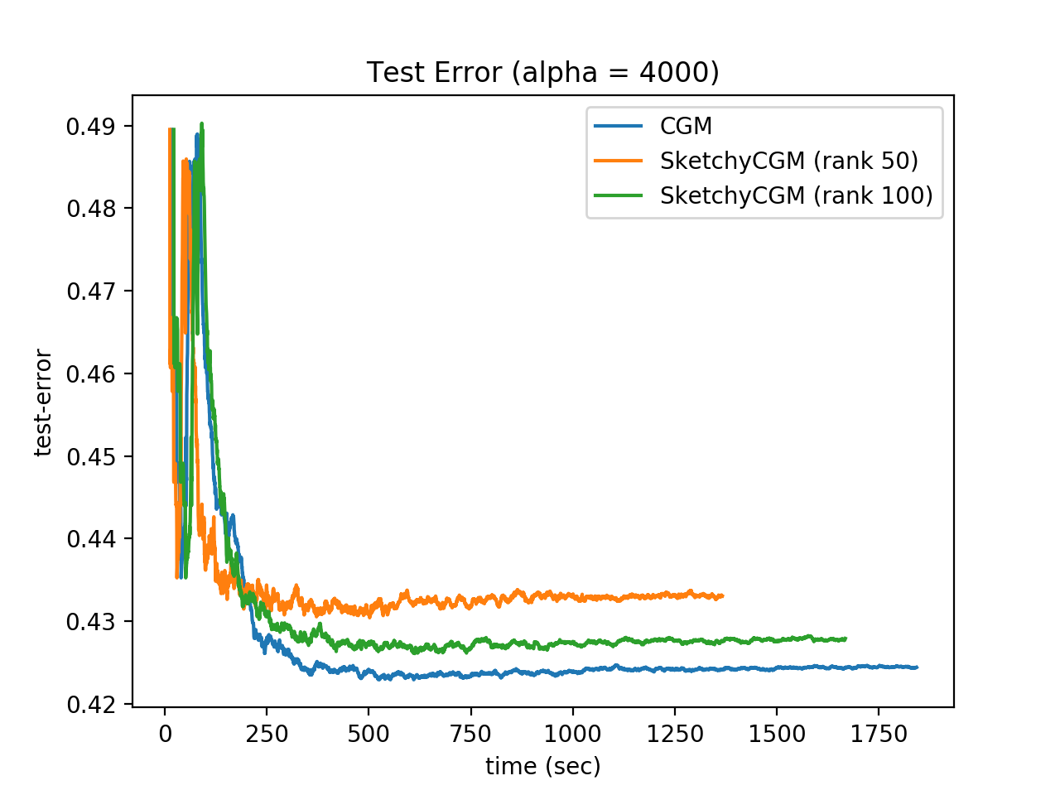
Error Plot
Compared rank of 50 and 100 for SketchyCGM

Slide 36
Conclusion
SketchyCGM provides an optimal storage algorithm for convex matrix optimization problems
This method can obtain a solution close to the CGM method without storing the full matrix at each iteration
If the solution matrix is exactly low rank then, SketchyCGM solution will be equal to the CGM solution

Slide 37
Questions?
Thank You

