Slide 1
LEARN DEPTH ACADEMY LLP | INTERNSHIP CAPSTONE
FinShield
AI-Powered Payment Transaction Anomaly Detection System
FinTech Domain • Binary Classification • Extreme Imbalance Learning
Target Metric: ROC-AUC
Final Model: Logistic Regression
Deployment: Streamlit Web UI

Slide 2
BACKGROUND & MOTIVATION
The Fraud Detection Challenge in Digital Payments
Why standard machine learning assumptions fail in high-volume financial transaction streams
01 | Severe Class Imbalance
• Fraudulent events represent only 0.173% of total transactions (~578 genuine to 1 fraud).
• Extreme rarity creates a 'needle in a haystack' classification problem.
• Naive models predict majority class ('all genuine') to achieve >99.8% accuracy while detecting zero fraud.
02 | Asymmetric Error Costs
• False Negatives (Missed Fraud): Unrecoverable financial loss, chargeback penalties, customer attrition.
• False Positives (False Alarms): Legitimate transactions interrupted, brief customer friction.
• Cost Ratio: Missing a fraud attempt is orders of magnitude more expensive than performing secondary verification.
03 | Real-Time Latency
• Modern payment rails require sub-second transaction scoring before payment authorization.
• Heavy distance-based algorithms (like KNN) scale poorly with millions of historical records.
• The anomaly detection engine must balance high sensitivity with lightweight inference computation.

Slide 3
PROJECT SCOPE
FinShield Project Objectives
Formulating an end-to-end machine learning solution for payment anomaly detection
1. Leak-Free Preprocessing Pipeline
Deduplicate 1,081 redundant transactions; enforce strict stratified train/test split (80/20); scale Time and Amount solely on training distributions.
Key Engineering & Selection Principles
• ROC-AUC as North Star Metric:
Because threshold selection is business-dependent, models must be ranked on overall discriminatory power across all operating cutoffs.
• Prioritizing Recall Over Precision:
At the initial screening tier, capturing ~87% of fraud attempts protects capital, while flagged cases proceed to step-up verification.
• Production-Ready Pipeline Architecture:
Trained transformers and models are decoupled and saved to disk, ensuring identical preprocessing during web serving.
• Academic Prototype Reality:
Designed as an educational machine learning prototype demonstrating core data science competencies for Learn Depth Academy LLP.
2. Cost-Sensitive Imbalance Modeling
Penalize minority misclassifications using balanced class weights (class_weight='balanced') rather than introducing noisy synthetic interpolations.
3. Rigorous Multi-Model Benchmarking
Train Logistic Regression, Decision Trees, and KNN; benchmark on Accuracy, Precision, Recall, F1-Score, and ROC-AUC.
4. Interactive Demonstration UI
Persist serialized pipeline artifacts with joblib and deploy a responsive Streamlit dashboard supporting simulated genuine and fraud transactions.

Slide 4
DATA UNDERSTANDING
Credit Card Transaction Dataset
Benchmark dataset collected by Université Libre de Bruxelles (ULB) / Kaggle
284,807
Total Transactions
492
Fraudulent Cases (0.173%)
284,315
Genuine Cases (99.827%)
30 + 1
Features & Target
Feature Anatomy & Confidentiality
V1 to V28 (PCA Features):
28 numerical features resulting from Principal Component Analysis transformation to protect user identity and cardholder confidentiality.
Time (Original Feature):
Elapsed seconds between each transaction and the first record in the dataset (covers 48 hours).
Amount (Original Feature):
Transaction amount in Euros. Exhibits extreme variance (mean €88.35, max €25,691.16).
Class (Target Variable):
Binary flag: 0 = Genuine transaction, 1 = Fraudulent/anomalous transaction.
Data Integrity & Hygiene Assessment
Zero Missing Values:
Initial verification confirmed zero null/NaN values across all 31 features, ensuring no synthetic imputation was necessary.
Duplicate Row Identification:
Identified exactly 1,081 identical transaction rows. These were dropped to prevent data leakage between train and test splits.
Post-Deduplication Volume:
283,726 unique transactions retained (473 fraud cases, 283,253 genuine cases).
Extreme Ratio Confirmation:
Fraud incidence after deduplication is 0.167%, reinforcing the necessity for cost-sensitive penalization.

Slide 5
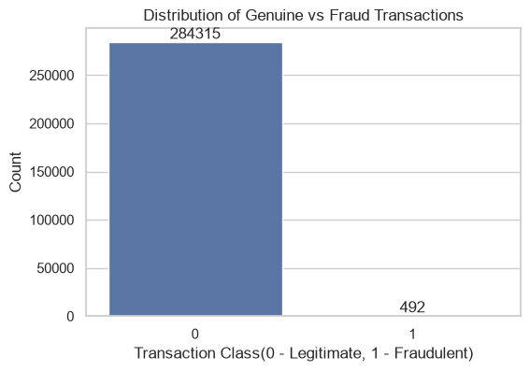
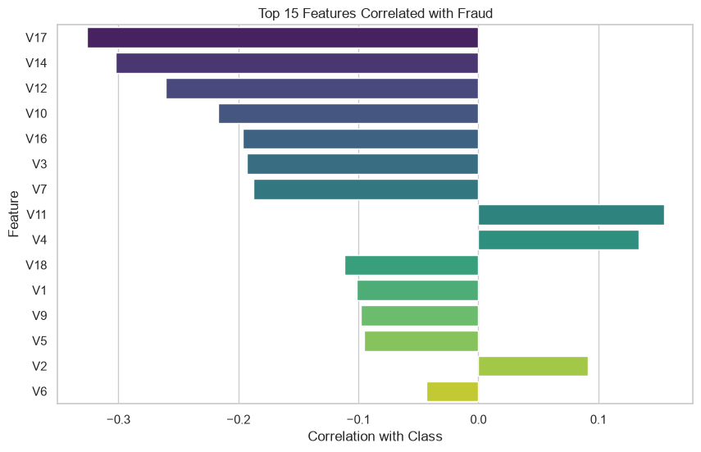
DATA EXPLORATION
Key Exploratory Data Analysis (EDA) Findings
Empirical patterns extracted from notebooks/01_EDA.ipynb
Key Empirical Observations
Class Imbalance Reality:
Visualized via countplot & pie chart: 99.83% genuine vs. 0.17% fraud. A default classifier predicting majority achieves near-perfect accuracy while completely failing its purpose.
Temporal Circadian Trend:
Engineering the Hour feature ((Time // 3600) % 24) revealed that while genuine transactions drop sharply between 01:00 and 05:00 AM, fraud rates remain elevated during nighttime hours.
Discriminative PCA Components:
Strong negative correlation with fraud observed in V14 (-0.302), V17 (-0.326), V12 (-0.260), and V10 (-0.216). Fraudulent events exhibit heavy negative outlier tails.
Transaction Amounts:
Median fraud amount is €9.25 vs €22.00 for genuine, confirming fraudsters deliberately keep amounts modest to evade automated alerts.

Slide 6
PIPELINE ARCHITECTURE
Data Preprocessing & Imbalance Strategy
Constructing a leak-free transformation pipeline to prepare features for model estimation
01 | Deduplication & Split
• Deduplication: Removed 1,081 redundant rows to prevent identical transactions appearing in both splits.
• Stratified Partitioning: Executed 80/20 train/test split with stratify=y and random_state=42.
• Training Set: 226,980 samples (397 fraud cases).
• Testing Set: 56,746 samples (95 fraud cases).
• Integrity: Identical minority proportion strictly maintained in both partitions.
02 | Feature Scaling
• PCA Invariance: Features V1 through V28 were already standardized from original PCA projection.
• StandardScaler Application: Applied strictly to Time and Amount.
• Zero Data Leakage: The scaler is fitted exclusively on X_train, then applied via transform() onto X_test and inference streams.
• Hour Feature Engineering: Time converted into cyclic hour of day ((Time // 3600) % 24) to capture diurnal behavior.
03 | Cost-Sensitive Weights
• class_weight='balanced': Configured directly inside loss functions of Logistic Regression and Decision Tree.
• Mathematical Mechanism: Automatically computes weights inversely proportional to class frequencies: W_c = N / (2 * N_c).
• Fraud Penalty: Scales minority misclassification penalty by ~578x.
• Why not SMOTE: Preserves exact genuine boundary geometry without generating synthetic artifacts in PCA space.

Slide 7
MODEL ARCHITECTURE
Candidate Classification Models
Three contrasting algorithms trained under identical splits and evaluation metrics
Logistic Regression
Linear Probabilistic Baseline
class_weight:
'balanced' (proportional penalty)
max_iter:
1000 (ensures full convergence)
random_state:
42 (deterministic reproducibility)
Core Advantage:
Generates smooth, well-calibrated continuous probabilities; convex loss guarantees global optimum; ultra-low inference latency for payment gateways.
Decision Tree
Non-Linear Rule Partitioner
class_weight:
'balanced'
max_depth:
8 (explicit tree pruning)
random_state:
42
Core Advantage:
Captures non-linear thresholds and feature combinations; transparent split rules; pruned depth explicitly limits tree capacity to prevent memorization of noise.
K-Nearest Neighbors
Instance-Based Local Density
n_neighbors:
5 (neighborhood vote count)
metric:
Euclidean distance
weights:
'uniform'
Core Characteristic:
Non-parametric instance clustering; relies on local density; does not incorporate class weighting natively; high test-time computational complexity.

Slide 8
BENCHMARKING & RESULTS
Model Comparison & Selection Criterion
Comparative performance on held-out test set (56,746 transactions: 56,651 genuine, 95 fraud)
Model Architecture | Accuracy | Precision | Recall | F1-Score | ROC-AUC
Logistic Regression (Selected) | 0.9748 | 0.0553 | 0.8737 | 0.1040 | 0.9684
Decision Tree | 0.9913 | 0.1374 | 0.8000 | 0.2346 | 0.9074
KNN (K-Nearest Neighbors) | 0.9994 | 0.9420 | 0.6842 | 0.7927 | 0.8841
Why Logistic Regression Was Selected
• Highest ROC-AUC (0.9684): Explicitly defined as the primary selection criterion.
• Superior Sensitivity (Recall = 87.37%): Successfully detected 83 out of 95 fraud attempts, yielding the lowest miss rate (only 12 false negatives).
• Calibrated Threshold Adaptability: High AUC confirms the model separates distributions well, allowing fraud teams to fine-tune cutoff thresholds dynamically.
Why KNN & High F1 Were NOT Selected
• Lowest ROC-AUC (0.8841): Ranks poorest in overall discriminatory separation.
• Unacceptable Miss Rate (Recall = 68.42%): Missed 31.6% of all fraudulent transactions (30 missed fraud cases vs. only 12 for Logistic Regression).
• F1 Metric Flaw: KNN's high F1 reflects high precision at a fixed 0.5 cutoff at the cost of letting 30 fraudulent transactions bypass the barrier.
• Production Bottleneck: Evaluating distance across 226k+ vectors is infeasible for low-latency payment processing.

Slide 9
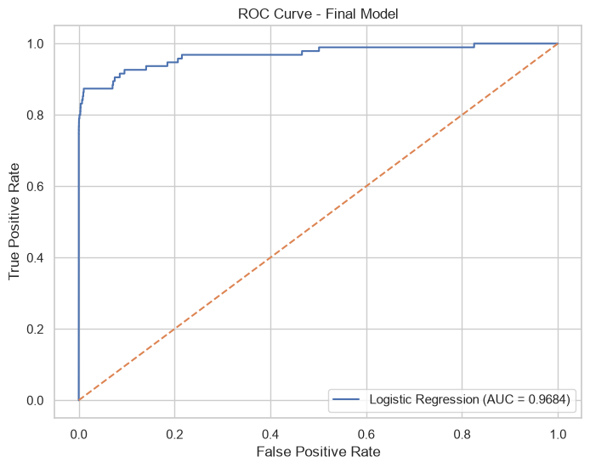
MODEL ASSESSMENT
Final Model Evaluation: Logistic Regression
Detailed metrics and Receiver Operating Characteristic (ROC) curve analysis
Evaluation Summary (Test Set)
Accuracy: 97.48%
Overall classification accuracy across 56,746 test transactions.
ROC-AUC: 0.9684 (96.84%)
Primary metric demonstrating strong discriminatory capability across all potential decision thresholds.
Recall: 87.37%
Successfully captured 83 out of 95 fraud cases, prioritizing capital protection.
Precision: 5.53%
Reflects low baseline fraud prevalence (0.17%); flagged transactions proceed to step-up verification (OTP/SMS).
F1-Score: 10.40%
Harmonic mean of precision and recall under cost-sensitive balanced weighting.

Slide 10
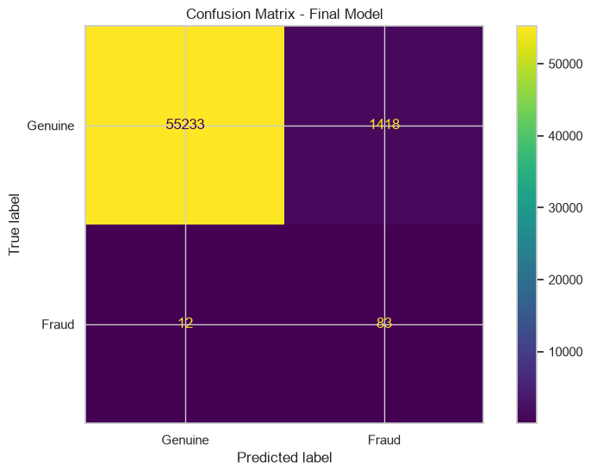
ERROR ANALYSIS
Confusion Matrix & Operational Interpretation
Detailed audit of model decisions across 56,746 test transactions
Confusion Matrix Breakdown
True Negatives (TN = 55,233):
Genuine transactions correctly cleared with zero customer friction (97.5% specificity).
False Positives (FP = 1,418):
Legitimate transactions routed to step-up authorization (e.g., SMS OTP challenge).
False Negatives (FN = 12):
Fraudulent transactions missed by the model. Represents only 12.6% of all fraud attempts.
True Positives (TP = 83):
Fraudulent transactions successfully intercepted and blocked (87.4% sensitivity).
Business Impact Assessment:
Missing 12 fraudulent charges protects ~87% of potential fraud losses, while routing ~2.5% of genuine volume to secondary verification is commercially acceptable.

Slide 11
INTERACTIVE DEPLOYMENT
FinShield Streamlit Web Application
Interactive inference interface executing real-time payment anomaly scoring
Application Architecture & Features
Model & Scaler Deserialization:
Loads model.pkl and scaler.pkl via @st.cache_resource for instant zero-overhead scoring.
Dynamic Feature Engineering:
Derives the Hour feature ((Time // 3600) % 24) and guarantees exact model column ordering (model.feature_names_in_).
Continuous Risk Stratification:
Outputs probability percentage and classifies transactions into 3 actionable risk tiers: Low (<50%), Medium (50–79%), High (>=80%).
Fast Execution Command:
cd app; uv run streamlit run streamlit_app.py (hosted locally at http://localhost:8501).
Pre-Configured Demo Scenarios
🟢 Genuine Transaction Demo
• Input: Time = 50,000s | Amount = €100.00 | V1–V28 = 0.0
• Prediction: Genuine Transaction (Normal)
• Risk Tier: LOW RISK (Approval Cleared)
🔴 Fraudulent Transaction Demo
• Input: Time = 60,000s | Amount = €150.00
• Signature Outliers: V10 = -6.2, V12 = -5.8, V14 = -7.1, V17 = -6.4
• Prediction: 🚨 Fraudulent Transaction Detected
• Risk Tier: HIGH RISK (>95% Fraud Probability)

Slide 12
SUMMARY & ROADMAP
Conclusion & Future Research Directions
Project Conclusions
End-to-End Pipeline Completed:
Successfully engineered a complete data science pipeline covering EDA, deduplication, leak-free scaling, and model persistence.
ROC-AUC Model Selection Validated:
Selected Logistic Regression based strictly on maximum ROC-AUC (0.9684), capturing 87.37% of fraud events.
Rejection of Naive Metrics:
Demonstrated that raw accuracy (>99.8%) and default F1 scores conceal severe fraud leakage in imbalanced regimes.
Interactive Prototype Operational:
Streamlit application serves predictions and risk assessments with instant responsiveness.
Future Scope & Enhancements
Gradient Boosted Ensembles:
Benchmark XGBoost, LightGBM, and CatBoost with custom focal loss functions.
Cost-Matrix Threshold Optimization:
Calibrate dynamic decision thresholds based on explicit dollar-value cost of false positives vs. false negatives.
Explainable AI (XAI):
Integrate SHAP / LIME attribution scores into the Streamlit UI to display top contributing features for flagged transactions.
Streaming Ingestion Pipeline:
Connect scoring models to Apache Kafka / Apache Flink for real-time sub-millisecond event processing.
Concept Drift Monitoring:
Implement automated drift detection (KS-tests, PSI) to trigger periodic model retraining.

