Slide 1
Confidence Intervals: Bootstrap Distribution
STAT 101
Dr. Kari Lock Morgan
9/18/12
SECTIONS 3.3, 3.4
Bootstrap distribution (3.3)
95% CI using standard error (3.3)
Percentile method (3.4)

Slide 2
Common Misinterpretations
“A 95% confidence interval contains 95% of the data in the population”
“I am 95% sure that the mean of a sample will fall within a 95% confidence interval for the mean”
“The probability that the population parameter is in this particular 95% confidence interval is 0.95”

Slide 3
Standard Error
The standard error of a statistic, SE, is the standard deviation of the sample statistic
The standard error can be calculated as the standard deviation of the sampling distribution

Slide 4
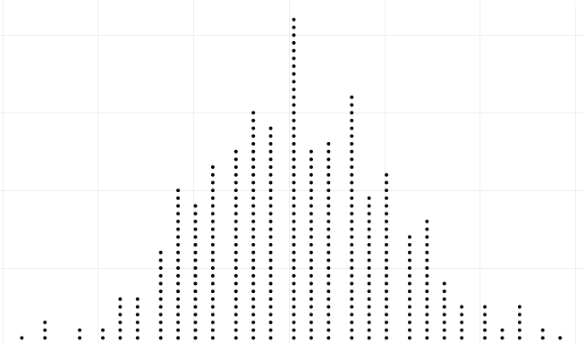
Confidence Intervals
Confidence Interval
statistic ± ME
Population
Sample
Sample
. . .
Sample
Sample
Margin of Error (ME)
(95% CI: ME = 2×SE)
Sample
Sample
Sampling Distribution
Calculate statistic for each sample
Standard Error (SE): standard deviation of sampling distribution

Slide 5
Summary
To create a plausible range of values for a parameter:
Take many random samples from the population, and compute the sample statistic for each sample
Compute the standard error as the standard deviation of all these statistics
Use statistic ± 2×SE
One small problem…

Slide 6
Reality
… WE ONLY HAVE ONE SAMPLE!!!!
How do we know how much sample statistics vary, if we only have one sample?!?
BOOTSTRAP!

Slide 7
ONE Reese’s Pieces Sample
Sample: 52/100 orange
Where might the “true” p be?

Slide 8
“Population”
Imagine the “population” is many, many copies of the original sample
(What do you have to assume?)

Slide 9
Reese’s Pieces “Population”

Slide 10
Sampling with Replacement
To simulate a sampling distribution, we can just take repeated random samples from this “population” made up of many copies of the sample
In practice, we can’t actually make infinite copies of the sample…
… but we can do this by sampling with replacement from the sample we have (each unit can be selected more than once)

Slide 11
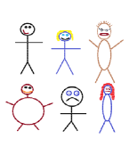
Suppose we have a random sample of 6 people:
Notes:
Patti

Slide 12
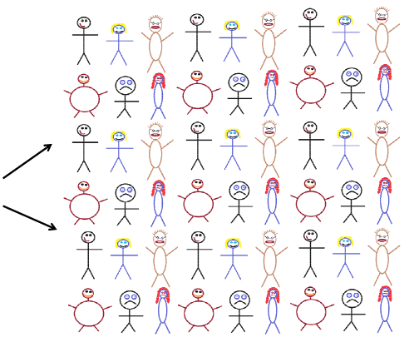
Original Sample
A simulated “population” to sample from
Notes:
Patti

Slide 13




Bootstrap Sample: Sample with replacement from the original sample, using the same sample size.
Original Sample
Bootstrap Sample
Notes:
Patti

Slide 14
Reese’s Pieces
How would you take a bootstrap sample from your sample of Reese’s Pieces?

Slide 15
Reese’s Pieces “Population”

Slide 16
Bootstrap
A bootstrap sample is a random sample taken with replacement from the original sample, of the same size as the original sample
A bootstrap statistic is the statistic computed on a bootstrap sample
A bootstrap distribution is the distribution of many bootstrap statistics

Slide 17
BootstrapSample
Bootstrap Statistic
BootstrapSample
Bootstrap Statistic
Original Sample
Bootstrap Distribution
.
.
.
.
.
.
Sample Statistic
BootstrapSample
Bootstrap Statistic

Slide 18

Bootstrap Sample
Your original sample has data values
18, 19, 19, 20, 21
Is the following a possible bootstrap sample?
18, 19, 20, 21, 22
Yes
No
22 is not a value from the original sample

Slide 19
Bootstrap Sample
Your original sample has data values
18, 19, 19, 20, 21
Is the following a possible bootstrap sample?
18, 19, 20, 21
Yes
No
Bootstrap samples must be the same size as the original sample

Slide 20
Bootstrap Sample
Your original sample has data values
18, 19, 19, 20, 21
Is the following a possible bootstrap sample?
18, 18, 19, 20, 21
Yes
No
Same size, could be gotten by sampling with replacement

Slide 21
Bootstrap Sample
You have a sample of size n = 50. You sample with replacement 1000 times to get 1000 bootstrap samples.
What is the sample size of each bootstrap sample?
50
1000
Bootstrap samples are the same size as the original sample

Slide 22
Bootstrap Distribution
You have a sample of size n = 50. You sample with replacement 1000 times to get 1000 bootstrap samples.
How many bootstrap statistics will you have?
50
1000
One bootstrap statistic for each bootstrap sample

Slide 23
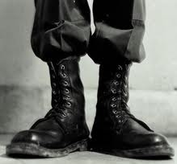
Why “bootstrap”?
“Pull yourself up by your bootstraps”
Lift yourself in the air simply by pulling up on the laces of your boots
Metaphor for accomplishing an “impossible” task without any outside help

Slide 24
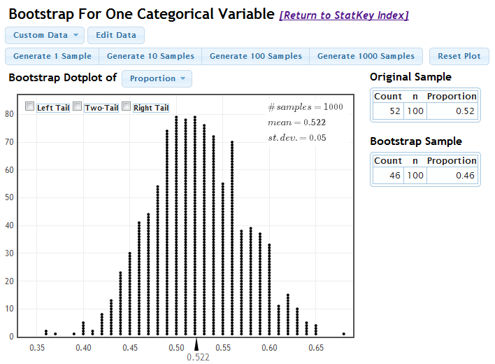
StatKey
lock5stat.com/statkey/

Slide 25
Sampling Distribution
Population
BUT, in practice we don’t see the “tree” or all of the “seeds” – we only have ONE seed
µ

Slide 26
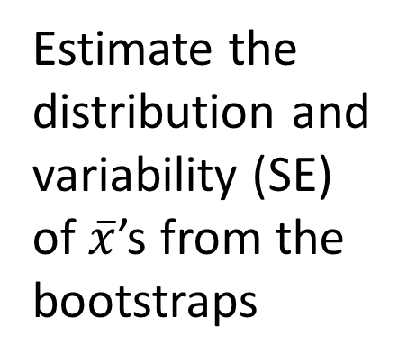

Bootstrap Distribution
What can we do with just one seed?
Bootstrap
“Population”
Estimate the distribution and variability (SE) of $\overline{x}$’s from the bootstraps
Grow a NEW tree!
$$\overline{x}$$
µ

Slide 27
Golden Rule of Bootstrapping
Bootstrap statistics are to the original sample statistic
as
the original sample statistic is to the population parameter

Slide 28
Standard Error
The variability of the bootstrap statistics is similar to the variability of the sample statistics
The standard error of a statistic can be estimated using the standard deviation of the bootstrap distribution!

Slide 29
Confidence Intervals
Confidence Interval
statistic ± ME
Sample
Bootstrap Sample
Bootstrap Sample
Bootstrap Sample
. . .
Bootstrap Sample
Margin of Error (ME)
(95% CI: ME = 2×SE)
Bootstrap Sample
Bootstrap Distribution
Calculate statistic for each bootstrap sample
Standard Error (SE): standard deviation of bootstrap distribution

Slide 30
Reese’s Pieces
Based on this sample, give a 95% confidence interval for the true proportion of Reese’s Pieces that are orange.
(0.47, 0.57)
(0.42, 0.62)
(0.41, 0.51)
(0.36, 0.56)
I have no idea
0.52 ± 2 × 0.05

Slide 31
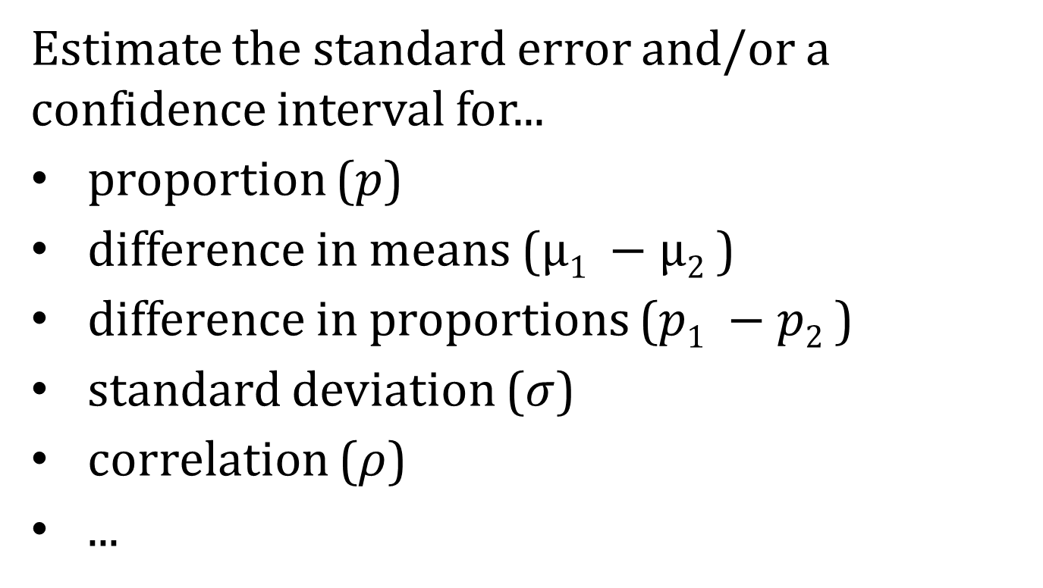
What about Other Parameters?
Estimate the standard error and/or a confidence interval for...
proportion ($p$)
difference in means ($µ1 −µ2$)
difference in proportions ($p1 −p2$)
standard deviation ($σ$)
correlation ($ρ$)
...
Generate samples with replacement
Calculate sample statistic
Repeat...

Slide 32
The Magic of Bootstrapping
We can use bootstrapping to assess the uncertainty surrounding ANY sample statistic!
If we have sample data, we can use bootstrapping to create a 95% confidence interval for any parameter!
(well, almost…)

Slide 33
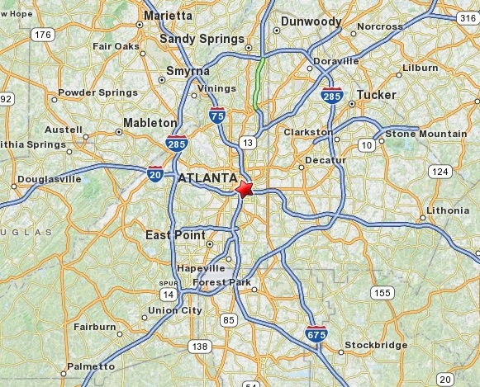
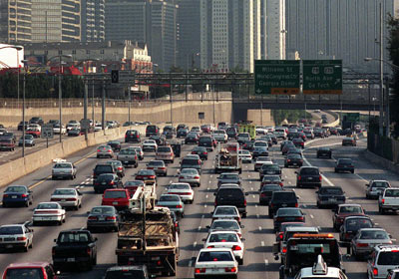
Atlanta Commutes
What’s the mean commute time for workers in metropolitan Atlanta?
Data: The American Housing Survey (AHS) collected data from Atlanta in 2004

Slide 34
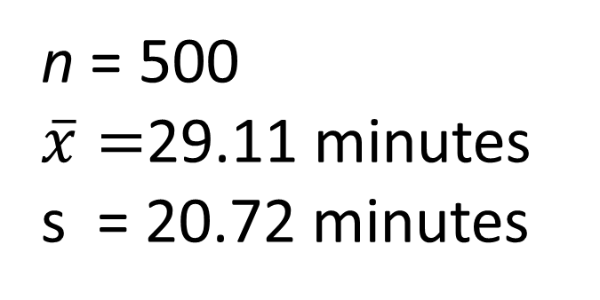
Random Sample of 500 Commutes
Where might the “true” μ be?
WE CAN BOOTSTRAP TO FIND OUT!!!

Slide 35
Original Sample

Slide 36
“Population” = many copies of sample
Sample from this “population”

Slide 37
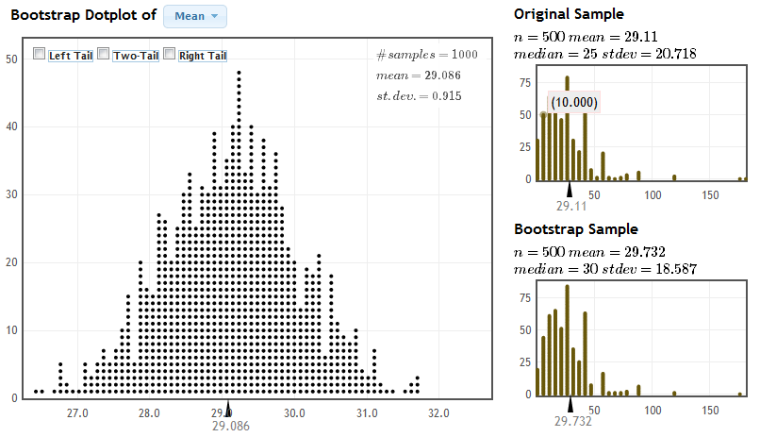
Atlanta Commutes
29.11 ± 2 × 0.915
95% confidence interval for the average commute time for Atlantans:
(a) (28.2, 30.0) (b) (27.3, 30.9) (c) 26.6, 31.8 (d) No idea

Slide 38
Global Warming
What percentage of Americans believe in global warming?
A survey on 2,251 randomly selected individuals conducted in October 2010 found that 1328 answered “Yes” to the question
“Is there solid evidence of global warming?”
www.lock5stat.com/statkey
Source: “Wide Partisan Divide Over Global Warming”, Pew Research Center, 10/27/10. http://pewresearch.org/pubs/1780/poll-global-warming-scientists-energy-policies-offshore-drilling-tea-party

Slide 39
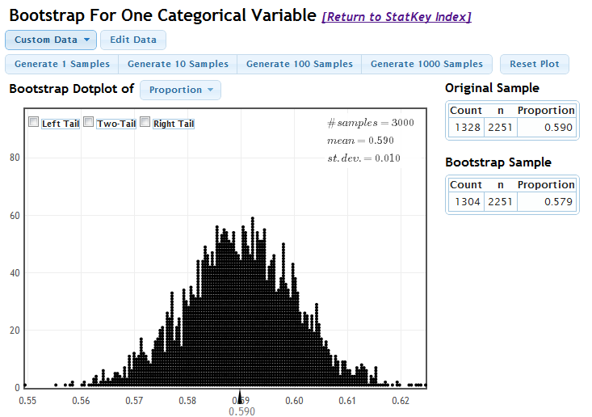
Global Warming
www.lock5stat.com/statkey
We are 95% sure that the true percentage of all Americans that believe there is solid evidence of global warming is between 57% and 61%

Slide 40
Global Warming
Does belief in global warming differ by political party?
“Is there solid evidence of global warming?”
The sample proportion answering “yes” was 79% among Democrats and 38% among Republicans.
(exact numbers for each party not given, but assume n=1000 for each group)
Give a 95% CI for the difference in proportions.
www.lock5stat.com/statkey
Source: “Wide Partisan Divide Over Global Warming”, Pew Research Center, 10/27/10. http://pewresearch.org/pubs/1780/poll-global-warming-scientists-energy-policies-offshore-drilling-tea-party

Slide 41
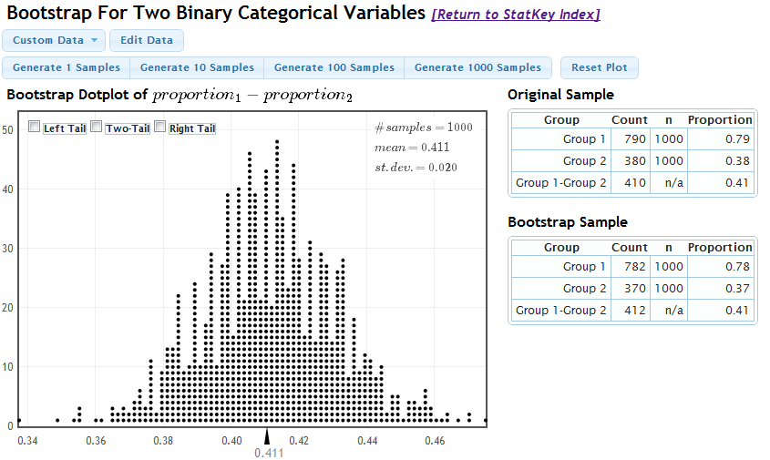
Global Warming
www.lock5stat.com/statkey
We are 95% sure that the difference in the proportion of Democrats and Republicans who believe in global warming is between 0.37 and 0.45.

Slide 42
Global Warming
Based on the data just analyzed, can you conclude with 95% certainty that the proportion of people believing in global warming differs by political party?
(a) Yes
(b) No
Yes. We are 95% confident that the difference is between 0.37 and 0.45, and this interval does not include 0 (no difference)

Slide 43
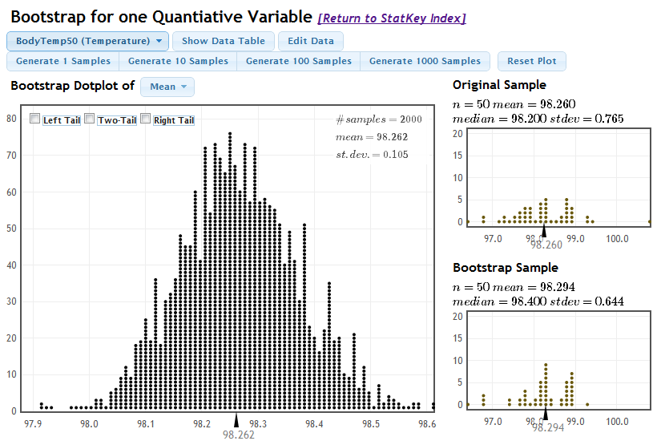
Body Temperature
What is the average body temperature of humans?
www.lock5stat.com/statkey
We are 95% sure that the average body temperature for humans is between 98.05° and 98.47°
98.6° ???
Shoemaker, What's Normal: Temperature, Gender and Heartrate, Journal of Statistics Education, Vol. 4, No. 2 (1996)

Slide 44

Other Levels of Confidence
What if we want to be more than 95% confident?
How might you produce a 99% confidence interval for the average body temperature?

Slide 45
Percentile Method
For a P% confidence interval, keep the middle P% of bootstrap statistics
For a 99% confidence interval, keep the middle 99%, leaving 0.5% in each tail.
The 99% confidence interval would be
(0.5th percentile, 99.5th percentile)
where the percentiles refer to the bootstrap distribution.

Slide 46
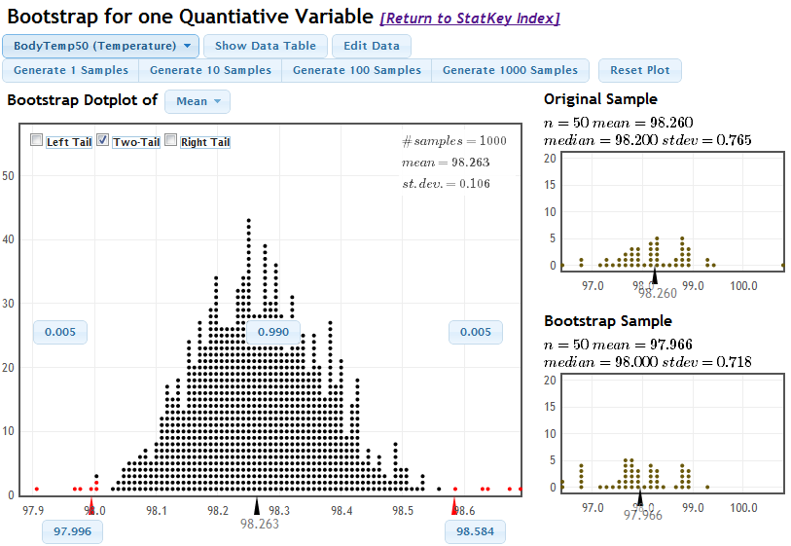
Body Temperature
www.lock5stat.com/statkey
We are 99% sure that the average body temperature is between 98.00° and 98.58°

Slide 47
Level of Confidence
Which is wider, a 90% confidence interval or a 95% confidence interval?
(a) 90% CI
(b) 95% CI
A 95% CI contains the middle 95%, which is more than the middle 90%

Slide 48

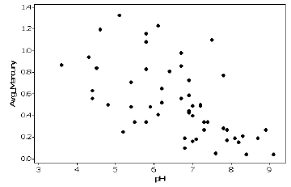

Mercury and pH in Lakes
For Florida lakes, what is the correlation between average mercury level (ppm) in fish taken from a lake and acidity (pH) of the lake?
$$r=−0.575$$
Give a 90% CI for ρ
Lange, Royals, and Connor, Transactions of the American Fisheries Society (1993)

Slide 49
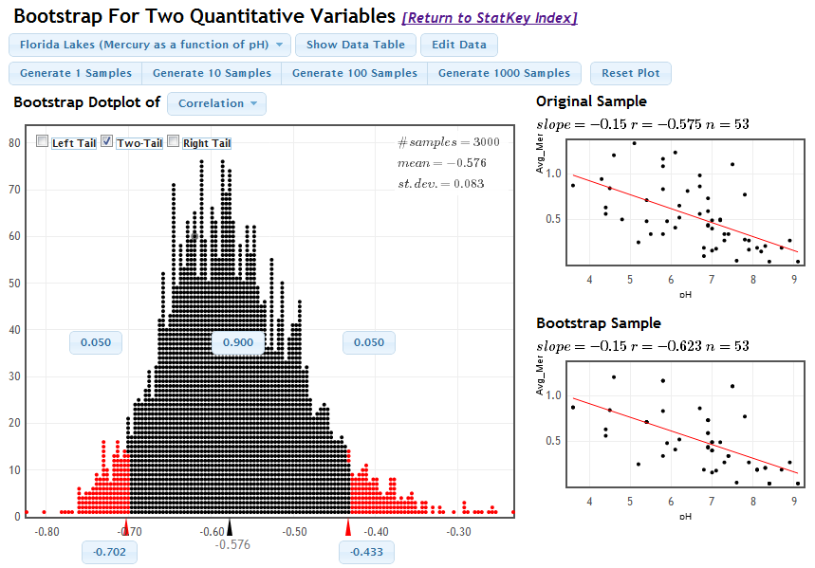
Mercury and pH in Lakes
www.lock5stat.com/statkey
We are 90% confident that the true correlation between average mercury level and pH of Florida lakes is between -0.702 and -0.433.

Slide 50
Bootstrap CI
Option 1: Estimate the standard error of the statistic by computing the standard deviation of the bootstrap distribution, and then generate a 95% confidence interval by
Option 2: Generate a P% confidence interval as the range for the middle P% of bootstrap statistics

Slide 51
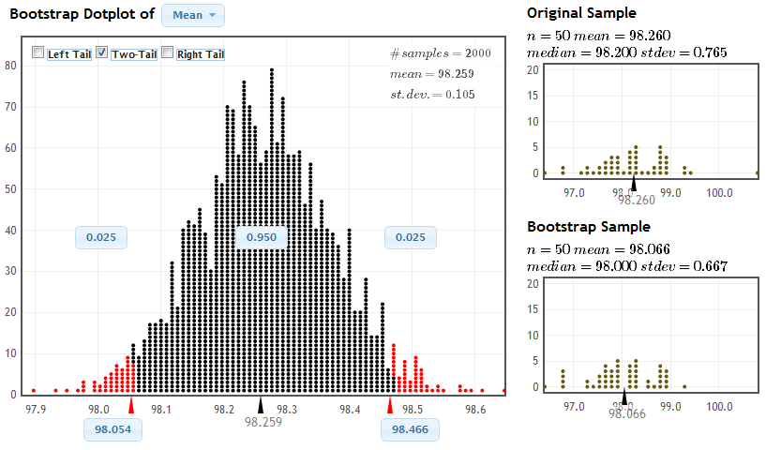
Two Methods for 95%

Slide 52
Two Methods
For a symmetric, bell-shaped bootstrap distribution, using either the standard error method or the percentile method will given similar 95% confidence intervals
If the bootstrap distribution is not bell-shaped or if a level of confidence other than 95% is desired, use the percentile method

Slide 53
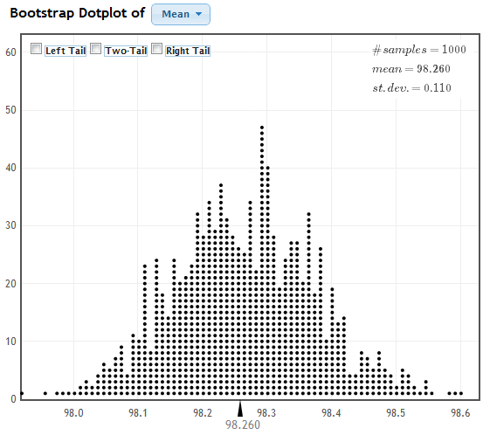
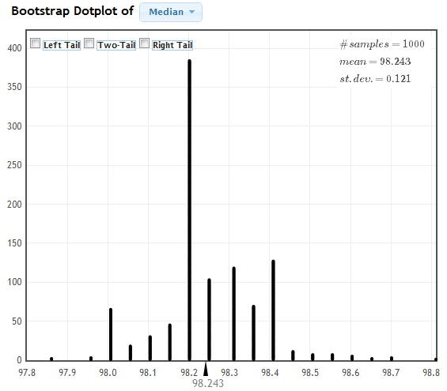
Continuous versus Discrete
A continuous distribution can take any value within some range. The distribution will look like a smooth curve, without any gaps
A discrete distribution only takes certain values. The distribution will be spiky, with gaps.
Continuous
Discrete

Slide 54
Criteria for Bootstrap CI
Using the percentile method for a confidence interval bootstrapping for a confidence interval works for any statistic, as long as the bootstrap distribution is
Approximately symmetric
Approximately continuous
Using the standard error method also requires
Approximately bell-shaped
Always look at the bootstrap distribution to make sure these are true!

Slide 55
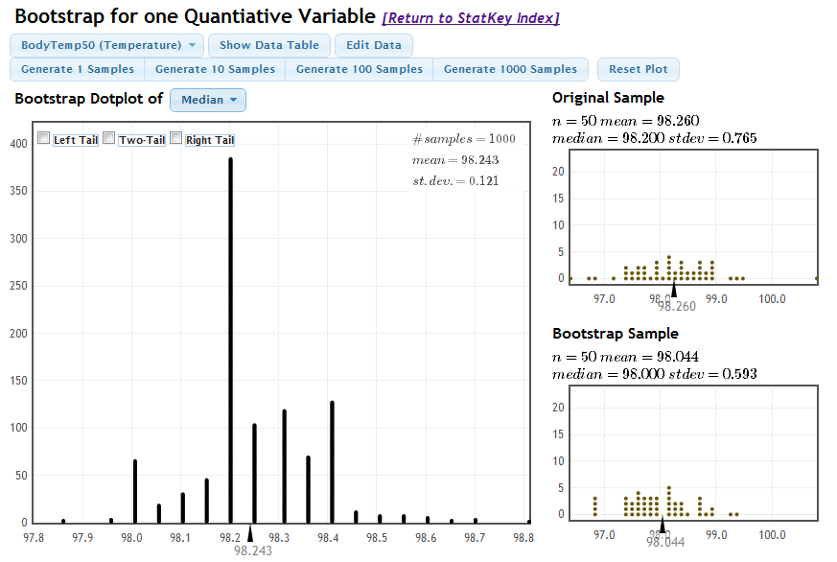
Criteria for Bootstrap CI

Slide 56
Number of Bootstrap Samples
When using bootstrapping, you may get a slightly different confidence interval each time. This is fine!
The more bootstrap samples you use, the more precise your answer will be.
For the purposes of this class, 1000 bootstrap samples is fine. In real life, you probably want to take 10,000 or even 100,000 bootstrap samples

Slide 57
Summary
The standard error of a statistic is the standard deviation of the sample statistic, which can be estimated from a bootstrap distribution
Confidence intervals can be created using the standard error or the percentiles of a bootstrap distribution
Confidence intervals can be created this way for any parameter, as long as the bootstrap distribution is approximately symmetric and continuous

Slide 58
Project 1
Pose a question that you would like to investigate. If possible, choose something related to your major!
Find or collect data that will help you answer this question (you may need to edit your question based on available data)
You can choose either a single variable or a relationship between two variables

Slide 59
Project 1
The result will be a five page paper including
Description of the data collection method, and the implications this has for statistical inference
Descriptive statistics (summary stats, visualization)
Confidence intervals
Hypothesis testing
Proposal due 9/27
Can submit earlier if want feedback sooner
Include data if you are using existing data
If collecting your own data, proposal should include a detailed data collection plan

Slide 60
Data for Project 1
Collect your own data
Representative sample?
Randomized experiment?
Use existing data
Internet!
Ongoing research in your home department
http://library.duke.edu/data/

Slide 61
To Do
Read Sections 3.3, 3.4
Do Homework 3 (due Tuesday, 9/25)
Idea and data for Project 1 (proposal due 9/27)

