Slide 1
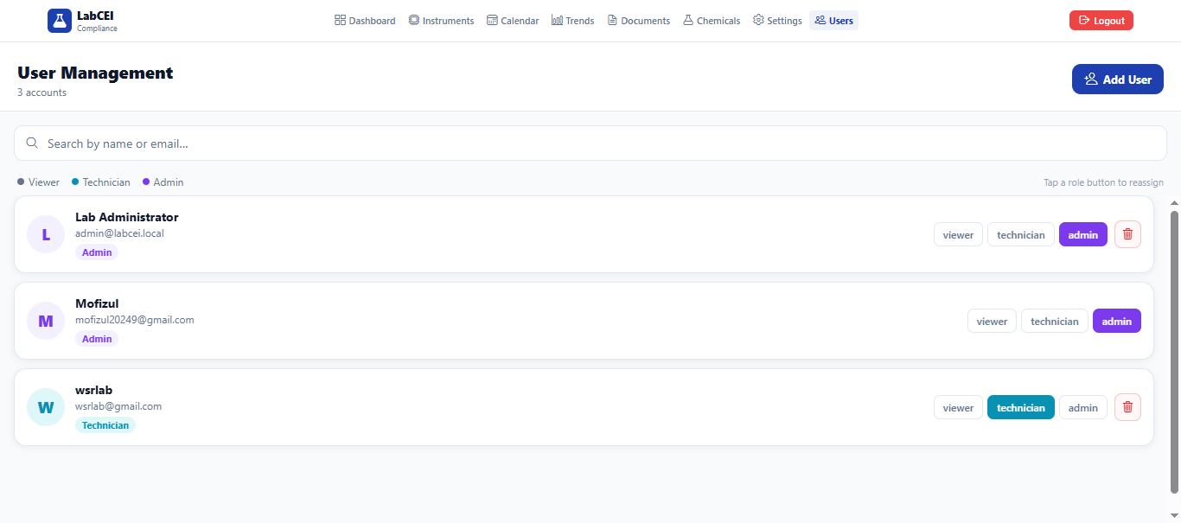
User
Now
Requirement
User management is OK.
The main issue is the localhost. We need to configure the Wi-Fi to cover the entire laboratory.
Both HRMS user credentials (username and password) and manually created user accounts should work.

Slide 2
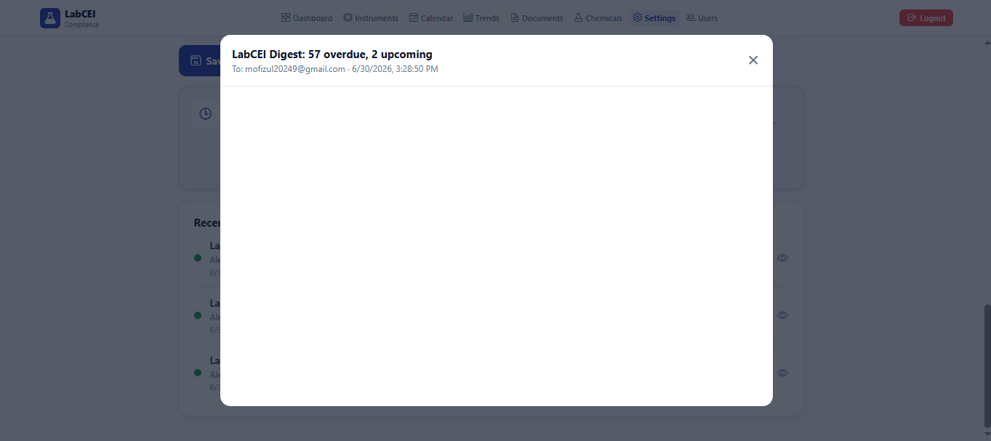
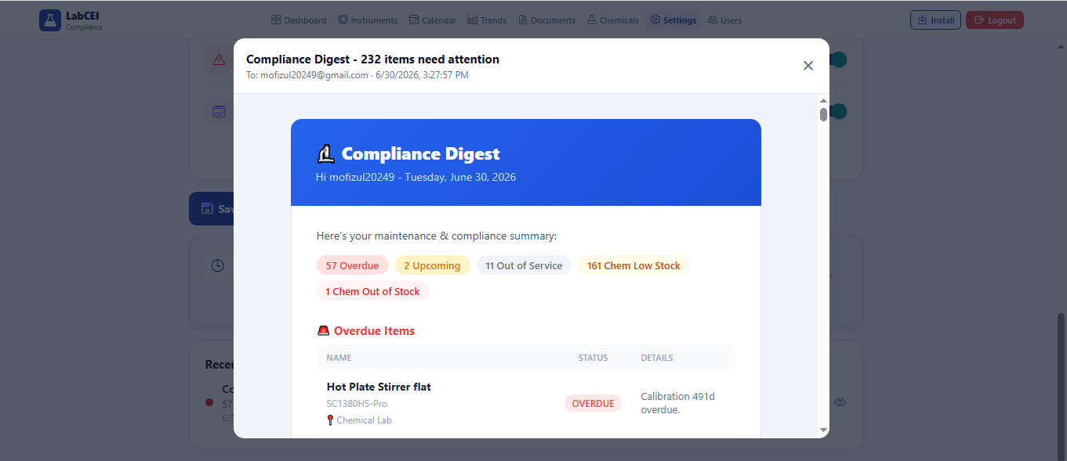
Setting
Now
Requirement

Slide 3
Setting
Now
Requirement
Automated Scheduling: "Run Digest for All Users" and "Send Notification" should work properly.

Slide 4
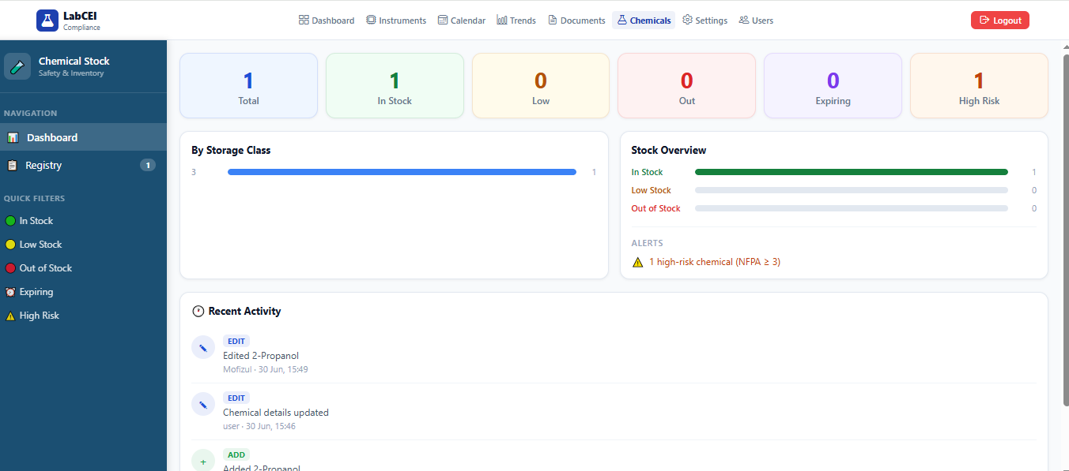
Chemical
Now
Requirement
ok

Slide 5
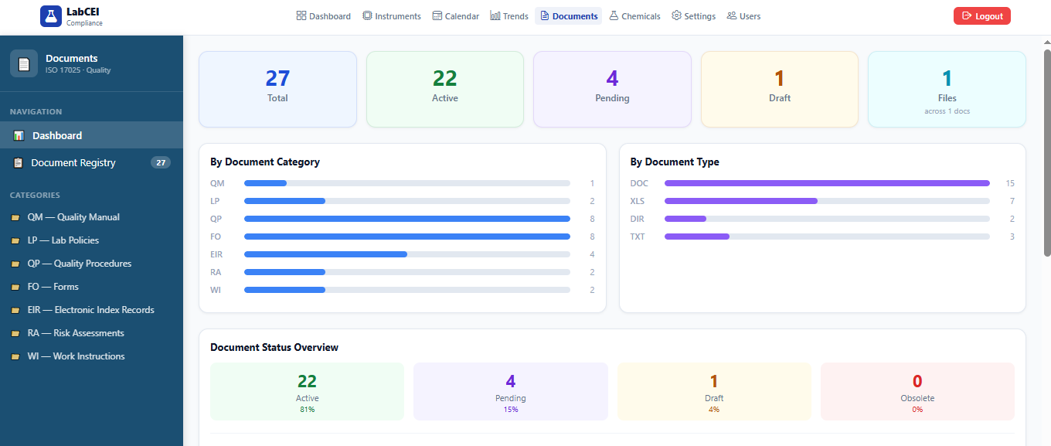
Documents
Now
Requirement
Ok

Slide 6
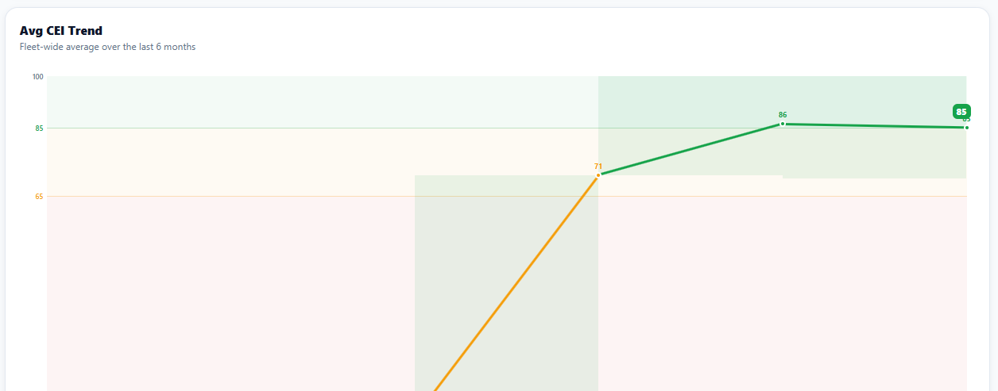
Trends
Now
Requirement
Average trend missing

Slide 7
Trends
Now
Requirement
The average trend should be added.

Slide 8
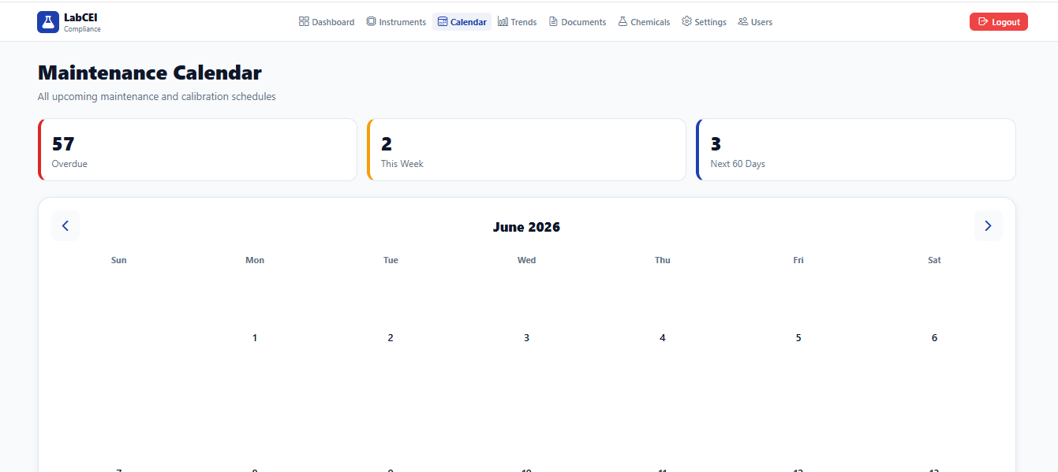
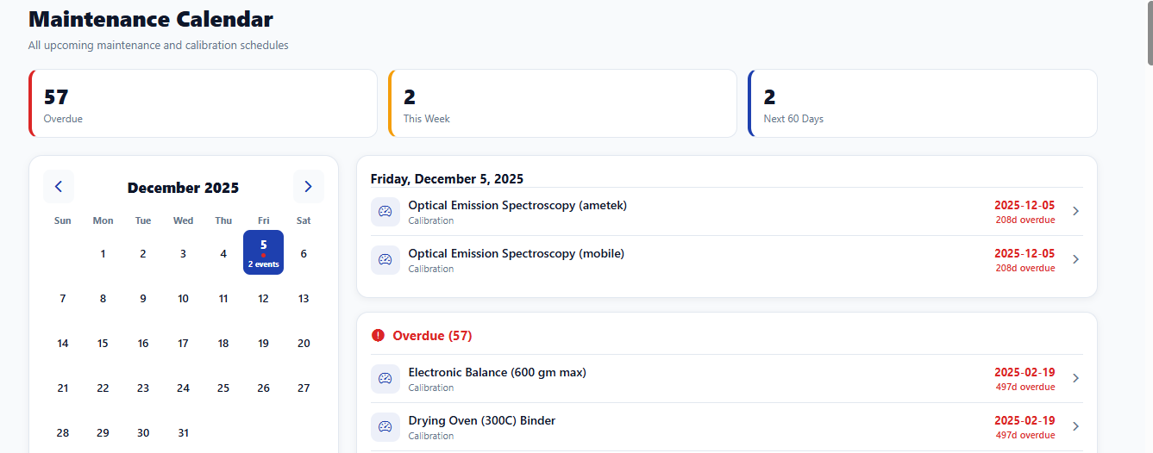
Calendar
Now
Requirement

Slide 9
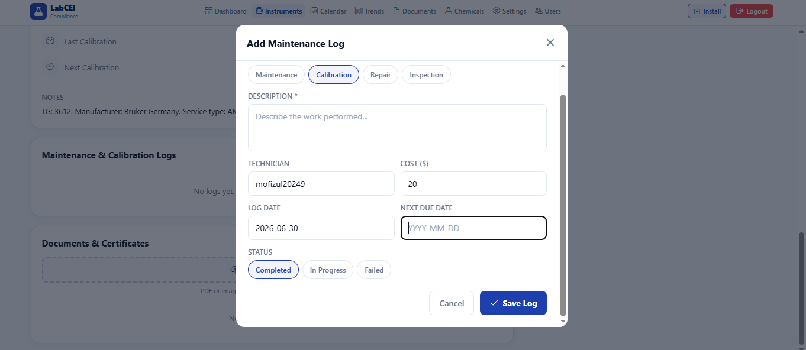
Instruments
Now
Requirement
A clickable calendar should be added to select the date.

Slide 10
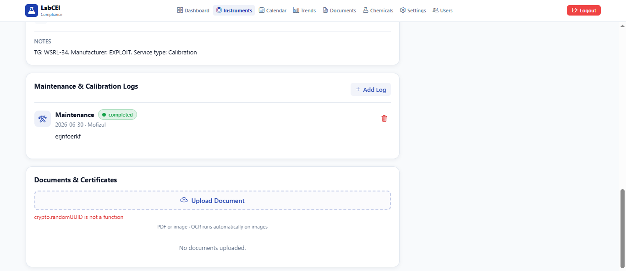
Instruments
Now
Requirement
The document upload feature with OCR should work properly.

Slide 11
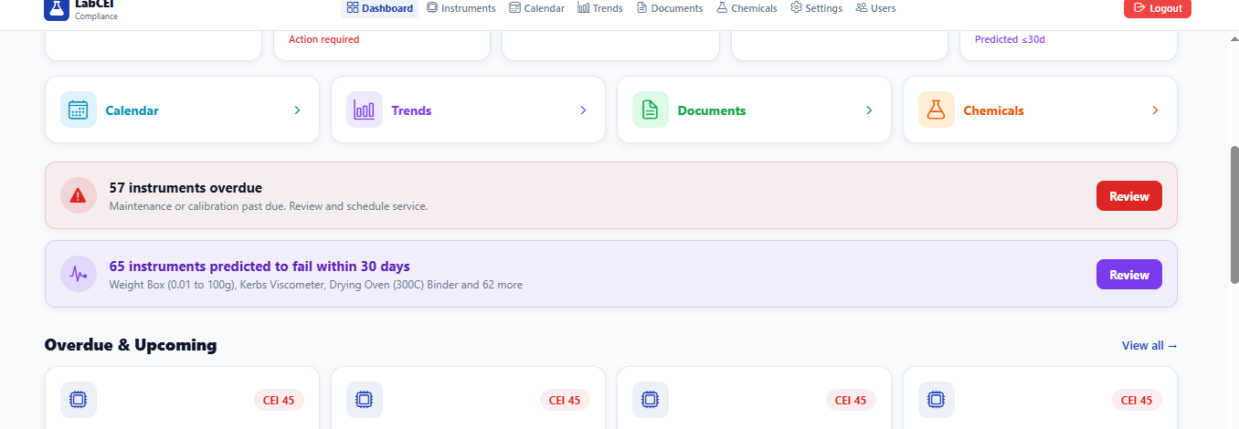
Dashboard
Now
Requirement
Clicking "Review" should redirect with the appropriate filter applied, not show all records.

Slide 12

Dashboard
Now
Requirement
Absent
An Install button should be added for mobile app installation.

Slide 13
AI Function
Now
Requirement
Now ok
We will verify the functionality after entering real data and reviewing the details.

