Slide 1


SMART INDIA HACKATHON 2025
"PM-AJAY Connection" -
One Nation, One Dashboard for Agency Mapping
Problem Statement ID –25153
Problem Statement Title-Mapping of Implementing and Executing Agencies across PM- AJAY Components
Theme- Smart Automation
PS Category- Software
Team ID –65856
Team Name - DarshanGo

Slide 2

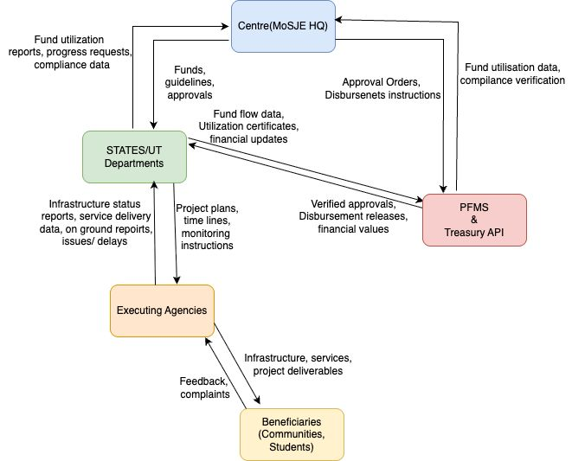
"PM-AJAY Connection" - One Nation, One Dashboard for Agency Mapping
Your Team Name
PROPOSED SOLUTION:
Central Agency Repository: All implementing & executing agencies are housed in a searchable central database.
Dynamic Mapping Dashboard: Interactive state/UT-wise map to track projects, agencies, funds, and timelines.
Upwork/task-based workflows: Using digital tools, roles are established to define tasks, deadlines, and where to escalate.
Smart Communications Hub: Built-in messaging & notifications from Centre - State - Agencies.
Time-sensitive Fund-Flow Checkpoint: Visual checkpoint for approvals, releases, and utilizations certificates.
Analytics / Reporting : AI tracked preformance including progress alerts for bottlenecks and compliance scores.
UNIQUENESS:
First integrated system covering all 3 components of PM-AJAY.
Accountability graph at every level from state through village.
Purpose built for transparency, inclusivity, and rapid decision making.
PROCESS FLOW

Slide 3
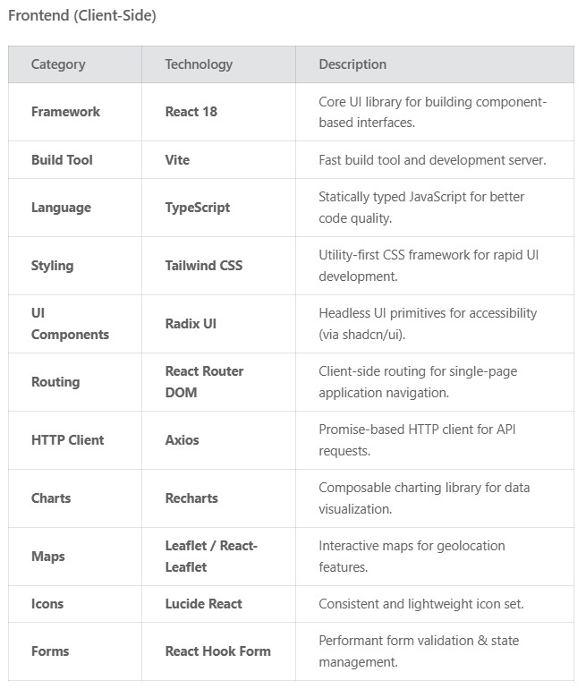
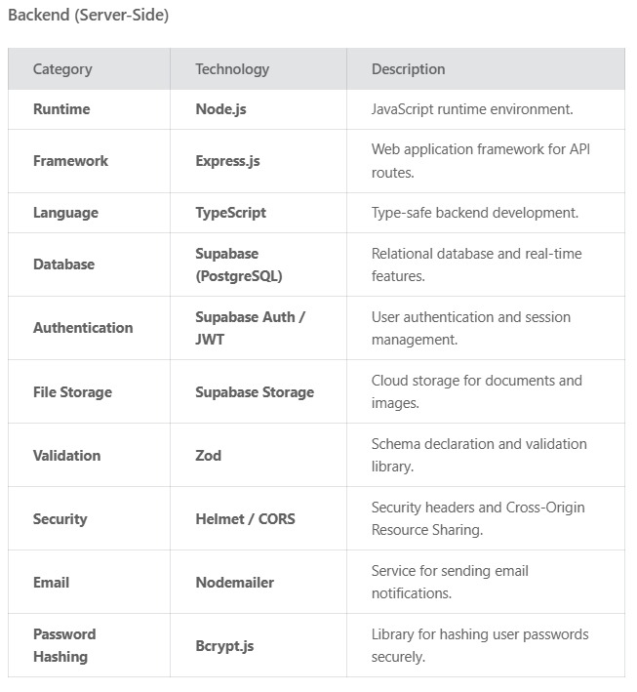
TECHNICAL APPROACH
Your Team Name

Slide 4
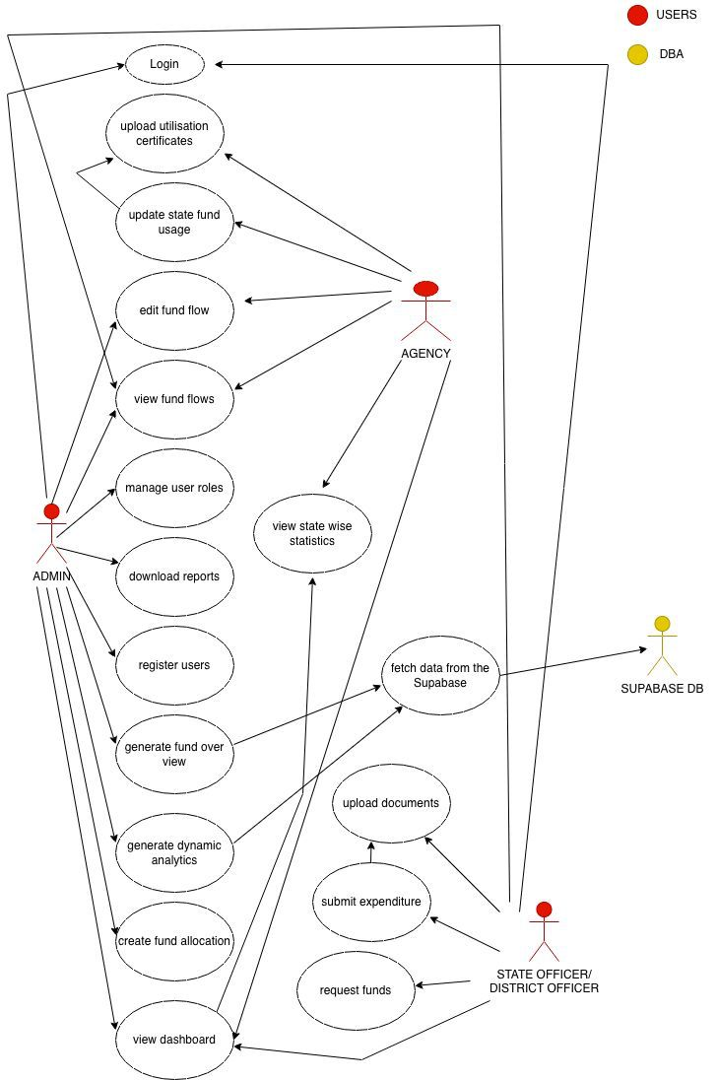
USECASE DIAGRAM
Your Team Name

Slide 5
FEASIBILITY AND VIABILITY
Your Team Name
Feasibility | Viability
Digital Stacks Utilizes government digital tools such as DigiLocker, PFMS, and API-based tools, all of which facilitate seamless sharing of data with the Centre, States, and agencies. GIS and Cloud Technology Based on established GIS dashboards and cloud-based technology that can scale with no new hardware requirements required. Real time Sync Built for areas with better connectivity, the system automatically syncs. | Economic Guarantees low infrastructure expenditure by utilizing a clod-pay-as-you-go model and is easily scaleable for other central schemes. Social Enables State and UT administrations to enhance development in villages and have an improved service delivery to communities. Administrative Digitizes approvals and fund transfers to reduce paperwork, as well as provide a single, transparent source of truth. Sustainability Utilizes a government-owned open-API platform to easily enable further expansion and onboarding of future welfare schemes.

Slide 6
IMPACT AND BENEFITS
Your Team Name
IMPACT
For MoSJE & States:
Increased project visibility and fund tracking in real time.
A reduced approval time, and quicker decision-making.
Accountability with a digital audit trail in place.
For Implementing Agencies:
More defined task allocation & reminders for timelines.
Less duplication of effort & paperwork.
For Communities / Beneficiaries:
Faster project completion, with schools, hostels and upgraded villages sooner.
A transparent way of showing how funds are spent enhances trust in the governance.
FUTURE SCOPE:
AI chatbots .
Blockchain-based ledger
Inter-scheme Integration
Expansion to other socio-justice schemes.
BENEFITS
🟩 Operational Benefits 1.Single destination mapping 2.Swifter communication 3.Intelligent funding visibility | 🟩 Benefits of Governance & Transparency 1.Open and Transparent 2.Better Decision-making 3.Audit-ready tracking

Slide 7
RESEARCH AND REFERENCES
Your Team Name
Ministry of Social Justice & Empowerment: https://socialjustice.gov.in
PFMS Portal: https://pfms.nic.in
NIC: https://www.nic.in
Open Government Data Platform: https://data.gov.in
Digital India: https://www.digitalindia.gov.in
PM GatiShakti: https://pmgatishakti.gov.in/pmgatishakti/login

