Slide 1
Motion Field Estimation using MRF
Anil Kumar Batra

Slide 2
Agenda
What is Edge Flow?
MRF
Belief Propagation
Edge Flow using MRF and Belief Propagation
Tools Used for Edge Flow
Results on Synthetic Images
Results on Natural Images

Slide 3
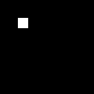
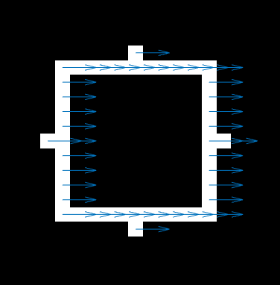

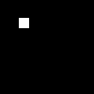
Edge Flow
Motion of Image edges is called Edge Flow

Slide 4
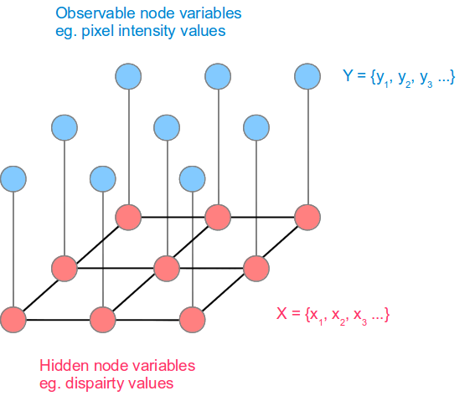
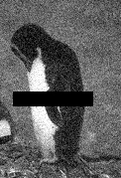

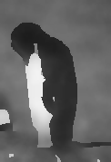
Markov Random Field

Slide 5
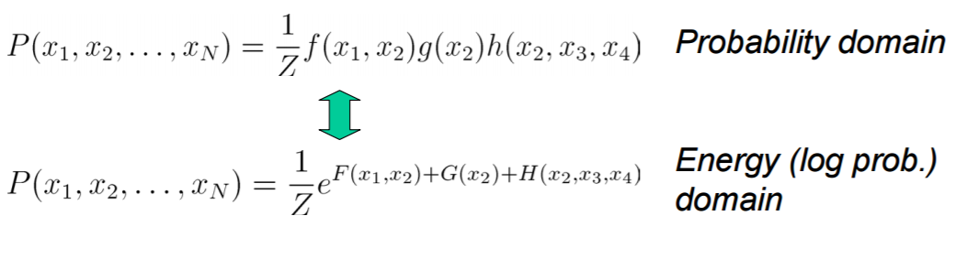
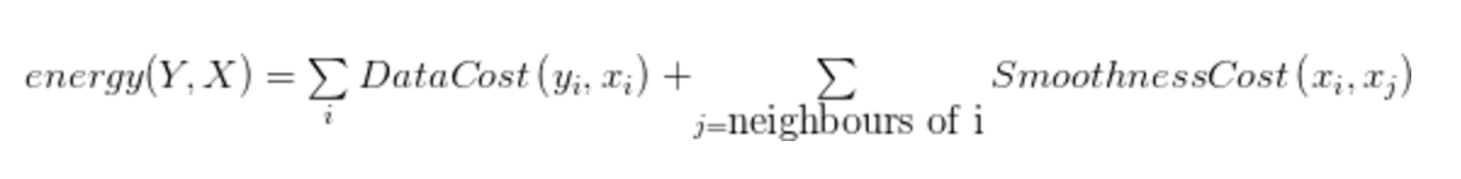
Markov Random Field

Slide 6
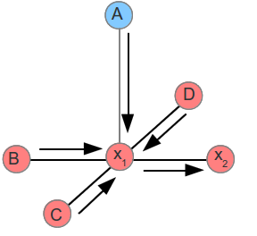
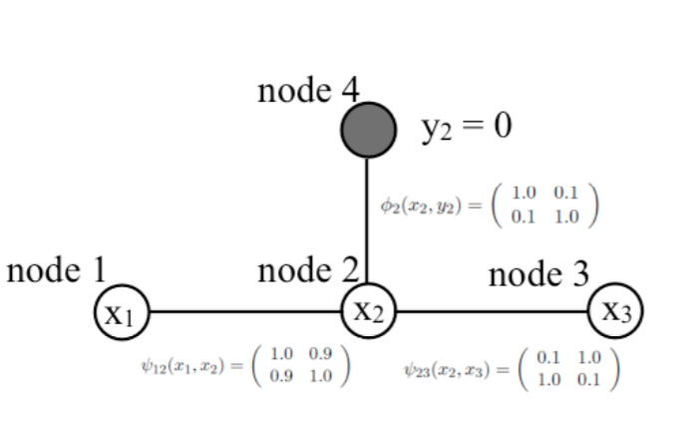
Belief Propagation

Slide 7
Edge Flow Using MRF & BP
Data Cost
Sum of Squared Differences
Smoothness Term
Dot Product of Velocity Vectors

Slide 8
Tools Used
OpenCV 3.2, 64 Bit
Matlab 2016b
Yaml – To Read openCV yml in Matlab

Slide 9
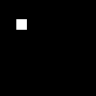
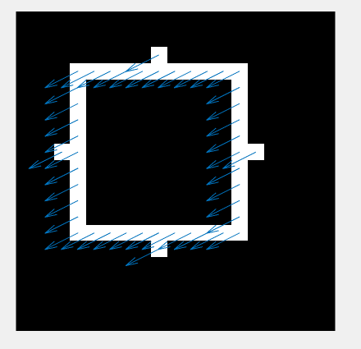
Results on Synthetic Image

Slide 10
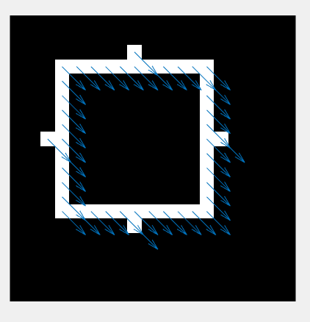
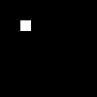
Results on Synthetic Image

Slide 11
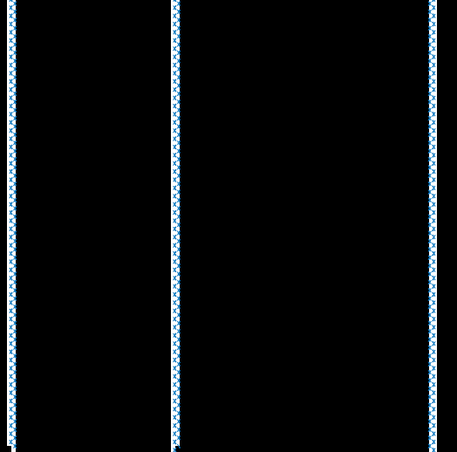
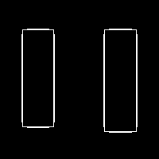


Results on Synthetic Image

Slide 12
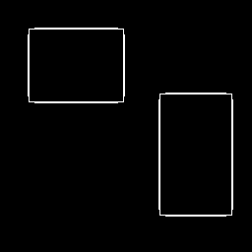

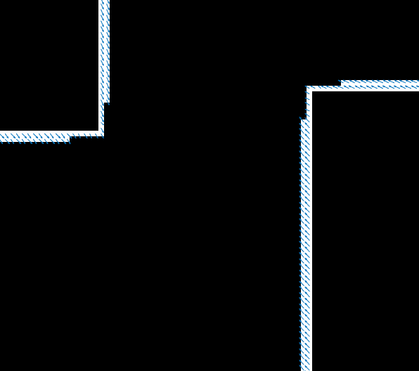

Results on Synthetic Image

Slide 13
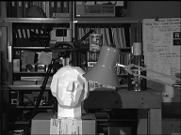
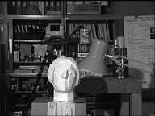
Results on Natural Images
Stereo Image

Slide 14
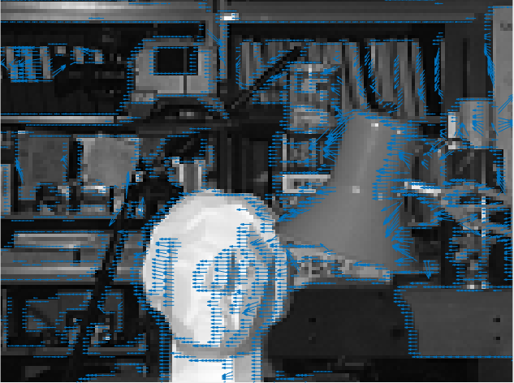
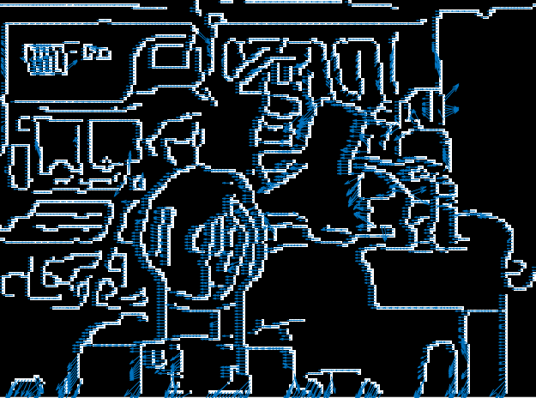
Results on Natural Image

Slide 15
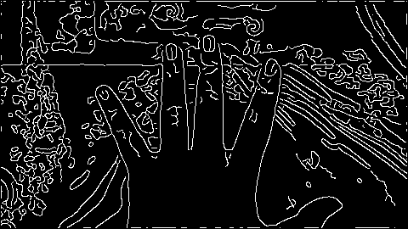
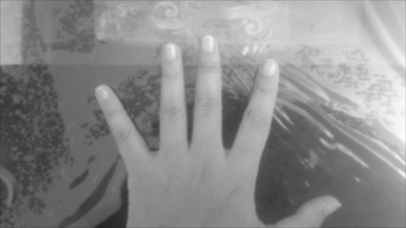
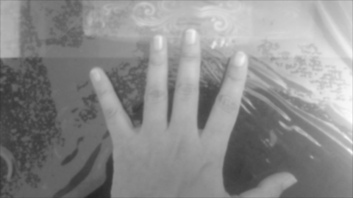
Results of Natural Image

Slide 16
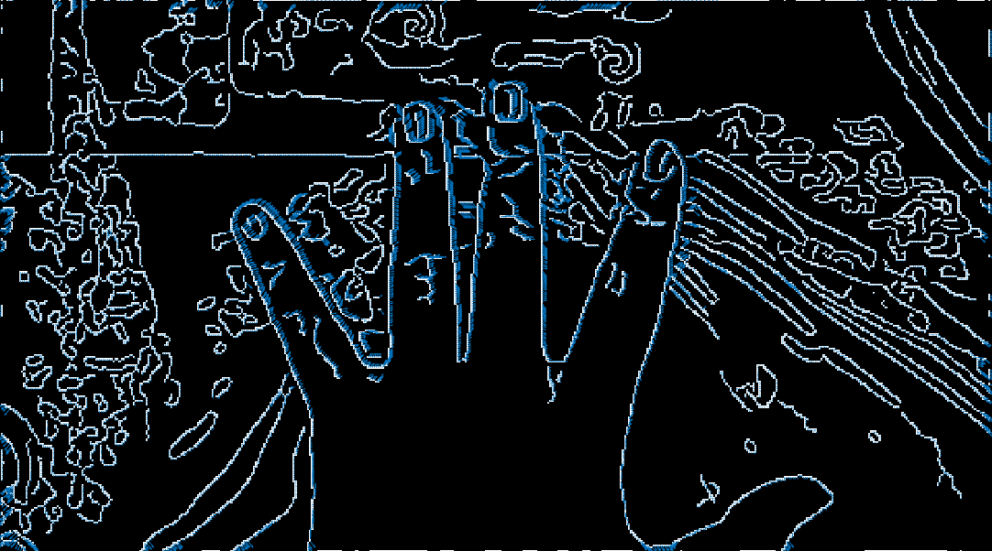

Slide 17
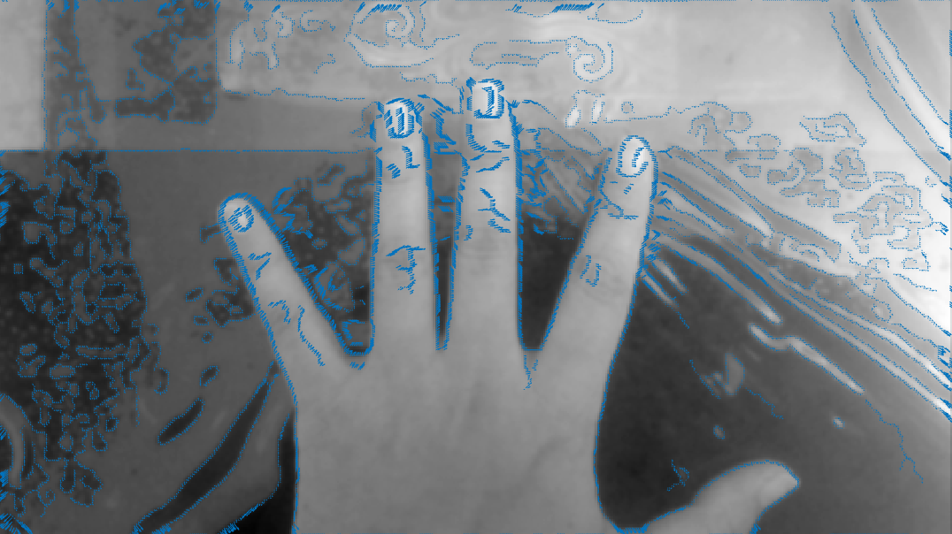

Slide 18
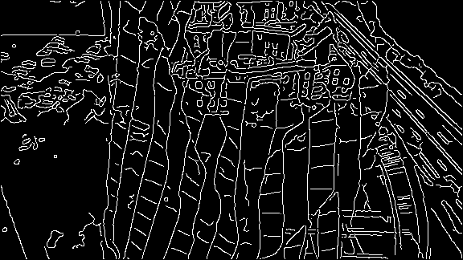
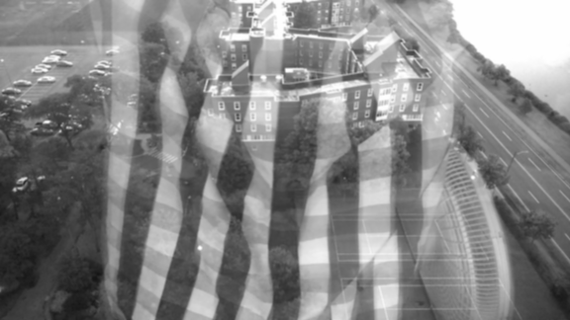
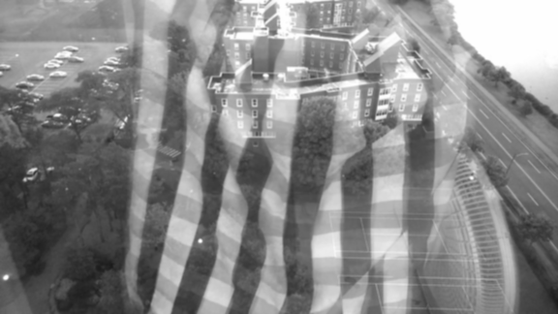
Results of Image with Reflections

Slide 19
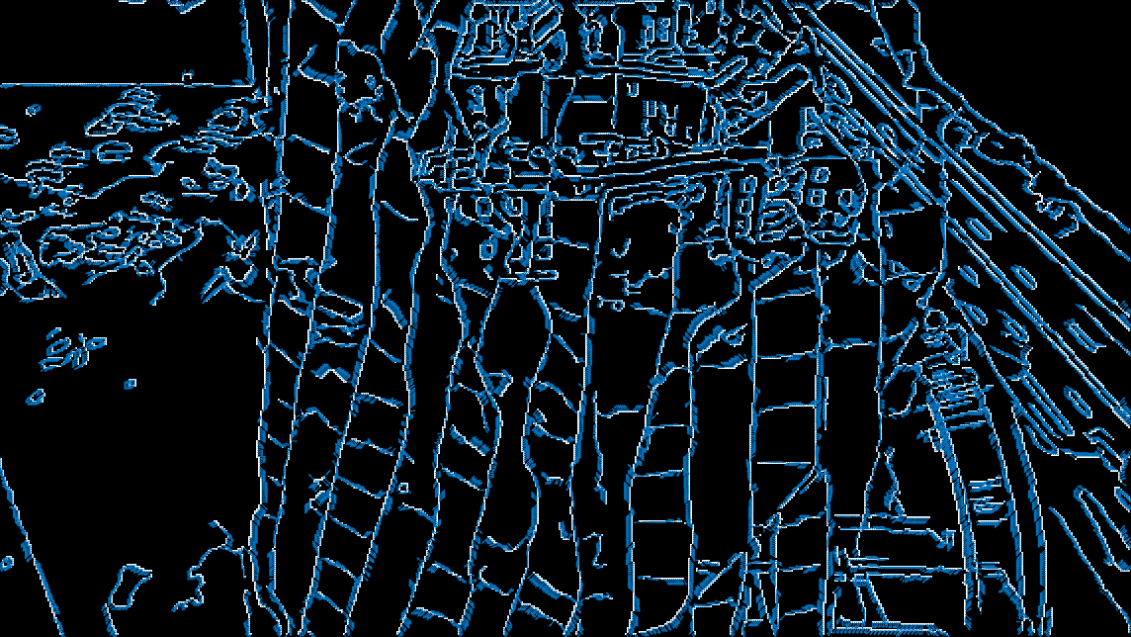

Slide 20
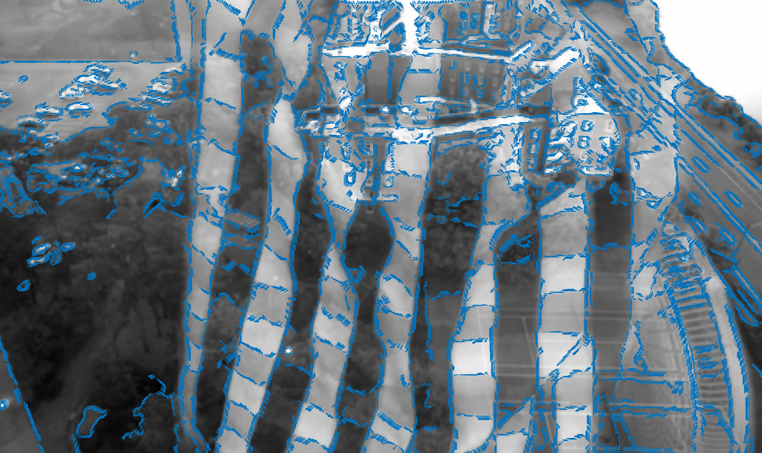

Slide 21
References
A Computational Approach for Obstruction-Free Photography – SIGGRAPH 2015, Michael Rubinstein, Ce Liu, William T. Freeman, Tianfan Xue
Ce Liu Motion Estimation Lectures – 19 & 20 (http://people.csail.mit.edu/torralba/courses/6.869/lectures/)
LOOPY BELIEF PROPAGATION, MARKOV RANDOM FIELD, STEREO VISION (http://nghiaho.com/?page_id=1366#LBP)
MRF Minimization (http://vision.middlebury.edu/MRF/)
Image-Based Rendering in the Gradient Domain, Johannes Kopf
Christopher Bishop MLSS 2013 (https://www.youtube.com/watch?v=c0AWH5UFyOk&t=2931s)

