Slide 1

Vue.js
The Progressive JavaScript Framework

Slide 2




Section 02 Team 06
Anil Bomma Omkar Abhiteja
Bharat Reddy Yugandhar Rao

Slide 3
JavaScript can
React to events & create new events
Modify the DOM: Change/Remove/Add all HTML elements & attributes & CSS styles.
provide logic, animations, calculations
call web services
and more....

Slide 4



JavaScript frameworks

Slide 5
Why Vue?
Vue.js is an easy addition that enables two-way data binding.
Vue is more accessible than the others.
Vue is light weight.
Vue is progressive framework.

Slide 6
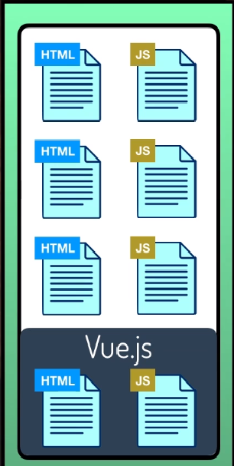
Wait..
What is a progressive Framework?
Add vue to only one part of an already
existing web app
Or if you really like it, vue has the got all
the content you need(libraries and
eco-system) to make it completely based on vue.

Slide 7
#CDN <!-- development version, includes helpful console warnings --> <script src="https://cdn.jsdelivr.net/npm/vue/dist/vue.js"></script> <!-- production version, optimized for size and speed --> <script src="https://cdn.jsdelivr.net/npm/vue"></script> #NPM npm install vue #CLI https://cli.vuejs.org/
Use it in your app

Slide 8
Vue Components
Components are one of the most powerful features used in Vue.js.
Components can have their own state, markup and style.
Components can be used multiple times and a new instance will get created on using it every time.
There is no negative effect by using components on the entire system.

Slide 9
Components continued..
Components can be used in 4 different ways:
new Vue()
vue.component()
.vue
Using local components.
Components can be registered in 2 types:
global
local
Components can be created using the command vue.extend()
Syntax: const MyComponents = vue.extend() ({ ....... })

Slide 10
Vue.extend()
There are 2 special cases used in Vue.extend, they are:
data (the inputs, defined in your HTML with the 'v-model' attribute)
el (short for HTML element for this component)
"is" a special attribute is used in case of a custom element
<tr is= 'my-component'></tr>

Slide 11
<div id="app"> {{ message }} </div> const app = new Vue({ el: '#app', data: { message: 'Hello World!' } })
The Hello world app in vue.js

Slide 12
Vue Directives
v-model:
The v-model vue directive allows us to create a two-way binding. You can bind a form input element for example, and make it change the vue data property when the user changes the content of the field.
<input v-model="message" placeholder="Enter a message"> <p>Message is: {{ message }}</p>
v-model.lazy (update when the change event occurs).
v-model.trim (automatically removes whitespace).
v-model.number (accept a number instead than a string).

Slide 13
Vue Directives contd..
v-on:
We can use the v-on directive to listen to DOM events and run some JavaScript when they’re triggered
<div id="example-1">
<button v-on:click="counter += 1">Add 1</button>
<p>The button above has been clicked {{ counter }} times.</p>
</div>
v-bind:
It is one way data binding, means you can only bind data to input element but can't change bounded data changing input element. v-bind is used to bind html attribute
<input type="text" v-bind:class="abc" v-bind:value="">
<a v-bind:href="home/abc" > click me </a>

Slide 14
Vue Directives contd..
V-if:
The directive v-if is used to conditionally render a block. The block will only be rendered if the directive’s expression returns a true value.
<h1 v-if="awesome">Vue is awesome!</h1>
It is also possible to add an “else block” with v-else:
<h1 v-if="awesome">Vue is awesome!</h1> <h1 v-else>Oh no 😢</h1>
V-show:
Another option for conditionally displaying an element is the v-show directive. The usage is largely the same:
<h1 v-show="ok">Hello!</h1>

Slide 15
Vue Directives contd..
Few more to look out for-
v-text
v-ref
v-transition
v-pre
v-el
Find more about them here https://012.vuejs.org/guide/directives.html

Slide 16
Oops..
Quiz Time

Slide 17
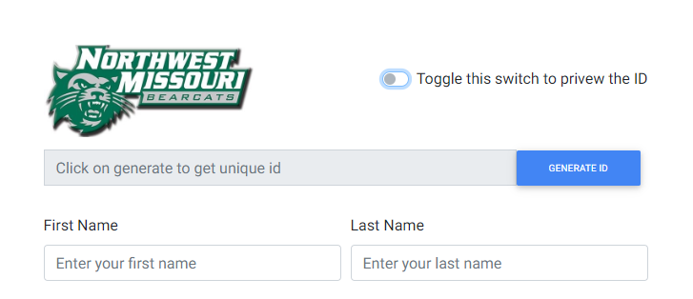
Just kidding, it’s demo time
You can access our application using the url:
https://yugimamidi.github.io/44-563-Sec-02-6-VueJs/

Slide 18
Questions?

Slide 19
References
https://vuejs.org/
https://v1.vuejs.org/guide/syntax.html
https://github.com/denisecase/js-gui-vue
https://docs.google.com/presentation/d/1a2JwLOXVX2-A_wDDyFt3lFqqfYQXNni7eVLkkKO7AqA/edit#slide=id.g647ae5a787_4_19

Slide 20
Thanks for bearing with us.
Your feedback is valuable

