Slide 1
CI/CD Intro
Jesse Aalberg

Slide 2
Continuous Integration
Continuous Integration (CI) is a development practice where developers integrate code into a shared repository frequently, preferably several times a day. Each integration can then be verified by an automated build and automated tests. While automated testing is not strictly part of CI it is typically implied.
One of the key benefits of integrating regularly is that you can detect errors quickly and locate them more easily. As each change introduced is typically small, pinpointing the specific change that introduced a defect can be done quickly.
Notes:
Source:
https://codeship.com/continuous-integration-essentials

Slide 3
Continuous Delivery
Continuous Delivery (CD) is the practice of making sure your software is always production ready throughout its entire lifecycle. Beyond making sure your application passes automated tests it has to have all the configuration necessary to push it into production using a fully automated process in a matter of seconds or minutes
Notes:
Source:
https://codeship.com/continuous-integration-essentials

Slide 4
Continuous Deployment
Continuous Deployment (CD) refers to automatically releasing to the production environment if the latest version passes all automated tests.
Notes:
Source:
https://continuousdelivery.com/2010/08/continuous-delivery-vs-continuous-deployment/
https://codeship.com/continuous-integration-essentials

Slide 5

CI/CD
Just keep deploying

Slide 6
CI/CD
Continuous Deployment and Continuous Delivery have developed as best-practices for keeping your application deployable at any point or even pushing your main codebase automatically into production whenever new changes are brought into it. This allows your team to move fast while keeping high quality standards that can be checked automatically.
This approach results in the ability to rapidly, reliably and repeatedly push out enhancements and bug fixes at low risk and with minimal manual overhead.

Slide 7
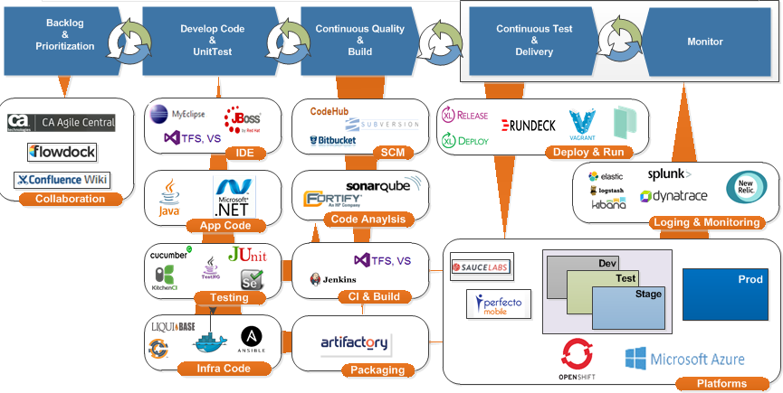
OSAM Continuous Delivery & Quality
source: https://hubconnect.uhg.com/groups/osam-continuous-delivery-quality
Notes:
Source: https://hubconnect.uhg.com/groups/osam-continuous-delivery-quality

Slide 8
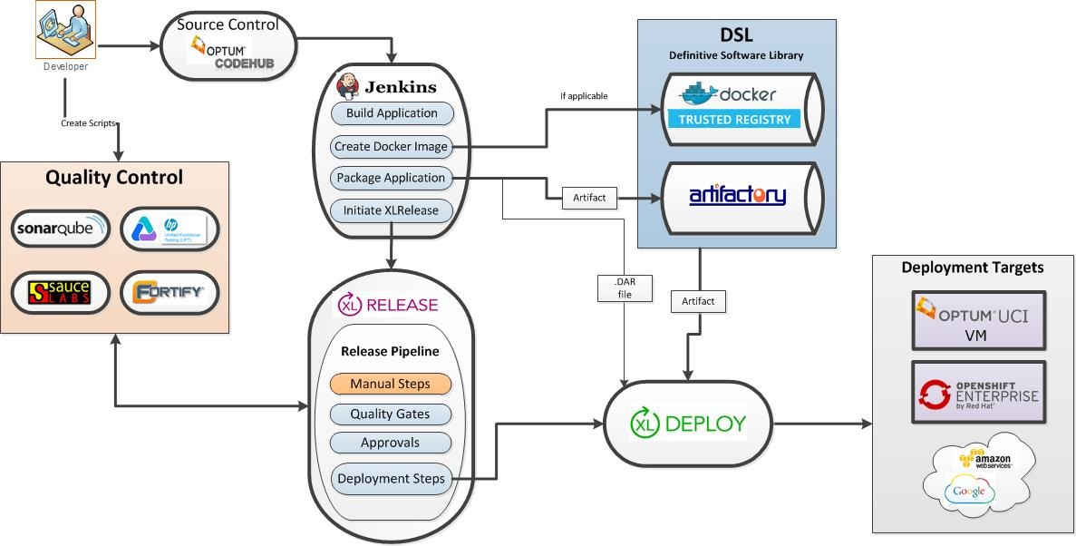
Optum Enterprise Tech CI/CD Services
Notes:
Source: https://hubconnect.uhg.com/docs/DOC-75599

Slide 9
Getting Started Cheat Sheet
Source Code Management
Git on CodeHub
Team Foundation Server (.NET)
Build Services
Maven
Artifactory
Jenkins
Team Foundation Server (.NET)
Deployment Management
XLDeploy
Team Foundation Server (.NET)
Release Management
XLRelease
Team Foundation Server (.NET)
Cloud
OpenShift Enterprise
Windows Azure Pack (.NET)

Slide 10
Resources
Getting Started
Agile Development Center
OSAM User Group
Continuous Integration Services User Group
CI/CD @ DevDays ‘16
Tools Overview
Agile Delivery Training Curriculum
SS&MO
Consulting/Support
DevOps Tools & Services
Advanced
Optum Quality Central
PaaS Development Center
Container Development
Misc
Choosing the Right PaaS
Strategic Enterprise Software
Development Tools & Standards

Slide 11
Thank you.
Jesse Aalberg
Software Developer Advocate
tel: 952.294.9244

