Slide 1
WebServices

Slide 2
Agenda
What is a Webservice ?
RestFul Webservice
Demo of RestFul Webservive
Soap Webservice
Demo of Soap Webservice
RestFul vs Soap Webservice
API implementation using Swagger

Slide 3
RestFul Webservice
REST - Representational State Transfer

Slide 4
What is REST ?
REST is a term coined by Roy Fielding to describe an architecture style of networked systems. REST is an acronym standing for Representational State Transfer.

Slide 5
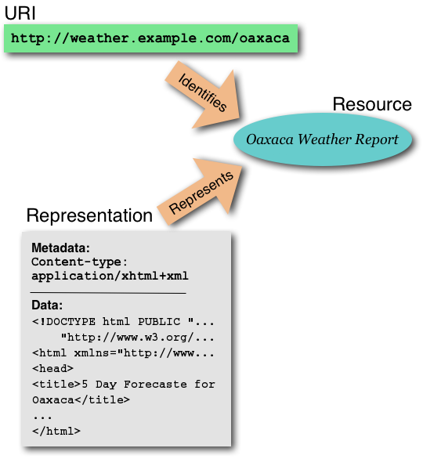
What is REST ?
Resource
URI-Uniform Resource Identifier (or URL)
Web Page (HTML Page)

Slide 6
Why is it called Representational State Transfer ?
Client
http://weather.example.com/oaxaca
Resource
OaxacaWeather.html

Slide 7
Why is it called Representational State Transfer ?
"Representational State Transfer is intended to evoke an image of how a well-designed Web application behaves: a network of web pages (a virtual state-machine), where the user progresses through an application by selecting links (state transitions), resulting in the next page (representing the next state of the application) being transferred to the user and rendered for their use."
Roy Fielding.

Slide 8
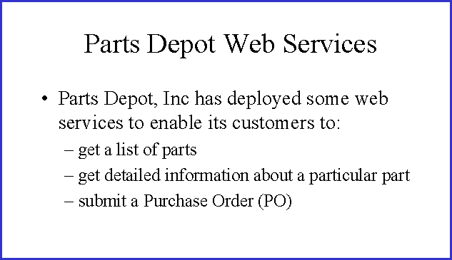
REST way of Implementing the web services

Slide 9
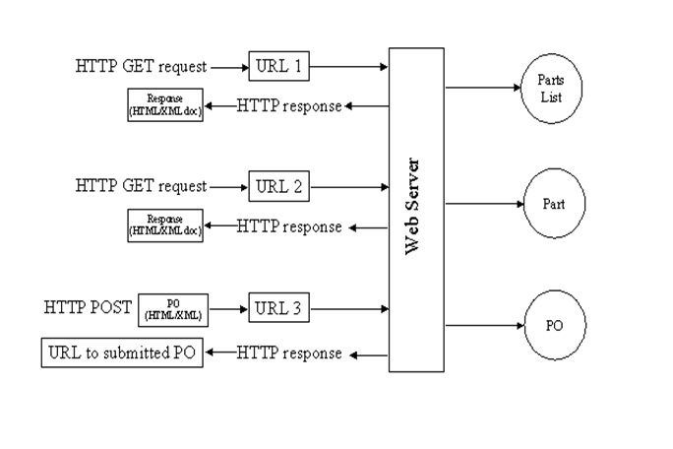
REST way of Implementing the web services

Slide 10
Service – Get parts list
The web service makes available a URL to a parts list resource
Client uses : http://www.parts-depot.com/parts
Document Client receives :
<?xml version="1.0"?>
<p:Parts xmlns:p="http://www.parts-depot.com" xmlns:xlink="http://www.w3.org/1999/xlink">
<Part id="00345" xlink:href="http://www.parts-depot.com/parts/00345"/>
<Part id="00346" xlink:href="http://www.parts-depot.com/parts/00346"/>
<Part id="00347" xlink:href="http://www.parts-depot.com/parts/00347"/>
<Part id="00348" xlink:href="http://www.parts-depot.com/parts/00348"/>
</p:Parts>

Slide 11
Service – Get detailed part data
The web service makes available a URL to each part resource.
Client uses : http://www.parts-depot.com/parts/00345
Document Client receives :
<?xml version="1.0"?>
<p:Part xmlns:p="http://www.parts-depot.com" xmlns:xlink="http://www.w3.org/1999/xlink">
<Part-ID>00345</Part-ID>
<Name>Widget-A</Name>
<Description>This part is used within the frap assembly</Description>
<Specification xlink:href="http://www.parts-depot.com/parts/00345/specification"/> <UnitCost currency="USD">0.10</UnitCost>
<Quantity>10</Quantity>
</p:Part>

Slide 12
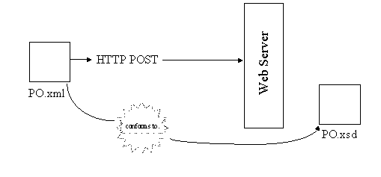
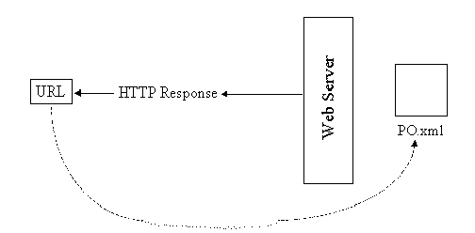
Service – Submit purchase order (PO)
The web service makes
available a URL to submit a PO.
1)The client creates a PO instance
document (PO.xml)
2)Submits the PO.xml(HTTP POST)
3)PO service reponds with a URL
to the submitted PO.

Slide 13
Characteristics of a REST based network
Client-Server: a pull-based interaction style(Client request data from servers as and when needed).
Stateless: each request from client to server must contain all the information necessary to understand the request, and cannot take advantage of any stored context on the server.
Cache: to improve network efficiency, responses must be capable of being labeled as cacheable or non-cacheable.
Uniform interface: all resources are accessed with a generic interface (e.g., HTTP GET, POST, PUT, DELETE).
Named resources - the system is comprised of resources which are named using a URL.
Interconnected resource representations - the representations of the resources are interconnected using URLs, thereby enabling a client to progress from one state to another.

Slide 14
Principles of REST web service design
Identify all the conceptual entities that we wish to expose as services. (Examples we saw include resources such as : parts list, detailed part data, purchase order)
Create a URL to each resource.
Categorize our resources according to whether clients can just receive a representation of the resource (using an HTTP GET), or whether clients can modify (add to) the resource using HTTP POST, PUT, and/or DELETE).
All resources accessible via HTTP GET should be side-effect free. That is, the resource should just return a representation of the resource. Invoking the resource should not result in modifying the resource.
Put hyperlinks within resource representations to enable clients to drill down for more information, and/or to obtain related information.
Design to reveal data gradually. Don't reveal everything in a single response document. Provide hyperlinks to obtain more details.
Specify the format of response data using a schema (DTD, W3C Schema, RelaxNG, or Schematron). For those services that require a POST or PUT to it, also provide a schema to specify the format of the response.
Describe how our services are to be invoked using either a WADL document, or simply an HTML document.

Slide 15
DEMO
Creating a Simple Restful Webservice

Slide 16
SOAP Web Service
SOAP Web Services

Slide 17
What is a SOAP Web Service ?
SOAP defines the XML-based message format that Web service-enabled applications use to communicate and inter-operate with each other over the Web.
The heterogeneous environment of the Web demands that applications support a common data encoding protocol and message format.
SOAP is a standard for encoding messages in XML that invoke functions in other applications.
SOAP specifies exactly how to encode an HTTP header and an XML file so that a program in one computer can call a program in another computer and pass along information.
SOAP also specifies how the called program can return a response.
SOAP Web Services follow specifications given by a committee.
If a Web Service fails to follow even one specification specified by a committee it is not qualified as a SOAP Web Service.

Slide 18
Universal Description Discovery Integration < UDDI >
Consumer Application
UDDI
Provider Application
WSDL
methodName
inputArgs
returnType
WSDL
methodName
inputArgs
returnType
WSDL
methodName
inputArgs
returnType
gets
Registers

Slide 19
Understanding WSDL
definitions
types
messages
portType
operation
operation
binding
operation
service
port

Slide 20
Marshalling
Language specific Datatypes
< Java >
XML Datatypes

Slide 21
Java - XML Marshalling < Primitive data types >
Java Type | XML Type
boolean | xsd:boolean
byte | xsd:byte
short | xsd:short
int | xsd:int
long | xsd:long
float | xsd:float
double | xsd:double
String | xsd:string
BigInteger | xsd:integer
BigDecimal | xsd:decimal
Calendar | xsd:dateTime
Date | xsd:dateTime

Slide 22
Java - XML Marshalling < User defined data types >
Java Type | XML Type
JavaBean | <xsd:complexType>
java.util.Collection | Literal Array
java.util.List | Literal Array
java.util.ArrayList | Literal Array
java.util.LinkedList | Literal Array
java.util.Vector | Literal Array
java.util.Stack | Literal Array
java.util.Set | Literal Array
java.util.TreeSet | Literal Array
java.utils.SortedSet | Literal Array
java.utils.HashSet | Literal Array

Slide 23
Unmarshalling
XML Datatypes
Language Specific Datatypes
< Java >

Slide 24
XML – Java Unmarshalling < Primitive data types >
XML Type | Java Type
xsd:boolean | boolean
xsd:byte | byte
xsd:short | short
xsd:int | int
xsd:long | long
xsd:float | float
xsd:double | double
xsd:string | String
xsd:integer | BigInteger
xsd:decimal | BigDecimal
xsd:dateTime | Calendar
xsd:dateTime | Date

Slide 25
XML – Java Unmarshalling < User defined data types >
XML Type | Java Type
<xsd:complexType> with elements of both simple and complex types. | JavaBean
<xsd:complexType> with simple content. | JavaBean
<xsd:attribute> in <xsd:complexType> | Property of a JavaBean
<xsi:nil> and <xsd:nillable | Java null value
<xsd:list> | Array of the list data type.
<xsd:anyType> | java.lang.Object
< xsd:any> | javax.xml.soap.SOAPElement or org.apache.xmlbeans.XmlObject
< xsd:any[]> | javax.xml.soap.SOAPElement[] or org.apache.xmlbeans.XmlObject[]

Slide 26
General SOAP structure
SOAP Message
Envelope
Header
Body
Fault

Slide 27
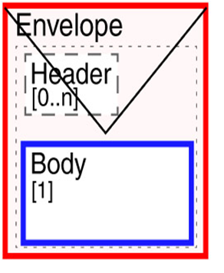
General SOAP structure

Slide 28
To summarize
Web services
Data types marshalling & unmarshalling
JAXB
Web services Description
WSDL
Web Services Discovery
UDDI
Web services Understand
SOAP
Web Services SOAP Message
Transport Protocol
HTTP

Slide 29
Web Service Provider Components
Application Server
Web Application
WSDL
WSDL
Generation
Tool
Service Endpoint
Interface
< SEI >
Skeleton
HTTP / SOAP Request
SOAP Request
HTTP / SOAP Response
SOAP Response
web.xml
Web Service
Deployment Descriptor
Implementation Class
< SEI Implementation >

Slide 30
Web Service Consumer Components
Application Server
Web Application
WSDL
Stub Generation Tool
Stub
Generated Classes
Client Class
SOAP
Request
HTTP/SOAP Request
SOAP
Response
HTTP/SOAP Response

Slide 31
DEMO
Creating a Simple SOAP Webservice

Slide 32
RestFul vs Soap Webservice
SOAP stands for Simple Object Access Protocol. REST stands for Representational State Transfer.
SOAP is a XML based messaging protocol and REST is not a protocol but an architectural style.
SOAP has a standard specification but there is none for REST.
Whole of the web works based on REST style architecture. Consider a shared resource repository and consumers access the resources.
Even SOAP based web services can be implemented in RESTful style. REST is a concept that does not tie with any protocols.
SOAP is distributed computing style and REST is web style (web is also a distributed computing model).
REST messages should be self-contained and should help consumer in controlling the interaction between provider and consumer(example, links in message to decide the next course of action). But SOAP doesn’t has any such requirements.
REST does not enforces message format as XML or JSON or etc. But SOAP is XML based message protocol.

Slide 33
RestFul vs Soap Webservice
REST follows stateless model. SOAP has specifications for stateful implementation as well.
SOAP is strongly typed, has strict specification for every part of implementation. But REST gives the concept and less restrictive about the implementation.
Therefore REST based implementation is simple compared to SOAP and consumer understanding.
SOAP uses interfaces and named operations to expose business logic. REST uses (generally) URI and methods like (GET, PUT, POST, DELETE) to expose resources.
SOAP has a set of standard specifications. WS-Security is the specification for security in the implementation. It is a detailed standard providing rules for security in application implementation. Like this we have separate specifications for messaging, transactions, etc. Unlike SOAP, REST does not has dedicated concepts for each of these. REST predominantly relies on HTTPS.
Above all both SOAP and REST depends on design and implementation of the application.

