Slide 1


Cloud Computing using AWS
C. Edward Chow
Notes:
©2005 Microsoft Corporation. All rights reserved.
This presentation is for informational purposes only. Microsoft makes no warranties, express or implied, in this summary.

Slide 2

Outline of the Talk
Introduction to Cloud Computing
AWS EC2
EC2 API
A Case Analysis on using AWS
Future Directions
Advanced Internet & Web Systems
chow
Notes:
©2005 Microsoft Corporation. All rights reserved.
This presentation is for informational purposes only. Microsoft makes no warranties, express or implied, in this summary.

Slide 3

Cloud Computing: XaaS Terms
CaaS, IaaS, MaaS, NaaS, PaaS, TaaS
SaaS: Software as a Service. eg. google doc/group, Microsoft cloud services, iCloud?
PaaS: Platform as a Service. Amazon EC2
  Windows 2008 $0.12/hr (server license included)
  Linux $0.085/hr
  Small instance: 1.7GB, 1 virtual core, 160GB, 32bits
  24x7 Power, AC, Rack, Space, Security Guard paid!!
  Six locations world wide; Singapore, Tokyo, Ireland, ..
IaaS: Infrastructure as a Service, CU UIS hosted by host.com. Vmware supports IaaS
StaaS: Storage as a Service. Carbonite ($59/yr), Amazon S3 (0.14/GB, month; 0.01/1000reqs)
Freshmen Welcome 8/20/2011
Edward Chow
Notes:
Carbonie $59/yr home (All user-generated files on internal hard drive, after 200GB backup speed will be slow!!, $229/yr small business (all computers; $250 GB)
XaaS → pronounced as zaas.

Slide 4
Public Cloud vs. Private Cloud
Amazon: “poor man’s public cloud”
HP/Microsoft: Enterprise Public Cloud
GoDaddy: What type of public cloud is this?
How do we define these terms?
Integrated Cloud and research issues
Advanced Internet & Web Systems
chow

Slide 5

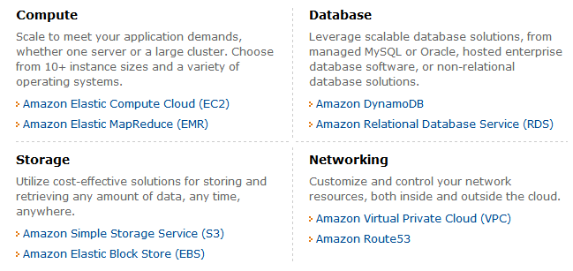
Amazon Web Services (AWS)
Advanced Internet & Web Systems
chow

Slide 6
Amazon EC2 Functionality
Select a pre-configured, templated image to get up and running immediately. Or create an Amazon Machine Image (AMI) containing your applications, libraries, data, and associated configuration settings.
Configure security and network access on your Amazon EC2 instance.
Choose which instance type(s) and operating system you want, then start, terminate, and monitor as many instances of your AMI as needed, using the web service APIs or the variety of management tools provided.
Determine whether you want to run in multiple locations, utilize static IP endpoints, or attach persistent block storage to your instances.
Pay only for the resources that you actually consume, like instance-hours or data transfer.
Advanced Internet & Web Systems
chow

Slide 7

Elastic
Elastic – Amazon EC2 enables you to increase or decrease capacity within minutes, not hours or days.
  You can commission one, hundreds or even thousands of server instances simultaneously.
  controlled with web service APIs, application can automatically scale itself up and down depending on its needs.
Elastic Block Store vs. local Disk (not backup)
Elastic IP Addresses vs. Static IP Addresses
  Interesting charging scheme; you are charged when not using it
  programmatically remapping your public IP addresses to any instance in your account
Advanced Internet & Web Systems
chow

Slide 8
Security
Amazon EC2 includes web service interfaces to configure firewall settings that control network access to and between groups of instances.
When launching Amazon EC2 resources within Amazon Virtual Private Cloud (Amazon VPC), you can isolate your compute instances by specifying the IP range you wish to use, and connect to your existing IT infrastructure using industry-standard encrypted IPsec VPN.
You can also choose to launch Dedicated Instances into your VPC. Dedicated Instances are Amazon EC2 Instances that run on hardware dedicated to a single customer for additional isolation.
Advanced Internet & Web Systems
chow

Slide 9
Cost Saving Considerations
On-Demand Instances – On-Demand Instances let you pay for compute capacity by the hour with no long-term commitments. This frees you from the costs and complexities of planning, purchasing, and maintaining hardware and transforms what are commonly large fixed costs into much smaller variable costs.
Reserved Instances – Reserved Instances give you the option to make a low, one-time payment for each instance you want to reserve and in turn receive a significant discount on the hourly charge for that instance.
Spot Instances – Spot Instances allow customers to bid on unused Amazon EC2 capacity and run those instances for as long as their bid exceeds the current Spot Price.
Advanced Internet & Web Systems
chow

Slide 10
EC2 Features
Multiple Locations: Regions/Availability Zones
  8 regions: US East (Northern Virginia), US West (Oregon), US West (Northern California), EU (Ireland), Asia Pacific (Singapore), Asia Pacific (Tokyo), South America (Sao Paulo),
  Inexpensive, low latency network connectivity to other Availability Zones in the same Region, 99.95% SLA.
Amazon Virtual Private Cloud –secure and seamless bridge between a company’s existing IT infrastructure and the AWS cloud.
Amazon CloudWatch
Auto Scaling
Elastic Load Balancing
HPC Clusters
VM Import
Advanced Internet & Web Systems
chow

Slide 11
Instance Types
1EC2CU: equivalent of 1.0-1.2GHz 2007 Opteron or 2007 Xeon processor
Standard Instances:
  Small: 1.7GBmem, 1EC2Compute Unit (EC2CU), 160GB local instance storage(lis), 32/64bits.
  Medium: 3.75 GBmem, 2EC2CU, 410GBlis, 32/64bits.
  Large: 7.5GBmem, 4EC2CU, 850GBlis, 64bits
  Extra Large: 15GBmem, 8EC2CU, 1690GBlis, 64bits.
Micro Instances: 613MBmem, 2ECUs, EBS
High-Memory Instances: 17.1, 34.2, 68.4GBs.
High-CPU Instances (5EC2CU or 20EC2CU)
Cluster GPU Instances (22GBmem, 33.5EC2CU, 2xNVIDIA Tesla “Fermi” M2050 GPUs, 1690GBlis, 10GEthernet.
Advanced Internet & Web Systems
chow

Slide 12
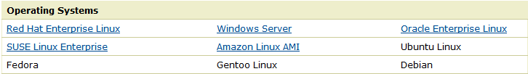
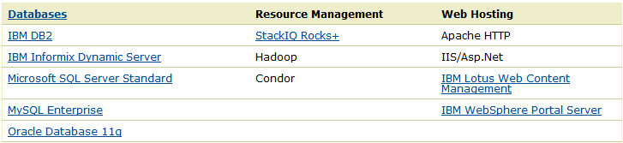
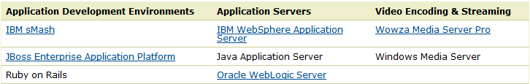
OS and Software
Amazon Machine Images (AMIs) are preconfigured with an ever-growing list of operating systems (win2008OS including in price!!).
Advanced Internet & Web Systems
chow

Slide 13
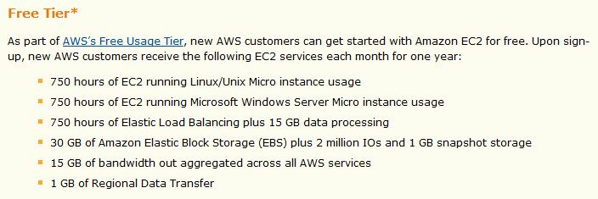

Enticing New Customers
Advanced Internet & Web Systems
chow

Slide 14
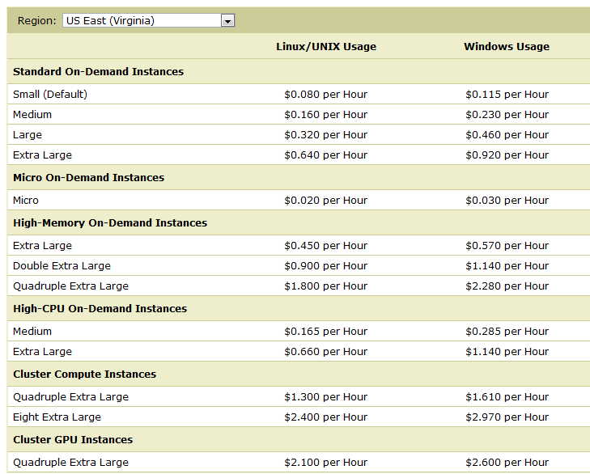
Pricing: On-Demand Instance
Advanced Internet & Web Systems
chow

Slide 15
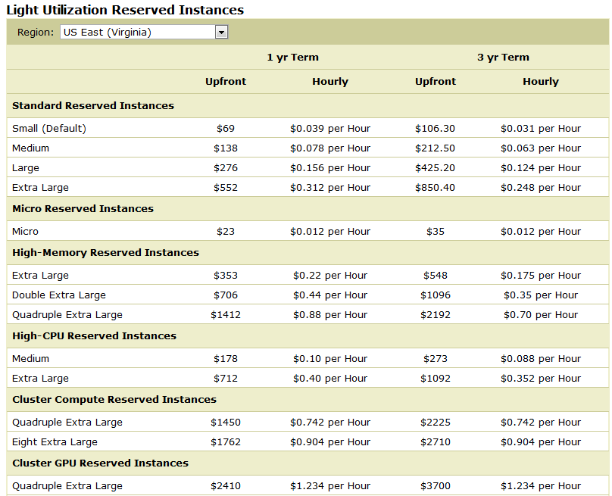
Pricing: Reserved Instances
Advanced Internet & Web Systems
chow

Slide 16
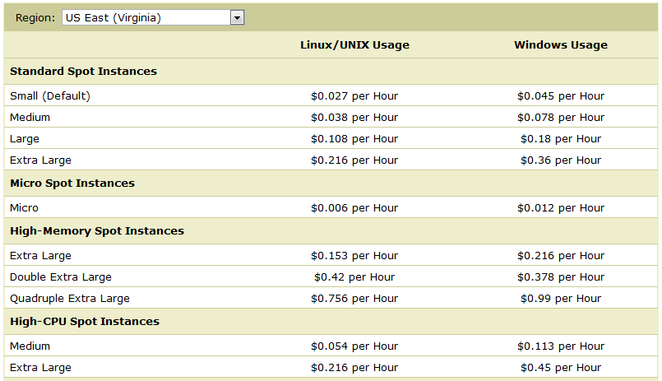
Spot Instances: (Lowest)
Advanced Internet & Web Systems
chow

Slide 17
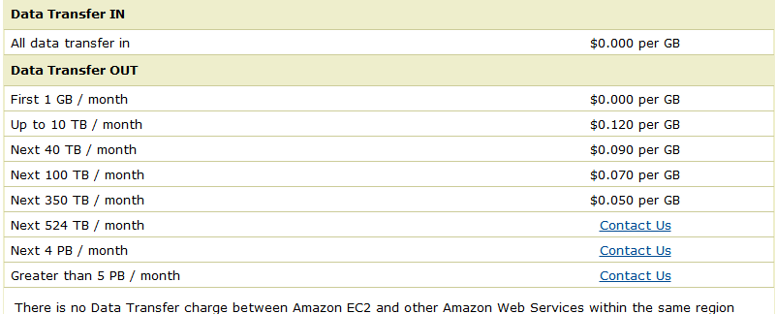
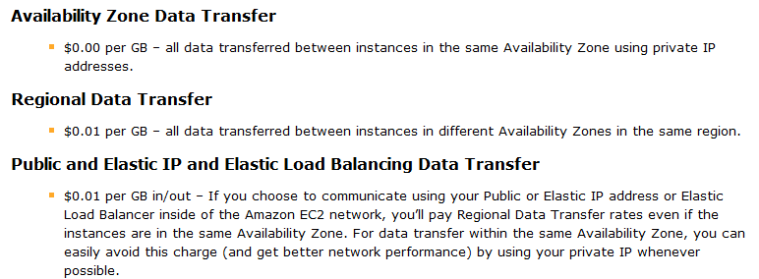
Data Transfer Charge
Advanced Internet & Web Systems
chow

Slide 18
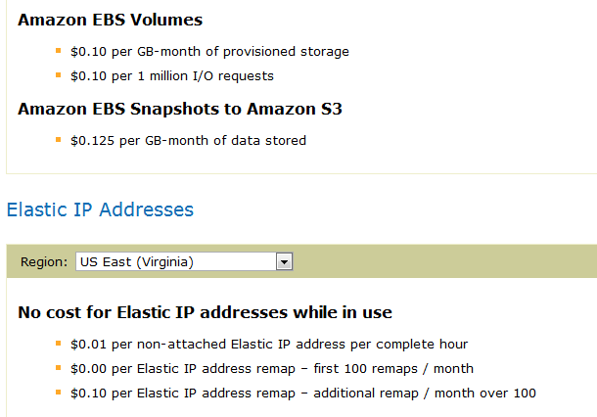
Elastic Block Store/IP Addr Charge
Advanced Internet & Web Systems
chow

Slide 19
EC2 API
Resources:
  http://docs.amazonwebservices.com/AWSEC2/latest/UserGuide/
  http://docs.amazonwebservices.com/AWSEC2/latest/CommandLineReference/
  http://docs.amazonwebservices.com/AWSEC2/latest/APIReference/
Why we use EC2 API?
Advanced Internet & Web Systems
chow

Slide 20
EC2 API to Control instances
<See http://cs.uccs.edu/~cs526/hw4S2011.html>
To be expanded.
Advanced Internet & Web Systems
chow

