Slide 1
Error Handling in Adapters
Error Handling in ESB
Error Handling in BPEL
Copyright - http://soatraining.hpage.com

Slide 2
Lesson Objectives
After completing this Lesson, you should be able to do the following:
  Understand how adapters handle errors
  Understand ESB error handling
Copyright - http://soatraining.hpage.com

Slide 3
Error Handling
Errors in BPEL and ESB are generated at two places:
  In JCA Adapters and
  BPEL/ESB Systems
BPEL / ESB System
Adapter
Adapter
Copyright - http://soatraining.hpage.com

Slide 4
Error Handling in Adapters and ESB
Provision of handling Adapter errors is through Handlers, i.e. Rejection Handler, Fatal Error Handler.
Oracle ESB System uses a topic called ESB_ERROR for all exceptions generated in the routing services. This is called Error Hospital
ESB System
Adapter
Adapter
Handlers
ESB_ERROR
Handlers
Copyright - http://soatraining.hpage.com

Slide 5
Error Handling in BPEL
In BPEL System errors are handled through
  in-built try-catch which can be used to implement a custom error hospital
    Create your own queue, say BPEL_ERROR_TOPIC and insert the error from BPEL into that.
  Utilizing the new Fault Handling Framework
BPEL System
Adapter
Adapter
try-catch
Handlers
BPEL_ERROR_TOPIC
Handlers
Copyright - http://soatraining.hpage.com

Slide 6
Why Error handling for Adapters
We can get errors both during inbound and outbound interactions
Possible errors
  Adapter cannot be instantiated
  Trying to access a resource which is not available – a procedure, a directory, a table
  Reading a file that is corrupt or data not in correct format
  Reading a file that does not conform to a XSD
  Fatal error like disk full
  Error during batching debatching
Copyright - http://soatraining.hpage.com

Slide 7
What are the different types of Adapter Exceptions?
WSIFException
ActivationException
PCRetriableResourceException
Binding Exception (Translation and data)
A ResourceException is thrown in all cases.
Copyright - http://soatraining.hpage.com

Slide 8
WSIFException
  The JCA artifacts for both the Inbound and Outbound Interactions are captured in the WSDL defining the Adapter Service.
  At run-time, the JCA WSIF Provider component of the Adapter Framework (AF) parses the WSDL for JCA artifacts and appropriately creates the InteractionSpec for Outbound Interaction.
  The AF throws the WSIFException if the InteractionSpec class cannot be located in the class path, or the instantiation fails.
Copyright - http://soatraining.hpage.com

Slide 9
ActivationException
The ActivationException is thrown on failure of activation of the Adapter endpoint associated with JCA Inbound Interaction.
Copyright - http://soatraining.hpage.com

Slide 10
PCRetriableResourceException
The Adapter throws PCRetriableResourceException for transient connection errors for the Outbound Interaction.
For BPEL, the above type of error can be retried by defining a “retry” policy in bpel.xml. (discussed later)
For ESB, we have endpoint properties to do the same (discussed later)
Copyright - http://soatraining.hpage.com

Slide 11
Binding Exception
The Adapter throws BindingException when it encounters
  translation errors
    Error while converting from native backend data to standard XML and vice-versa) and
  data related exceptions.
    E.g. Inserting a duplicate row into a database. This would result in a BindingException being thrown with the foreign key constraint violation thrown by the database.
  WSDL of partnerlink has changed
Copyright - http://soatraining.hpage.com

Slide 12
Adapter Error Handling
Copyright - http://soatraining.hpage.com

Slide 13
Adapter Error Handling
Inbound Interaction
Outbound Interaction
Copyright - http://soatraining.hpage.com

Slide 14
Inbound Interaction
Possible Errors
  Messages getting rejected (Binding Exception)
  Unrecoverable system error
  Subsequent routing service not available
    perhaps because it has been deleted or is not enabled
Copyright - http://soatraining.hpage.com

Slide 15
Translation Errors
A translation error is thrown when the translation of native data to XML (during inbound flow) and XML to native data (during outbound flow) fails
In Outbound flow
  The BPEL process throws a corresponding BindingFault that needs to be captured for error repair and recovery
In Inbound flow
  a Message Rejection Handler can be configured to process the translation errors and to take corrective action. The next slide discusses Message Rejection Handlers
Copyright - http://soatraining.hpage.com

Slide 16
Rejection Handlers
For incoming connections, it is possible to define a "Message Rejection Handler".
This allows a developer an alternative process as soon as an error occurs when receiving data.
This is available for both BPEL and ESB
There are four different Rejection Handlers:
  Write the error to a specific directory
  Write the error to an Advanced Queue (AQ) queue
  Send the error to an error handler BPEL process
  Call a WSIF service
Copyright - http://soatraining.hpage.com

Slide 17
File system based Rejection Handler
If a message is rejected by an adapter, a file is sent to a specific directory
This is achieved by setting the rejectedMessageHandlers endpoint property in ESB and also in BPEL
The handler writes the bad messages to the configured directory by using the following file name pattern:
  INVALID_MSG_ + <process-name> + <operation-name> + <current-time>
The syntax for specifying a file system based Rejection handler is as follows:
  For BPEL
<property name="rejectedMessageHandlers">file://<directory-path>
</property>
  For ESB
We can use JDeveloper
An example for specifying file based Rejection handler is as follows:
<property name="rejectedMessageHandlers"> file://C:/orabpel/domains/default/rejectedMessages</property>
Copyright - http://soatraining.hpage.com

Slide 18
Default Error Directory
If you do not set the rejectedMessageHandlers property, then errored records during translation are placed in a default directory
For BPEL
<SOA_HOME>\bpel\domains\<domain_name>\jca\<BPELProcess_Name>\rejectedMessages
Eg: D:\product\10.1.3.1\OracleAS_1\bpel\domains\default\jca\BPELProcess1\rejectedMessages
For ESB
<SOA_HOME>\j2ee\home\jca\<ESBSystem.RoutingServiceName.Operation>\rejectedMessages
Eg. D:\product\10.1.3.1\OracleAS_1\j2ee\home\jca\DocumentProcessingSystem.ReadDocument_RS.Read\rejectedMessages
Copyright - http://soatraining.hpage.com

Slide 19
Custom Rejection Handler for Third-Party Adapters
Third-party adapters such as the SAP adapter do not have support for the custom rejection handler.
Starting from 10.1.3.4, you can invoke the custom rejection handler from ESB
Set the SupportCustomRejectionForThirdPartyAdaptor endpoint property to true
ESB identifies this property as a third-party adapter and calls the onReject function.
Copyright - http://soatraining.hpage.com

Slide 20
Shutdown of the Inbound Adapter
Whenever ESB fails to post the message on ERROR_TOPIC, you might want to shut down the inbound adapter to avoid any further loss of error messages. You can achieve this by setting the shutdownInboundAdaptorOnError endpoint property to true. This property can be used only for the synchronous ESB service and when the messages on the ERROR_TOPIC AQJMS topic are posted from the inbound service. By default, the messages on the ERROR_TOPIC AQJMS topic are enqueued at the service where the error has happened. To enable the messages on ERROR_TOPIC to be enqueued from the inbound service, you need to set the EnqueueErrorFromInbound to true in the ESB_config.ini file.
Copyright - http://soatraining.hpage.com

Slide 21
fatalErrorFailoverProcess Property
If the adapter encounters an unrecoverable system error (such as no more memory or a full disk), it can instruct the adapter framework to shut down the BPEL process
Its available only in BPEL, not in ESB. In ESB we have reverse control (next slide)
You can optionally configure a standby (or failover) BPEL process to be invoked when the adapter starts the shutdown request of the (main) BPEL process.
      You configure this failover BPEL process by setting the fatalErrorFailoverProcess property as an activationAgent property in the bpel.xml file
Copyright - http://soatraining.hpage.com

Slide 22
Reverse Control
The reverse control mechanism helps in a scenario where you want all the inbound adapters in the cluster to be shut down and also the status to be updated on the console. You can use the reverse control mechanism, where the design-time is notified by the run time. The run-time updates the status of the service and notifies all the run time services about the change in state. Then, all the run-time services shut down the inbound adapter. This shutdown happens only when the disable_service_on_all_nodes endpoint property is set to true in the ESB_config.ini file.
The reverse control mechanism is used in conjunction with shutdownInboundAdaptorOnError. This means that when posting a message on ERROR_TOPIC fails, the inbound adapter is shut down and then, if the system is configured such that all the other nodes need to be shut down, then reverse control kicks in.
Copyright - http://soatraining.hpage.com

Slide 23
Next service not available
If the next service that the inbound adapter invokes does not exist, perhaps because it has been deleted or is not enabled, then the inbound adapter processor disables itself and marks itself broken.
If a subscription fails a certain number of consecutive times, the service notifies the repository to mark it as in a broken state. The dispatcher does not dispatch this subscription after it is marked as broken.
  The Oracle ESB Control displays this event source with a special icon to visually represent its disabled state. You can enable the adapter service.
The administrator is notified of any disabled services
Copyright - http://soatraining.hpage.com

Slide 24
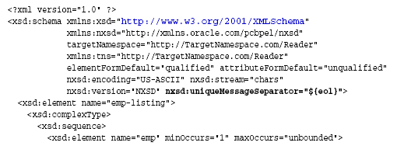
One batch has bad message in a batched processing scenario
In the case of debatching (multiple messages in a single file), messages from the first bad message to the end of the file are rejected.
What if we want to just skip the bad record
Use uniqueMessageSeparator
Copyright - http://soatraining.hpage.com

Slide 25
Outbound Interaction
Possible Errors
  Messages getting rejected (Binding Exception)
  Unrecoverable system error
  Target unavailable
      By default, an adapter retries the message three times at five second intervals for an error condition.
        The retry count and interval can be specified in the endpoint properties of the adapter service.
Copyright - http://soatraining.hpage.com

Slide 26
Endpoint retry
The transient connection exceptions can be retried by defining a “retry” policy for the Adapter Service
The “retry” policy is available to all types of Adapter Services in BPEL as well as ESB and also all BPEL Partner Links
The Legacy and Packaged Application Adapters do not throw the retriable exception on transient connection errors for the Outbound Interaction. They throw a regular ResourceException which translates to BPEL BindingFault exception which then has to be caught and retried within the BPEL process.
Copyright - http://soatraining.hpage.com
Notes:
Note:

Slide 27
Endpoint retry in BPEL
For BPEL, its defined in bpel.xml under the pertinent PartnerLinkBinding
    <BPELSuitcase>
    <BPELProcess ...>
    <partnerLinkBindings>
      <partnerLinkBinding name="myOutboundPartnerLink">
      <property name="wsdlLocation">Outbound.wsdl</property>
      <property name="retryInterval">10</property>
      <property name="retryMaxCount">30</property>
    </partnerLinkBinding>
Copyright - http://soatraining.hpage.com

Slide 28
Endpoint retry in ESB
For ESB, the same effect can be achieved by editing the esbsvc file. After the </ Invocation> tag the following XML fragment needs to be placed:
  <endpointProperties>
    <property name="RetryInterval" value="15"/>
    <property name="RetryCount" value="3"/>
  </endpointProperties>
  For ESB, we can also specify it using JDeveloper.
For ESB, we can also set these properties at application server level itself, by defining OutboundRetryCount, OutboundRetryInterval and OutboundRetryEnabled properties in esb_config.ini file
Copyright - http://soatraining.hpage.com

Slide 29
ESB Error Handling
When an error occurs in Oracle Enterprise Service Bus processing, the error is noted by visual cues, such as icon and color changes, in the Oracle ESB Control
You can also set up notifications by email, fax, or phone when errors occur
Copyright - http://soatraining.hpage.com

Slide 30
Errors in ESB
Application or Business Faults
Retryable Exceptions
    A temporary loss of a service impacting the routing of the message, but is usually resolved in a relatively short time period
Fatal Exceptions
    A disabled or deleted service or system, out of memory condition, or other serious problem
Copyright - http://soatraining.hpage.com

Slide 31
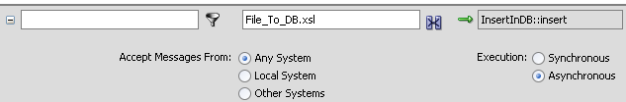
Sync and Async execution of ESB
Error handling is processed differently whether asynchronous and synchronous execution is specified for a routing service
Synchronous execution provides an immediate response to a request; asynchronous does not
Asynchronous execution is useful for environments in which a service can take a long time to process a request.
Asynchronous services also provide a more reliable fault-tolerant and scalable architecture than synchronous services.
Copyright - http://soatraining.hpage.com

Slide 32
Synchronous execution
Errors are rolled back and cannot be retried with Oracle ESB Control
An error notification is returned to the adapter that initiated the processing.
The calling adapter is expected to handle the error and resubmission. (as per the Inbound Error Handling rules)
Copyright - http://soatraining.hpage.com

Slide 33
Asynchronous execution
Error is sent to ESB Error Hospital
    ESB_ERROR topic gets the error
Errors can be resubmitted
    User can resubmit the transaction after the error condition has been resolved
    Errors can be resubmitted manually from ESB console or programmatically via ESB Client API
    Example of resubmittable errors
      Incorrect format in payload (with validation of the payload at runtime is enabled)
Copyright - http://soatraining.hpage.com

Slide 34
Shutdown of the Inbound Adapter
Whenever ESB fails to post the message on ERROR_TOPIC, you might want to shut down the inbound adapter to avoid any further loss of error messages
Set shutdownInboundAdaptorOnError endpoint property to true.
Can be used only for the synchronous ESB service and when the messages on the ERROR_TOPIC AQJMS topic are posted from the inbound service
To enable the messages on ERROR_TOPIC to be enqueued from the inbound service, you need to set the EnqueueErrorFromInbound to true in the <SOA_HOME/integration/esb/config/ESB_config.ini file.
Copyright - http://soatraining.hpage.com

Slide 35
Where are the errors stored in DB
Regardless of the type of flow, synchronous or asynchronous,
  the JMS topic ESB_ERROR gets filled,
  the message is stored in the repository in the ORAESB’s ESB_FAULTED_INSTANCE table.
  Error Hospital Concept
    Write a BPEL process to listen to the ESB_ERROR topic
    When there is a message, handle it appropriately in BPEL – send emails etc
Copyright - http://soatraining.hpage.com

Slide 36
What if ?
What if a FTP/File adapter reads a file, then errors out
If rejectedMessageHandlers is set, the file’s data, now in XML form, is written to the file/sent to AQ, BPEL or WSIF handler
If rejectedMessageHandlers is not set, the the file’s data, now in XML form, is written to the default directory <SOA_HOME>\j2ee\home\jca\<ESBSystem.RoutingServiceName.Operation>\rejectedMessages
Copyright - http://soatraining.hpage.com

Slide 37
What if ?
What if an ESB reads a file, then tries to insert data into a database table which is not available and the insertion was done synchronously? Is the data lost
No, the data is not lost
The transaction is rolled back
The error is returned to the inbound adapter, in this case, the file adapter
The file adapter writes the xml message to rejectedMessageHandlers folder
There is an entry in ESB_ERROR topic
There is an entry in ESB_FAULTED_INSTANCES table.
Copyright - http://soatraining.hpage.com

Slide 38
What if ?
What if an ESB reads a file, then tries to insert data into a database table which is not available and the insertion was done asynchronously? Is the data lost
No, the data is not lost
The transaction is rolled back
The error is returned to the ESB routing service which invoked the outbound adapter
There is an entry in ESB_ERROR topic
The error can be retried
Copyright - http://soatraining.hpage.com

Slide 39
Let’s run a test!
Copyright - http://soatraining.hpage.com

Slide 40
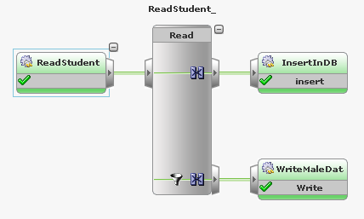
Normal successful flow
The ESB process we will use for our experiments reads a file and inserts the data into STUDENT table in database
In case the student is male, it writes to a file
Copyright - http://soatraining.hpage.com

Slide 41
Experiments
Experiment 1.1: Modify input, deficient data, synchronous operation
Experiment 1.2: Modify input, extra comma, synchronous operation
Experiment 1.3: Modify input, extra comma, asynchronous operation
Experiment 2: Delete output directory, sync/asynchronous operation
Experiment 3.1: Drop a column in table, synchronous operation
Experiment 3.2: Drop a column in table, asynchronous operation
Experiment 4: Delete the table, synchronous operation
Experiment 5: Disable routing service after the input adapter
Copyright - http://soatraining.hpage.com

Slide 42
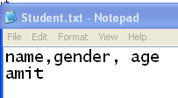
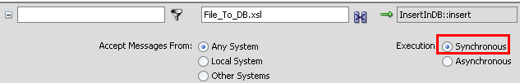
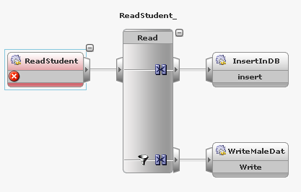
Experiment 1.1: Modify input, deficient data, synchronous operation
Input
Synchronous mode
Error at Inbound adapter
Default Rejected messages directory
Copyright - http://soatraining.hpage.com

Slide 43
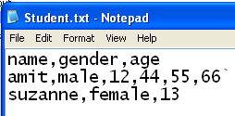
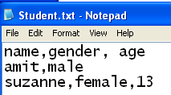
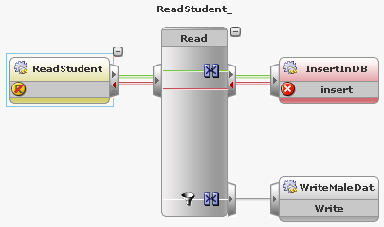
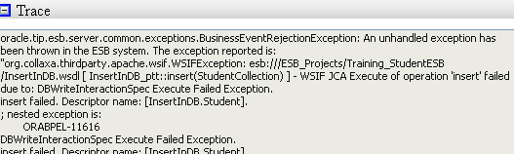
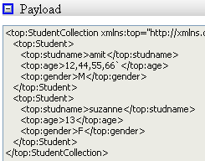


Experiment 1.2: Modify input, extra comma, synchronous operation
Input
or
WSIFException
Yellow represents non transactional endpoint
Red line represents failed transaction. Note that the error goes back to the inbound adapter
or
Red represents failed transaction
Default Rejected messages directory
Copyright - http://soatraining.hpage.com

Slide 44
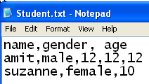
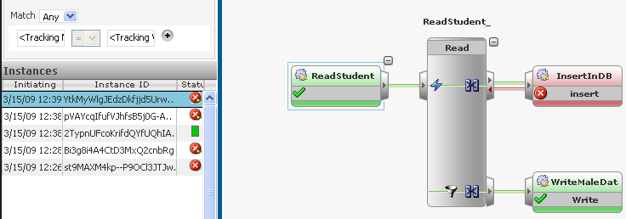
Experiment 1.3: Modify input, extra comma, asynchronous operation
Error has not been propagated to inbound adapter. Inbound adapter completed successfully
Asynchronous mode
Small arrow. Represents that error is retryable
Copyright - http://soatraining.hpage.com
This routing rule was still in synchronous mode

Slide 45
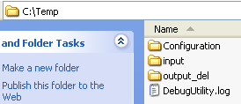
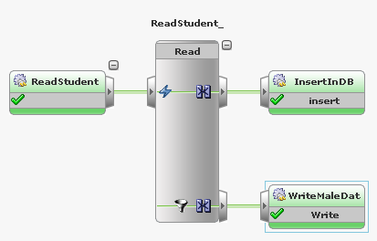
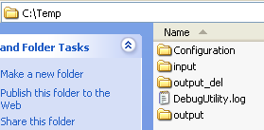
Experiment 2: Delete the output directory, sync/asynchronous operation
Rename the Output directory, effectively deleting it
Operation is successful
Output directory is created automatically
Copyright - http://soatraining.hpage.com

Slide 46
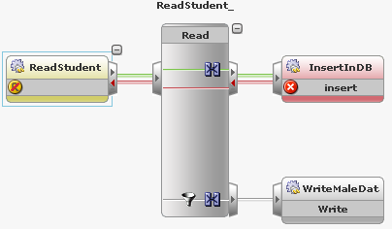
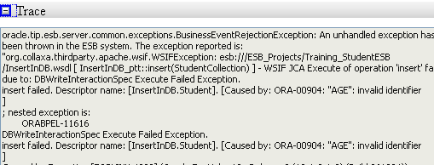
Experiment 3.1: Drop a column in table, synchronous operation
WSIFException
Error propagated to inbound adapter.
Copyright - http://soatraining.hpage.com

Slide 47
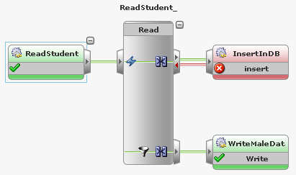
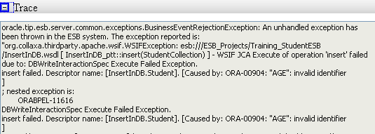
Experiment 3.2: Drop a column in table, asynchronous operation
Error has not been propagated to inbound adapter. Inbound adapter completed successfully
This routing rule was still in synchronous mode. This completes successfully
Copyright - http://soatraining.hpage.com

Slide 48
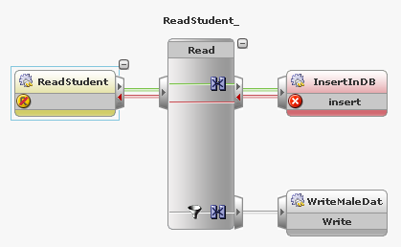
Experiment 4: Delete the table, synchronous operation
Error propagated to inbound adapter.
Copyright - http://soatraining.hpage.com

Slide 49
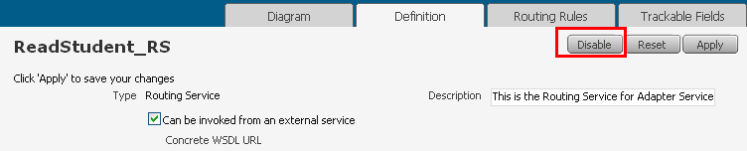
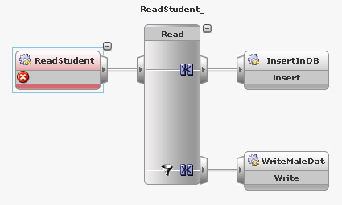
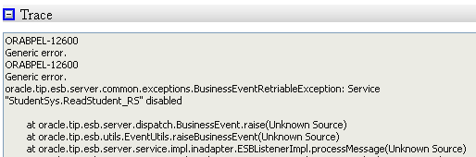
Experiment 5: Disable routing service
Disable the routing service from ESB console
Copyright - http://soatraining.hpage.com

Slide 50
Error Handling in BPEL
Try-catch mechanism
failover
  Allows multiple service implementations to be configured for a given partnerLink. If a retryable runtime fault (discussed in the following slide) occurs, the server will try other implementations
retry
  The server retries based on a user specified retry interval and retry count
Copyright - http://soatraining.hpage.com

Slide 51
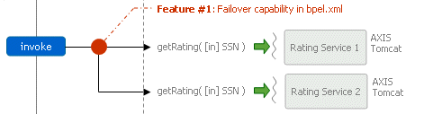
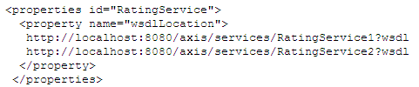
Testing Failover
We configure RatingService1's wsdl to have a nonexisting soapAddress, while RatingService2 is correct and should work. So when the <invoke> tries to call RatingService1, a RuntimeFault named "ConnectionRefused" will occur. Since this is a retryable fault, the BPEL server will automatically try to call the other service, RatingService2.
Copyright - http://soatraining.hpage.com

Slide 52


Testing Retry
The <invoke> activity in the process shows how the system retry works. The partnerLink of this <invoke> is configured as follows:
Suppose the service is not listening at port 2222. Then this invoke will fail with a "ConnectionRefused" RuntimeFault. Since it is a retryable fault and the retryCount and retryInterval are defined, to 2 and 60 respectively, the server will retry twice, with 60 seconds intervals between each attempt.
Copyright - http://soatraining.hpage.com

Slide 53
Fault Policy Management Framework
Before 10.1.3.3, we needed to design the fault-handling individually for every bpel-process.
In 10.1.3.3, Oracle provided a new Fault Management framework.
      This framework gives us the opportunity to handle all the business and runtime faults for an “invoke” activity. With the framework we can define one policy for every bpel domain.
      So, using this, you can say –
        Whenever there is fault X, do this..
Copyright - http://soatraining.hpage.com

Slide 54
Practising Fault Policy Management Framework
Two excellent links:
  http://www.it-eye.nl/weblog/2007/09/10/oracle-bpel-10133-fault-policy-management/
  http://www.it-eye.nl/weblog/tag/bpel/
Copyright - http://soatraining.hpage.com

Slide 55
References
Oracle Technote: http://www.oracle.com/technology/products/ias/bpel/htdocs/orabpel_technotes.tn007.html
Fault Policy Management - http://www.it-eye.nl/weblog/2007/09/10/oracle-bpel-10133-fault-policy-management/
Adapter Technical Note
Copyright - http://soatraining.hpage.com

