Slide 1
Application Integration Architecture (AIA)
Copyright - http://soatraining.hpage.com

Slide 2
Lesson Objectives
After completing this Lesson, you should be able to do the following:
  Describe the AIA architecture solution
  Describe the purpose and development of EBS
  Describe EBOs and EBMs and how they are used
  Describe ABC Services
  Describe enterprise business flows
Copyright - http://soatraining.hpage.com

Slide 3
Why AIA
The Integration problem
  Oracle acquired other ERP solution vendors like PeopleSoft, Siebel, JD Edwards
  So a lot of customers have been asking Oracle, “How are you going to help us bring all this together? How are you going to help me optimize my existing investments (Oracle as well as non-Oracle -based)?”
Oracle has come up with AIA
  Oracle proposes an architecture, plus provides building blocks
  The architecture leverages Fusion Middleware technology to create an open standards based solution that allows one to create loosely coupled end to end businesses processes across applications, that can be continually modified and optimized over time
Copyright - http://soatraining.hpage.com

Slide 4
AIA
Is an architecture proposed by Oracle
Follows SOA paradigm
Provides a foundation for SOA based development
AIA is built on Fusion Middleware
Copyright - http://soatraining.hpage.com

Slide 5
I want to use AIA
AIA consist of two flavors
  AIA Foundation Pack
    Provides the infrastructure to create your own solutions
    Infrastructure ≡ An architecture, Common XSD
  Process Integration Packs (PIPs)
    Are pre-built solutions given by Oracle for a few common scenario
    Essentially, Oracle has a team of developers sitting who are creating these PIPs
    They develop these based on requirements from customers, and then try to make them generic enough to be sold as out-of-the-box solutions
    So, in essense, a PIP is a predefined end-to-end integration solution (for specific application end points) built by Oracle and sold as a product.
Copyright - http://soatraining.hpage.com

Slide 6
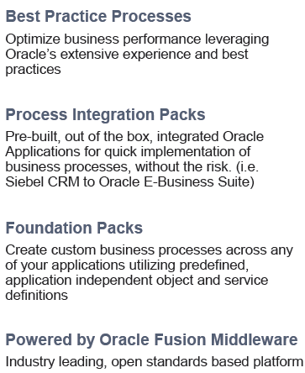
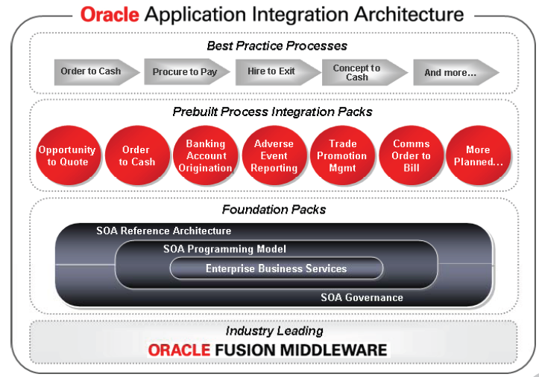
What does it consist of
Copyright - http://soatraining.hpage.com

Slide 7
What Pre-built integrations are available today?
Copyright - http://soatraining.hpage.com

Slide 8
Cross Application Pre-built Integrations
  Order to Cash
    Siebel CRM Integration Pack for Oracle EBS Order Management
  Trade Promotion Management
    Siebel CRM Integration Pack for Trade Promotion Management
  Design to Release
    Agile Product Lifecycle Management integration Pack for Oracle E-Business Suite
  Oppty to Quote
    Oracle CRM On Demand Integration Pack for Oracle E-Business Suite
  Oppty to Quote
    Oracle CRM On Demand Integration to Siebel CRM
Copyright - http://soatraining.hpage.com

Slide 9
Industry Specific Pre-built Integrations
  Comms:
    Siebel CRM Integration Pack for Oracle Comms Billing and Revenue Management: Order to Bill
    Siebel CRM Integration Pack for Oracle Comms Billing & Revenue Management: Agent Assisted Billing Care
    Oracle Comms Billing and Revenue Management Integration Pack for Oracle E-Business Suite: Revenue Accounting
  Banking
    Siebel CRM Integration Pack for i-flex FLEXCUBE Account Originations
    Siebel CRM Integration Pack for Banking Account Originations
  Life Sciences
    Siebel Life Sciences Integration for Oracle Adverse Event Reporting System
  Consumer Goods
    Demantra Integration Pack for Siebel CRM Consumer Goods
  Transportation
    Oracle Transportation Management (Glog) Integration to E-Business Suite
  Retail
    Oracle Retail Integration to E-Business Suite Financials
Copyright - http://soatraining.hpage.com

Slide 10

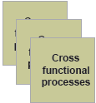





Typical AIA Solution
Copyright - http://soatraining.hpage.com

Slide 11
Solution Artifacts
The solutions that AIA delivers are composed of the following artifacts
Enterprise Business Objects (EBO)
  These are enterprise business documents based on the application independent object model. These, along with enterprise business services, act as the cornerstones of AIA.
Enterprise Business Services (EBS)
  These are application and implementation independent service definitions and business level interfaces. These service definitions are implemented by all applications that participate in an integration.
Application Business Connector Services (ABC services)
  These services are responsible for exposing business functions available in Oracle applications as services that are able to participate in the AIA ecosystem.
Orchestrated Process Flows
  These process flows are responsible for performing the end-to-end processes that involve activities spanning application and business boundaries.
Copyright - http://soatraining.hpage.com

Slide 12
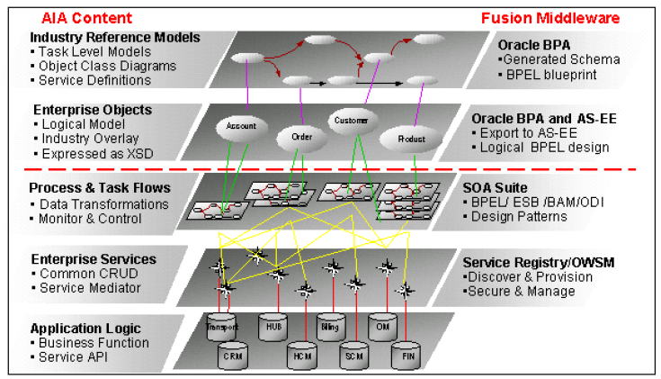
Solution Artifacts
Copyright - http://soatraining.hpage.com

Slide 13
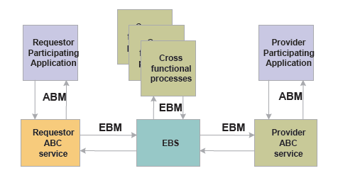
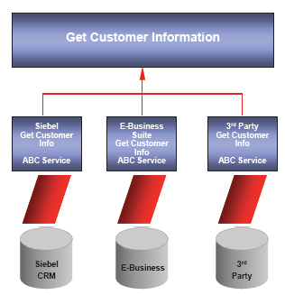
EBS
These are application and implementation independent service definitions and business level interfaces. These service definitions are implemented by all applications that participate in an integration.
Example:
      Get Customer Information is the business level interface
      Siebel CRM, E Business and a 3rd party CRM participate in this integration
      They all provide implementation to the interface
      At runtime, we can choose any of the implementations
Copyright - http://soatraining.hpage.com

Slide 14
Purpose of EBS
The purpose of the EBS is to:
Receive the request from the calling application.
Identify the implementation as well as the deployment that is responsible for providing the requested service.
Delegate the requested task to the right implementation.
Receive the response and return the EBM to the calling application.
Copyright - http://soatraining.hpage.com

Slide 15
EBS Types
There are two types of EBS:
Entity Services
  These expose a set of operations acting on the Business Object, i.e. the Enterprise Business Object (EBO)
Process Services
  By definition, these expose the operations related to the business processes
Copyright - http://soatraining.hpage.com

Slide 16
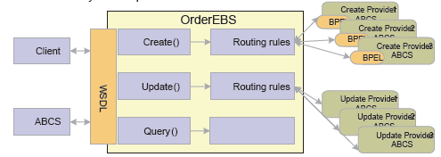
Entity Services
Each of the business object entities has a corresponding enterprise business service; all of the actions that can be performed on this object are exposed as service operations and are part of this Enterprise Business Service
The entity operations consist of standard CRUD operations that have the same look and feel across services as well as any specialized operations specific to the EBO
Entity services are implemented as ESB routing services
Entity services receive and return messages in the form of EBMs
Entity services leverage the context-based routing rules to delegate the request to the appropriate application-specific ABC service containing the actual implementation
Copyright - http://soatraining.hpage.com

Slide 17
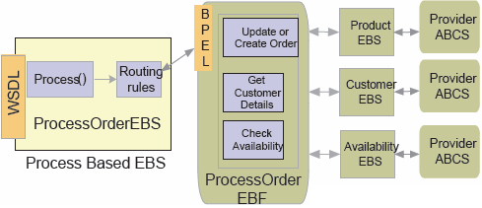
Process Services
Process services expose operations related to an enterprise business process
Each enterprise business flow has a corresponding enterprise business service; all of the actions that can be performed on this flow are exposed as service operations and are part of this Enterprise Business Service.
Process services are implemented as ESB Routing Services.
Process services receive and return messages in the form of EBMs
Operations exposed on the EBS will initiate cross-functional enterprise business flows that coordinate complex long-lived flows that span multiple services. These flows can only interact with EBS services. This way both the Process EBS and the related business flows are completely application agnostic.
Copyright - http://soatraining.hpage.com

Slide 18
What’s an EBO?
Standardized semantic representation of business objects
e.g Invoice, Customer, Sales Order, Payment, etc
EBO= xsd
EBM=actual xml message
Copyright - http://soatraining.hpage.com

Slide 19
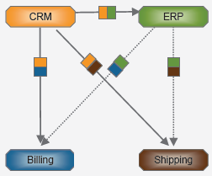
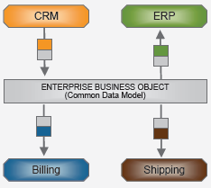
Purpose of an EBO
Use Case
  We want to integrate CRM with Billing and Shipping, and also ERP with Billing and Shipping
  Need to develop 4 kind of messages
Use a common message - EBO
  It supports the loose coupling of systems in AIA and eliminates the need for one-to-one mappings of the disparate data schemas between each set of systems.
Copyright - http://soatraining.hpage.com

Slide 20
What’s an ABCS
Application business connector service
Facilitate the exposing of core business transactions as well as data access as web services
Serve as a glue to integrate applications with Enterprise business services
Allow for participating applications to become service providers as well as service consumers without disruption to code
Allow for applications having non standard connectivity to expose their functionality as services
Copyright - http://soatraining.hpage.com

Slide 21
ABCS Types
Two types of ABCS:
Requestor ABCS
  Interfaces between Requesting / Source application and Enterprise Business Service
  Service provided by requesting applications to interface with an EBS for performing a single business task
Provider ABCS
  Interfaces between EBS and Provider / Target application
  Service provided by provider application to interface with an EBS for catering to a single business task
Copyright - http://soatraining.hpage.com

Slide 22
Purpose of ABCS
Establishing connectivity with the participating application – WS-Based & non WS Based
Message transformation from application-specific format to application independent format and vice versa
Invocation of EBS and / or Application Services
Managing cross-referencing of instance identifiers
Population of EBM Headers (sender’s information, security, correlation)
Internationalization and localization of message content
Content validation (if required)
Message enrichment (if required)
Copyright - http://soatraining.hpage.com

Slide 23
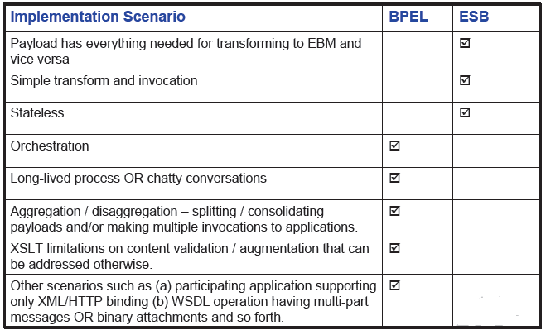
Implementing ABCS
ABCS can be implemented using BPEL or ESB
Copyright - http://soatraining.hpage.com

Slide 24
EBF
Is an orchestration of services
Can involve multiple EBOs
Implemented using BPEL
Copyright - http://soatraining.hpage.com

Slide 25
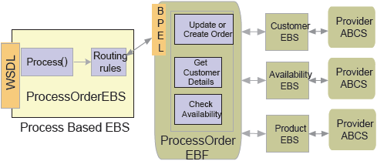
EBF and EBS
EBF is similar to EBS as
  It operates only on EBMs
  Is application independent
  Designed to perform a specific business activity
EBF is distinct from an EBS as
  It can operate on multiple EBMs
  Can only talk to EBS, while EBS can talk to other EBSs, ABCSs or EBFs
Copyright - http://soatraining.hpage.com

Slide 26
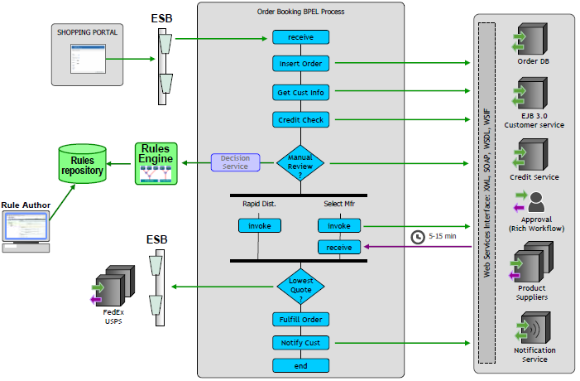
SOA Order Demo
Copyright - http://soatraining.hpage.com

Slide 27
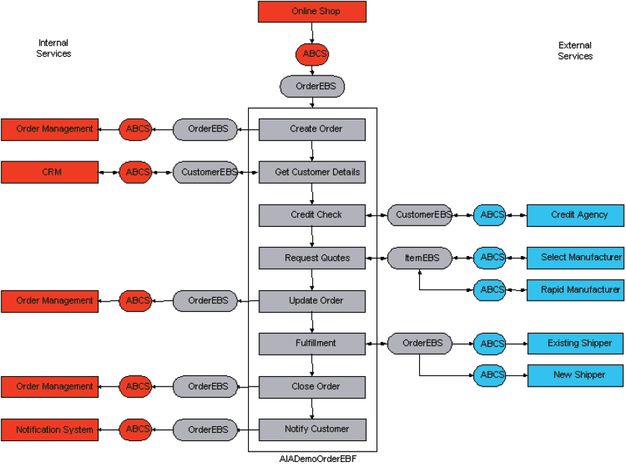
SOA Order Demo modified to use AIA
OrderEBS exposes the CreateOrder service of the EBF
An EBF can only talk to an EBS
The EBF can talk to multiple EBSs, using multiple EBMs
An EBS can talk to multiple ABCSs based on routing rules
Copyright - http://soatraining.hpage.com

Slide 28
Other components of AIA
Extensibility
  Ability to introduce extensions to pre-built integrations in a structured, upgrade-safe manner
    Customers do not have to make changes to the delivered code
    Changes / extensions done by customers are clearly identifiable
  AIA Artifacts have inherent support for extensibility
    Designed and constructed to accommodate customer extensions
  Extensions are durable – protected during upgrades
  Ability to extend various AIA artifacts
    EBOs and EBMs
    Transformations
    Enterprise Business Services
    Routing Rules
  The trick is to have a custom element in every EBO – it’s a pointer to another xsd file, that actually holds the extension to that object.
    So we do not modify the file provided by Oracle directly
    Instead, we create a new file and refer that from the main file
Copyright - http://soatraining.hpage.com

Slide 29
Other components of AIA
Business Service Repository (BSR)
  Catalog of ALL AIA delivered SOA interfaces
    WSDLs for services (ABCS & EBS)
    XSDs for EBO
    Relationships
  Based on UDDI
  The BSR uses the concept of the integration scenario that represents the end-to end flows across the pillar. Having this information, it allows you to see how one service relates to other services, how one object relates to other objects, and how an object is manipulated by other services. This information can be viewed in context.
Copyright - http://soatraining.hpage.com

Slide 30
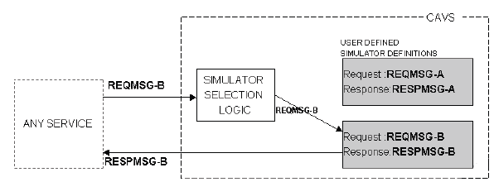
Other components of AIA
Composite Application Validation System (CAVS)
  Is a testing tool
  The ability to substitute part of an integration scenario (like participating applications alone or a Application business connector service) with dummy applications also known as Simulators
      there is no business logic in a simulator. Rather it is returns a pre-defined response whenever a combination of input is present in the request.
Copyright - http://soatraining.hpage.com

Slide 31
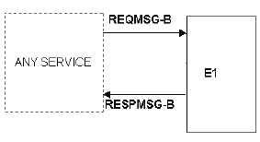
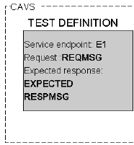
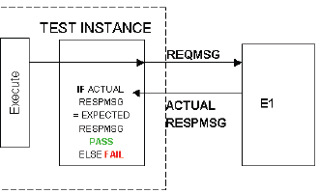
We want to test this flow
First, create a Test Definition, that contains the endpoint URL and the request message.
We can then use this test definition to test E1 itself
We can then substitute E1 and use this during testing other services. E1 need not be available
Copyright - http://soatraining.hpage.com

