Slide 1
Logging and Debugging in BPEL and ESB
Copyright - http://soatraining.hpage.com

Slide 2
Lesson Objectives
After completing this Lesson, you should be able to do the following:
  Learn how to look at log files
  Understand options available in BPEL for logging
  Understand options available in ESB for logging
Copyright - http://soatraining.hpage.com

Slide 3
Checking Log Files
You can view logs for
        OC4J components using Java logging
        Application Server Control Console
        Applications deployed into OC4J
        Global (default) application
        Default Web site access logging
        OC4J server
        JMS
        RMI
        OPMN
You can set the level of information in a log file with the Logger Configuration page.
The log files you would view the most – 1, 9 above
Copyright - http://soatraining.hpage.com

Slide 4
1. OC4J components using Java logging
Configuration File
  OC4J provides a number of component loggers that write to the OC4J log file (log.xml).
  The available component loggers can be viewed and configured through the Logger Configuration page in Application Server Control Console (see next slide).
  These files are rotated by default
Default Log File Name and Location
  <SOA_HOME>/j2ee/instance/log/instance_default_group_1/oc4j/log.xml
  Example
  D:\product\10.1.3.1\OracleAS_1\j2ee\oc4j_soa\log\oc4j_soa_default_group_1\oc4j
Copyright - http://soatraining.hpage.com

Slide 5
Viewing Log Files
Login to Enterprise manager.
Select the oc4j instance for which you want to see the log. Say home
Click Logs in the upper right corner to display the Log Files page
Expand Components > OC4J > name-of-application server
Copyright - http://soatraining.hpage.com

Slide 6
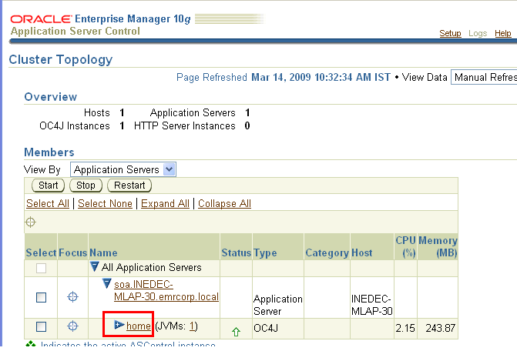
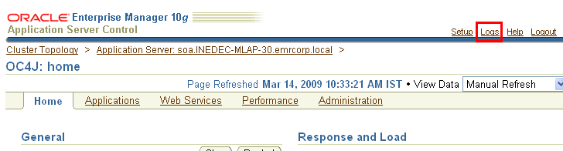
Copyright - http://soatraining.hpage.com

Slide 7
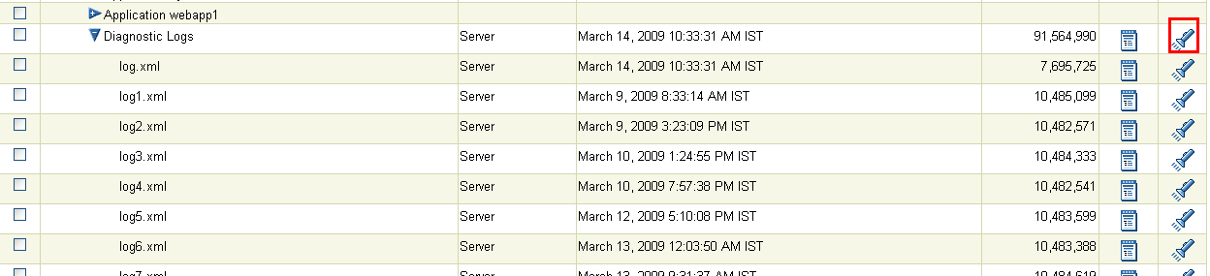
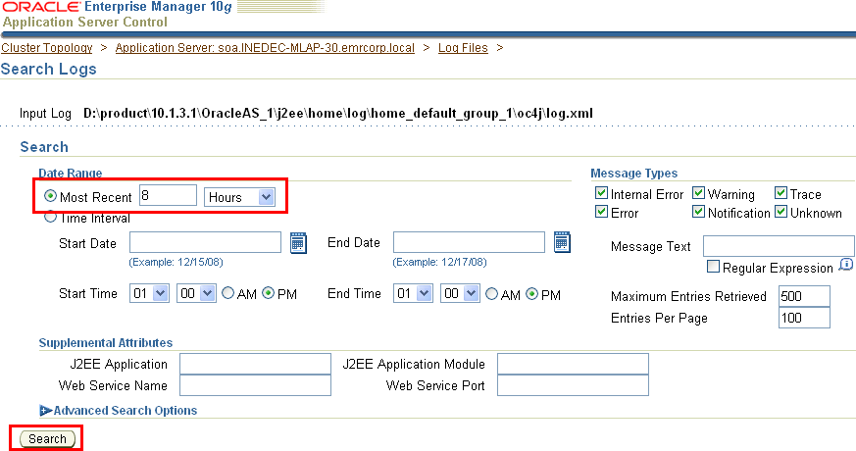
Diagnostic Log
Diagnostic logs give a very detailed view.
You can search in the log
Copyright - http://soatraining.hpage.com

Slide 8
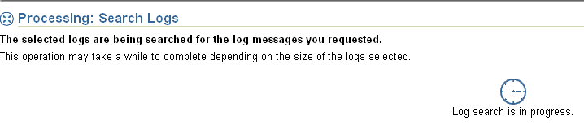
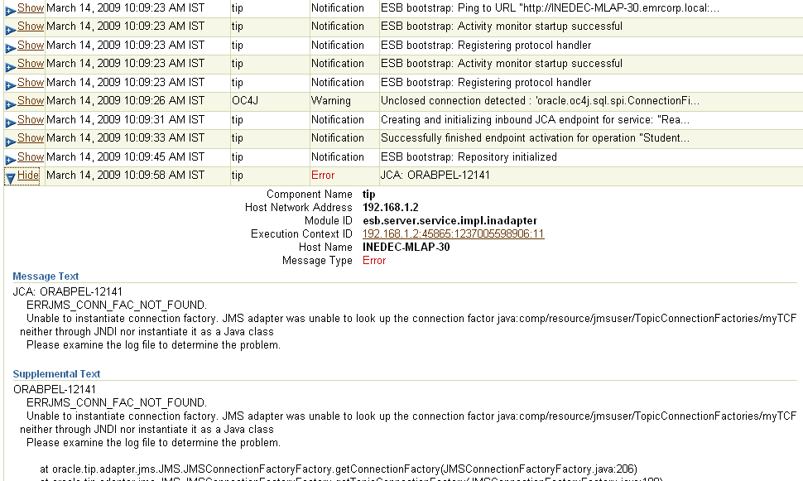
Diagnostic Log
The log is shown in a very formatted manner
Expand to see more details
Copyright - http://soatraining.hpage.com

Slide 9
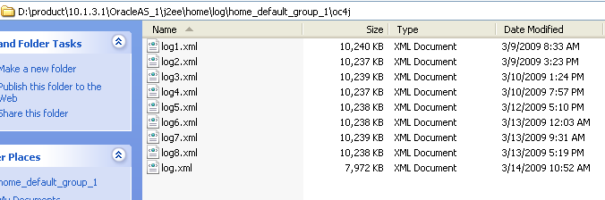
Diagnostic Log
Diagnostic log files can be looked at directly from the following location
<SOAHOME>/j2ee\home\log\home_default_group_1\oc4j, assuming the oc4j name is home
Copyright - http://soatraining.hpage.com

Slide 10
Configuring Log Files
You can configure log file settings for individual logger classes to display more information in the log files.
  To configure the log file settings:
  Login to Enterprise manager.
  Click an application server to display the home page of the server.
  Click the Administration tab.
  Under Administration Tasks > Properties, click Go to Task next to Logger Configuration.
Copyright - http://soatraining.hpage.com

Slide 11
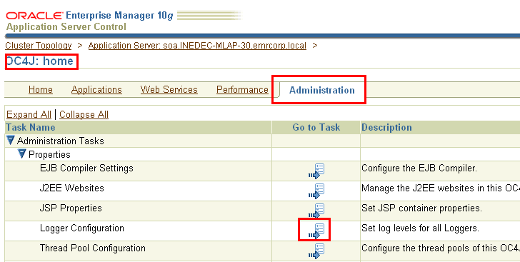
Configuring Log Files
Copyright - http://soatraining.hpage.com

Slide 12
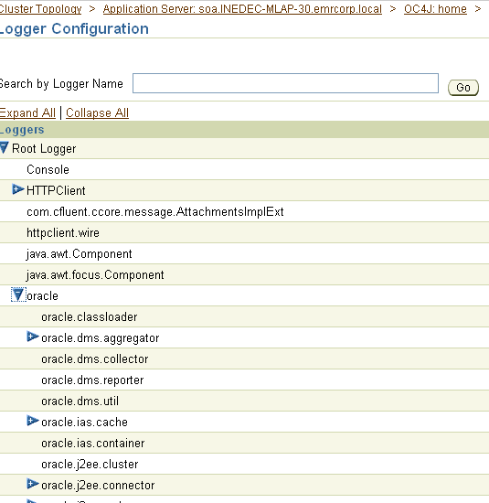
Viewing all Loggers
Expand Root Logger > oracle to display the logger classes and the Log Level settings.
Copyright - http://soatraining.hpage.com

Slide 13
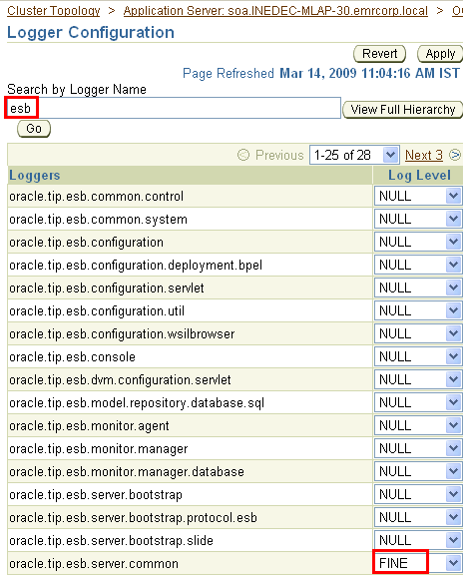
Setting Log Levels for a logger
  You can locate specific logger classes by name with the search option. In the Search by Logger Name field, enter a string and then click Go.
  For example, enter esb in the Search by Logger Name field.
  In the Log Level list, select a level option for the logger classes you want to
  configure.
  For example, set oracle.tip.esb.server.common to FINE, as shown
Copyright - http://soatraining.hpage.com

Slide 14
Setting Log Levels – more info
The log level value set on a logger through the Logger Configuration page is not persisted, but is applied to the OC4J runtime only; when OC4J is restarted, the log level reverts back to the default setting inherited from the parent logger – oracle logger.
The configuration for the oracle logger is defined in <SOA_HOME>/j2ee/instance/config/j2ee-logging.xml
Copyright - http://soatraining.hpage.com

Slide 15
2. Application Server Control Console
Configuration File
  <SOA_HOME>/j2ee/instance/application-deployments/ascontrol/orion-application.xml
Default Log File Name and Location
  <SOA_HOME>/j2ee/instance/log/instance_default_group_1/ascontrol-application.log
Copyright - http://soatraining.hpage.com

Slide 16
3. Applications deployed into OC4J
Every application deployed into the oc4j will create its own log file.
Configuration File
  <SOA_HOME>/j2ee/instance/application-deployments/app_name/orion-application.xml
Default Log File Name and Location
  <SOA_HOME>/j2ee/instance/application-deployments/app_name/instance_default_group_1/application.log
  These can be viewed as follows
Copyright - http://soatraining.hpage.com

Slide 17
Copyright - http://soatraining.hpage.com

Slide 18
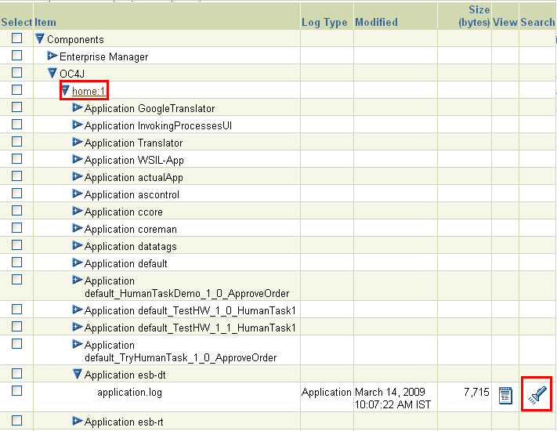
These are all the applications deployed in the oc4j instance called home
Every application creates its own log file
Copyright - http://soatraining.hpage.com
Notes:
How to enable debugging in Oracle ESB
Quite some times it is little frustrating to understand what happens inside Oracle ESB. It is because of Error reporting which is very limited and not to the point.
This can be resolved by enabling the ESB log level FINE in the Oracle application server control and below are the steps to do that.
1. Login into the Application Server Control at http://Server.Client.com:7777/em
2. Click on the oc4j_soa instance and Administration tab.
3. Click on Logger Configuration.
4. Now expand Root Logger / oracle to display the logger classes and the Log Level settings.
5. In the Log Level list, select the level FINE for the following classes
. oracle.tip.esb.server.common
. oracle.tip.esb.server.service
6. Restart the SOA suite to apply the changes and the logs can be found at
\\SERVER\\j2ee\oc4j_soa\application-deployments\esb-dt\oc4j_soa_default_group_1\application.log
\\SERVER\\j2ee\oc4j_soa\application-deployments\esb-rt\oc4j_soa_default_group_1\application.log

Slide 19
4. Global (default) application
Configuration File
  <SOA_HOME>/j2ee/instance/config/application.xml
Default Log File Name and Location
  <SOA_HOME>/j2ee/instance/log/instance_default_group_1/global-application.log
Copyright - http://soatraining.hpage.com

Slide 20
5. Default Web site access logging
Configuration File
  <SOA_HOME>/j2ee/instance/config/default-web-site.xml
Default Log File Name and Location
  <SOA_HOME>/j2ee/instance/log/instance_default_group_1/default-web-access.log
Copyright - http://soatraining.hpage.com

Slide 21
6. OC4J server
Configuration File
  <SOA_HOME>/j2ee/instance/config/server.xml
Default Log File Name and Location
  <SOA_HOME>/j2ee/instance/log/instance_default_group_1/server.log
Copyright - http://soatraining.hpage.com

Slide 22
7. JMS
Configuration File
  <SOA_HOME>/j2ee/instance/config/jms.xml
Default Log File Name and Location
  <SOA_HOME>/j2ee/instance/log/instance_default_group_1/jms.log
Copyright - http://soatraining.hpage.com

Slide 23
8. RMI
Configuration File
  <SOA_HOME>/j2ee/instance/config/rmi.xml
Default Log File Name and Location
  <SOA_HOME>/j2ee/instance/log/instance_default_group_1/rmi.log
Copyright - http://soatraining.hpage.com

Slide 24
9 OPMN
Configuration File
  <SOA_HOME>/j2ee/instance/
Default Log File Name and Location
  <SOA_HOME>/j2ee/instance/
Copyright - http://soatraining.hpage.com

Slide 25
OPMN
1.1 What is OPMN?
Oracle Process Manager and Notification Server (OPMN) is installed and configured with every Oracle Application Server installation type and is essential for running Oracle Application Server. OPMN provides an integrated way to manage all Oracle Application Server components. OPMN consists of two main pieces the process manager and the notification server.
    Process manager is the centralized process management mechanism in Oracle Application Server and is used to manage all Oracle Application Server processes. The PM starts, restarts, stops, and monitors every process it manages. It also performs death-detection and automatic restart of the processes.
    Oracle Notification Server (ONS) is the transport mechanism for failure, recovery, startup, and other related notifications between components in Oracle Application Server.
Copyright - http://soatraining.hpage.com

Slide 26
OPMN Logging Mechanism
OPMN and OPMN-managed processes generate log files during processing to enable you to troubleshoot difficulties you might have in execution of the process.
OPMN’s own log file = opmn.log
OPMN-managed processes’ log files are
    <SOA_HOME>\opmn\logs\default_group~oc4j_soa~default_group~1 and similar such files
    These log files have standard output and standard error of OPMN managed processes.
    OPMN creates a log file for each component and assigns a unique concatenation of the Oracle Application Server component with a number
Copyright - http://soatraining.hpage.com

Slide 27
Rotating log files
Most of the log files of the AS are configured to be rotated.
    This means that after a period or when they reach a particular size, the log file is copied and a new log files is created.
    However $ORACLE_HOME/opmn/logs/default_group~OC4J_INSTANCE_NAME~default_group~1 is not rotating out of the box
It is possible to make this file rotatable.
  You need to add one or more of the following settings in java-options for the oc4j you are interested in
      -Dstdstream.filesize=8
      Note: 8 means, rotate after 8 MB in size.
      -Dstdstream.filenumber
      Max number of files that oc4j can keep as archives. The oldest file will be automatically deleted if the limit is exceeded.
      Dstdstream.rotatetime
      Time everyday at which this file will be rotated
  You need to add a new section for oc4j-options, with the following values
      In oc4j-options:
      -out $ORACLE_HOME/opmn/logs/oc4j_soa.out
      -err $ORACLE_HOME/opmn/logs/oc4j_soa.err
      .
Copyright - http://soatraining.hpage.com

Slide 28
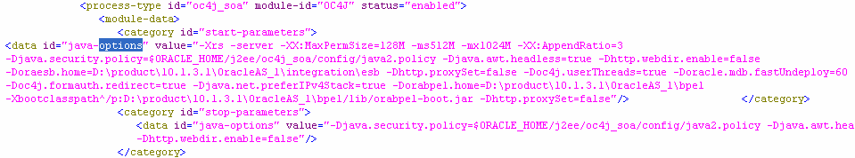
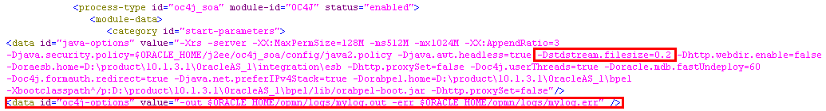
How to Rotate log files
Backup and then open <SOAHOME>/opmn/conf/opmn.xml.
Search for the java-options node with category Id = start-parameters, for the oc4j for which you want to rotate the file
Modify it as shown below. Here we specify that rotate after 0.2 mb and add the new
Section for oc4j-options
Copyright - http://soatraining.hpage.com

Slide 29
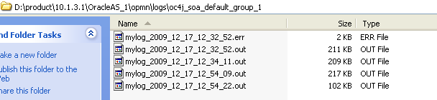
Rotating Log files – How it will look
Separate files for err and out
A new directory got created
Files are getting rotated after
0.2 mb
Copyright - http://soatraining.hpage.com

Slide 30
Logging in BPEL
Use sensors with DB
Use sensors with BAM
Use addAuditTrailEntry
Use setIndex
Copyright - http://soatraining.hpage.com

Slide 31
Logging in ESB
Use tracking fields
Copyright - http://soatraining.hpage.com

Slide 32
So what do you need to remember vis-à-vis logging
Diagnostic logs (which are written into by multiple loggers, with configurable logging level, and can be viewed in EM) and opmn logs (which are plain text files, and can’t be seen in EM) are the most important loggers
Copyright - http://soatraining.hpage.com

Slide 33
References
Logging in OC4J -http://download-uk.oracle.com/docs/cd/B31017_01/web.1013/b28950/logadmin.htm
Rotating files -http://orasoa.blogspot.com/2008/06/application-server-rotating-log-files.html
Is it possible to see logs in opmn/log from EM –Answer no. http://forums.oracle.com/forums/thread.jspa?threadID=904944&tstart=15
Copyright - http://soatraining.hpage.com

