Slide 1

TOGAF – A Summary Architecture Capability Framework (ACF)

Slide 2
Where ACF fits into TOGAF

Slide 3
What is ACF?
In order to successfully operate an architecture function within an enterprise, it is necessary to put in place appropriate
Organisation structures
Processes
Roles and Responsibilities
Skills
Not intended to be a comprehensive template for operating an enterprise architecture capability

Slide 4
Business Capability for Architecture - Operating at a level of maturity
Governance Bodies
Direct
Setting priority
and focus
Measuring
success
Skilled Resource Pool
Project/Portfolio Governance
Setting
priority
and focus
Business Operations
Participate in
Contract
Training
Roles and Responsibilities
(both generic and specific to a particular project)
Improves
Projects/ Portfolio governed against their contracts
Skills
Knowledge
Requires
Requires
Possess
Possess
Projects/Portfolios
Delivering aligned Solutions
Architecture Professionals
Participate in
Assigns
Populating the repository
Re-using building blocks and complying with standards
Enterprise Continuum
Architecture Repository

Slide 5
Components of ACF
External Stakeholders
Architecture
Capability
Internal Stakeholders
Using ADM to establish architecture capability
Architecture
Board
Architecture
Maturity
Models
Contracts
Compliance
Principles
Architecture Skills Framework
Sponsors,
projects
Architecture Governance Framework
Evolving and improving
the EA function
Guidance on Architecture Governance by defining how best the EA function should interact with other parts of the company
Recommends the use of the ADM itself as a means to define the architecture function and defined a roadmap on how it should improve
Using EA Maturity Models to assess you company’s maturity and to use as a means to get guidance on where to improve
Using the skills framework to make sure the team are competent enough to preform their tasks
Defining the governance rules with key stakeholders to agree how best to manage the enterprise’s architecture
Use of a Architecture Board to ensure that the company is following its governance rules
Developing a process to assess Architecture Compliance
Development of architecture contracts to clearly state the agreements between the enterprise architect and the sponsor.

Slide 6
How to establish an Architecture Capability
Using ADM to establish architecture capability
Establishing a sustainable architecture practice within an organization can be achieved by adhering to the same approach that is used to establish any other capability — such as a business process management capability — within an organisation.
The ADM is an ideal method to be used to architect and govern the implementation of such a capability. Applying the ADM with the specific Architecture Vision to establish an architecture practice within the organization would achieve this objective
This shouldn’t be seen as a phase of an architecture project, or a one-off project, but rather as an on-going practice that provides the context, environment, and resources to govern and enable architecture deliver y to the organisation

Slide 7
Establishing a Architecture Capability
Using ADM to establish architecture capability
Define the vision, business goals and drivers , and principles of the architecture practice
Define the processes, views and how the framework will be used. Also what performance metrics are required
Preliminary
Define the data required to store and how it will be stored in the architecture repository. Also what applications will be required to assist with the processes defined in Phase B
Changes to the processes or systems should be managed here
A.
Architecture
Vision
H.
Architecture
Change
Management
B.
Business
Architecture
Requirement to be clearly articulated and align to vision
G.
Implementation
Governance
Requirements
Management
C.
Information
Systems
Architectures
Define technology infrastructure supporting the architecture practice
Governing the implementation of the business architecture
F.
Migration
Planning
D.
Technology
Architecture
E.
Opportunities
And Solutions
How best to manage organisational changes that are required and how this is achieved
How best to adopt the new systems and processes.

Slide 8
Using the Architecture Skills Framework
Architecture Skills Framework
Provides a view of the competency levels required for specific roles. They define:
The roles within a work area
The skills required by each role
The depth of knowledge required to fulfil the role successfully
Why do we need it
Confusion in industry over the competencies required makes recruitment difficult.
Ensure a successful Enterprise Architecture practice needs staff with the relevant experience and skills in or to fulfil their roles. However these roles need to be well defined in the first place! This is what the skills framework tries to do.
Having under-qualified personnel in the role of Enterprise Architecture will increase costs off re-hiring and the quality of their work adversely impacting the company’s Enterprise Architecture.

Slide 9

Using the Architecture Skills Framework
Architecture Skills Framework
Roles
Proficiency
Levels
Skills
Generic Skills
Leadership, team working, inter-personal skills etc
Business Skills & Method
Business cases, business processes, strategic planning
Enterprise Architecture Skills
Modelling, building block design, applications and role design, systems integration
Program or Project Management
Managing business change, project management methods and tools
IT General Knowledge Skills
Brokering Applications, asset management, migration planning, SLAs
Technical IT Skills
Software engineering, security, data interchange, data management
Legal Environment
Data Protection, Contract Law, Procurement, fraud
1: Background
Not a required skill, though should be able to define and manage skill if required
Architecture
Board Members
Architecture
Sponsor
2: Awareness
Understands the background, issues and implications sufficiently to be able to understand how to proceed further and advice client accordingly
Architecture
Manager
Enterprise
Architect –
Business
Enterprise
Architect –
Data
3: Knowledge
Detailed knowledge of subject area and capable of providing professional advice and guidance. Ability to integrate capability into architecture design
Enterprise
Architect –
Application
Enterprise
Architect –
Technology
4: Expert
Program and/or
Project Managers
IT Designer
Extensive and substantial practical experience and applied knowledge of subject

Slide 10
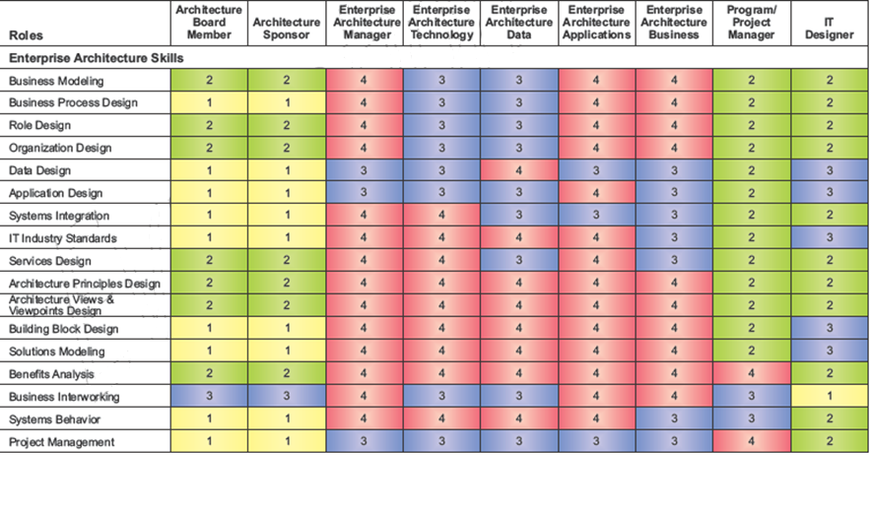
Using the Architecture Skills Framework
Architecture Skills Framework
Example For Enterprise Architecture Skills

Slide 11
Using the Architecture Skills Framework – Role of Enterprise Architect
Architecture Skills Framework
JOB DESCRIPTION
City Planner rather than a Building Architect.
Does not create a technical vision of the enterprise, rather develops professional relationships with executives of the enterprise to gather and articulate the technical vision based on the business plans of these executives.
Needs to work closely within the Architecture Governance process to ensure that all design decisions are following both Business and IT strategy.
Produces documentation of the architecture for application development teams or product implementation teams to execute.
Manage and schedule the work of others segment or solution architects.
KEY ACTIVITIES
Understand and interpret requirements: Probe and listen for information, influence people, facilitate consensus building, synthesize and translate ideas into actionable requirements. Participates in the discovery and documentation of the customers business scenarios that are driving the solution
Create a useful model: Take the requirements and develop well formulated models of the components. Show multiple views to communicate effectively. Ensure architecture integrity and vision and also needs to understand all the business components.
Validate, refine, and expand the model: verify assumptions, bring in subject matter experts, to improve the model and further define it.
Manage the architecture: Continuously monitor the models and update them as changes occur.
KEY CHARACTERISTICS
Skills and Experience in Producing Designs
Extensive Technical Breadth, Technical Depth in one or a few disciplines
Method Driven approach to execution
Full Project Scope Experience
Leadership
Personal and Professional Skills
Skills and Experience in One or More Industries

Slide 12
Summary of Architecture Maturity Models
External Stakeholders
Architecture
Maturity Models
Architecture
Capability

Slide 13
EA Maturity Models
There is no standard model for EA Maturity
Common Traits for all EA Maturity Models
Most are modelled on the Capability Maturity Model Integration (CMMI)
The model has a number of levels(from 4-7) of maturity
Each level has an attribute or characteristic that can be rated based on the maturity of the activities performed by the EA function
Some models make recommendations in what are the areas of improvement.
TOGAF refers to US Government – Dep't of Commerce - Doc ACMM as an example.

Slide 14
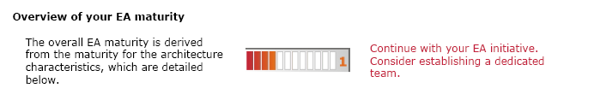
US Government - Doc US ACMM
Open
Downloadable for free,
Levels
Six – None, Initial, Developing, Defined, Managed and Optimizing
Attributes: -
Uses 9 characteristics
Architecture Process
Architecture Development
Business Linkage
Senior Management Involvement
Operating Unit Participation
Architecture Communication
IT Security
Governance
IT Investment and Acquisition Strategy
Provides a means to do the measurement by not a tool as such. However enterprise-architecture.com provides a tool to assist in assessment called Eavaluator.

Slide 15
Summary of the Architecture Governance Framework (AGF)
Internal Stakeholders
Architecture
Board
Architecture
Capability
Contracts
Compliance
Principles
Sponsors,
projects
Architecture Governance Framework

Slide 16
Definition of Governance
A generic prospective to governance
Ensuring that business is conducted properly.
Less about following overt control and strict adherence to rules, more about guidance and effective and equitable usage of resources to ensure sustainability of an organisation’s strategic objectives
Principles of Organisation for Economic Co-operation and Development (OECD)
Focus on rights, roles and equitable treatment of shareholders
Disclosure and transparency and responsibilities of the board
Ensures sound strategic guidance to organisation, effective monitoring and accountability for the company
Characteristics of governance
Discipline : All parties commit to adhering to governance
Transparency : All actions and decisions are provided to all
Independence : All processes , decisions and mechanisms used will be established so as to minimised potential conflicts of interest
Accountability : All identifiable groups involved are accountable for their actions
Responsibility : All parties to act responsibly to the organisation and stakeholders
Fairness : All decisions taken and processes used will not be allowed to create unfair advantage to any one particular party

Slide 17
Definition of Architecture Governance
Architecture Governance is the practice and orientation by which enterprise architectures and other architectures are controlled and managed at an enterprise-wide level. It includes the following
Implementing a system of controls over the creation and monitoring of all architecture components and activities
Implementing a system to ensure compliance with internal and external standards and regulatory obligations
Establishing processes that support effective management of the above processes within agreed parameters

Slide 18
Definition of Architecture Governance
Architecture Governance does not operate in isolation, and is likely to be linked to other governance domains.
Corporate
Governance
IT
Governance
Technology
Governance
Architecture
Governance

Slide 19
Architecture Governance a key step in the development of architectures
Preliminary
A.
Architecture
Vision
H.
Architecture
Change
Management
B.
Business
Architecture
Implementation guidance
is just one aspect of
architecture governance
G.
Implementation
Governance
Requirements
Management
C.
Information
Systems
Architectures
AGF
F.
Migration
Planning
D.
Technology
Architecture
E.
Opportunities
And Solutions
Architecture Governance Framework feeds into the Implementation Governance Step when developing architectures

Slide 20
Architecture Governance – Key Processes
Policy Management and Take-On
Formal process to register, validate, ratify, manage new or updated content
Compliance
Compliance Assessment against SLAs, OLAs, standards etc
Dispensation
Compliance Assessment can be rejected where the subject area is not compliant. In the case the subject area can:
Be adjusted or realigned in order to meet the compliance requirements
Request a dispensation. These are granted for a time period and service and operational criteria may be enforced during the dispensation’s lifespan.
Monitoring and reporting
Performance Management is required to ensure that both the operational and service elements are managed against an agreed set of criteria
Business Control
Relates to the business process invoked to ensure compliance with the organisation’s business policies

Slide 21
Elements of an Effective Architecture Governance Strategy
Cross-organisational architecture board must be established with the backing of top management to oversee the implementation of IT Governance strategy
A comprehensive set of architecture principles should be established to guide, inform and support the way in which an organisation sets about fulfilling its mission through the use of IT
An Architecture Compliance strategy should be adopted – specific measures to ensure compliance with the architecture
1
2
3

Slide 22
AGF – Guidance on Organisational Structure
Cross-organisational architecture board must be established with the backing of top management
CIO
Develop
Implement
Deploy
1
Chief
Architect
Architecture Board
Program Management Office
Service Management
Alignment
Alignment
Guidance
Enterprise
Architects
Risk Management
Monitoring
2
3
Solution
Architects
Solution
Architects
Solution
Architects
Solution
Architects
Solution
Architects
Solution
Architects
Solution
Architects
Implementation Projects
Operational Systems
Conformance
Change
A comprehensive set of architecture principles should be established
An Architecture Compliance strategy should be adopted
Enterprise Continuum
Architectures
Processes
Solutions
SLAs/OLA
Regulatory requirements
Standards

Slide 23
Architecture Board
1
Why is it needed
Preventing one-off solutions and unconstrained developments across the enterprise, which will lead to:
High costs of development
High costs of operation and support due to multiple platforms using non standard infrastructure
Lower quality and Higher risk
Difficulty in replicating and re-using solutions
Can have multiple types of architecture board
Local ( domain experts, line responsibility )
Global ( organisation-wide responsibility )

Slide 24
Architecture Board
1
Responsibilities include
Ensuring the effective and consistent management and implementation of the architectures
Resolving ambiguities, issues or conflicts that have been escalated
Providing advice, guidance and information
Ensuring compliance with the architectures and granting dispensations that are keeping with the technology strategy and objectives
Considering policy changes
Providing a mechanism for the formal acceptance and approval of architecture through consensus
Establishing and maintaining the link the business strategy and objectives

Slide 25
Architecture Board
1
Guidance on the setting up of the Architecture Board
Need Executive Sponsor from the highest level of the corporation
Size of architecture board is a minimum of four or five and no more than 10 permanent members. Rotation is important
Suggested Agenda
Requests for Change
Dispensations
Compliance Assessments
Dispute Resolution
Architecture Strategy and Direction

Slide 26
Guidance on applying Enterprise Architecture Principles
2
The architecture board requires principles and guidance in order to help their decision making.
The Chief architect and his team of architects should provide these principles to the board
The development of these principles need to be agreed across the enterprise

Slide 27
Architecture Compliance strategy
3
Conduct Architecture Compliance review
Ensuring the compliance of individual projects with the enterprise architecture is an essential aspect of architecture governance. An important process that should be formalised by the IT Governance is Architecture Compliance review process.
Develop Architecture Contracts
The use of Architecture Contracts will help ensure the quality of the deliverables and fitness-for-purpose of the architecture

Slide 28
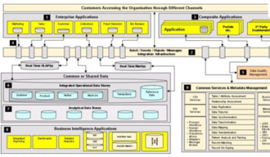
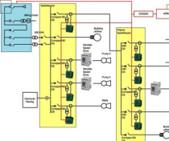
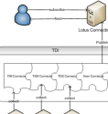


Architecture Compliance strategy - Conduct Architecture Reviews
3
Ensuring the compliance of individual projects with the enterprise architecture is an essential aspect of architecture governance. IT Governance function within the enterprise will normally define two complementary processes
Architecture function preforming solution architectures
Solution Architectures
Do these solution architecture
comply with Enterprise
Architecture’s standards and principles etc.?
IT Governance

Slide 29
Architecture Compliance strategy - Conduct Architecture Reviews
3
What is Architecture Compliance?
Ensuring that the implementation of an architecture is “in accordance with” its specification.
“In accordance with” means:-
Supports the stated strategy and future direction
Adheres to the stated standards
Provides the stated functionality
Adheres to the stated principles
Architecture
Specification
Irrelevant:
No features in common
Implementation
Consistent:
Where there is commonality the implementation complies. However there are elements in the spec, not handled by the implementation and elements in the implementation not asked for in the spec
Compliant:
Some features not implemented but the elements that were implemented fully comply
Conformant:
All the features in the spec are implemented but some elements are implements that are no in accordance with it
Full Conformant:
Full compliance between spec and its implementation. No features outside spec implemented
Non- Conformant:
Any of the above in which some features in the architecture specification are implemented not in
accordance with the specification

Slide 30
Architecture Compliance strategy - Conduct Architecture Reviews
3
Goals of Architecture Review
Catch errors in project architecture early thus reducing the costs and risks
Ensure that best practices are applied to architecture work
Overview of compliance of an architecture to mandated enterprise standards
Communicate to management the technical readiness of a project
Identify key criteria for procurement activities
More political goals
Keep the Architecture Function involved in the projects to help their understanding of the systems that are and will be used by the business
Allow CIO to assist decision making in business projects
Increase profile of Architecture function with business stakeholders.
Management of System integrators

Slide 31
Architecture Compliance strategy - Conduct Architecture Reviews
3
Q: When should Architecture Compliance reviews be done?
A: As soon a practical, at a stage when there is still time to correct any major errors or shortcomings with the obvious proviso that there needs to have been some significant development on the architecture in order to have something to review. E.g.
After the initial development of the architecture itself in a project
After the implementation of the developed architecture
After any major design change in a project

Slide 32
Architecture Compliance strategy - Conduct Architecture Reviews
3
The process of Architecture Compliance Review
Larger projects with practicing or full-time architect involved
EA deeply involved in project under review
Review conducted by lead EA or member of Architecture Board and will set-up a virtual team and compile the answers to a large list of questions to create a report
Project with no practicing or full-time architect to date
EA will be organising and conducting the review with business domain experts
EA provides some informal best practice guidance to the project
Small scale projects
Series of questions using a checklist that project leaders ask themselves
Answers form a project report
Report could be given to architecture board

Slide 33
Architecture Compliance strategy - Conduct Architecture Reviews
3
Example of an Architecture Review Process
To address business requirements
Architecture Review
Co-ordinator
To get background and technical information. Use the checklists
Lead
Architect
Identify Responsible Organization
Identify Lead Architect
Determine scope of review
Tailor Checklists
Schedule Architecture review meeting
Interview Project Principals
Analyse Completed Checklists
Prepare Architecture Review Report
Present Review Findings
Accept, Review and Sign off
Architecture
Board
Identify which other business units/departments are involved. Understand where the system fits in the corporate architecture framework
Review against corporate standards. Identify and resolve issues. Make recommendations
Project Leaders,
Customers
Project Leaders,
Customers

Slide 34
Architecture Compliance strategy - Conduct Architecture Reviews
3
Example of Checklists (Pg 635)
Hardware and Operating System
Software Services and Middleware
Applications
Infrastructure Applications
Business Application
Application Integration Approach
Information Management
Data Values
Data Definition
Security/Protection
Hosting, Data types and Sharing
Common Services
Access Method
Security
System Management
System Engineering/ Overall Architecture
General
Processors/Services/Clients
Client
Application Server
Data Server
COTS
Systems Engineering/Methods and Tools

Slide 35
Architecture Compliance strategy - Use Architecture Contracts
3
Architecture contracts are the joint agreements between the development partners and the sponsors on the deliverables, quality, and fitness-for-purpose of the architecture
By implementing a governed approach to the management of these contracts, the following are ensured:-
Continuous monitoring to check integrity, changes, decision making and audit of all architecture activities within organisation
Adherence to principles and standards
Identification of risks in all aspects of the development and implementation of the architecture
Formal understanding of the governance organisation responsible for the contract, the level of authority and scope of the architecture under governance of this body

Slide 36
Architecture Compliance strategy - Use Architecture Contracts
3
Architecture Contracts can occur at various stages of the architecture’s development method (ADM):-
Statement of architecture work, contract between development partner and sponsor
Development of one or more architecture domains, could be contracted out to system integrator or service provider etc.
At the handover of the architecture for implementation in beginning of Phase G
At the handover from implementation to support at the end of Phase G
Preliminary
Statement of work
Handover from implementation to business users
A.
Architecture
Vision
H.
Architecture
Change
Management
B.
Business
Architecture
G.
Implementation
Governance
Requirements
Management
C.
Information
Systems
Architectures
F.
Migration
Planning
D.
Technology
Architecture
E.
Opportunities
And Solutions
Handover from architecture function to implementation partner
Development of one or more of the architecture domains

Slide 37
Architecture Compliance strategy - Use Architecture Contracts
3
Types of architecture contract
1. Statement of work
A standard deliverable of the ADM Phase A that includes a detailed description of the scope and approach used to conduct the architecture work
2. Contract between architecture design and implementation partners
Signed contract of intent on designing and developing the enterprise architecture, or significant parts of it from partner organisations, including system integrators etc
This allows good management of out sourced components of the ADM. Typical contents include: - Scope, architecture principles and requirements, conformance requirements, architecture development, prioritised work plan, timeframe
3. Contract between architecture function and business users
This is a signed agreement to conform to the enterprise architecture by the business users.
Similar in content to previous contract exception SLA and a more service architecture focus in the provision of service architecture

