Slide 1


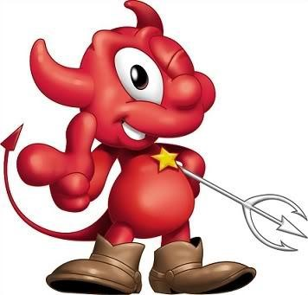
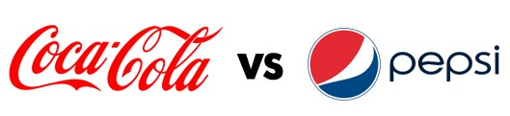
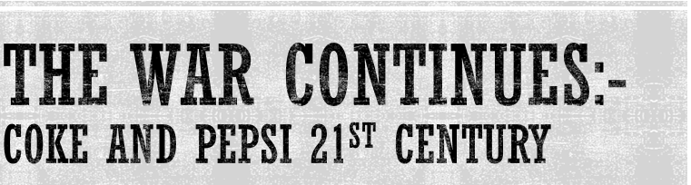

Slide 2
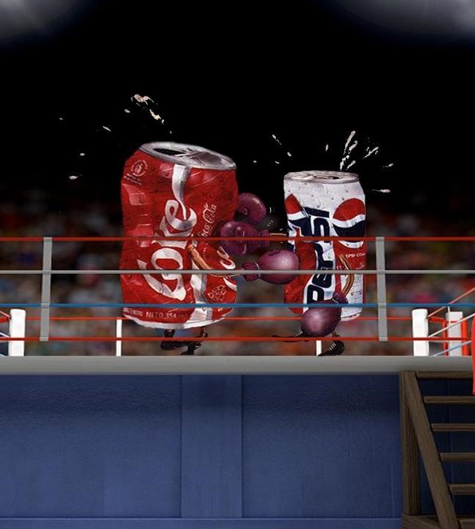
Presented to You by
13203-Smruthi Buddu
13209-Sushant Sawant
13228-Shreyasi Joshi
13242-Sonal Attarde
13249-Ashish Kamble
13271-Sulabh Subedi
(2013-2015)

Slide 3
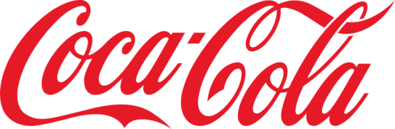
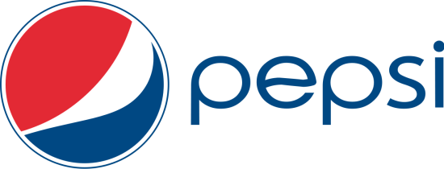
Background
Americans consumed 23 gallons of CSDs annually in 1970
Consumption grew by 3% per year over the next 3 decades
Increasing availability of CSDs and introduction of diet and flavored varieties
Non-cola CSDs were introduced

Slide 4
History
Coca cola was formulated by John Pemberton in 1886 in Atlanta, Georgia, who sold it at drug store soda fountain as potion for mental and physical disorders. In 1899, Candler granted coca cola’s first bottling franchise and network grew quickly.
During 1920s and 1930s, woodroof(CEO) developed coke’s international business. During the world war II,64 coca cola bottling plants were set up. This contributed to Coke’s dominant market shares in most European and Asian countries.

Slide 5
History
Pepsi cola was invented in 1893 in New Bern, North Carolina by pharmacist Caleb Bradhan.
Like coke, pepsi adopted a franchise bottling system, and by 1910 it had built network of 270 franchised bottlers.
But in 1923 and in 1932, pepsi struggled and declaring bankruptcy. Pepsi lowered the price and tried to expand its network.
In 1938, coke filed suit against Pepsi, claiming Pepsi-cola was an infringement on the coca-cola trademark. In 1941, court ruled in favor of Pepsi. And Cola wars began.

Slide 6
Production & distribution of CSD
concentrate producers
Bottlers
Retail channels
suppliers

Slide 7
Concentrate Producer
The concentrate producer blended raw material ingredients, packaged it in plastic canisters and shipped it to bottler.
Concentrate manufacturing plant cost: approximately $25 million to $50 million
Product planning, market research and advertising programs are implemented by concentrate producers.

Slide 8
Bottlers
Bottlers purchased concentrate, added carbonated water and high fructose corn syrup, bottled the CSD and delivered it to customer accounts.
Coke and pepsi bottlers offered “direct store door” delivery.
Cost of bottling plant: $25million to $35 million
Cooperative merchandizing agreements is a key ingredient of soft drink sales.
Packaging accounted for 40% to 45% of sales, same for concentrate and sweeteners for 5% to 10%.

Slide 9
Retail channel
Supermarkets
Vending machines
Convenience stores
Fountain Outlets
Other outlets

Slide 10
Suppliers
Majority of US CSD’s are packaged in Metal cans, Plastic bottles, Glass bottles.
Major “CAN” producers
American national can
Crown cork and seal
Reynolds metal

Slide 11
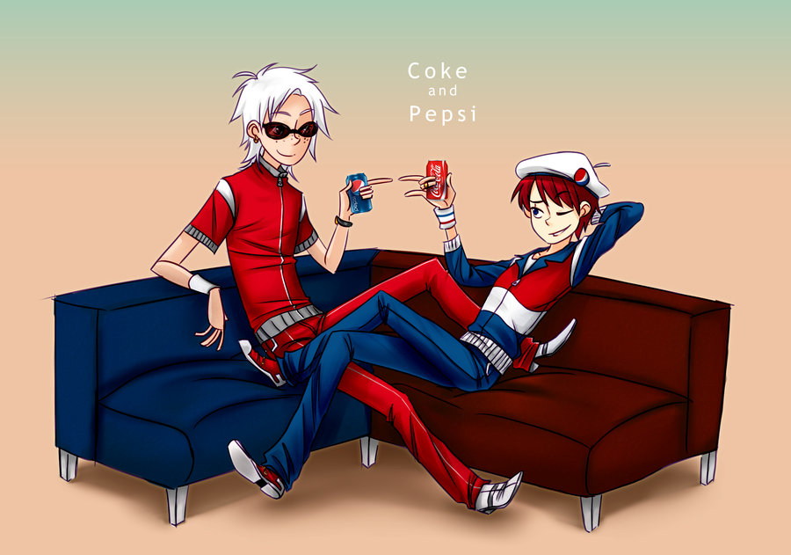
STRATEGIC PATH

Slide 12
Stage 1 – (1970 – 1990)
Major Events
Coke had fragmented bottlers, >800 franchised High-fructose corn syrup replaces sugar Price cuts , discounts and rebates to counter “Pepsi Challenge”. New Coke fails, Coca Cola Classic returns Coca Cola Enterprises established Maintains lead in cola market share | In 1974, The “Pepsi Challenge” In 1970’s sold concentrate to bottlers at 20% lower rate than Coke. Pepsi Lite (1 Calorie) introduced In 1978, 15% increase in price of concentrate. Enters fast-food business Outpaces Coke in food store sales

Slide 13
Strategies Adopted
Product Development and Line Extension – 11 new products in 80’s Forward Integration - CCE, independent bottling subsidiary of coke in 1986. Divestment – Non CSD businesses were sold off. Low – pricing strategy and increase on advertising expenditure. Re-franchising bottling operations | Product Development and Line Extension – 13 new products Diversification – Acquired Pizza Hut, KFC, Taco Bell Low – pricing strategy and increase on advertising expenditure. Expansion in bottling by major acquisitions.

Slide 14
Stage 2 – (1991- 2010)
Major Events
Association of CSD’s to obesity Wins Subway account, retains exclusive deals with Burger King and McDonalds Holds big lead over Pepsi in cola market Legal Issues and Currency crisis in Russia and Asia. | Association of CSD’s to obesity Snack food lines very profitable Impact of Venezuela crisis Challenges of internationalization. Pepsi Bottling Group (PBG) is established in 1999.

Slide 15
Strategies Adopted
Growing attention to bottled water category. Packaging Innovation – Fridge Pack (2001) Introduction Diet Coke (2005) and Coke Zero (2005) to tackle obesity issue. | Concentric Diversification Product Development – Aquafina (1998) Market Development – Sierra Mist (2000) and Mountain Dew Code Red (2001) Pepsi declared itself as a total beverage company and move more aggressively in non CSD’s segment. Treating Diet Pepsi as its flagship brand.

Slide 16

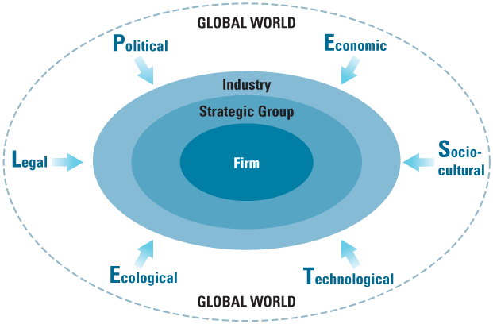
PESTEL ANALYSIS

Slide 17
POLITICAL
Government influence all 5 forces of porters model.
Trade, tax policy, labor laws, amount of permitted goods and services by government.
Food & drug Administration (FDA)
Political Condition in international market Unrest or change in government
Inability to penetrate market due to conflict, war
Fines for different rules & regulations
Changes in laws & regulation
Land acquisition and permits
Import – export regulations
India- Food, drug & cosmetic Act, Occupational Safety & health Act
Foreign, State & local laws
ex. Case against Coca cola by Government of kerala in 2010
Notes:
Ex. State gov. of kerala, march 22- 2010, filled case against coca cola saying it is responsible for causing polluiton & water depletion of state of kerala and made it liable for Rs. 216 crore for damaged caused as a result of company’s bottling operation.
Coca cola lost brand value and sales for some time then.
high court gave result in favour of coca cola saying water depletion was due to rain problem and not because of coca cola company.

Slide 18
ECONOMIC
Growth rate, interest rates, employment rates, currency exchange rates, inflation rate
Purchasing power of customers
Revenue
Accounting standards
Cost incurred- raw material, wages
Fuel Prices- Distribution network
Fluctuation in market, money supply, business cycle
Different Strategy for- underdeveloped, developing, rural-urban
ex. Net operating profit for coca cola outside US stands 72%. Companies uses 64 various types of currencies

Slide 19
SOCIAL
Lifestyle changes- its base in advertising campaign
Company has to adjust with changing society
Adopting management strategies to adopt the social trends
Important to know culture before entering the market
Consumer & Gov. are increasing awareness of public health consequences, mainly obesity
Diversity management
Age distribution of country
Main consumer- young & children
Old celebrates with alcohol
Age 37-55 years- concerns nutrition
Time saving product for many homes
Ex. Coca cola donates 1% of profits to charity in spain & creates friendly company range
Coca cola has been awarded Social & Corporate governance award for best practices in corporate social responsibility in 2009
Notes:
Ex. Coca cola india has been awarded Social & corporate governance award for best practices in corporate social responsibility in 2009. in next year, 2010-kerala case
Ex. In 2007 & 2008, pepsico honoured by environment protction agency (EPA) “energy star partner of year” for energy conservation

Slide 20
TECHNOLOGICAL
Production & Distribution cost control and up gradation
Availability whenever and wherever with affordable price. (ex. vending machine)
Labeling & Packaging ( recyclable bottles, cans, plastic bottles)
Marketing & promotion programs (internet, TV.)
New machineries for higher production with minimum costs, top quality
Newer & attractive Designs
Social networking sites
Supply chain management & improve efficiency
ex. Sodastream international limited- do-it yourself, beverage carboration system
Notes:
Ex. SodaStream is the maker of a consumer home carbonation product. SodaStream is currently headquartered in Israel.
Since Coca-Cola agreed Feb. 5, 2014 to buy a 10 percent stake in Green Mountain Coffee Roasters Inc. (GMCR), a company developing a make-your-own, single-serve product similar to SodaStream’s, short interest on the stock has fallen. (bloomberg)
the number one "fundamental theme" in soft drinks centers around "Changing consumer beverage preferences, featuring a shift toward health-oriented wellness drinks." SodaStream plans to pounce on this trend by doubling down on its marketing of the "health and wellness" aspects of its products. And there's reason to believe it could succeed in setting itself apart from brands like Coke and Pepsi.

Slide 21
LEGAL
Change in laws and regulations may results in change in costs & capital expenditure
Company must ready to future changes in laws and ready to adopt
Discrimination laws, customer laws, employment laws, antiturst laws, health & safety laws
Advertising and labeling laws
Environmental protection act
ex. Federal food, drug and cosmetic act, trade commission act, occupation safety, health act
Sales, distribution, production all come under different acts in different countries.
Notes:
Ex. In kerala case, coca cola said it was target of handful of extremist protesters.

Slide 22
ENVIRONMENTAL
Pollution & global warming issues
Sales variation with Weather conditions & seasons
Local, national, world environmental laws
Waste management
Recycling- renewable plastics
ex. Coca cola developed innovative energy managing system that delivers energy savings of up to 35%
Notes:
Ex.- According to ngo- it requires 9 lit water to make 1 lit of cola. According to coke- 3.2 lit.
In 2000, pepsico filled antitrust lawsuit against coca cola for monopolistic approach.
coca cola built $60 million world’s largest plasticbottle-to bottle recycling plant and support recycling in us.

Slide 23
Porter’s Five Forces Model
Competitive Rivalry
Barriers to Entry
- High
Bargaining power of buyers - Low
Threat of substitutes
Bargaining power of Suppliers - Low

Slide 24
Intensity of competitive rivalry
Duopoly with Coke and Pepsi
Unequal size competitors
Growth rate of the soft drinks market
Fixed storage cost
Differentiation
Notes:
The industry is almost dominated by the Coke and Pepsi. This industry is well known as a Duopoly with Coke and Pepsi as the companies competing. These both players have the majority of the market share and rest of the players have very low market share. Otherwise; competition is comparatively low to result any turmoil of industry structure. Coke and Pepsi primarily are competing on advertising and differentiation rather than on pricing. This resulted in higher profits and disallowed a decline in profits. Pricing war is nevertheless experienced in their global expansion strategies.
Composition of Competitors
Except the Coke and Pepsi other competitors are of unequal size especially in local markets. Coke and Pepsi both players have the majority of the market share and rest of the players have very low market share.
Scope of Competition
Scope of competition in this industry is generally global; Coke and Pepsi are approximately presents in 200 countries.
Market Growth Rate
The soft drinks business will not see growth in near future, with the smoothie and bottled water sectors mainly hit by a decline in 2008, and across all sectors volume declined by 1.1 percent.
Fixed Storage Cost
This industry needs huge manufacturing plants and contracts with bottling network companies. These contracts make sure that bottler’s must have standard manufacturing plant; these plants need huge capital and exertion.
Degree of differentiation
Marketing and Product differentiation have become more significant. Coke and Pepsi mainly are competing on advertising and differentiation rather than on pricing. Coke has diverse advertisement campaigns according to conditions. Coca-Cola is recognized as the best-known brand name in the globe. More prominently, its consumers would not do without it, and have established a loyalty.

Slide 25
Bargaining power of buyers
Different buyers
Fast food fountains – high
Vending machines – low
Convenience stores – low
Supermarkets and food stores – medium
End customers – low switching cost, not an essential product
Notes:
Fast Food Fountain
Pepsi and Coke mainly regard this segment as “Paid Sampling” due to small margins. This division of buyer’s is the slightest profitable because of the high bargaining power of the buyers. The bargaining power of the buyers is high because they purchase in bulks.
Vending Machines
Vending Machines provide products to the customers in a straight line with enormously no power with the buyer.
Convenience Stores
This segment is tremendously fragmented and has no bargaining power due to which it has to pay superior prices.

Slide 26
Bargaining power of suppliers
Few inputs like phosphoric/citric acid, natural flavors, caffeine, sweetener, etc which are basic commodities
Easily accessible to manufacturers, thus switching cost is low
Notes:
The suppliers of these commodities have no bargaining power over the pricing due to which the suppliers in soft drink industry are relatively weak.

Slide 27
Barriers to entry
Advertising and marketing
Customer loyalty/brand image
Significant margins to retailers
Huge investments in bottling
Notes:
Coke classic - $207 million
Pepsi $130 million
Total of top 10 brands- 604 million- exceptionally hard for a new competitor to struggle with the current market and expand visibility.
Pepsi and Coke have been investing huge amount on advertisement and marketing throughout their existence. This has resulted in higher brand equity and strong loyal customers’ base all over the globe. Therefore, it becomes nearly unfeasible for a new comer to counterpart this level in soft drink industry.
This industry provides significant margins to retailers. For example, some retailers get 15-20% while others enjoy 20-30% margins. These margins are reasonably enough for retailers to entertain the existing players. This makes it very difficult for new players to persuade retailers to carry their new products or substitute products for Coke and Pepsi.

Slide 28
Threat of substitutes
Many substitutes: tea, coffee, juices, water, beer, etc and switching cost is low
Massive advertising and brand loyalty
Large distribution network – making products easily accessible to customers
Notes:
This industry is enriched with enormous statistics of substitutes such as: water, tea, beer, juices, coffee, etc presented to the end-consumers. But all the suppliers of these substitutes need massive advertising, brand equity, brand loyalty and making sure that their brands are effortlessly accessible to the consumers. Most of the substitutes cannot counterpart the existing players’ offers or diversify business by offering new product lines of the substitute products to safeguard themselves from rivalry.
Aggressiveness of substitute products in promotion
Soft drink industry companies spend huge amount of money on advertisement and marketing to differentiate their products from others and also create brand equity, base of loyal customers and increase visibility.
Switching Cost
Switching cost of the substitute products is very low so consumers can easily shift towards the substitute products.
Perceived price/ value
Perceived price/value in this industry is very low because all products are comparatively same and are only differentiated by promotional activities.

Slide 29
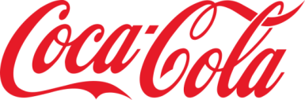




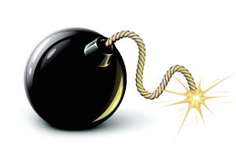
S.W.O.T Analysis -
Strengths
Weakness
Opportunities
Threats

Slide 30
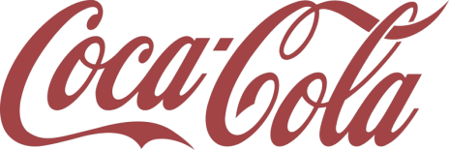
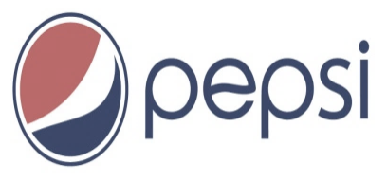
S.W.O.T - Strengths
First mover advantage.
Dominator of fountain market with 65 % of market Share
More loyal customer base.
Large market share of 44.1%.
International Brand recognition.
Huge distribution network.
Strategic move during world wars.
Efficient diverse global operations
Guerrilla Marketing strategies.
More focus on young generation.
International Brand recognition.
Huge distribution network.
Innovative advertising strategies.
More flexible franchise network.

Slide 31
S.W.O.T - Weaknesses
Moving away from core competencies.
Brand Failures
Product Recalls
Smaller market than Coke.
Slower take off in international markets.
Imitation of Coca-Cola.

Slide 32
S.W.O.T - opportunities
Entry into new developing international markets.
Introduction of newer brands.
Innovative advertising strategies.
Introduction of “Pepsi Health Drink”.
Entry new developing international markets.
Introduction of newer brands.

Slide 33
S.W.O.T - Threats
Fear of losing market share due to rapid market fluctuations.
Barriers of entry in international markets.
Decreasing brand loyalty among consumers.
New age beverages.
Fierce competitors in local markets; Private labels at low prices.

Slide 34
The Battle For India
VS

Slide 35
Introduction
Both Coke and Pepsi departed India prior to 1987, Coke in 1977 and Pepsi in 1961, and were to return in 1993 and 1989 respectively.
Indian Soft Drink Industry
Estimated US$380 million annual sales volume.
75% market share is with Parle group.
Tea was a popular substitute to Cola.
Parle’s Thums Up held 36% in Cola segment
Soft drinks were sold at variety of retail channels.

Slide 36
Entrance of Pepsi
First Entry Proposal – 1985 – 35% equity by Pepsi
Other stakeholders – PCI ,Duncans, PAIC
Import of Pepsi concentrate to be sold to local bottlers and marketed throughout the country.
Denial of proposal and raised opposition
Second Entry Proposal – 1986 – 39.9% equity by Pepsi
Other stakeholders – Voltas and PAIC
Local manufacturing of soft drinks.
Export – import ratio 5:1
In 1994, pepsi had 32% market share in Indian market.

Slide 37
Entrance of Coke
Entry in 1993 via agreement with Parle Exports and purchase of Parle’s local brands.
Construction of concentrate plant and bottling operations.
60% market share from Parle’s brands and used Parle’s bottlers as franchise.
Broke-even in one year and then targeted national distribution.

Slide 38
Porter’s Six Forces Model
Competitive Rivalry
Barriers to Entry
- High
Bargaining power of buyers - Low
Threat of substitutes
Bargaining power of Suppliers - Low
Government

Slide 39
SWOT(PEPSI)
STRENGTHS International Brand and Global Experience Benefitted by learning from Coca Cola mistakes in India from 1958 to 1977 Good Market Research on Indian market Willingness to comply with stringent Indian Laws | WEAKNESS Lack of Experience in Indian market
OPPURTUNITIES Early entry (1980) facilitated no competition from any major International Brand India huge size market with availability of raw materials locally (vegetables) In 1988, local brands forced to withdraw from market due to carcinogenic ingredient (BVO) | THREATS Unfriendly political environment and Indian legal framework. Competition from local manufacturers Low demand in Indian market for carbonated drinks Heterogeneous nature of Indian market Poor infrastructure especially in rural India

Slide 40
SWOT(COCA-COLA)
STRENGTHS Well established Global Brand Prior knowledge of Indian market (1958-1977) Tie up with local players (Britannia Ltd) Strong Fiscals to acquire local business (bottling plants/local brands) | WEAKNESS Improper appreciation of existing Indian Laws at entry time
OPPORTUNITIES Liberalization of Indian economy after 1991 Availability of better infrastructure Local bottling plants were available for sale Better acquisition opportunities (purchase of brands such as Thums Up, Limca, Citra, Gold Spot & Maza from Parle) Scope for marketing diversified products (fruit drinks, soda and packaged water) | THREATS Strong Competition from Pepsi and other local brands due to late entry (1993) Stricter legal framework (40% equity to Indian Investors) Decreasing popularity of carbonated drinks in India Threats of disclosure of concentrate formula “MERCHANDISE 7X” to local partner.

Slide 41
QUESTIONS
Who won the war?
What is current market & future of CSD?
With this fierce war, is this CSD business profitable?
What are the major challenges/opportunities for CSD?
Is there any difference in strategies between Coca- Cola and Pepsi in current Soda Tussle?

Slide 42

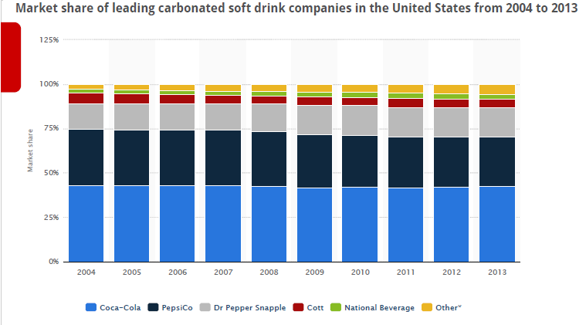
FACTS

Slide 43

U.S. Non-Alcoholic Beverage Market Share, % share by volume
Company | 2005 | 2009 | 2011
Coca-Cola | 30% | 42.8% | 43%
Pepsi-Cola | 22.6% | 31.1% | 31%
Cadbury Schweppes | 10.6% | 15% | 18%
Other | 36.9% | 11.1% | 8%

Slide 44
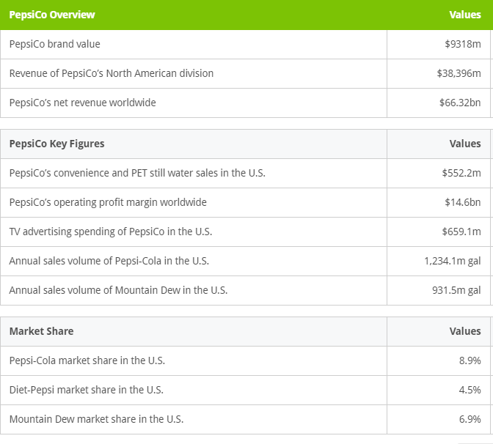

Slide 45
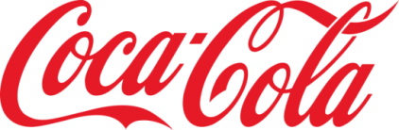
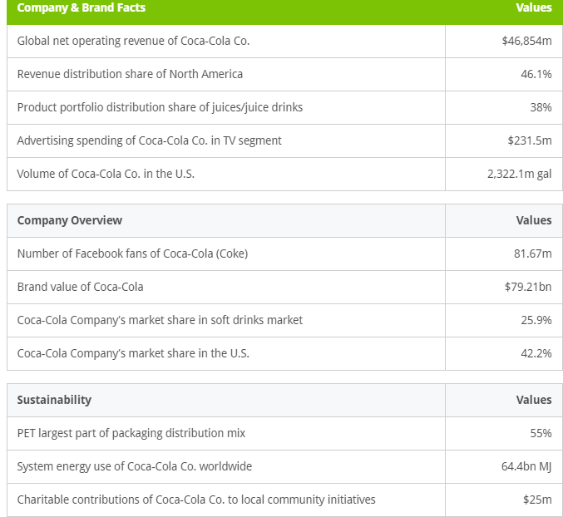

Slide 46
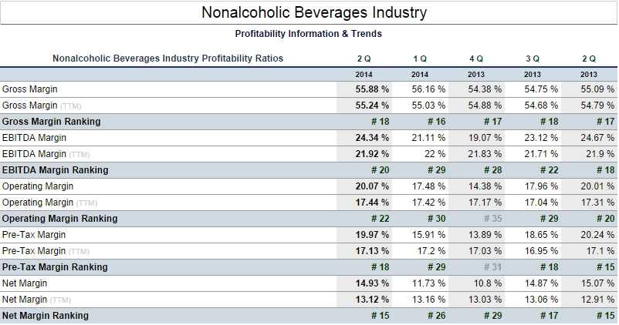

Slide 47
CURRENT FACTS
Coca-Cola is winning the cola war (csd). Coke controls 42% of the total carbonated soft drink market, compared with Pepsi's 30%, according to Beverage Digest.
In 2013, Coke products could be found in over 200 countries worldwide, with consumers downing more than 1.8 billion company beverage servings each day.
PepsiCo's brands generated retail sales of more than $1 billion apiece, and the company's products were distributed across more than 200 countries.
Due to changing tastes and health awareness, substitutes, both csd brands have been in decline. Profitability is also decreasing with stagnating growth.
Soda remains 75% of Coca-Cola's global sales.
Pepsi's snack division makes up about 50% of the company's sales volume.
Soda is just 25% of the Pepsi’s U.S. sales compared to 60% of Coca Cola's.
Coca-Cola and PepsiCo together dominate the market for carbonated soft drinks in India. Coke accounted for 60% of retail value sales of carbonated soft drinks in India in 2012 versus PepsiCo's 37%, according to data from Euromonitor International.

Slide 48
LEARNINGS
Global mindset
Competitor strategy
Gov has influence on all other 5 forces of porters model. Political changes cannot be anticipated
Know your Consumer and Environment. Ultimately customers decide which product they want.
Manage Local competitors
When and how to do diversify
Market entry- exit strategy
secrecy about your technology, formula is the icing sugar.
Multiple competitive advantages to succeed and lead in competition
You can copy and learn then make better than original. Invest in R & D and make new innovations

Slide 49
Environmental mapping
Reaching to doorsteps of customers wherever and whenever they want- Direct store delivery (DSD)
Pricing control
Anticipate competitors attack & prepare for defense or counterattack strategy
Mutual understanding - not to destroy industry
Creativity is important in marketing
Taking help of government, local player, lobbying if possible
Managing supply chain - value chain
How and when to bridge contracts
Backward and forward integration
Importance of regulator like federal trade commission
Special strategy for instability
Managing internal opposition
Leadership advantage
Uncontrolled environmental actions
Cultural Diversity management

Slide 50
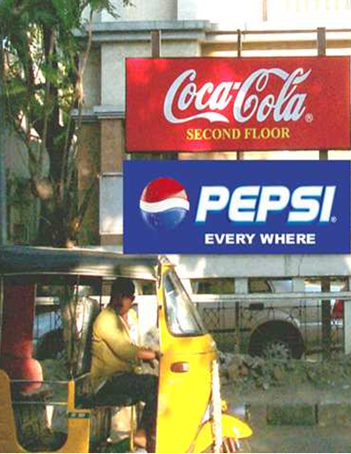
THANK
YOU!

