Slide 1

Introduction to Bash
Ian Miell
Twitter: @ianmiell
Ian.miell@gmail.com

Slide 2
Bash and Me
Used throughout career
Never learned formally
Stumbled around, lots of mistakes
Slowly learned concepts and key points
Wrote a book

Slide 3
This Course
Live Walkthroughs
Encourage you to follow - ‘Hard Way’ Method
Exercises
Group chat
Materials:
https://github.com/ianmiell/introduction-to-bash

Slide 4
Pre-Requisites
Familiar with command line
Bash version 4+
$ echo $SHELL
$ bash --version
<4 is still ok
Using zsh (eg on Mac)
Type ‘bash’ to get a bash shell
Basic shell utilities (eg grep, cat, ls)
Any editor (I use vim)

Slide 5
Why This Course?
Bash is everywhere
Shells are everywhere
Work with it every day
Taken for granted that it’s known
Studying it pays massive dividends
Gateway to deeper OS concepts

Slide 6
Bash is under-served
Man page is hard to follow if you don’t know the jargon
One-liners are easy to find but concepts give you real power
Guides that assume knowledge you may not have

Slide 7
Target Audiences
No knowledge assumed
Advanced questions outside the course please
‘Hardly/never used bash’
Coverage of 90% of bash features
‘Used bash casually for a while’
Refresher on some topics, learn some new things
‘Used bash for years, but never studied’
A-ha moments

Slide 8
Ever been confused by…?
Diffference between ‘[‘ and ‘[[‘
Globs vs regexes
Single vs double quotes
Difference between `` and $()
How a bash script is created

Slide 9
Recently I’ve used bash to…
Fix a Terraform script
Write and debug various CI/CD pipelines
Robustly apply changes in a cloud-init VM script
Automate the renaming of files with spaces in my backup folders
Setup environments at work

Slide 10
Poll - Experience
Never used bash
Used bash for <2 years
Used bash for >2 years
Used bash for >5 years
Studied bash seriously

Slide 11
Structure of Course
Part I – Bash Basics
Part II – Further Bash Basics
Part III - Scripting

Slide 12
Discussion
What do you want to achieve in bash?
Any specific goals?
What have you been frustrated by with bash?

Slide 13
Part I – Bash Basics
1.1 Bash background
1.2 Variables
1.3 Globs
1.4 Pipes and Redirects

Slide 14
1.1 What is Bash?
What is a shell?
A program takes input from a terminal
Translates input into:
System calls
Calls to other programs
Computation within the bash program
Bash excels at ‘gluing’ other commands together

Slide 15
Other shells
sh
ash
ksh
tcsh
zsh

Slide 16
What is Bash? - Walkthrough
Run tcsh from bash

Slide 17
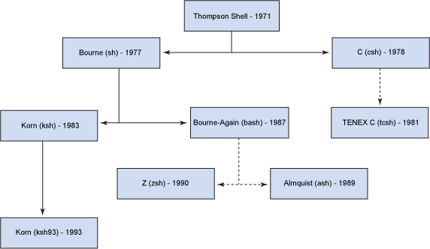
History of Shells

Slide 18
Bash in the Market
Most popular shell
Lots of competition:
zsh now default on mac
fish is also popular
Very rarely, you find servers that don’t have bash on still

Slide 19
1.2 Variables
Basic variables
Quoting variables
‘env’ and ‘export’
Simple arrays

Slide 20
Variables - Recap
$ dereferences
Variables in double quotes are interpreted, single quotes not
Exported variables are passed to programs run within the shell
Env shows exported variables, ‘declare’ shows all variables

Slide 21
1.3 Globbing
What is a glob?
What does ‘*’ mean?
Differences to regular expressions
Not familiar with regexes?
Dotfiles

Slide 22
Recap - Globs
What a glob is
What a dotfile is
Special directory files
Globs, regexps and dots

Slide 23
1.4 Pipes and Redirects
Basic redirects
Basic pipes
File descriptors
Special files
Standard out vs standard error

Slide 24
Pipes and Redirects - Walkthrough
Simple pipes and redirects
Standard in/out/error
File Descriptors

Slide 25
File Descriptors (I)
Every process gets three file descriptors:
0 - ‘standard input’
1 - ‘standard output’
2 - ‘standard error’
‘Normal’ output goes to file descriptor 1
Programs generally output errors to file descriptor 2
Normally ‘stderr’ and ‘stdout’ both go to the terminal – but you can change that!

Slide 26
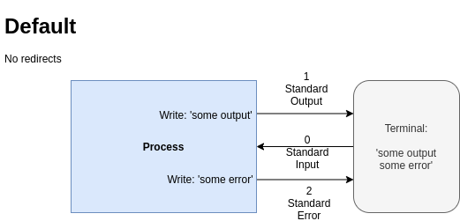
Pipes and Redirects

Slide 27
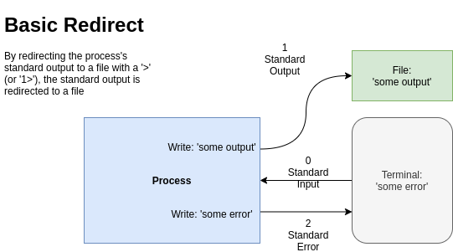
Pipes and Redirects

Slide 28
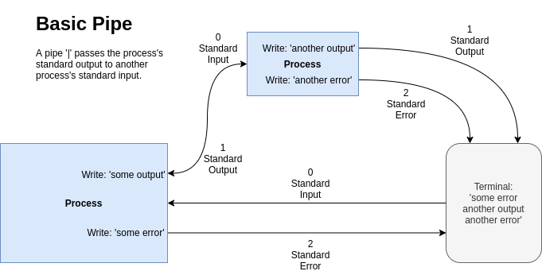
Pipes and Redirects

Slide 29
File Descriptors (II)
‘>’ operator sends standard output to a file
‘1>’ is the same (1 is assumed)
‘2>’ sends standard error to a file
‘|’ sends standard output to a process
Advanced, but often seen:
2>&1 sends standard error to whatever standard output is pointed at
A way of sending ‘all’ output to a file

Slide 30
Recap – Pipes vs Redirects
The main 3 file descriptors
‘>’ vs ‘|’
n> and standard error
2>&1 and ordering

Slide 31
Part I Recap
Globs
vs regexps
Variables, arrays
Pipes and redirects
File descriptors

Slide 32
Exercise I / Break

Slide 33
Part II – Further Bash Basics
2.1 Command Substitution
2.2 Functions
2.3 Tests
2.4 Loops
2.5 Exit Codes

Slide 34
Discussion
Is bash a programming language?
What is a programming language?
Why has bash lasted so long?

Slide 35
2.1 Command Substitution
The ‘$()’ operator
$() vs ``
Nesting

Slide 36
2.2 Functions in Bash
Four types of command:
Function
Alias
Program
Builtin

Slide 37
2.3 Tests
Bash tests
Different ways of writing tests
Logical operators
Binary and unary operators
‘if’ statements

Slide 38
2.4 Loops
‘C’-style for loops
‘for’ loops over items ‘in’ lists
‘while’ loops
‘case’ statements

Slide 39
2.5 Exit Codes
What an Exit Code is
The ‘$?’ variable
How to set one
Exit Code conventions
Other ‘special’ parameters

Slide 40
Standard Exit Codes
0 – OK
1 – General Error
2 – Misuse of shell builtin
126 – Cannot execute
127 – No file found matching command
128 – Invalid exit value
(128 + n) – Process killed with signal ‘n’
(Signals covered in Part IV)

Slide 41
Recap – Exit Codes
Standard exit codes
Exit code usage (eg grep)
Setting exit codes
‘return’ing from functions
Special parameters

Slide 42
Discussion / Recap – Part II
Bash more as programming language:
Functions
Tests / ifs
Loops
Return/Exit codes
Process and command substitution
$() vs ``

Slide 43
Exercise II / Break

Slide 44
Part III - Scripting
Scripts and Startup
The ‘set’ Command
Debugging in bash
Subshells
IFS

Slide 45
3.1 Scripts and Startup
What shell scripts are
What happens on bash startup
This has cost me many hours!
Executable files
‘source’ vs ‘./’

Slide 46
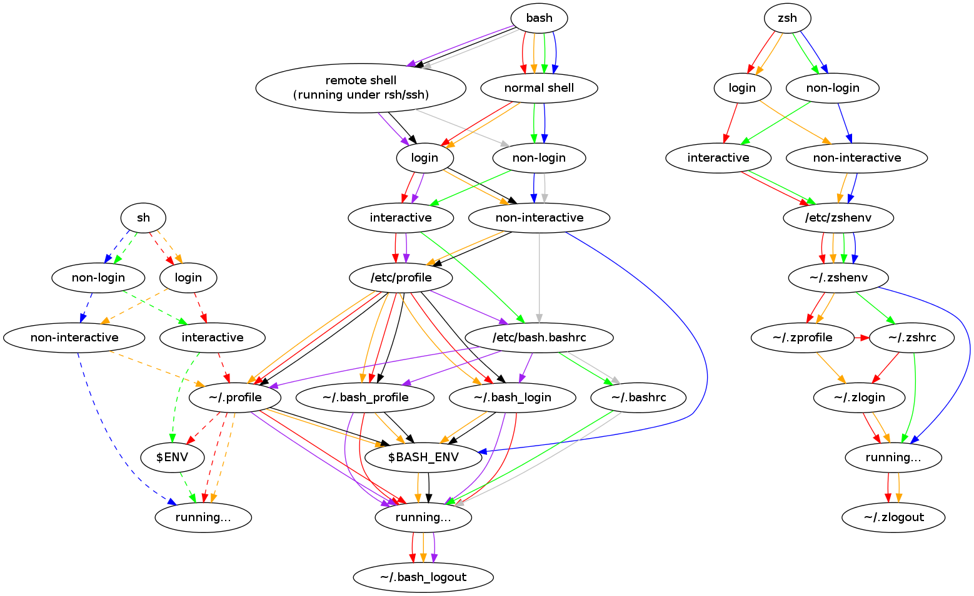
Walkthrough – Startup Explained

Slide 47
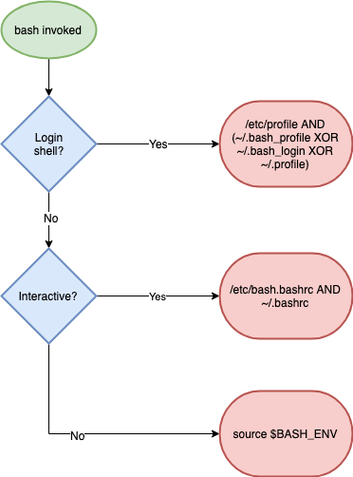
Walkthrough – Startup Explained (simpler)

Slide 48
Recap - Scripts and Startup
What shell scripts are
How complex bash startup can be
Keep diagram handy!

Slide 49
3.2 The ‘set’ builtin
Setting options in bash
What POSIX is
Most useful options:
nounset
xtrace
errexit
‘set’ vs ‘shopt’

Slide 50
Recap - ‘set’
Options: + off, - on
POSIX
Most common options
shopt and set
xtrace, nounset, errexit

Slide 51
Exercise III / Break

Slide 52
3.3 Subshells
What is a subshell?
How to create a subshell
Why they are useful
() vs {}

Slide 53
3.4 Internal Field Separator
aka IFS
Why it’s important
How to use it

Slide 54
Walkthrough – Spaces in Filenames
‘for’ looping over files
The IFS shell variable
The $’’ construct

Slide 55
Walkthrough – Spaces in Filenames
Setting IFS
The ‘find’ command and ‘xargs’
find, xargs and the null byte separator

Slide 56
Part III – Discussion / Recap
Shell Startup
Practical bash usage
Shell options
Shell debugging
IFS

Slide 57
Exercise IV / Break

Slide 58
Part IV – Advanced Bash
Traps
String manipulation
Autocomplete
Walkthrough a ‘real’ script

Slide 59
4.1 Jobs and Traps
Background jobs
Traps and signals
The ‘kill’ command
The ‘wait’ builtin
Trapping signals
Process groups

Slide 60
Standard Exit Codes - Refresher
0 – OK
1 – General Error
2 – Misuse of shell builtin
126 – Cannot execute
127 – No file found matching command
128 – Invalid exit value
(128 + n) – Process killed with signal ‘n’

Slide 61
4.2 Process Substitution
The ‘<()’ operator
Substitution of file arguments

Slide 62
Process Subsitution - Walkthrough
The ‘<()’ operator
Substitution of file arguments

Slide 63
Exercise V

Slide 64
Wrapup
https://github.com/ianmiell/introduction-to-bash
@ianmiell
ian.miell@gmail.com

Slide 65
Introduction to Bash
Ian Miell
@ianmiell

