Slide 1
Expense Approval Workflow
Abijith Anil 041194855 CST8917 – Serverless Applications

Slide 2
Project Overview
Expense Approval Workflow
Employee submits an expense request
System validates the request
Under $100 → auto-approved
$100 or more → manager review required
No manager response → escalated
Employee receives final notification

Slide 3
Version A: Durable Functions
Built with Python v2 programming model
Uses orchestrator + activity functions
HTTP starter function begins the workflow
Manager decision sent through external event
Durable timer handles timeout and escalation

Slide 4
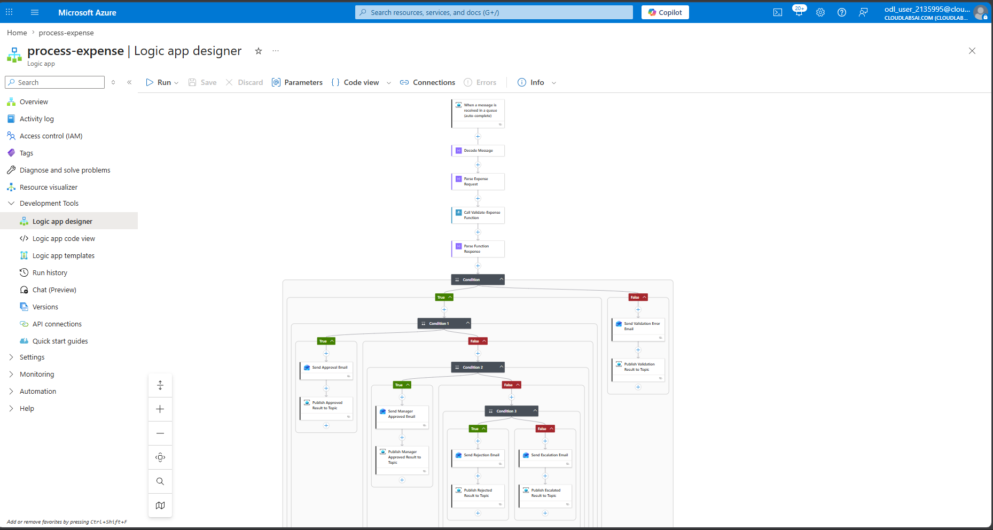
Version B: Logic Apps + Service Bus
Expense request sent to Service Bus queue
Logic App reads and processes the message
Azure Function validates the request
Result sent by email
Final status published to topic subscriptions:
approved
rejected
escalated

Slide 5
Comparison
Durable Functions | Logic Apps + Service Bus
Easier to test locally | More realistic cloud architecture
Better control in code | Better visual monitoring
More natural for timers and approvals | Easier to show workflow branches
Simpler debugging | More flexible for service integration

Slide 6
Recommendation
Same business rules can be implemented in very different ways
Durable Functions is great for code-driven orchestration
Logic Apps is better for visual workflow integration
Small configuration mistakes can break cloud workflows
Testing each branch carefully is very important

Slide 7
Final tips & takeaways​
Consistent rehearsal​
Practice makes perfect, so strengthen your familiarity with the presentation​
Refine delivery style​
Pacing, tone, and emphasis​
Timing and transitions​
Aim for seamless, professional delivery​
Practice audience
Enlist colleagues to listen & provide feedback​
Seek feedback​
Reflect on performance​
Explore new techniques​
Set personal goals​
Iterate and adapt

Slide 8
THANK YOU

