Slide 1

Project Title: Swedish Third-party Car Insurance Claims Predictor Model
Name: Anil Raju

Slide 2

Introduction
Software - R programming language
Dataset - motorins from GLMsData library in R
Objective - create a GLM model to predict number of claims from the given data
Response Variable - number of claims made in a year, (count or positive continuous)
Explanatory Variable:
Kilometers(categorical variable)
The number of kilometers travelled per year
5 levels - <10k,10-15k,15-20k,20-25k,>25k kilometers
Bonus (categorical variable)
Number of years with no claims +1
7 levels – 1 to 7
Insured (numerical variable)
Number of insured members
Payment (numerical variable)
The total payment made

Slide 3

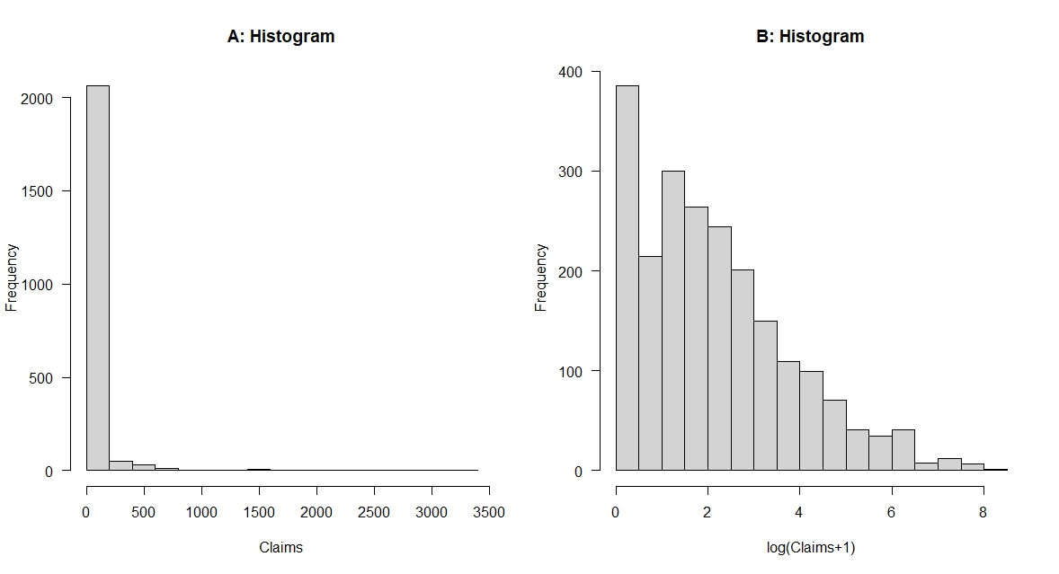
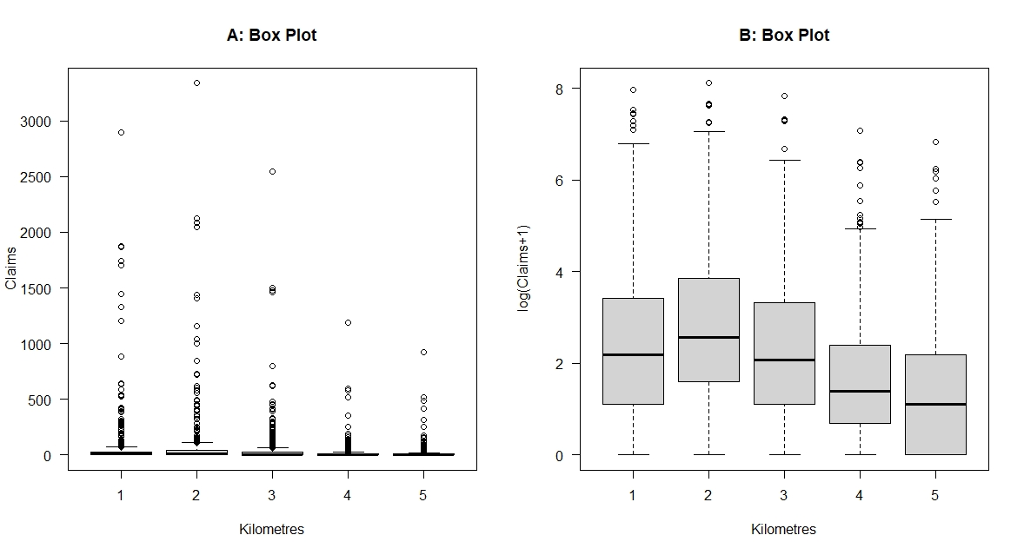
Statistical Methods – Exploratory Analysis
Histogram plot assesses the response variable distribution
Both plots confirm it’s not a normal distribution – no linear GLM models
Box plot assesses the explanatory variable for skewness
Response variable was transformed to have a more normal relationship with Kilometers

Slide 4
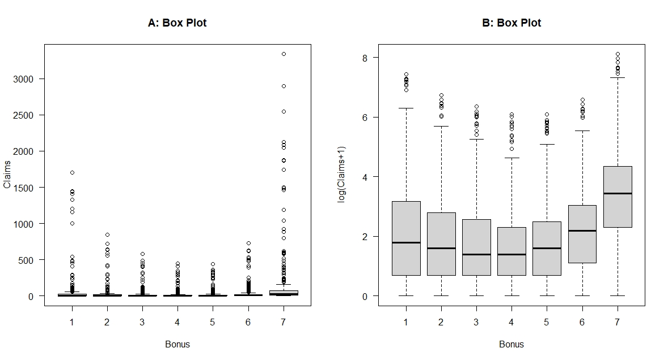
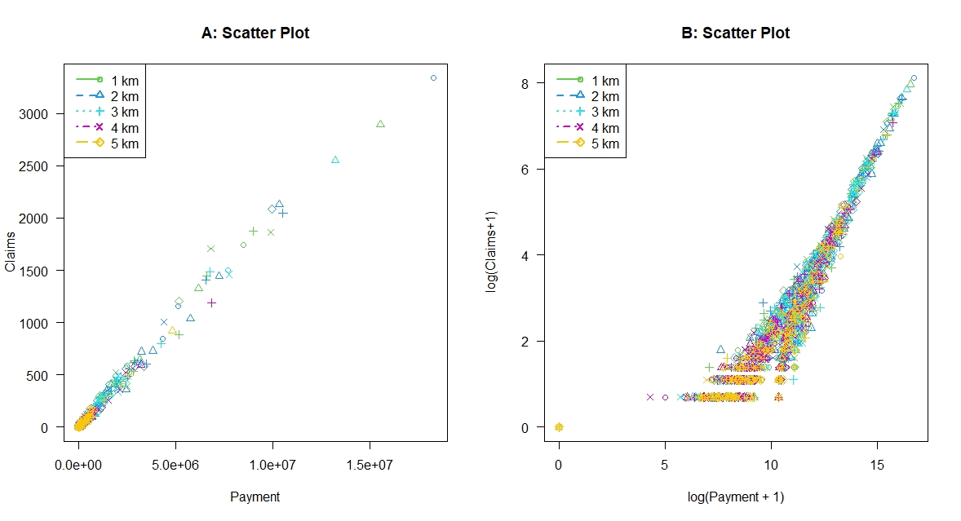
Statistical Methods – Exploratory Analysis
Box plot assesses the explanatory variable for skewness
Response variable was transformed to have a more normal relationship with Bonus
Scatter plot assesses the explanatory variable for skewness
Response variable and the explanatory variable was transformed to have a more normal relationship with Payment

Slide 5
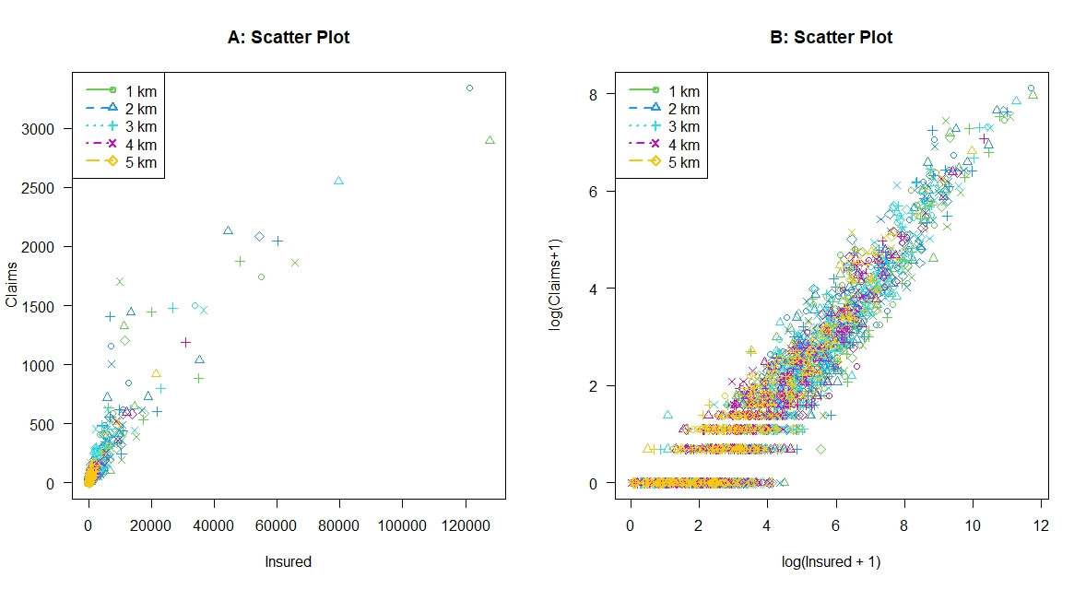
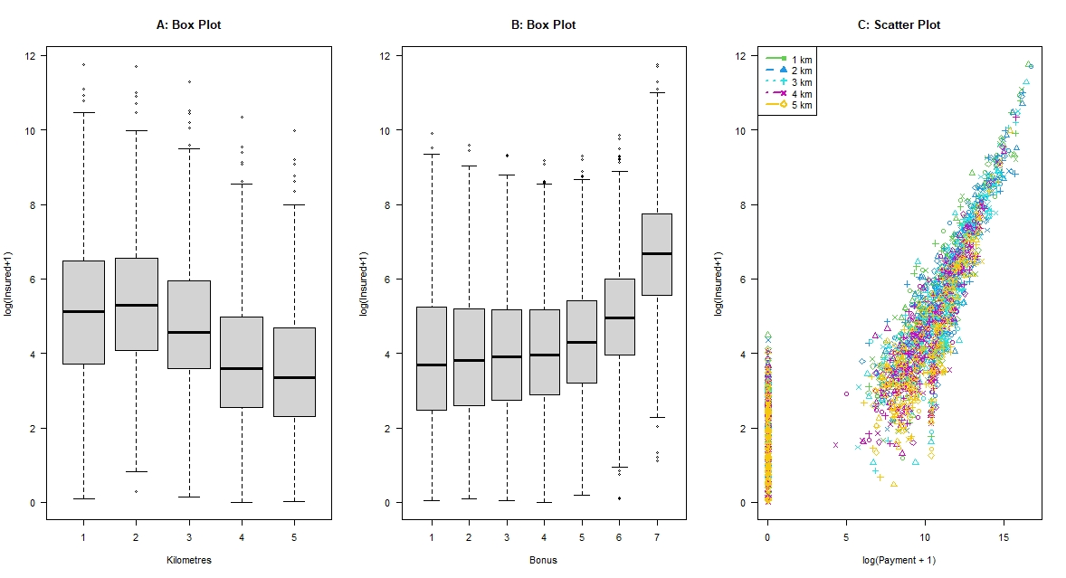
Statistical Methods – Exploratory Analysis
Scatter plot assesses the explanatory variable for skewness
Response variable and the explanatory variable was transformed to have a more normal relationship with Insured
Box plot and scatter plot between explanatory variables clarify the relationship between them
Response variable and the explanatory variable was transformed to have a more normal relationship with Payment

Slide 6


Statistical Methods – GLM Results
Wald Test Table
Variables | Estimate | Std. Error | t-value | p-value
Intercept | 0.2412 | 0.0354 | 6.816 | 1.21e-11
Kilometers2 | 0.0776 | 0.0120 | 3.881 | 0.000107
Kilometers3 | 0.0990 | 0.0201 | 4.936 | 8.58e-7
Kilometers4 | 0.1230 | 0.0207 | 5.929 | 3.53e-9
Kilometers5 | 0.1597 | 0.0212 | 7.532 | 7.29e-14
Bonus2 | -0.2181 | 0.0239 | - 9.130 | <2e-16
Bonus3 | -0.3055 | 0.02405 | - 12.700 | <2e-16
Bonus4 | -0.3633 | 0.02421 | - 15.009 | <2e-16
Bonus5 | -0.4010 | 0.02433 | - 16.483 | <2e-16
Bonus6 | -0.4256 | 0.02452 | - 17.354 | <2e-16
Bonus7 | -0.6340 | 0.02652 | - 23.907 | <2e-16
Log (Payment + 1) | -0.01777 | 0.002870 | - 6.191 | 7.15e-10
Log (Insured + 1) | -0.03593 | 0.01275 | - 2.818 | 0.004869
Interaction | 0.05196 | 0.0008221 | 63.197 | < 2e-16
Deviance of Analysis Table
Source | Deviance | Degrees of Freedom | Mean Deviance | F | p-value
Kilometers | 806.1332 | 4 | 201.5333 | 2297.932 | <2.2e-16
Bonus | 1154.6892 | 6 | 192.4482 | 2194.341 | <2.2e-16
Log (Payment+1) | 4193.1056 | 1 | 4193.1056 | 47810.812 | <2.2e-16
Log (Insured+1) | 1351.4486 | 1 | 1351.4486 | 15409.546 | <2.2e-16
Interaction | 381.0543 | 1 | 381.0543 | 4344.874 | <2.2e-16
Residual | 194.2060 | 2168
Total | 8080.6367 | 2181
Two models were built
Model 1 - all variables
Model 2 - all variables + one interaction term
Model 2 is selected based on residual deviance and AIC comparison
Deviance of Analysis Table and Wald Test Table conclude that all variables are statistically significant

Slide 7
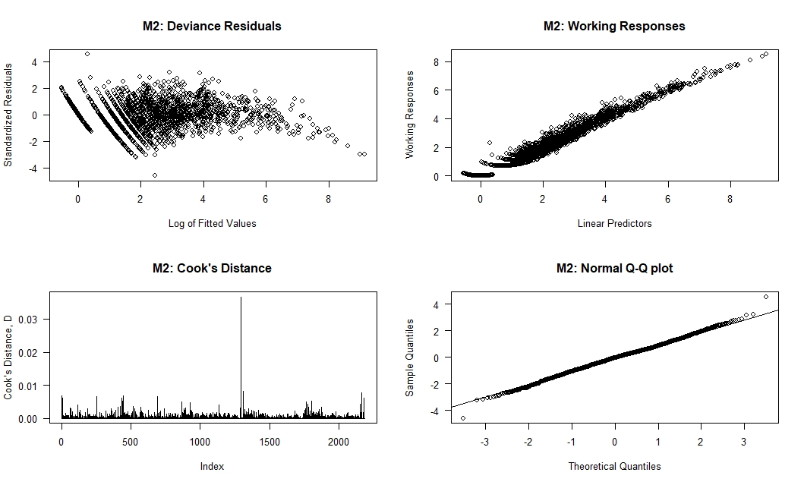
Statistical Methods – GLM Results
Standardized Deviance Residual plot shows overall assumption is violated along with incorrect EDM
Working Responses shows linear trend, confirming correct link function
Cook’s Distance plot shows no overly influential points
Normal Q-Q plot shows a linear plot, thus no violating linearity assumption

Slide 8

Summary
Model 2 created with Gamma GLM, and logarithmic link function is selected as the final model based on residual deviance and AIC comparison
The Weld test and the analysis of deviance confirms that all the variables in the model is statistically significant
The assumption of link function is valid, no overly influential points exist, and normality assumption is valid
The model is still missing some critical variable or transformations

