Slide 1
Household Power Consumption
Anil Raju
Justin DeHerder

Slide 2
Introduction
Electric power consumption measured in KW for a single household every minute for approximately 47 months
Source: UCI Machine learning Repository http://archive.ics.uci.edu/ml/datasets/Individual+household+electric+power+consumption
2075259 samples with 25979 missing values
207 weekly average samples computed
10% (21 samples) of the data reserved to assess forecasting accuracy
90% (186 samples) used for model building
Questions:
Is the weekly power use increasing year over year?
Does weekly power consumption exhibit seasonal trends?

Slide 3
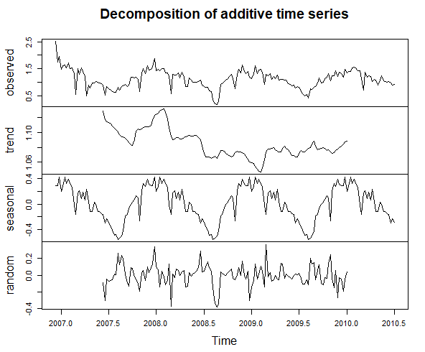
Weekly Average Active Power Time Series
Constant variance
No clear indication of polynomial trend
Indication of seasonality
Candidate models:
SARIMA
Seasonal Means

Slide 4
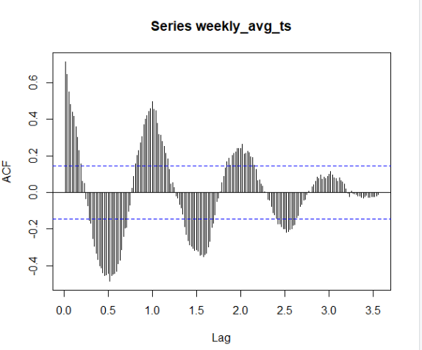
Weekly Data Stationary Check
ACF: slow decay
ADF p-value: 0.1441
PP-test p-value: 0.01
Not stationary

Slide 5
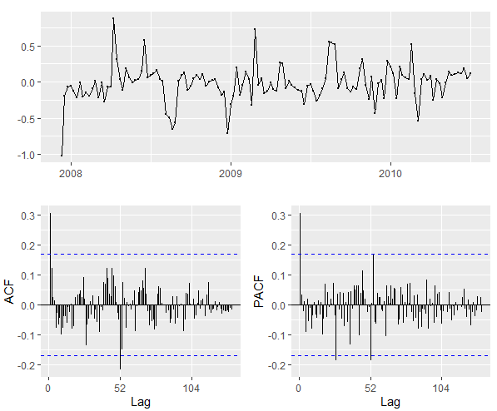
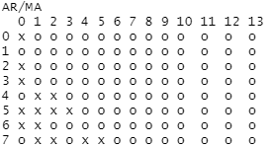
First Seasonal Difference
ADF and PP Test p-values <0.05
ACF plot decays quickly with significant value at lag 52
PACF plots cuts off after lag 1; p=1
EACF suggests p=0, q=1

Slide 6
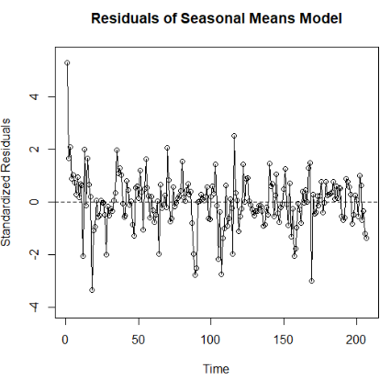
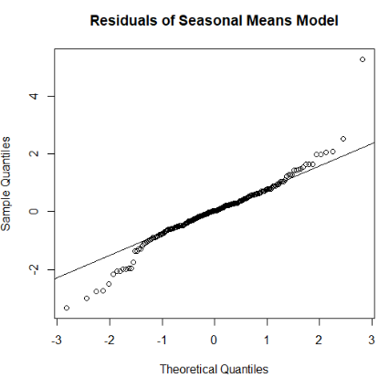
Seasonal Means Model with Linear Trend
Y_{t} = B₀ + B₁t + S_{t} + X_{t}

Slide 7
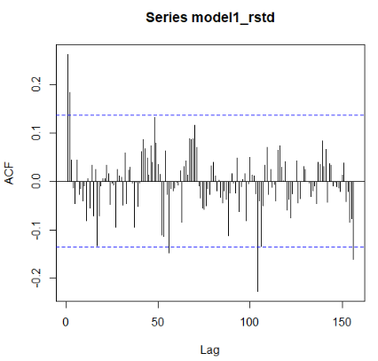
Seasonal Means Model Continued
Shapiro-Wilk p-value < 0.05
Runs Test p-value < 0.05
HAC test
Seasonal terms significant
Linear term insignificant
Adjusted R²: 0.6762

Slide 8
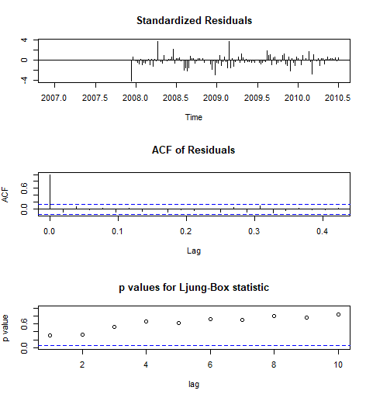
SARIMA Model
Preliminary SARIMA Models AICc SARIMA(1,0,0)x(0,1,1)₅₂ -9.605379 SARIMA(0,0,1)x(0,1,1)₅₂ -6.509080 SARIMA(1,0,1)x(0,1,1)₅₂ -8.641116
Overfitting SARIMA Models AICc
SARIMA(1,0,0)x(0,1,1)₅₂ -9.605379
SARIMA(2,0,0)x(0,1,1)₅₂ -8.911237
SARIMA(1,0,1)x(0,1,1)₅₂ -8.641116

Slide 9
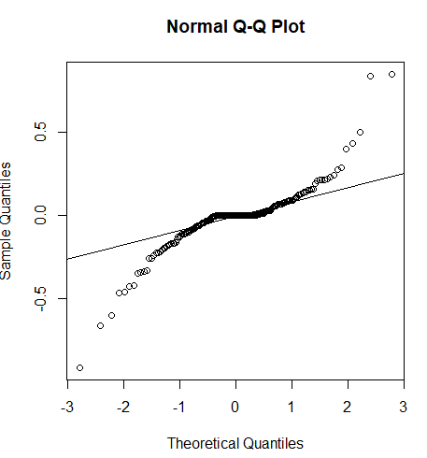
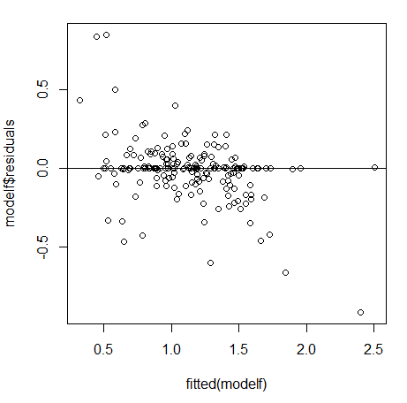
SARIMA Model
Fitted Residual Plot

Slide 10
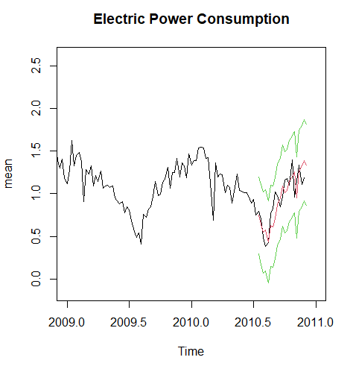
Forecasting and Conclusions
RMSE = 0.136
Final SARIMA Model AICc
SARIMA(1,0,0)x(0,1,1)₅₂ -9.605379
Predicted test set with 0.136 RMSE
Is weekly power use increasing year over year?
No, we found that the data can be explained with a seasonal trend model without any linear trend.
Does weekly power consumption exhibit seasonal trends?
Yes, significant seasonal terms deterministic model
SARIMA models forecasts 95%CI captures the actual data

