Slide 1
HalluciGuard:
A Multi-Agent Framework for Hallucination Mitigation
in
Large Language Models

Slide 2
PROBLEM STATEMENT
Large Language Models (LLMs) have revolutionized natural language processing, but they often generate hallucinations responses that are factually incorrect, fabricated, or unsupported by reliable evidence. Such inaccuracies reduce the trustworthiness of AI systems, especially in critical domains such as healthcare, cybersecurity, finance, and law. Existing approaches like prompt engineering and conventional Retrieval-Augmented Generation (RAG) improve performance but lack comprehensive mechanisms for confidence estimation, evidence-based verification, automated correction, and continual learning. Therefore, there is a need for an intelligent framework that can detect, verify, correct, and prevent hallucinations while providing accurate and trustworthy AI responses.

Slide 3
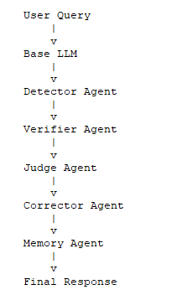
HalluciGuard: Multi-Agent Communication Architecture

Slide 4
HalluciGuard: Multi-Agent Communication Architecture
1. Detector Agent
Purpose
Detect hallucination risk.
Input
{ "query":"What is the latest treatment for diabetes?", "generated_response":"XYZ drug completely cures diabetes.", "model":"Llama-3-8B" }
Internal Processing
Token Probability
Entropy
Semantic Similarity
Self Consistency

Slide 5
HalluciGuard: Multi-Agent Communication Architecture
1. Detector Agent
Purpose
Detect hallucination risk.
Output
{ "confidence_score":0.62, "risk_level":"Moderate", "hallucination_probability":0.38, "next_action":"Verify" }

Slide 6
HalluciGuard: Multi-Agent Communication Architecture
2. Verifier Agent
Purpose
Retrieve evidence from external sources.
Input
{ "claim":"XYZ drug completely cures diabetes", "confidence_score":0.62, "domain":"Healthcare" }

Slide 7
HalluciGuard: Multi-Agent Communication Architecture
2. Verifier Agent
Purpose
Retrieve evidence from external sources.
RAG Retrieval
Knowledge Sources:
Healthcare
• PubMed
Cybersecurity
• MITRE ATT&CK
• CVE
Finance
• SEC EDGAR
Legal
• Government Acts

Slide 8
HalluciGuard: Multi-Agent Communication Architecture
2. Verifier Agent
Purpose
Retrieve evidence from external sources.
Output
{ "evidence":[ { "source":"PubMed", "text":"No drug completely cures diabetes" } ], "support_score":0.12, "contradiction_score":0.88

Slide 9
HalluciGuard: Multi-Agent Communication Architecture
3. Judge Agent
Purpose
Final decision maker.
Input
{ "response":"XYZ drug completely cures diabetes", "support_score":0.12, "contradiction_score":0.88, "evidence":"PubMed evidence" }

Slide 10
HalluciGuard: Multi-Agent Communication Architecture
3. Judge Agent
Purpose
Final decision maker.
Internal Logic
Contradiction Detection
Confidence Routing
Output
{ "decision":"Hallucinated", "severity":"High", "reason":"Medical evidence contradicts generated claim", "action":"Correct" }

Slide 11
HalluciGuard: Multi-Agent Communication Architecture
4. Corrector Agent
Purpose
Generate corrected answer.
Input
{ "original_response":"XYZ drug completely cures diabetes", "judge_decision":"Hallucinated", "evidence":"No complete cure exists" }
Processing
Prompt Repair
Evidence Grounding
Response Regeneration

Slide 12
HalluciGuard: Multi-Agent Communication Architecture
4. Corrector Agent
Purpose
Generate corrected answer.
Output
{ "corrected_response": "Currently there is no complete cure for diabetes. Several treatments help manage blood glucose levels effectively.", "correction_type":"Factual Correction“
}

Slide 13
HalluciGuard: Multi-Agent Communication Architecture
5. Memory Agent
Purpose
Store hallucination history.
Input
{ "hallucination_type":"Factual", "domain":"Healthcare", "original_claim":"XYZ drug completely cures diabetes", "corrected_claim":"No complete cure exists" }
Output
{ "stored":true, "knowledge_graph_id":"HG_1023", "future_prevention":"Enabled" }

Slide 14
HalluciGuard: Multi-Agent Communication Architecture
Base LLM
Recommended
Llama-3.1-8B-Instruct
Why?
Open source
Strong reasoning
Easy to fine-tune
Suitable for academic research
Alternative:
Qwen-3-8B
Mistral-7B

Slide 15
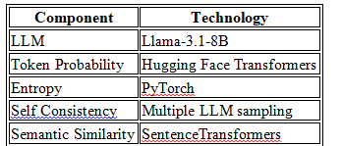
HalluciGuard: Multi-Agent Communication Architecture
Detector Agent
Role
Detect hallucination probability.
Technologies
Output:
• Confidence Score
• Hallucination Score

Slide 16
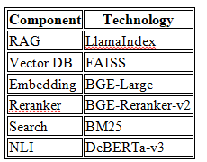
HalluciGuard: Multi-Agent Communication Architecture
Verifier Agent
Role
Evidence retrieval.
Technologies

Slide 17
HalluciGuard: Multi-Agent Communication Architecture
Verifier Agent
Role
Evidence retrieval.
Knowledge Sources:
Healthcare
• PubMed
Cybersecurity
• MITRE ATT&CK
Finance
• SEC EDGAR
Legal
• Government Acts

Slide 18
HalluciGuard: Multi-Agent Communication Architecture
Judge Agent
Role
Decision making.
Technologies
LLM : Qwen3-8B (open source)
Output:
• Accept
• Verify Again
• Correct
• Reject

Slide 19
HalluciGuard: Multi-Agent Communication Architecture
Corrector Agent
Role
Generate corrected answer.
Technologies
LLM: Llama-3.1-8B

Slide 20
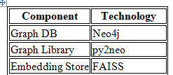
HalluciGuard: Multi-Agent Communication Architecture
Memory Agent
Role
Store hallucination history.
Technologies

Slide 21
HalluciGuard: Multi-Agent Communication Architecture
Detector Agent Confidence Score
The Detector Agent does not rely on a single metric.
Instead, it combines multiple confidence indicators from the LLM.
The four major indicators are:
Token Probability
Entropy
Semantic Similarity
Self Consistency
These are combined using a weighted scoring function.

Slide 22
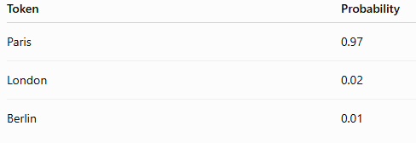
HalluciGuard: Multi-Agent Communication Architecture
Detector Agent Confidence Score
Token Probability
When the LLM generates every token, it also outputs a probability.
Example:
Query:
What is the capital of France?
LLM predicts

Slide 23

HalluciGuard: Multi-Agent Communication Architecture
Detector Agent Confidence Score
Token Probability
When the LLM generates every token, it also outputs a probability.
Example:
Query:
What is the capital of France?
LLM predicts
Average probability
Higher probability means higher confidence.

Slide 24

HalluciGuard: Multi-Agent Communication Architecture
Detector Agent Confidence Score
2: Entropy
Entropy measures uncertainty.
Formula
Example
Prediction
Paris = 0.95
London = 0.03
Berlin = 0.02
Entropy
Very Low

Slide 25

HalluciGuard: Multi-Agent Communication Architecture
Detector Agent Confidence Score
2: Entropy
Now suppose
Paris = 0.35
London = 0.33
Berlin = 0.32
Entropy becomes high.
High entropy means
The model is confused.
Normalize entropy
Range
0 to 1
Higher value = better confidence

Slide 26

HalluciGuard: Multi-Agent Communication Architecture
Detector Agent Confidence Score
3: Semantic Similarity
The generated answer is converted into an embedding.
The retrieved evidence is also converted into embeddings.
SentenceTransformer computes cosine similarity.
Formula

Slide 27
HalluciGuard: Multi-Agent Communication Architecture
Detector Agent Confidence Score
3: Semantic Similarity
Example
Generated Answer
"Diabetes can be cured permanently."
Retrieved evidence
"There is currently no complete cure for diabetes."
Cosine similarity
0.18
Very low
Detector confidence decreases.
If similarity is
0.95
Confidence increas.

Slide 28
HalluciGuard: Multi-Agent Communication Architecture
Detector Agent Confidence Score
4: Self Consistency
The same question is generated multiple times.
Example
Run LLM
5 times
Output
Run 1: Paris
Run 2 : Paris
Run 3 : Paris
Run 4 : Paris
Run 5 : Paris
Consistency
100%

Slide 29
HalluciGuard: Multi-Agent Communication Architecture
Detector Agent Confidence Score
4: Self Consistency
The same question is generated multiple times.
Example
Now
Run 1 :Paris
Run 2 : London
Run 3 : Berlin
Run 4 : Paris
Run 5 : Rome
Consistency
40%
Confidence decreases.
Formula

Slide 30

HalluciGuard: Multi-Agent Communication Architecture
Detector Agent Confidence Score
4: Self Consistency
The same question is generated multiple times.
Formula

Slide 31
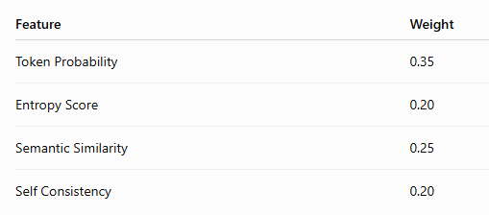
HalluciGuard: Multi-Agent Communication Architecture
Detector Agent Confidence Score
Final Confidence Score
Combine all scores using weighted averaging.
Example weights
Formula

Slide 32

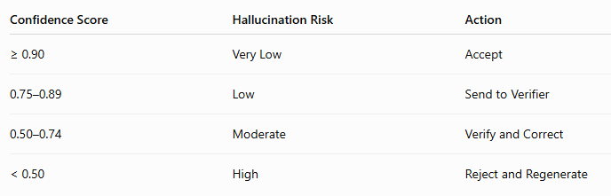
HalluciGuard: Multi-Agent Communication Architecture
Hallucination Score
The hallucination score can be computed as:
Decision Rules

Slide 33
HalluciGuard: Multi-Agent Communication Architecture
Each metric captures a different aspect of model confidence.
Token probability reflects prediction certainty, entropy measures uncertainty, semantic similarity checks agreement with trusted knowledge, and self-consistency evaluates output stability across multiple generations.
A weighted average combines these complementary signals into a robust confidence score, making the detector more reliable than relying on any single metric

Slide 34
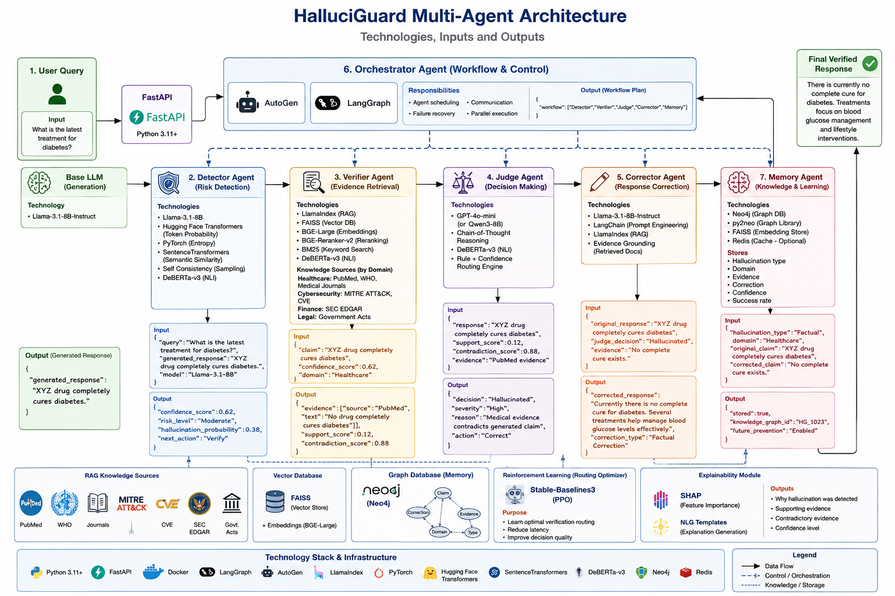

Slide 35
Dataset
Dataset: • HaluEval Typical attributes: Question Answering, Dialogue, General Text, Text Summarization Hallucination Label, Domain

Slide 36
Dataset
Dataset: • HaluEval Typical attributes: Question, Context, Generated Response, Ground Truth, Hallucination Label, Domain

