Slide 1

SCM & GIT

Slide 2

SCM
SCM – Software Configuration Management
Task of tracking and controlling changes in the software.
Artifacts, documents, code, and other related components.
Systematic Tracking, Versioning, Consistency

Slide 3
Importance of SCM
Structured approach to manage changes, version control and collaboration.
Version control
Correct and consistent version of code, documentation and other assets.
Changes Management
Changes are systematically reviewed, approved, and implemented, reducing the risk of errors and conflicts.
Collaboration
Concurrent development, branch management, and merging, enhancing teamwork and productivity

Slide 4

Benefits of SCM
Managing Complexity
Track of these complexities and ensures that all team members work with the same versions of software artifacts.
Version Control
Ensures accurate tracking and management of different versions of software.
Traceability and Accountability:
Helps answer questions about when, why, and by whom changes were made.
Consistency:
Across development environments, reducing configuration-related issues.

Slide 5

Need of SCM
Missing Feature
Tested Program Does not work
Tested Wrong version
Non-Traceability
Working on Wrong Version
Latest Version Not found

Slide 6
VCS – Versioning Controlling systems
Source code management (SCM) systems
Tools used in software development to manage
Track changes to source code, documents, and other files.
They enable developers to collaborate
Maintain a history of changes
Manage different versions of files

Slide 7

Types of Version Control System
There are two types of version control system.
Centralized Version control
Distributed Version control

Slide 8
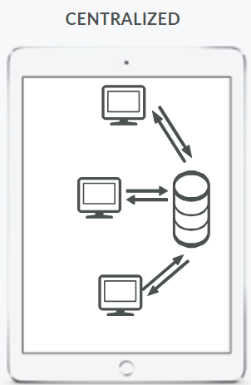
Centralized Version Control
Client-Server relationship
Located at Place and provides access to
many clients.
Easy to administrate and has more control over users
Access as the server is in one place.
Concurrent Version systems(CVS)
Perforce
Apache Subversion(SVN)

Slide 9
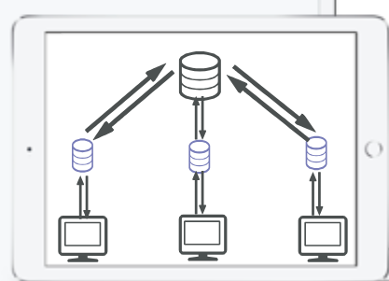
Distributed Version Control
Every use has a local copy of the repository, in addition to the central repository on the server side.
Developers to work offline and commit changes to their local repository. Changes can then be pushed or pulled to and from other repositories.
Even if the main repository crashes,
you still have access to the local repository.
GIT
Mercurial

Slide 10
Use of Versioning control system
Backup and restore
Synchronization
Undo Changes
Track Changes
Track ownership
Branching and merging

Slide 11
GIT

Slide 12
GIT
GIT – is a distributed version control that is widely used for tracking changes in source code during software development.
Open source, easy-to-install and setup.
Can share code easily across multiple users.
Git provides both
GIT GUI & Bash
Platform supported:
Windows, Linux and in Mac.

Slide 13

Why GIT
Opensource
Free
Fast
Branching/merging

Slide 14

Git Features
Works on Distributed System
Compatible with all operating systems
Allows for non-linear development
Branching
Reliable

Slide 15

Git Workflow
Local working directory - Modify files in your working directory present in the local system
Staging (Index) - Stage the files and add snapshots of them to your staging area(Index)
Git Repository - Perform a commit that stores the snapshots permanently to your Git directory. Checkout any existing version, make changes, stage them and commit.

Slide 16
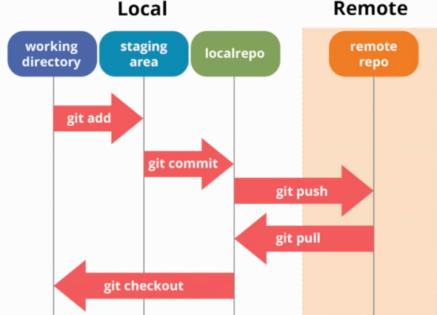
Git Workflow
Committed

Slide 17
Git Installation
https://git-scm.com/downloads

Slide 18
Git Config

Slide 19
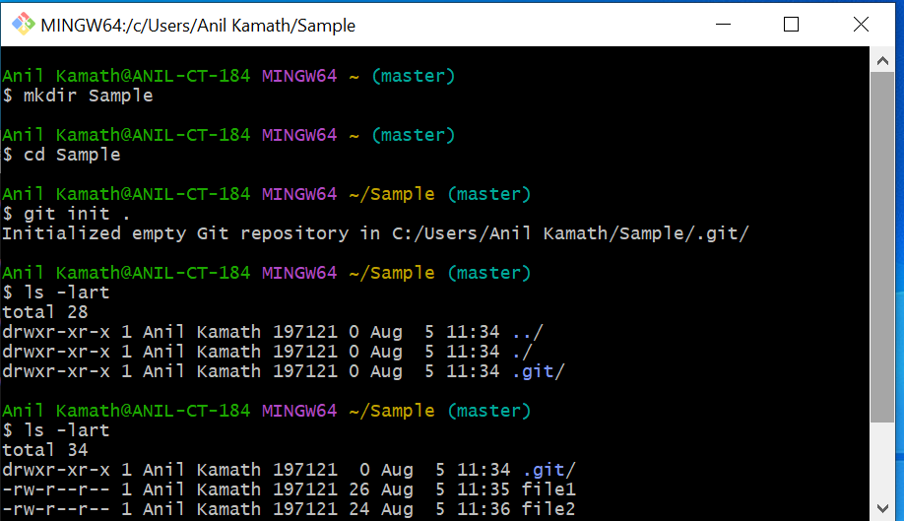
Git Initialize in the Local repository

Slide 20
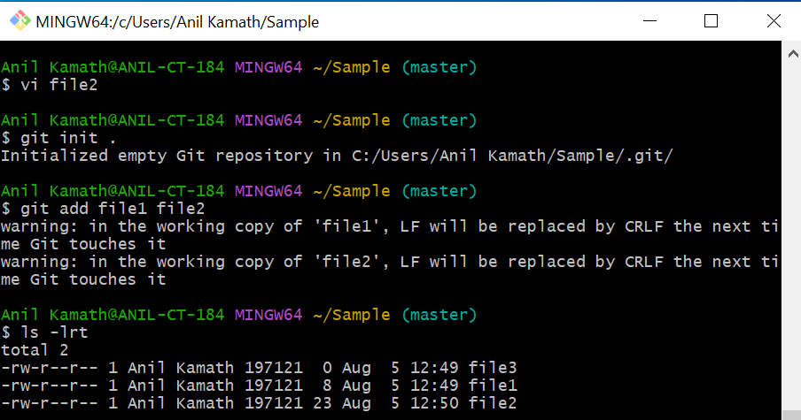
Git Add

Slide 21
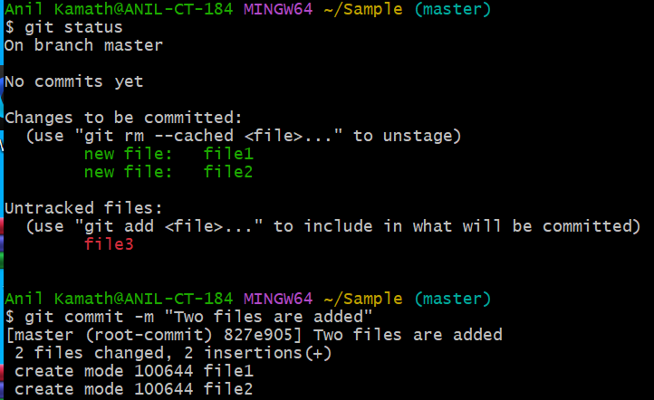
Git Commit

Slide 22
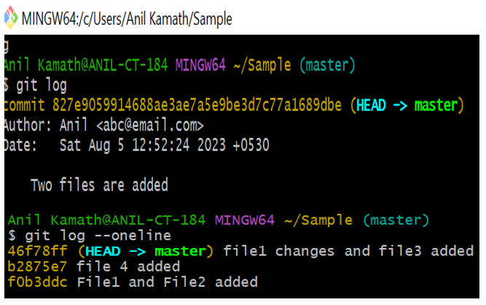
Git Log

Slide 23
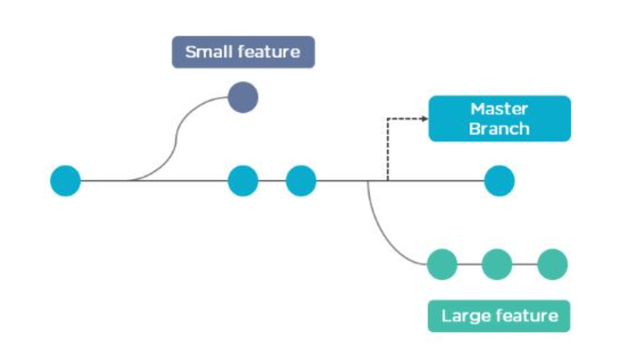
Git Branch

Slide 24
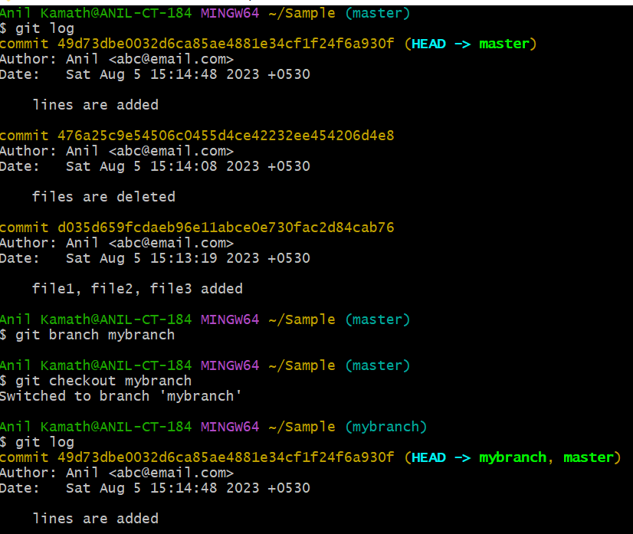
Git Branch

Slide 25
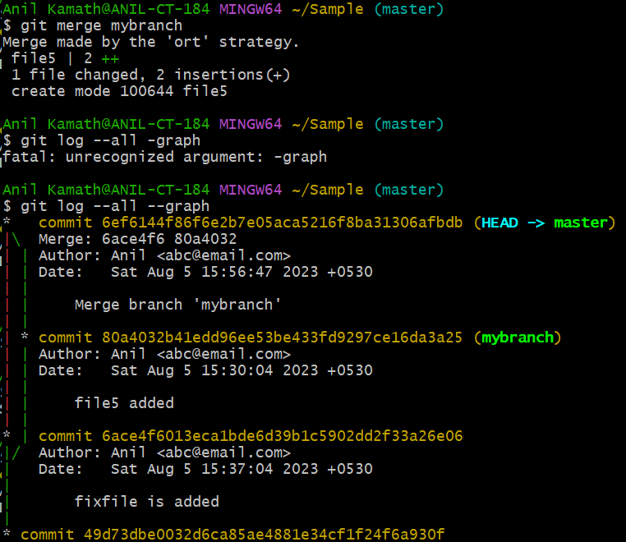
Git Merge

Slide 26
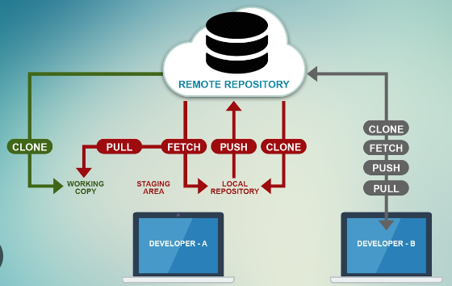
Git Remote Repository

Slide 27

GitHub
GitHub is a web-based platform used for version control and collaboration on software development projects.
It provides tools for managing and tracking changes to code repositories, facilitating collaboration among developers, and enabling seamless integration with various development workflows.

Slide 28
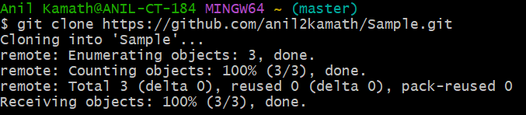
Git Clone

Slide 29
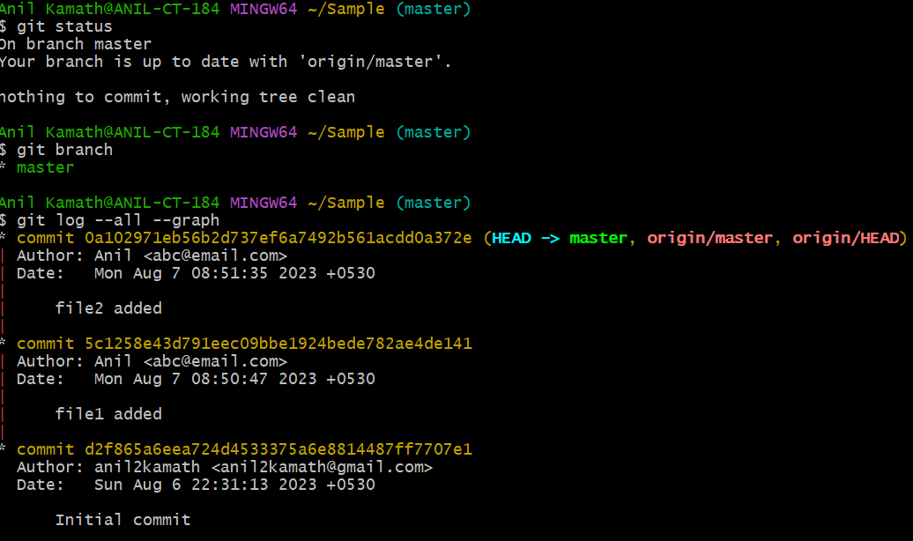
Git Status

Slide 30
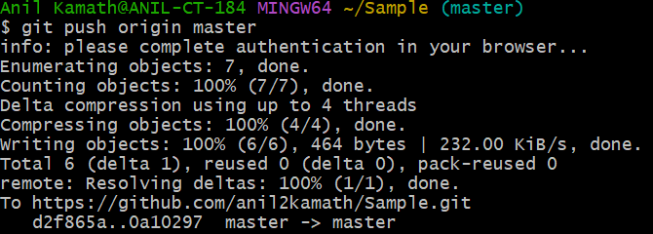
Git Push

Slide 31
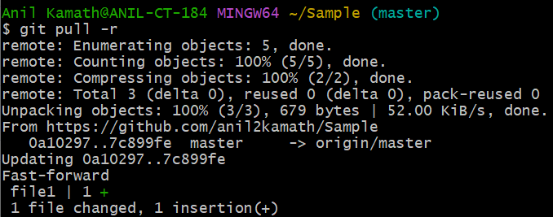
Git Pull

Slide 32
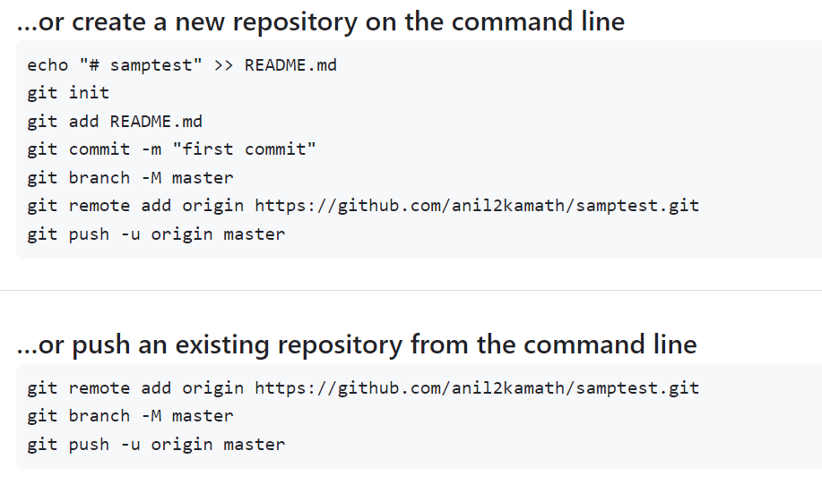
Push from Local repository to the Remote

Slide 33
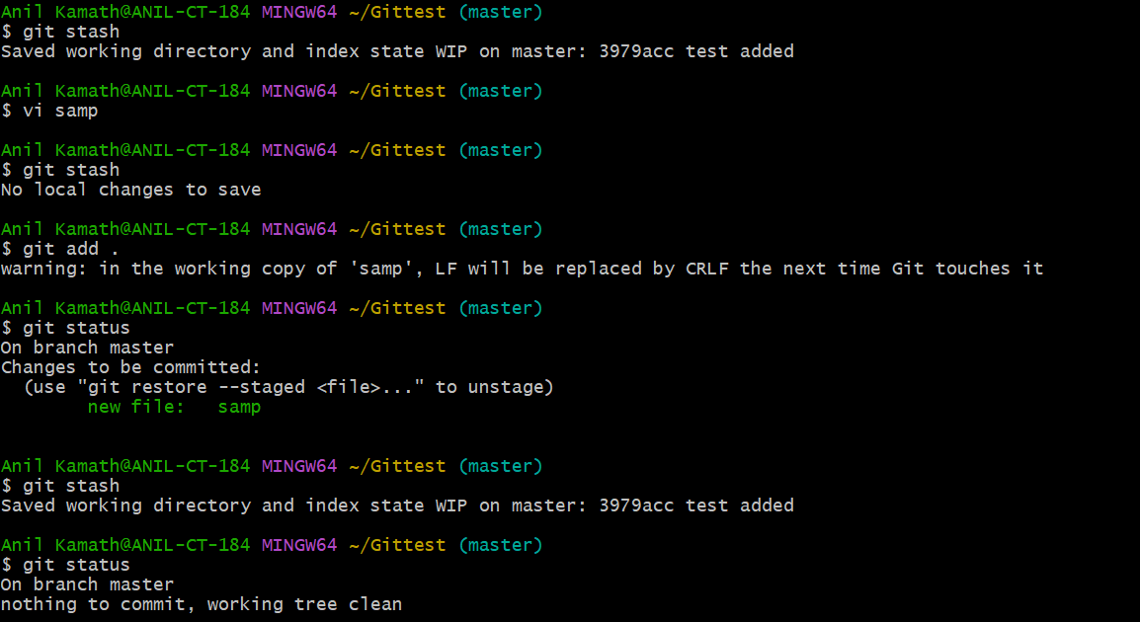
Git Stash

Slide 34
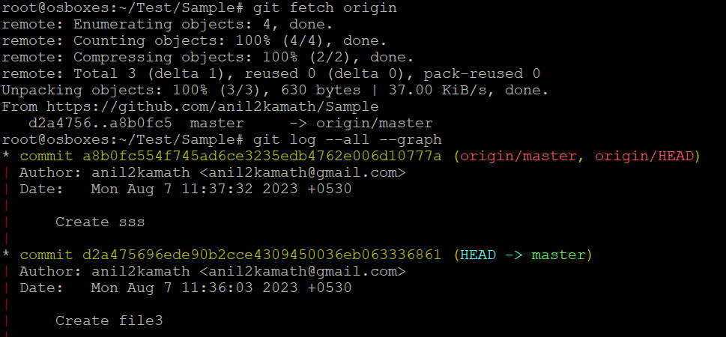
Git Fetch

Slide 35
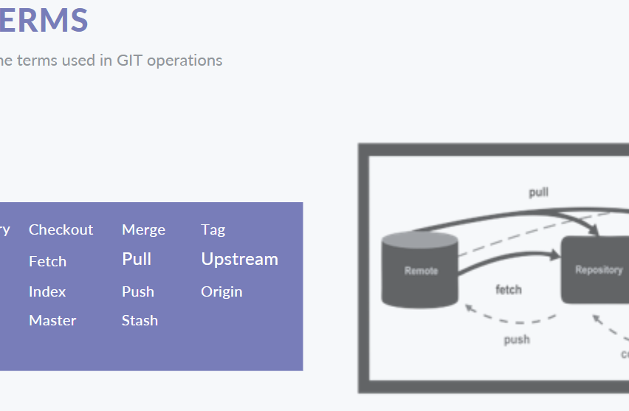

Slide 36
Terms of GIT
Repository (Repo): A repository is a collection of files and the complete history of changes made to those files over time. It can be thought of as a project's database that stores every version of every file.
Fork: Forking a repository means creating a copy of it
Branch: Creates a version of the repository from the main working project.
Head: It is a reference variable used to denote the current commit of the repository.
Checkout: Used to switch between branches.
Fetch : Fetching branch files to workstation.
Index: Changes will be staged within the index.
Master: The primary branch of all repositories.

Slide 37

Merge: Updating the changes from one branch to another branch.
Pull: Needed for adding the changes to the master branch.
Push: The commits made on the current branch can be updated to the remote branch.
Stash: If multiple changes are done to the files, but if not all changes needs to go into one commit you can use stash.
Tag: use to define the portion of a history which is most important.
Upstream: Pushing GIT changes to the master branch.
Origin: Conventional name for the primary version of a repository.

Slide 38
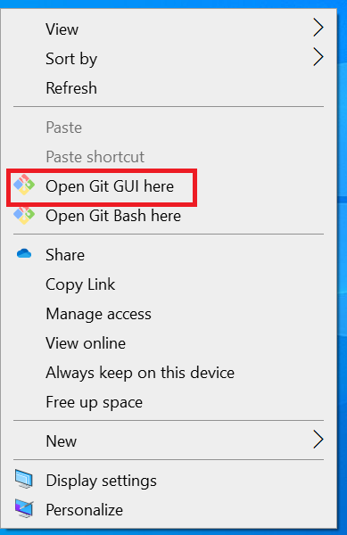
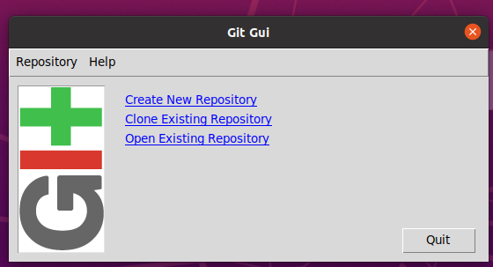
Git GUI

Slide 39
Thankyou

