Slide 1
​AI and Machine Learning for Data Science and Analytics Hissam Tawfik

Slide 2
Artificial Intelligence (AI)
Artificial intelligence (AI)
Broadly about designing and developing intelligent machines !
Making machines act “intelligently”
AI has many definitions…
Behaviour by a machine that, if performed by a human being, would be considered intelligent.
“…study of how to make computers do things at which, at the moment, people are better.
Theory of how the human mind works.

Slide 3
AI Objectives
Make machines smarter, intelligent and useful
Signs of intelligence…
Use ‘reasoning’ to solve problems
Learn or understand from experience,
Make sense out of ambiguous situations,
Apply knowledge to manipulate the environment.

Slide 4
Test for Intelligence
Turing Test for Intelligence
A computer can be considered to be smart only when a human interviewer, “conversing” with both an unseen human being and an unseen computer, can not determine which is which.
- Alan Turing

Slide 5
The AI Field…
Notes:
AI is many different sciences and technologies
It is a collection of concepts and ideas
Chemistry
Physics
Statistics
Mathematics
Management Science
Management Information Systems
Computer hardware and software
Commercial, Government and Military Organizations
Linguistics
Psychology
Philosophy
Computer Science
Electrical Engineering
Mechanics
Hydraulics
Physics
Optics
Management and Organization Theory
Chemistry

Slide 6
Expert Systems (ES)
Is a computer program that attempts to imitate expert’s reasoning processes and knowledge in solving specific problems.
Works best with narrow problem areas/tasks.
Expert systems do not always replace experts, but
Make their knowledge and experience more widely available, and thus
help non-experts to work better.

Slide 7
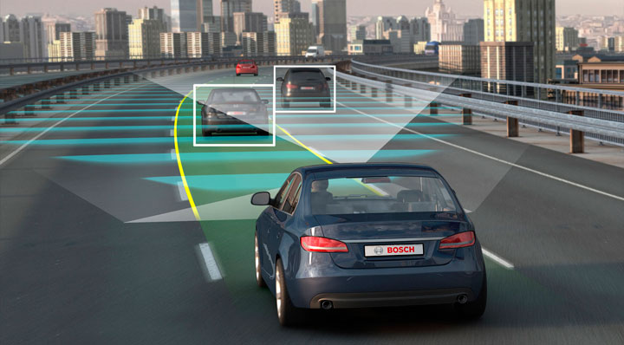
Problems and Limitations of ES
Knowledge is not always readily available.
ES work well only in a narrow domain of knowledge.
Knowledge is not exact or well defined.
Experts’ vocabulary often highly technical.
And … more …

Slide 10
Aoccdrnig to a rscheearch at an Elingsh uinervtisy, it deosn't mttaer in waht oredr the ltteers in a wrod are, the olny iprmoetnt tihng is taht frist and lsat ltteer is at the rghit pclae. The rset can be a toatl mses and you can sitll raed it wouthit porbelm.
[rscheearch at Cmabrigde Uinervtisy]

Slide 11
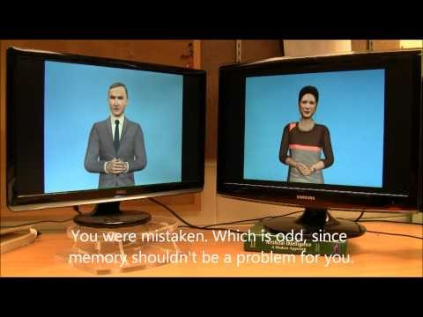
Demo – AI vs. AI: Two chatbots talking to each other
https://www.youtube.com/watch?v=WnzlbyTZsQY

Slide 12
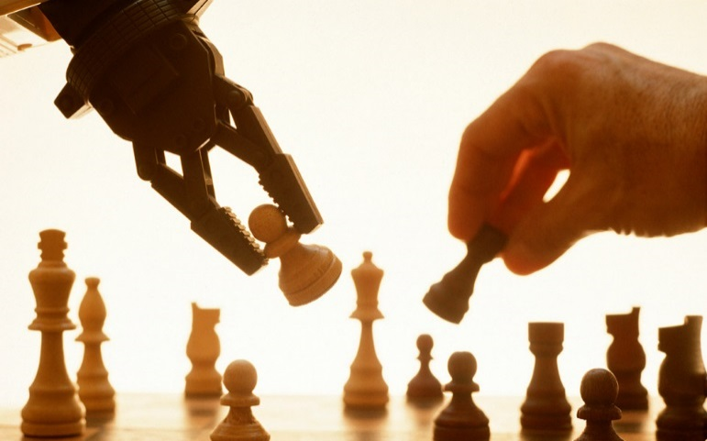
Conventional AI
Conventional AI follow a set of ‘well-defined’ instructions in order to solve a problem.
When equipped with the appropriate rules, it can perform many tasks better or faster than humans.
BUT
conventional AI ‘struggles’ with certain types of tasks !
playbuzz.com
Computer performed better than the human at chess in the late 1990’s !

Slide 13
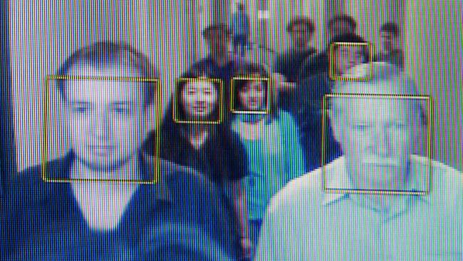
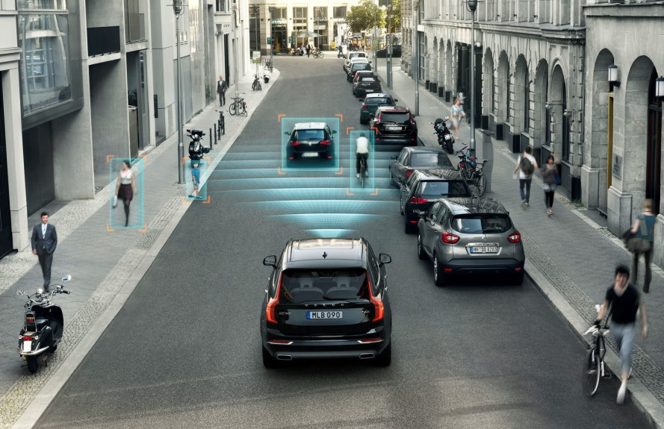
biometricupdate.com/
inhabitat.com

Slide 14
Conventional AI - Challenges
Examples:
Recognising complex patterns such as human faces or emotions
Recognising a variety of handwriting.
Identifying the words and context in spoken language.
Driving a car through busy streets.
Scenarios associated with
Limited or no knowledge
Context
New or previously unseen situations
Extremely large number of possible solutions to choose from

Slide 15
Machine Learning
It can be much easier to train a system by presenting it with examples of desired response than to program it to predict the response for all possible scenarios.
Machine Learning is a field of AI that trains the machine with previous/historic examples of the outcomes for a given problem.
Once trained, the Machine learning system can then be presented with new (previously unseen) cases of the problem to solve.
Training the Machine Learning
Training output
Training inputs
Testing Machine Learning
output
New Inputs

Slide 16
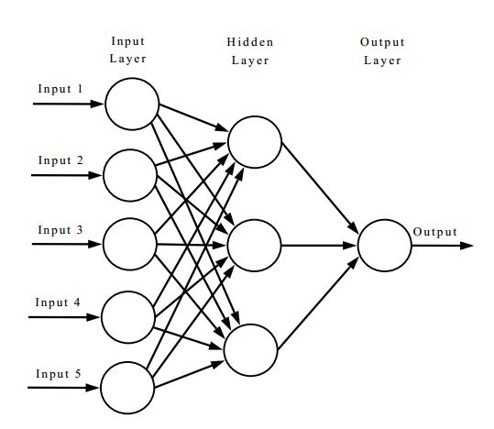
Machine Learning example: Artificial Neural Networks
A large number of highly interconnected processing units (neurons) working in parallel to solve a specific problem.
Not programmed to perform a specific task.
Instead, neural networks learn by example.
Go through a learning (training) process to become an ‘expert’ in a specific task.
Can then be used to perform this task in similar and new situations or scenarios.
Number of
bedrooms
Age
Size
House
price
Postcode
Condition

Slide 17
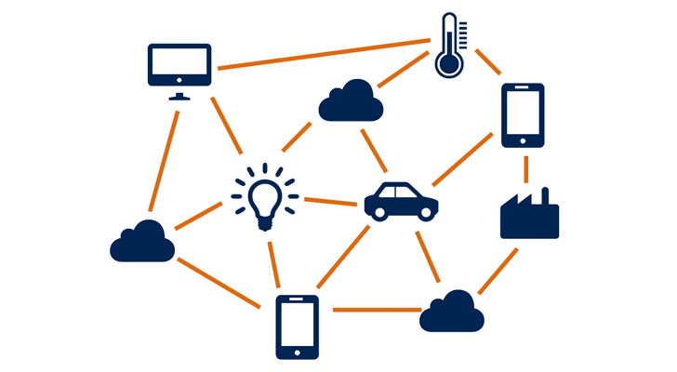
The rise of the Big Data
Huge growth of data in many areas as a result of:
The increasing availability of sensors.
Massive exchange of data among devices, data centres and the cloud.
Increase in storage and computing power.
The amount of data in the world is ‘doubling’ every
two years !
much faster than our ability to analyse it !
Great potential for business, health, government, the environment, manufacturing, robotics, security, transportation, education and more !

Slide 18
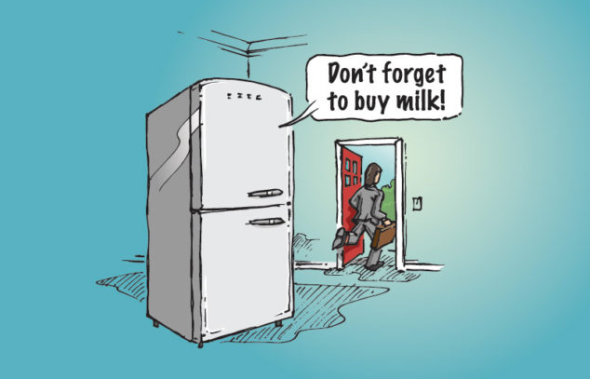
Applications of the Big Data
Transport and the environment:
e.g. improving traffic control using traffic data .
Government and security:
e.g. predicting and preventing crimes using crime data
Health and medicine:
e.g. predicting diseases by decoding DNA strands
If the volume of queries submitted to Google and with keywords like “flu symptom” and “flu treatment” increase in a region, then after a few weeks, the number of influenza patients to the emergency rooms of hospitals in the corresponding area will increase accordingly.
Ginsberg et. al. (2009). Nature.
information-age.com

Slide 19
Big Data characteristics
High Volume: Very large scale of data
High Velocity: Fast speed in which the data is generated and processed.
High Variety: Different types of data, multiple sources of data, structured and unstructured data (e.g. text, images, video, and voice).
Low Veracity: Low quality of data: Noise, faulty data, missing data, etc
High Value: relevance and usefulness of data.
Big data’s volume, velocity, variety and veracity make it difficult for conventional computing methods to effectively analyse big data.

Slide 20
Big Data science and machine learning
Adopts the philosophy that with sufficient data, science can be carried out by directly analysing and learning from data.
A lot of knowledge discovery can be driven by the availability of the massive amount of data.
Systems can learn from the data (Machine Learning)
Examples: House price predictions, weather forecasting, etc !
Big Data Science
Insights
Intelligence
Knowledge
Big Data

Slide 21
Big Data (Data-intensive) Science: The new paradigm of scientific discovery
First paradigm: based on experiments. (The empirical stage)
Second paradigm: Theoretical science, characterized by the study of various laws and theorems (e.g mathematical and physical laws to build models to explain the empirical observations)
Third Paradigm: Simulation based methods (Computers and computational science)
Fourth paradigm: data-intensive scientific research.
The fourth paradigm of scientific knowledge discovery adopts the philosophy that with sufficient data, science can be carried out by directly examining and analysing the data.

Slide 22
“The fact that the data gets collected is a good thing, It is up to society to creatively ask the right questions”.
Andreas Weigend, former Chief Scientist of Amazon
http://uk.businessinsider.com/mind-blowing-growth-and-power-of-big-data-2015-6?r=US&IR=T#ixzz3fr7ZPpgf
© Copyright Notice
Some of these slides were adapted from a set of slides by Pearson Education, Inc. from 2011.

Slide 23
Some recommended research articles
Xiaolong Jina, Benjamin W.Waha,b, XueqiChenga, YuanzhuoWanga (2015). “Significance and Challenges of Big Data Research”. Big Data Research; Vol 2 (2015) Pages 59–64.
H.V.Jagadish. (2015). “Big Data and Science: Myths and Reality”. Big Data Research, Vol 2, (2015), pages 49–52.
Jordan, M. I and Mitchell, T.M. (2015). “Machine Learning: Trends, perspectives, and prospects”, Science, Volume 349, Issue 6245, Pages 255-260.
http://uk.businessinsider.com/mind-blowing-growth-and-power-of-big-data-2015-6?r=US&IR=T#ixzz3fr7ZPpgf

Slide 24
Computing and BIT students – Team Building activity
Jubilee Room 1-3pm today 10th OCT.

