Slide 1

Coding standard & guidelines

Slide 2

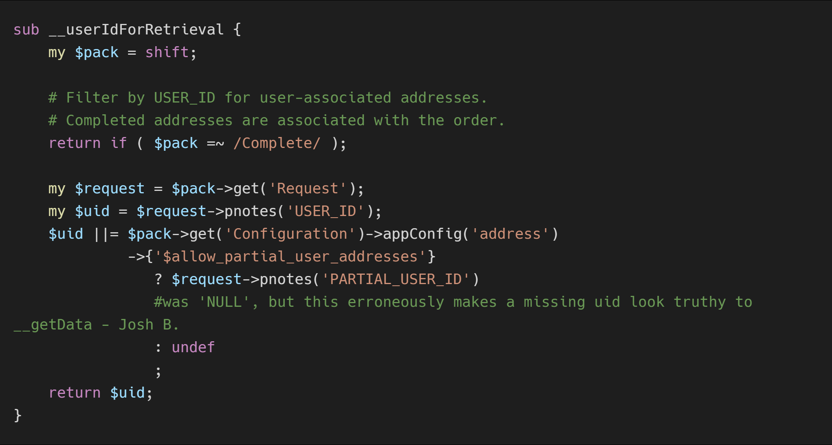
coding standard & guidelines
Do’s:
Write comments that are comprehensible for the maintainability of the code.
Modules should use strict. Assign variable using my(private).
Use defensive programming for undefined or invalid values.
Repetitive code has been factored out. Methods are not too large (30 lines is a high water mark).
2

Slide 3
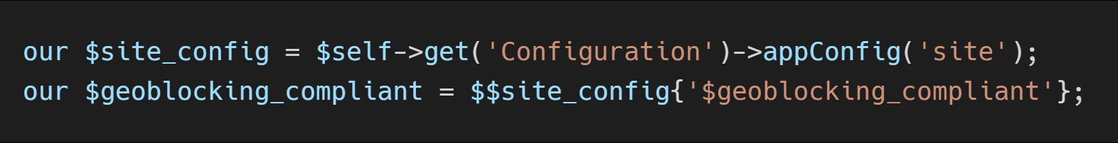
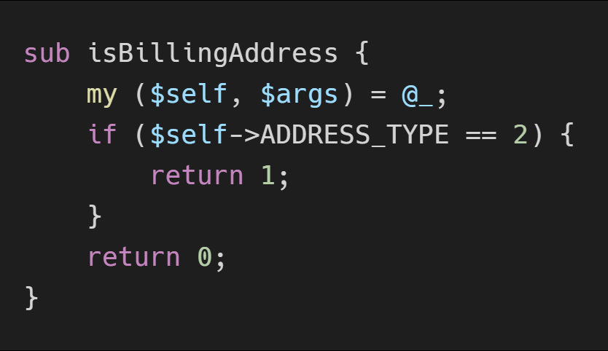
coding standard & guidelines
Cont...
Use of existing frameworks, libraries, and APIs correctly.
Use spaces, not tabs, for indenting. Nest loops sensibly.
Correct any defects in code that you copy from elsewhere.
Test on personal server before requesting Code Review.
Use underscores for variable names
Use camel case for package and method names
3

Slide 4
coding standard & guidelines
Cont...
While implementing any new feature, not only concentrate on PC view, we have to check both PC and MOBILE view.
Keep logic(Back-end) and presentation(Front-end) files separately.
HTML classes should be semantic to understand easily by the developer. Follow BEM standard for class creation.
Organize CSS styles in seperate file.
BEM standards and Drupal coding standards must be followed.

Slide 5

coding standard & guidelines
Don’t:
Hard code html or styles.
Leave debugging code in place on production.
Leave commented-out code before committing.
Hard code text, images, currency symbols, node IDs, or URLs.
Leave extra spaces, tabs, etc.
Attempt to change existing theme configurations.
Put images in the theme.
Make unnecessary Ajax calls to the PerlGem or Drupal servers.
Use inline styles unless it is necessary.
5

Slide 6
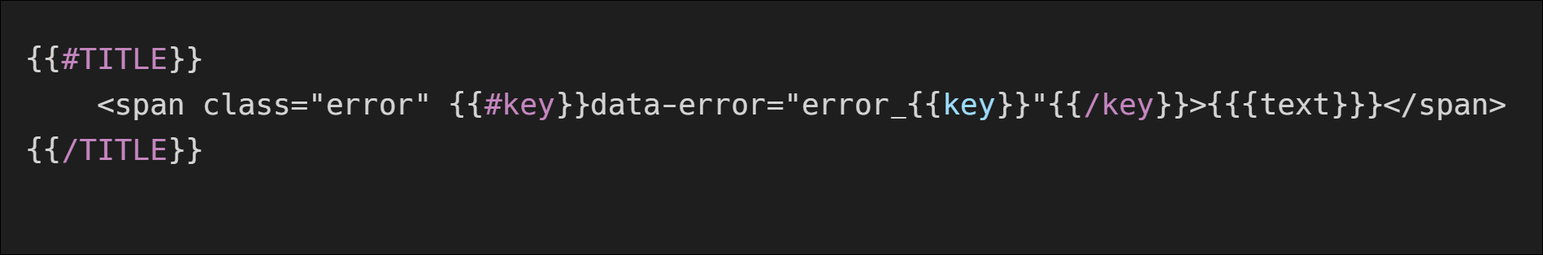
coding standard & guidelines
Cont...
Put CSS or JS code in the CMS.
Mustache conditionals - elements that don’t have a value should usually not be shown on the page.
Use triple braces {{{ }}} to display unescaped html.

Slide 7
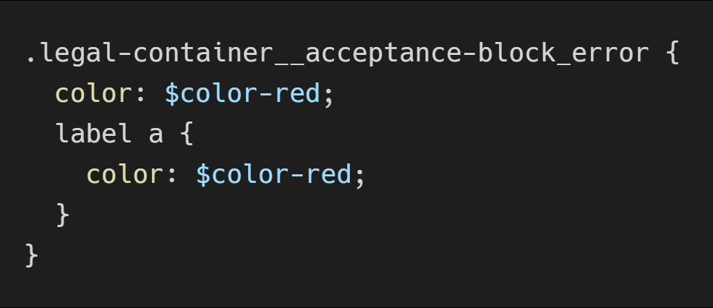
coding standard & guidelines
SCSS:
Please indent with 2 space. Do not use tab characters.
Do not hard-code hex values or font names.
Do not nest your identifiers more than 3 levels deep.
Use $ldirection and $rdirection variable instead of using left and right in css properties, to apply style changes easily from LTR(english) to RTL(arabic) direction in websites.
7

Slide 8
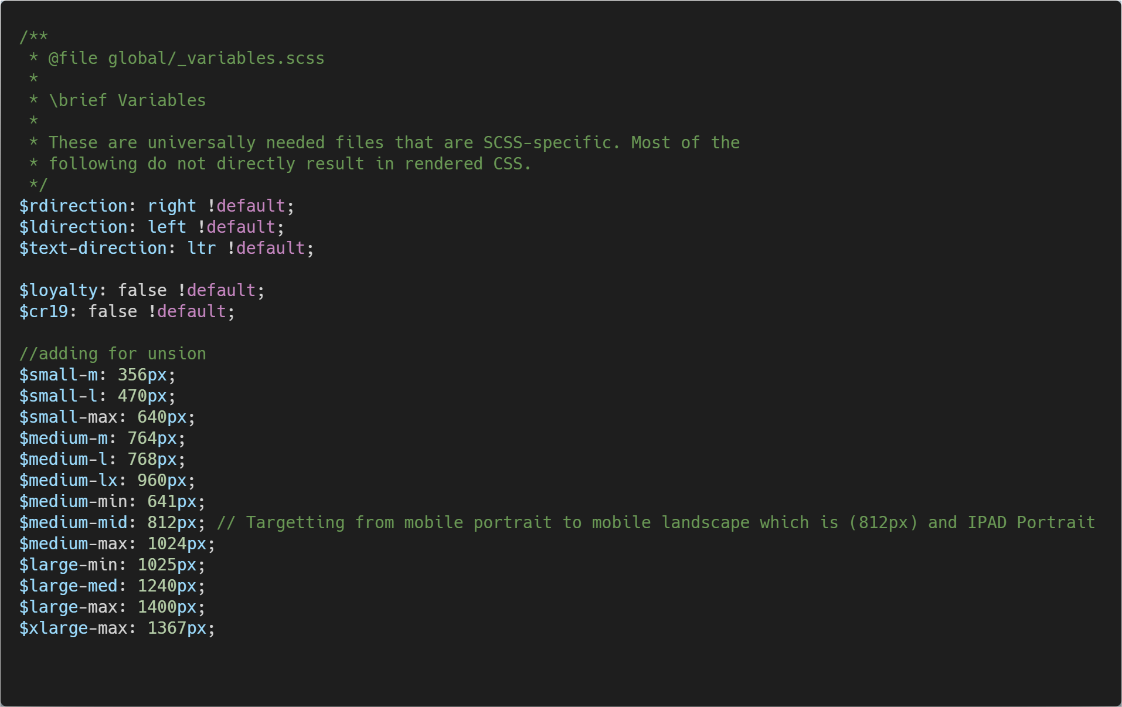
coding standard & guidelines
Cont...
_variables.scss exist in base theme folder. eg:)sites/clinique/themes/cl_base/scss/global/_variables.scss

Slide 9
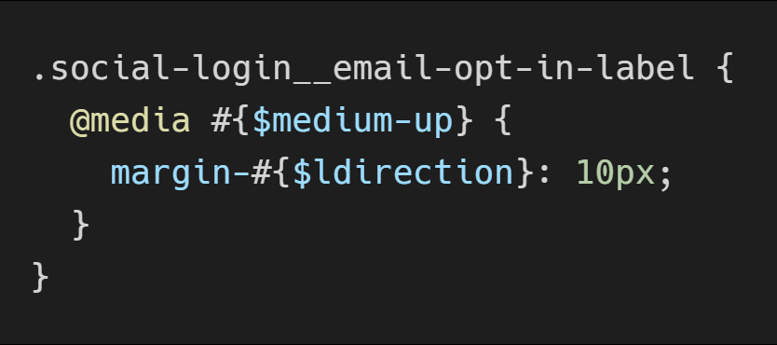
coding standard & guidelines
Cont...
The opening brace ({) spaced from the last selector by a single space.
Each declaration on its own new line.
A space after the colon (:).
A trailing semi-colon (;) at the end of all declarations.
The closing brace (}) on its own new line.
A new line after the closing brace }.
All media query breakpoints should use global variables.

Slide 10
coding standard & guidelines
JS:
Please indent with 2 space. Do not use tab characters.
Use 1 space in front of parentheses, unless you are invoking a method.
Do not overuse jQuery’s $() method.
Wrong
$('.js-section-wrapper').css('overflow','auto'); $('.js-section-wrapper').css('display','none');
Correct var $section = $('.js-section-wrapper');
$section.css('overflow','auto');
$section.css('display','none');
10

Slide 11
coding standard & guidelines
Cont...
JQuery objects should be preceded with '$' character , e.g $navLink
Do not use multi-line comments (/* comment*/), even for large block of code.
Delete unused code, Don't just comment it out.
Select elements only by class names prepended with "js-" in your javascript.
11

Slide 12

coding standard & guidelines
Example code review comments and changes:
1. Either make this as a single line or give 4 spaces for highlighted line
$address ||= $ADDRESS_ID
+ ? $self->get('Address', { ADDRESS_ID => $ADDRESS_ID })
+ : $self->get('AnObject', { });
2. Indent with 4 spaces
+ htmlattrs => {
+ class => 'field',
+ maxlength => 30,
+ 'data-test-id' => 'form_address_address3',
+ },
12

Slide 13
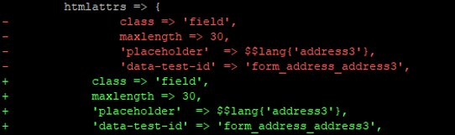
coding standard & guidelines
Cont...
3. Additionally provide line breaks before the following highlighted text
+ };
+ $FORM->{fields}->{STATE} = {
+ };
+ $FORM->{fields}->{COUNTRY_ID} = {
13

Slide 14
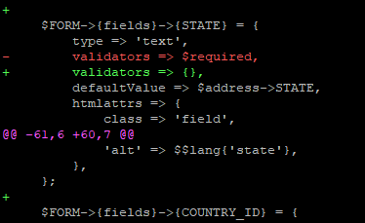

coding standard & guidelines
Cont...
4. Follow if standards in the following files such as highlighted example
+ if($$form{fields}{TITLE}){
14

Slide 15
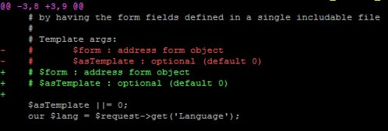
coding standard & guidelines
Cont...
5. Remove indentation provided to below highlighted and start parallel to above line – Ensure to do this changes across the branch.
+ # Template args:
+ # $form : address form object
+ # $asTemplate : optional (default 0)
15

Slide 16
coding standard & guidelines
Cont...
6. Additionally remove block space rendering at end of the highlighted
# Remove fields found in address_base that aren't required for our form
7. Remove space provided inside highlighted text - Carry out this fix wherever need.
+ $self->PHONE2 && $$args{phone} ? $$lang{'mobile_phone'} . ': ' . $self->PHONE2: ''
+ ) );
16

Slide 17

coding standard & guidelines
Cont...
8. Provide triple braces to the out statement.
{{#shippable}}
+ <a href="#" class="js-edit-address address-item__edit-address id-{{ADDRESS_ID}}" data-test-id="address_primary_edit">{{rb.language.edit}}</a>
{{/shippable}}
17

Slide 18
THANK YOU
18

