Slide 1
GLOBAL ECNOMIC HELTH ANALYISIS
ELEVATE LABS
Anila.AN

Slide 2
OVERVIEW
The GDP trend chart displays growth percent changes for multiple countries over time. Data points appear clustered, showing minor fluctuations around zero, with some countries showing slight positive or negative growth

Slide 3
OBJECTIVES
To track the two most critical "health vitals" of the world economy: Real GDP Growth and Consumer Price Inflation.
To geographically pinpoint which parts of the world are driving growth and which are lagging.
To show how current economic indicators compare to the volatile "Post-Pandemic" recovery period (2021–2023) and what the forecasted trajectory looks like for 2024 and beyond.

Slide 4
Average GDP Card
• Average GDP (Selected Countries): 2.415 Trillion USD
• Useful for comparing country performance with global average.
GDP Trend (2024)
• GDP growth rates range from -2% to 6% across countries.
• Indicates moderate and stable economic growth globally.

Slide 5
Average Global GDP
• Average Global GDP: 11.02 Trillion USD
• Indicates overall global economic productivity.
• Higher values show stronger economies.

Slide 6
Gold Price by Country
• Shows average gold price per ounce across countries.
• Countries like USA, UAE, Switzerland show higher gold prices.
• Reflects commodity price variations by region.

Slide 7
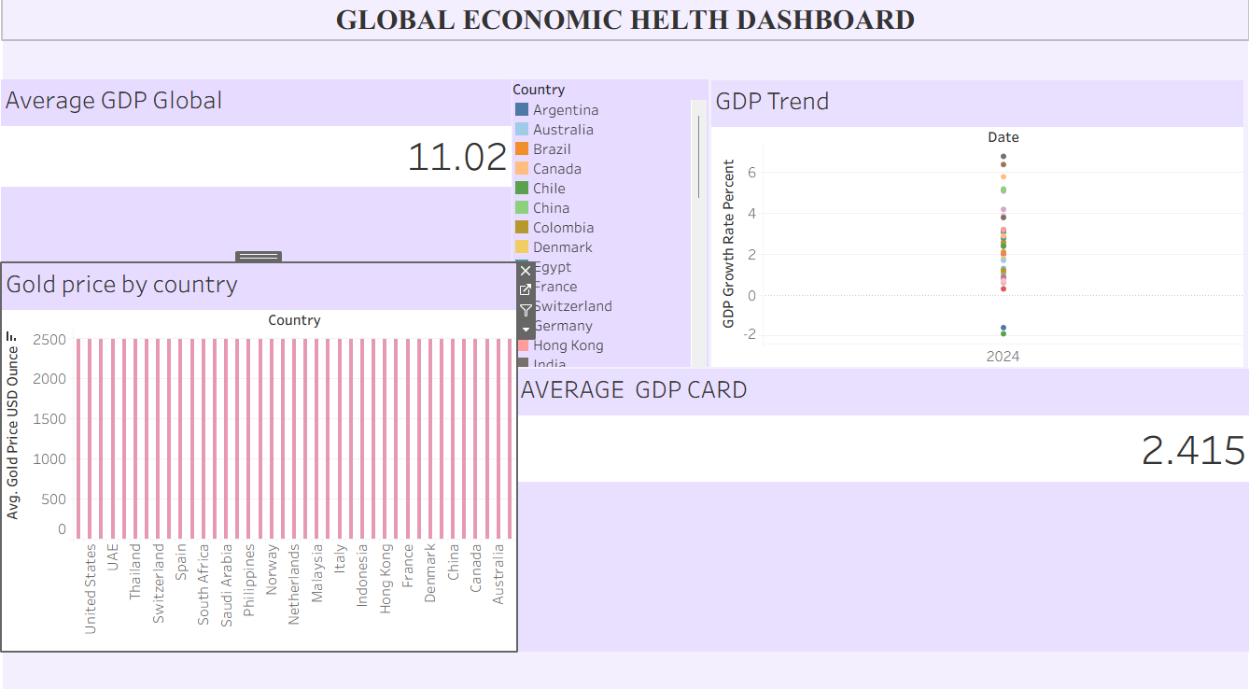
Global Economic Health Dashboard

Slide 8
Conclusion
• Global GDP remains stable.
• Gold price variations show regional economic differences.
• GDP trends indicate moderate global growth.
• Dashboard provides a clear view of economic health.

