Slide 1
HANDWRITTEN POLYNOMIAL EQUATION SOLVER
SUBMITTED BY
ANILA A L
MCA S3(ROLL NO:10)
REG NO: MCT20MCA-2011

Slide 2
WORKFLOW DIAGRAM
PREPROCEESING OF IMAGE
SEGMELINE AND CHARACTERSNTATION OF EQUATION
CLASSIFICATION OF CHARACTERS USING PRETRAINED CNN AND MAKE EQUATION LIKE STRING
APPLY STRING OPERATION FOR FINDING CALCULATIONS OF EACH

Slide 3

UI DESIGN

Slide 4
DATASET COLLECTION
The images of handwritten equations were collected from very short dataset from online sources such as GitHub, Kaggles and some images from MNIST dataset.
The acquired images contains some noise. The noise is removed using some filtering techniques and after that cropped and resized into small pixels and presently stored it as RGB format.

Slide 5
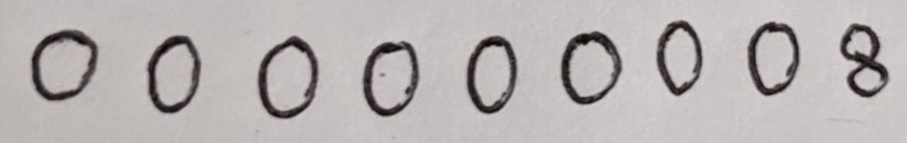
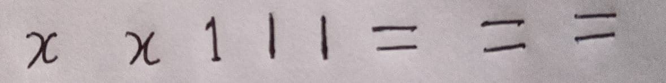
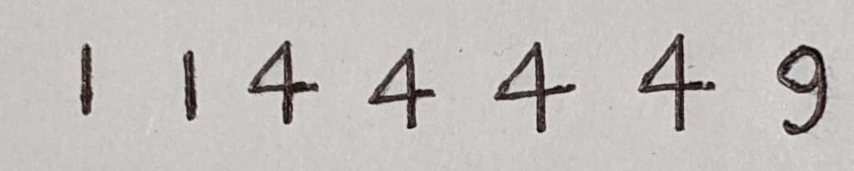
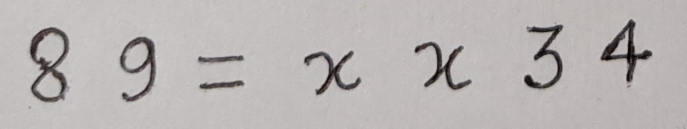
DATASET COLLECTION

Slide 6
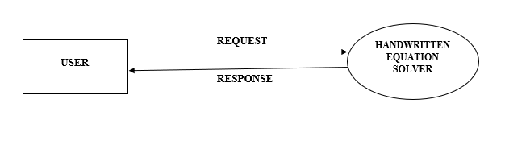
DATA FLOW DIAGRAM(LEVEL 0)

Slide 7
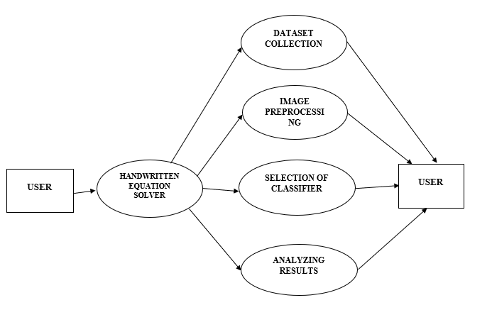
LEVEL 1

Slide 8
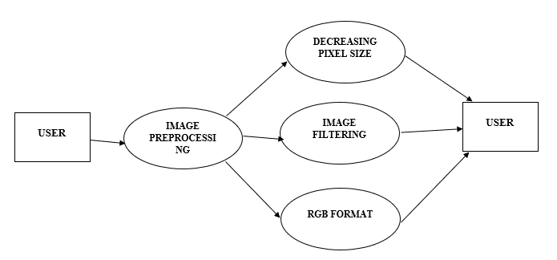
LEVEL 1.1

Slide 9
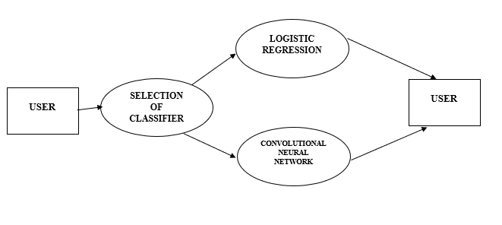
LEVEL 1.2

Slide 10
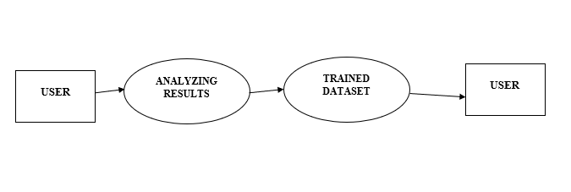
LEVEL 1.3

Slide 11
CLASSIFIER USING - CNN
Convolutional neural networks are distinguished from other neural networks by their superior performance with image, speech, or audio signal inputs. They have three main types of layers, which are:
Convolutional layer
Pooling layer
Fully-connected (FC) layer

Slide 12
Convolutional Layer
The convolutional layer is the core building block of a CNN, and it is where the majority of computation occurs. It requires a few components, which are input data, a filter, and a feature map. Let’s assume that the input will be a color image, which is made up of a matrix of pixels in 3D. This means that the input will have three dimensions—a height, width, and depth—which correspond to RGB in an image.
Pooling Layer
Pooling layers, also known as down sampling, conducts dimensionality reduction, reducing the number of parameters in the input. Similar to the convolutional layer, the pooling operation sweeps a filter across the entire input, but the difference is that this filter does not have any weights. Instead, the kernel applies an aggregation function to the values within the receptive field, populating the output array.

Slide 13
Fully-Connected Layer
In the fully-connected layer, each node in the output layer connects directly to a node in the previous layer. This layer performs the task of classification based on the features extracted through the previous layers and their different filters. While convolutional and pooling layers tend to use ReLu functions, FC layers usually leverage a softmax activation function to classify inputs appropriately, producing a probability from 0 to 1.

Slide 14
ALGORITHM
STEP 1 : SELECT THE SOLVER.
STEP 2 : PREPROCESSES THE IMAGE(APPLYING CNN).
STEP 3 : FILTERING THE IMAGE AND CROPS IT.
STEP 4 : DECREASES THE PIXEL SIZE AND TRAIN THE DATASET.
STEP 5 : SELECT THE IMAGE TO PREDICT THE RESULT.
STEP 6 : RETURNS THE RESULT.

Slide 15
SCRUM BOARD
TASK | START | FINISH | DURATION | STATUS
DATASET COLLECTION |  |  |  | COMPLETED
IMAGE PREPROCESSING |  |  |  | COMPLETED
CLASSIFICATION OF CHARACTERS |  |  |  | COMPLETED
RECOGNITION OF IMAGE |  |  |  | COMPLETED
DECREASING IMAGE SIZE |  |  |  | COMPLETED
ANALYZING RESULT |  |  |  | COMPLETED
DOCUMENTATION |  |  |  | IN PROGRESS

Slide 16
THANK YOU

