Slide 1

DATA SCIENCE
PROJECT TITLE:
RECOMMENDATION SYSTEMS
GROUP 4

Slide 2
Step:1
STEP 2
DATA
COLLECTION
DATA
PROCESSING
STEP 3
STEP 4
DATA
FILTERING
GENETATING
RECOMMENDATIONS

Slide 3


STEP 1
THE DATA IS AQUARIED FROM THE GIVEN SOURCE
THE DATA IS SHOWN BELOW:
BOOKS
USERS
RATINGS

Slide 4
STEP 1
Firstly import the libraries that are used:
import numpy as np
import matplotlib.pyplot as plt
import seaborn as sns
import pandas as pd

Slide 5
STEP 1
READ THE GIVEN DATA AS SHOWN:
user=pd.read_csv
(r"C:\Users\SYED RABBANI\OneDrive\Desktop\xl sheets\Users.csv")
rating=pd.read_csv
(r"C:\Users\SYED RABBANI\OneDrive\Desktop\xl sheets\Ratings.csv")
user=pd.read_csv
(r"C:\Users\SYED RABBANI\OneDrive\Desktop\xl sheets\Users.csv")

Slide 6
STEP 2
FOR PROCESSING THE DATA WE WILL STEP WITH
EDA PART THESE STEPS ATE INVOLVED IN EDA PART
Following things are part of EDA :
Get maximum insights from a data set.
Uncover underlying structure.
Extract important variables from the dataset.
Detect outliers and anomalies(if any)
Test underlying assumptions.
Determine the optimal factor settings.

Slide 7
STEP 2
import numpy as np
import matplotlib.pyplot as plt
import seaborn as sns
import pandas as pd
books=pd.read_csv(r"C:\Users\SYED RABBANI\OneDrive\Desktop\xl sheets\Books.csv")
books.head()
rating=pd.read_csv(r"C:\Users\SYED RABBANI\OneDrive\Desktop\xl sheets\Ratings.csv")
rating.head()
user=pd.read_csv(r"C:\Users\SYED RABBANI\OneDrive\Desktop\xl sheets\Users.csv")
user.head()
print(books.shape)
print(user.shape)
print(rating.shape)
print(books.shape)
print(user.shape)
print(rating.shape)
print(books.shape)
print(user.shape)
print(rating.shape)
print(books.dtypes)
print(user.dtypes)
print(rating.dtypes)
rint(books.info())
print("Number of unique values in each columns:",rating.nunique())
print("Number of missing values in each column:",books.isnull().sum())
books['Book-Author'].fillna('Book-Author', inplace=True)
books['Book-Author'].fillna('Publisher', inplace=True)
books.isnull().sum()print("Number of missing values in each column:",user.isnull().sum())

Slide 8
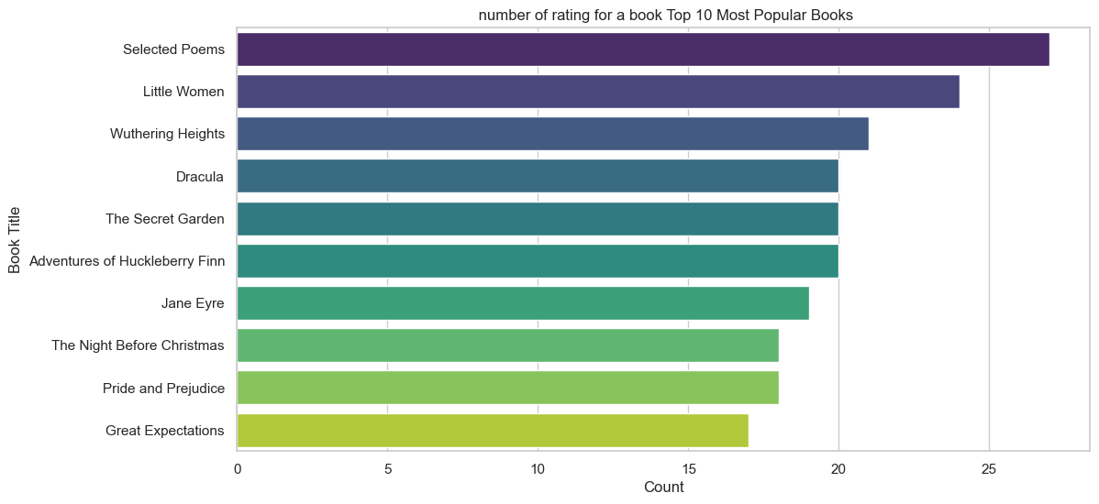
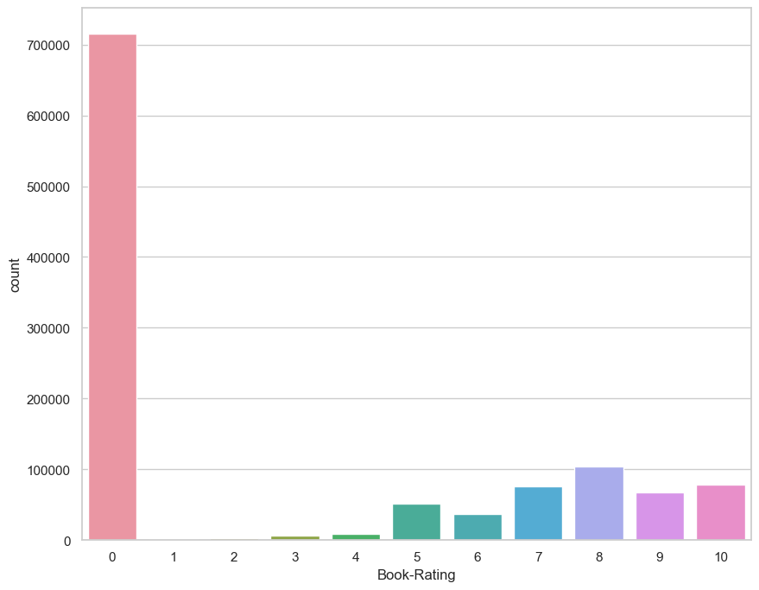
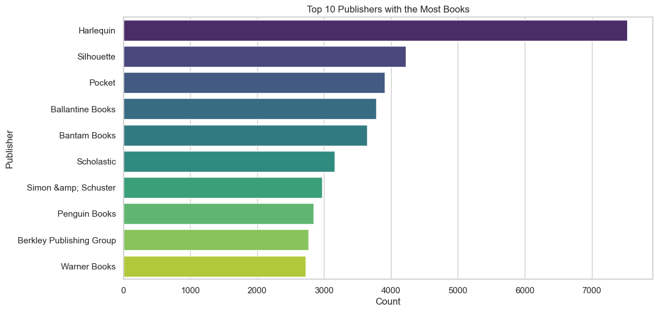
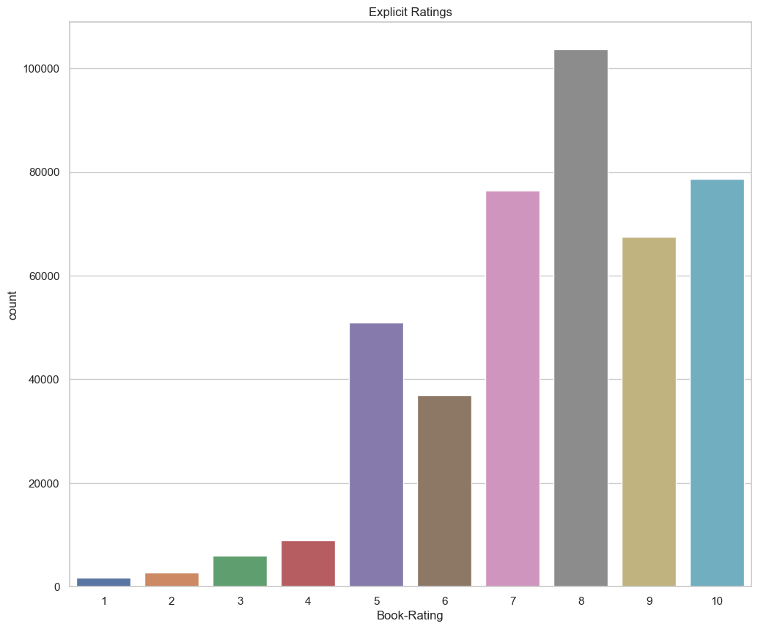
STEP 3
GRAPHICAL REPRESENTATIONS

Slide 9
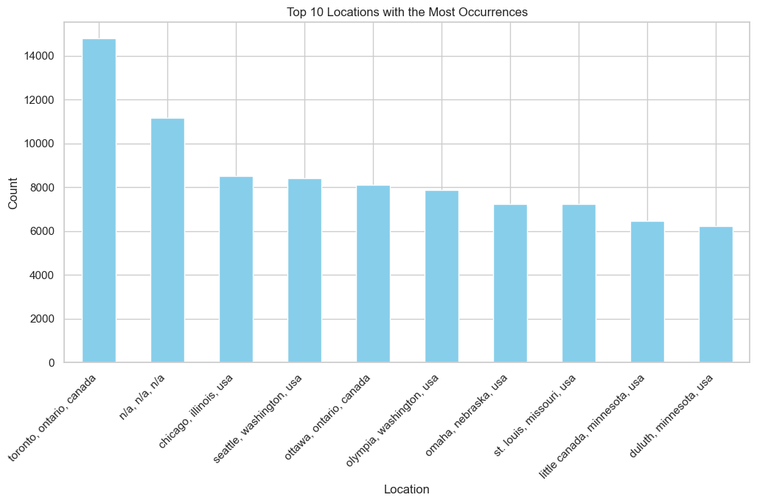
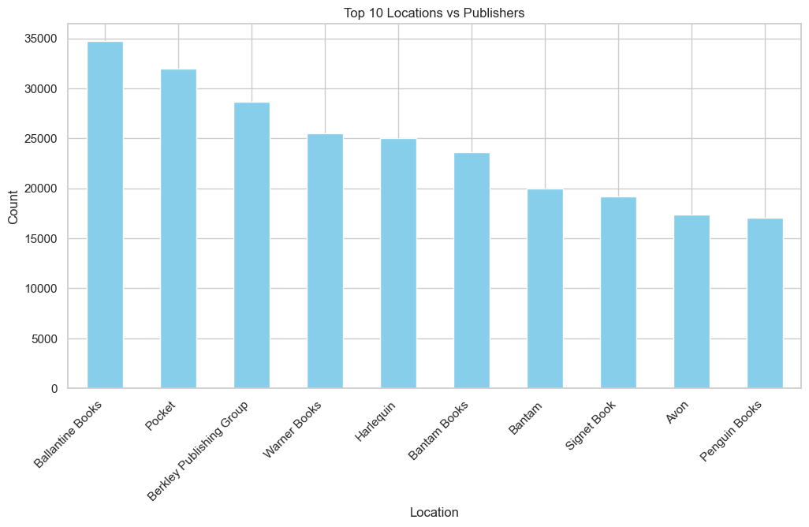
STEP 3

Slide 10
STEP 3
CODE FOR GRAPHICAL REPRESENTATION
import matplotlib.pyplot as plt
# Assuming your DataFrame is named 'merged_df'
# If not, replace 'merged_df' with the actual name of your DataFrame
# Create a bar graph between Age and Location
plt.figure(figsize=(12, 6))
merged_df[['Location', 'Age']].groupby('Location').size().sort_values(ascending=False).head(10).plot(kind='bar', color='skyblue')
plt.title('Top 10 Locations with the Most Occurrences')
plt.xlabel('Location')
plt.ylabel('Count')
plt.xticks(rotation=45, ha='right')
plt.show()
import pandas as pd
import matplotlib.pyplot as plt
# Assuming your DataFrame is named 'merged_df'
# If not, replace 'merged_df' with the actual name of your DataFrame
# Create a bar graph between Age and Location
plt.figure(figsize=(12, 6))
merged_df[['Location', 'Age']].groupby('Location').size().sort_values(ascending=False).head(10).plot(kind='bar', color='skyblue')
plt.title('Top 10 Locations with the Most Occurrences')
plt.xlabel('Location')
plt.ylabel('Count')
plt.xticks(rotation=45, ha='right')
plt.show()
import pandas as pd
import matplotlib.pyplot as plt
# Assuming your DataFrame is named 'merged_df'
# If not, replace 'merged_df' with the actual name of your DataFrame
# Create a bar graph between Age and Location
plt.figure(figsize=(12, 6))
merged_df[['Location', 'Age']].groupby('Location').size().sort_values(ascending=False).head(10).plot(kind='bar', color='skyblue')
plt.title('Top 10 Locations with the Most Occurrences')
plt.xlabel('Location')
plt.ylabel('Count')
plt.xticks(rotation=45, ha='right')
plt.show()
# Create a bar graph between Age and Location
plt.figure(figsize=(12, 6))
merged_df[['Location', 'Age']].groupby('Location').size().sort_values(ascending=False).head(10).plot(kind='bar', color='skyblue')
plt.title('Top 10 Locations with the Most Occurrences')
plt.xlabel('Location')
plt.ylabel('Count')
plt.xticks(rotation=45, ha='right')
plt.show()
import pandas as pd
import matplotlib.pyplot as plt
# Assuming your DataFrame is named 'merged_df'
# If not, replace 'merged_df' with the actual name of your DataFrame
# Create a bar graph between Age and Location
plt.figure(figsize=(12, 6))
merged_df[['Location', 'Age']].groupby('Location').size().sort_values(ascending=False).head(10).plot(kind='bar', color='skyblue')
plt.title('Top 10 Locations with the Most Occurrences')
plt.xlabel('Location')
plt.ylabel('Count')
plt.xticks(rotation=45, ha='right')
plt.show()
import pandas as pd
import matplotlib.pyplot as plt
# Assuming your DataFrame is named 'merged_df'
# If not, replace 'merged_df' with the actual name of your DataFrame
# Create a bar graph between Age and Location
plt.figure(figsize=(12, 6))
merged_df[['Location', 'Age']].groupby('Location').size().sort_values(ascending=False).head(10).plot(kind='bar', color='skyblue')
plt.title('Top 10 Locations with the Most Occurrences')
plt.xlabel('Location')
plt.ylabel('Count')
plt.xticks(rotation=45, ha='right')
plt.show()
import pandas as pd

Slide 11
## COllaborative filtering Based Recomendation system
x=merged_df.groupby('User-ID').count()['Book-Rating']>200
padhe_users=x[x].index
filtered_rating=new_book_df[new_book_df['User-ID'].isin(padhe_users)]
y=filtered_rating.groupby('Book-Title').count()['Book-Rating']>=50
famous_book=y[y].index
final_ratings=filtered_rating[filtered_rating['Book-Title'].isin(famous_book)]
pt=final_ratings.pivot_table(index='Book-Title',columns='User-ID',values='Book-Rating')
pt.fillna(0,inplace=True)
We convert our table to a 2D matrix, and fill the missing values with zeros. We then transform the values(ratings) of the matrix dataframe into a scipy sparse matrix for more efficient calculations.
pt
from sklearn.metrics.pairwise import cosine_similarity
similarity_score=cosine_similarity(pt)
similarity_score.shape
similarity_score
pt.columns
# Assuming 'User-ID' is the column containing user identifiers
user_id_input = int(input("Enter User-ID: "))
# Filter the DataFrame for ratings given by the user
user_ratings = merged_df[merged_df['User-ID'] == user_id_input]
# Group by 'Book-Title' and calculate the average rating
avg_ratings_for_user = user_ratings.groupby('Book-Title')['Book-Rating'].mean().reset_index()
STEP 3

Slide 12
# Sort the DataFrame by average rating in descending order
top_5_books_for_user = avg_ratings_for_user.sort_values(by='Book-Rating', ascending=False).head(5)
print(f"\nTop 5 Books with Highest Average Ratings for User-ID {user_id_input}:\n")
print(top_5_books_for_user[['Book-Title', 'Book-Rating']])
# Assuming 'User-ID' is the column containing user identifiers
user_id_input = int(input("Enter User-ID: "))
# Filter the DataFrame for ratings given by the user
user_ratings = merged_df[merged_df['User-ID'] == user_id_input]
# Group by 'Book-Title' and calculate the average rating
avg_ratings_for_user = user_ratings.groupby('Book-Title')['Book-Rating'].mean().reset_index()

Slide 13
CODE FOR STREAMLIT
if st.button("Enter"):
try:
user_input = int(user_input)
if user_input in pt.columns:
user_ratings = pt[user_input].dropna()
top_rated_books = user_ratings.sort_values(ascending=False).head(5)
st.write(f"Top 5 rated books for User {user_input}:")
st.write(top_rated_books)
else:
st.write("Invalid User ID. Please enter a valid User ID.")
except ValueError:
if user_input in pt.index:
recommended_books = recommend(user_input)
st.write(f"Books similar to '{user_input}':")
st.write(recommended_books)
else:
st.write(f"Book '{user_input}' not found in the dataset.")
st.title("Recommand Books")
book_input = st.text_input("Enter Book Name:")
if st.button("Recommend"):
if book_input in pt.index:
recommended_books = recommend(book_input)
st.write(f"Books similar to '{book_input}':")
st.write(recommended_books)
else:
st.write(f"Book '{book_input}' not found in the dataset.")
if __name__ == "__main__":
main()
import pandas as pd
import numpy as np
import streamlit as st
from sklearn.metrics.pairwise import cosine_similarity
# Assuming 'final_ratings.csv' is loaded somewhere in the code
final_ratings = pd.read_csv(r"C:\Users\Anil\Book recomendation project\final_ratings.csv")
pt=final_ratings.pivot_table(index='Book-Title',columns='User-ID',values='Book-Rating')
pt.fillna(0, inplace=True)
st.title('User-Based Book Recommendation System')
# Function to recommend similar books
def recommend(book_name):
index = np.where(pt.index == book_name)[0][0]
similarity_scores = cosine_similarity(pt)
similar_items = sorted(list(enumerate(similarity_scores[index])), key=lambda x: x[1], reverse=True)[1:6]
recommended_books = [pt.index[i[0]] for i in similar_items]
return recommended_books
# Streamlit app
def main():
st.title("Recommand Top 5 Books")
user_input = st.text_input("Enter User ID or Book Title:")

Slide 14

DEPLOYMENT VIEW

Slide 15
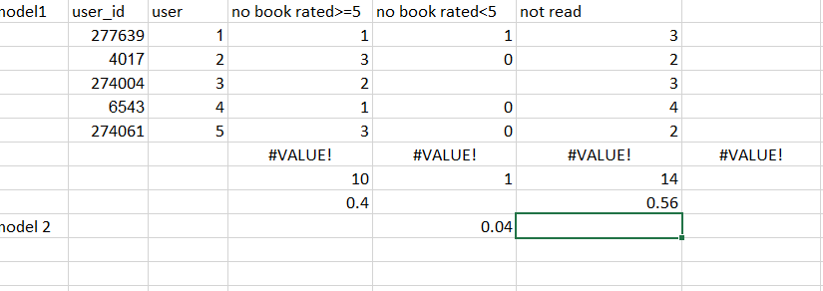
ACCURACY LEVEL

Slide 16


