Slide 1
Unified Modeling Language
Edited by R.A. Mustafa Büyükkeçeci from various UML resources.

Slide 2
What is a Model?
Creating models or modeling has been an essential part of engineering, art and construction for centuries.
Models are typically scaled down and abstracted representations of real-world objects and systems.
The reduction in scale may include size, detail, and aspect (a model that focuses on cost or durability while ignoring unrelated qualities of the system, for example).
Mostly when we are modeling a system, we must abstract away any details that are irrelevant or potentially confusing.
Model is a simplification of the real system, so it allows the design and viability of a system to be understood, evaluated, and criticized quicker than if you had to dig through the actual system itself.

Slide 3
Benefits of Modelling in SE
Complex software designs that would be difficult to describe verbally can readily be conveyed through modelling.
Some key benefits of modelling are: visualization of systems, clear communication between stakeholders, developers, and operations personnel, complexity management, better planning, prediction of risks, reduction and estimation of costs and effort.
Saving time, effort and money are key drivers of modelling.

Slide 4
What is UML?
The Unified Modeling Language (UML) is a general-purpose, developmental, modeling language in the field of software engineering, that is intended to provide a standard way to visualize the design of a system.
UML includes a set of graphic notation techniques to create visual models of software systems.
UML is the de-facto standard diagramming notation for drawing or representing pictures (with some text) related to object-oriented software.

Slide 5
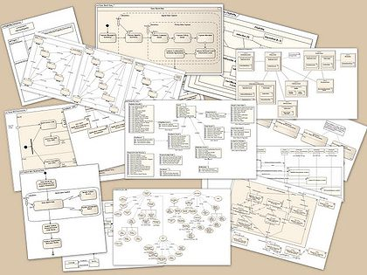
An Overview of UML Diagrams

Slide 6
Lifecycle of a Software Product
Gather, Analyse and Record User Requirements
Model the
Software Using
a
UML Tool
(OO-Modelling)
Code the Methods, Test and Finalize the OO Software Product

Slide 7
Software Lifecycle
OO-Analyze User Requirements: OOA
What is system to do?
What services is it to provide?
Provide requirements for designer.
OO-Design: OOD
What will be the parts & structure of the system?
How will they interact?
Provide blueprint for programmer.
OO-Programming: OOP
Convert skeleton code into real code and test the system.

Slide 8
Classification Of UML Diagrams
There are 3 types of UML diagrams:
Structure diagrams: emphasize the things that must be present in the system being modeled. Since structure diagrams represent the structure they are used extensively in documenting the architecture of software systems.
Behavior diagrams: emphasize what must happen in the system being modeled. Since behavior diagrams illustrate the behavior of a system, they are used extensively to describe the functionality of software systems.
Interaction diagrams: emphasize the flow of control and data among the things in the system being modeled.

Slide 9
UML Diagrams Overview
UML Diagrams
Structure Diagram
Object Diagram
Profile Diagram
Class Diagram
Component Diagram
Composite Structure Diagram
Deployment Diagram
Package Diagram
Behaviour Diagram
Activity Diagram
Use-Case Diagram
Interaction Diagram
State Machine Diagram
Sequence Diagram
Communication Diagram
Interaction Overview Diagram
Timing Diagram

Slide 10
What is SysML?
The Systems Modeling Language (SYSML) is a general-purpose visual modeling language for systems engineering applications.
SysML supports the specification, analysis, design, verification and validation of a broad range of systems and systems-of-systems.
These systems may include hardware, software, information, processes, personnel, and facilities.
We can’t model those systems with UML because it has a software bias.

Slide 11
What is SysML? - 2
SysML was originally developed by an open source specification project, and includes an open source license for distribution and use.
SysML offers systems engineers several noteworthy improvements over UML, which tends to be software-centric.
SysML is an extension to UML which enhances the ability to manage growing system complexity.
SYSML is a specified as a profile (dialect) of the Unified Modelling Language 2.0, the industry standard for modelling software-intensive systems, so SYSML is frequently implemented as a plugin for popular UML modelling tools.

Slide 12
UML and SysML
SysML Diagrams
Structural Diagram
Behavioural Diagram
Cross-Cutting Diagram
Requirements Diagram
Use-Case Diagram
Sequence Diagram
Activity Diagram
State Chart Diagram
Block Definition Diagram
Internal Block Diagram
Parametric Diagram
Same as UML
Modified from UML
Only in SysML

Slide 13
