Slide 1

CENG-303
Database Systems
Assist.Prof.Dr. Murat KOMESLİ
Chapter One: Introduction
Part One
Text Book:
David M. Kroenke’s
Database Processing
Fundamentals, Design, and Implementation
(10th Edition)

Slide 2
Chapter Objectives
To understand the nature and characteristics of databases
To survey some important and interesting database applications
To gain a general understanding of tables and relationships
To describe the components of a Microsoft Access database system and explain the functions they perform
To describe the components of an enterprise-class database system and explain the functions they perform
To define the term database management system (DBMS) and describe the functions of a DBMS

Slide 3
Chapter Objectives
To define the term database and describe what is contained within the database
To define the term metadata and provide examples of metadata
To define and understand database design from existing data
To define and understand database design as new systems development
To define and understand database design in database redesign
To understand the history and development of database processing

Slide 4
The Characteristics of Databases
The purpose of a database is to help people track things of interest to them
Data is stored in tables, which have rows and columns like a spreadsheet. A database may have multiple tables, where each table stores data about a different thing
Each row in a table stores data about an occurrence or instance of the thing of interest
A database stores data and relationships

Slide 5
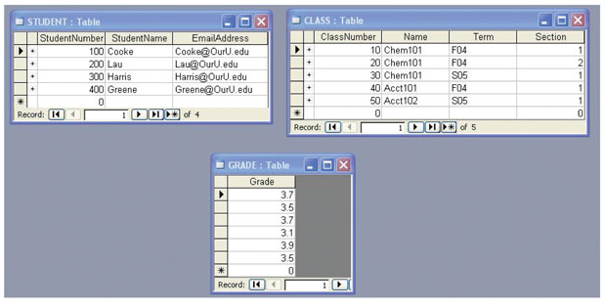
Data in Tables

Slide 6
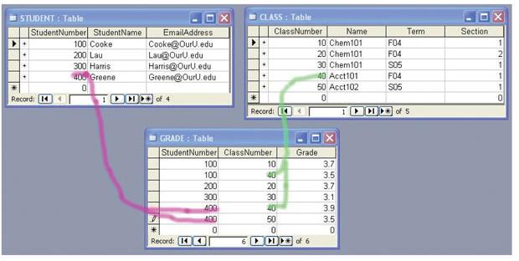
The Key Characteristic of Databases: Related Tables

Slide 7
Naming Conventions in the Textbook
Table Names are written with all capital letters:
  STUDENT, CLASS, GRADE
Column names are written with an initial capital letter, and compound names are written with a capital letter on each word:
  Term, Section, ClassNumber, StudentName

Slide 8
Databases Create Information
Data = Recorded facts and figures
Information = Knowledge derived from data
Databases record data, but they do so in such a way that we can produce information from the data
  The data on STUDENTs, CLASSes and GRADEs could produce information about each student’s GPA

Slide 9
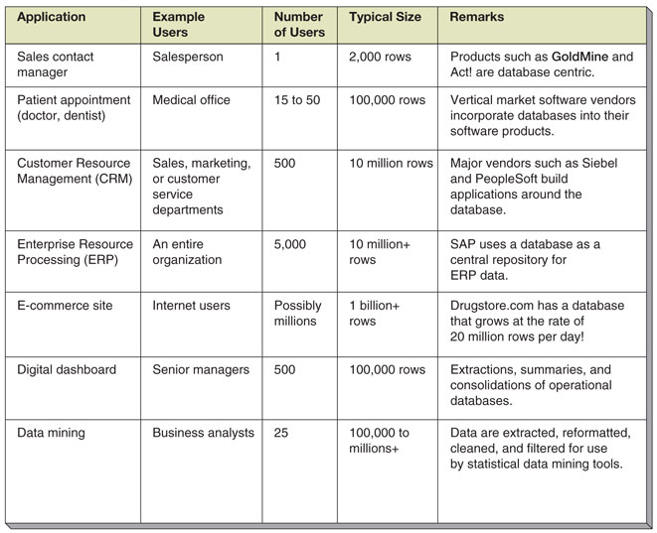
Database Examples

Slide 10
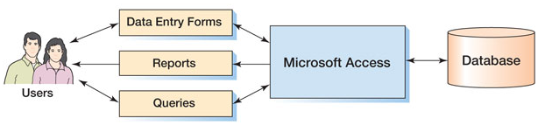
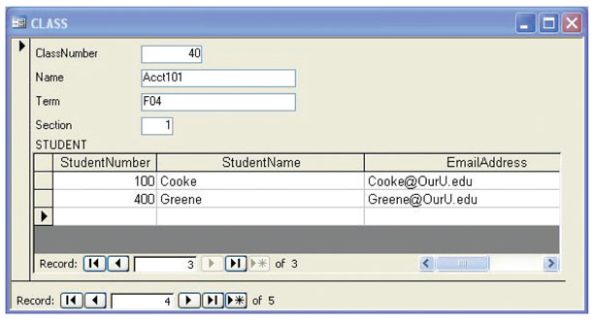
Components of a Database System: Microsoft Access

Slide 11
Microsoft Access
Microsoft Access is a low-end product intended for individual users and small workgroups
MS Access tries to hide much of the underlying database technology from the user
A good strategy for beginners, but not for database professionals
NOTE: MS Access is discussed in detail in Appendix A

Slide 12
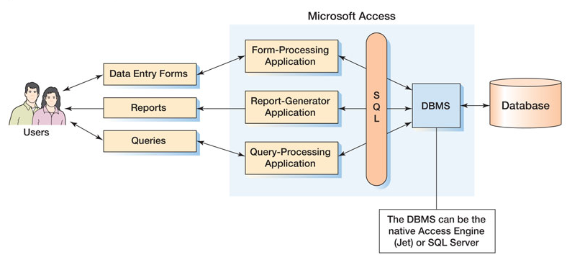
MS Access in Detail

Slide 13
Applications, the DBMS and SQL
Applications are the computer programs that users work with
The Database Management System (DBMS) creates, processes and administers databases
Structured Query Language (SQL) is an internationally recognized standard database language that is used by all commercial DBMSs

Slide 14
What Is MS Access?
MS Access is a DBMS plus an application generator:
  DBMS creates, processes and administers MS Access databases
  The application generator includes query, form and report components
The MS Access DBMS engine is called Jet, which is not sold as a separate product
MS Access 2000 and later can be used as an application generator for the MS SQL Server DBMS

Slide 15
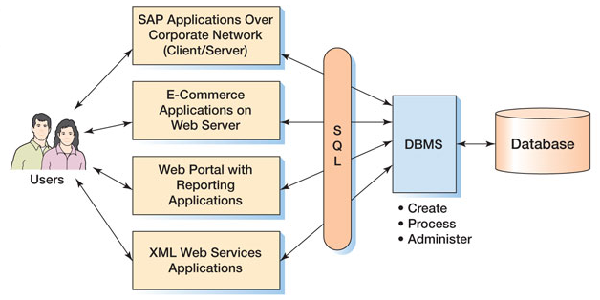
Enterprise-Class Database Systems

Slide 16
Prominent DBMS Products
Microsoft Access
Microsoft SQL Server
  New: Microsoft SQL Server Express
IBM DB2
Oracle Corporation ORACLE
And don’t overlook MySQL

Slide 17
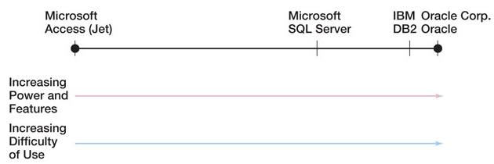
DBMS Power vs. Ease of Use

Slide 18
The Database
A database is a self-describing collection of integrated tables
The tables are called integrated because they store data about the relationships between the rows of data
A database is called self-describing because it stores a description of itself
The self-describing data are called metadata, which is data about data

Slide 19
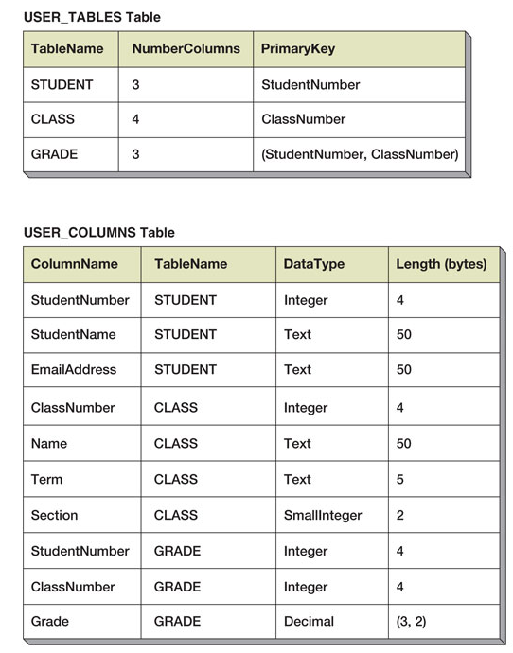
Typical Metadata Tables

Slide 20
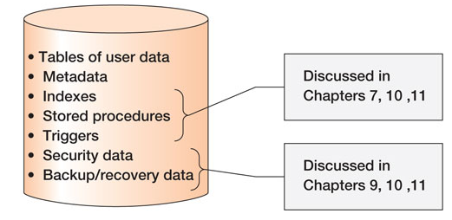
Database Contents

Slide 21
End of Presentation:
Chapter One - Part One

