Slide 1
SE - 222 Lab Database Systems
Database Modeling

Slide 2
Database Modeling Overview
A database model or database schema is the structure or format of a database, described in a formal language supported by the database management system.
In other words, a "database model" is the relatively simple representation, usually graphical, of complex real-world data structures.
The model’s main function is to help us understand the complexities of the real-world environment.

Slide 3
Database Modeling Overview
Within the database environment, a data model represents data structures and their characteristics, relations, constraints and transformations.
The database designer employs data models as communication tools to facilitate the interaction among the designer, the applications programmer, and the end user.

Slide 4
Database Modeling Overview (Cont’d)
There are several different database models:
Hierarchical model
Network model
Relational model
Entity-relationship
Object-relational model
Object model

Slide 5
Entity Relationship Diagrams
Entity relationship modeling is a database modeling method, used to produce a type of conceptual schema or semantic data model of a system, often a relational database, and its requirements in a top down fashion.
Entity relationship diagram (ERD) represents a detailed picture of the entities needed for a business.
In forward engineering, ERD will be transformed into a relational database eventually.

Slide 6
Overview
The first stage of information system design uses these models during the requirements analysis to describe information needs or the type of information that is to be stored in a database.
The data modeling technique can be used to describe any ontology (i.e. an overview and classifications of used terms and their relationships) for a certain area of interest.

Slide 7
Overview (Cont’d)
In the case of the design of an information system that is based on a database, the conceptual data model is, at a later stage (usually called logical design), mapped to a logical data model, such as the relational model; this in turn is mapped to a physical model during physical design.

Slide 8
Conceptual Design
A conceptual data model identifies the highest-level relationships between the different entities. Features of conceptual data model include:
Includes the important entities and the relationships among them.
No attribute is specified.
No primary key is specified.
The only information shown via the conceptual data model is the entities that describe the data and the relationships between those entities.
No other information is shown through the conceptual data model.

Slide 9
Conceptual Design

Slide 10
Logical Design
A logical data model describes the data in as much detail as possible, without regard to how they will be physical implemented in the database.
Features of a logical data model include:
Includes all entities and relationships among them.
All attributes for each entity are specified.
The primary key for each entity is specified.
Foreign keys (keys identifying the relationship between different entities) are specified.
Normalization occurs at this level.

Slide 11
Logical Design
The steps for designing the logical data model are as follows:
Specify primary keys for all entities.
Find the relationships between different entities.
Find all attributes for each entity.
Resolve many-to-many relationships.
Normalization.

Slide 12
Logical Design

Slide 13
Physical Design
A physical database model shows all table structures, including column name, column data type, column constraints, primary key, foreign key, and relationships between tables.
Features of a physical data model include:
Specification all tables and columns.
Foreign keys are used to identify relationships between tables.
De-normalization may occur based on user requirements.
Physical considerations may cause the physical data model to be quite different from the logical data model.
Physical data model will be different for different RDBMS.

Slide 14
Physical Design
The steps for physical data model design are as follows:
Convert entities into tables.
Convert relationships into foreign keys.
Convert attributes into columns.
Modify the physical data model based on physical constraints / requirements.

Slide 15
Physical Design

Slide 16
Comparison of the Models
Feature | Conceptual Design | Logical Design | Physical Design
Entity Name | ✔ | ✔ | ✔
Entity Relationships | ✔ | ✔ | ✔
Attributes |  | ✔ | ✔
Primary Keys |  | ✔ | ✔
Foreign Keys |  | ✔ | ✔
Table Names |  |  | ✔
Column Names |  |  | ✔
Column Data Types |  |  | ✔

Slide 17
Entity Relationship Diagram Notations

Slide 18
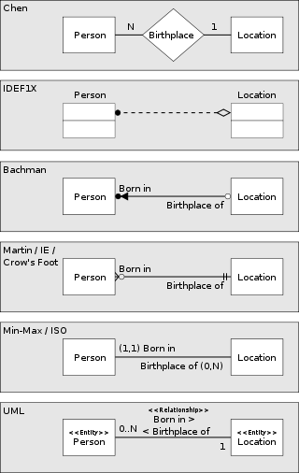

Slide 19
Chen’s Notation
Chen's notation for entity-relationship modeling uses rectangles to represent entities, and diamonds to represent relationships appropriate for first-class objects: they can have attributes and relationships of their own.
Chen’s notation was shown in the previous year.

Slide 20
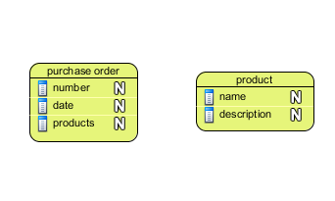
Conceptual ERD
Conceptual ERD outline the primary entities/components of proposed system by drawing a high level design.
It is developed by based on the requirements for the system/application to ne developed.

Slide 21
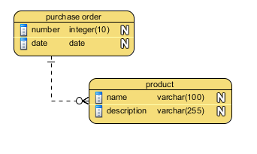
Logical ERD
Logical ERD refines conceptual design to include/exclude primary entities and relate them.

Slide 22
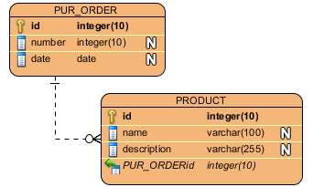
Physical ERD
The most detailed design that is readily adaptable to physical database.

