Slide 1
SE-222
Database Systems
Chapter One: Introduction
Part Two

Slide 2
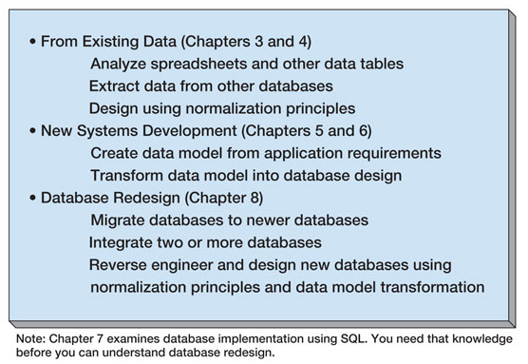
Three Types of Database Design

Slide 3
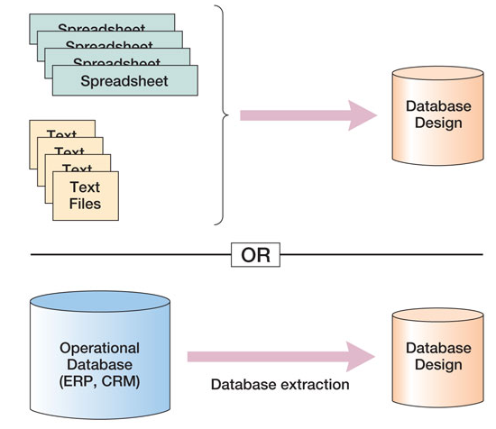
Database Design from Existing Data

Slide 4
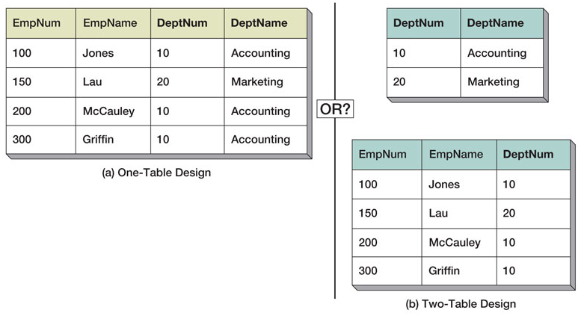
Data Import: One or Two Tables?
This is an important decision, and based on a set of rules known as normalization (which is covered in Chapter Three)

Slide 5
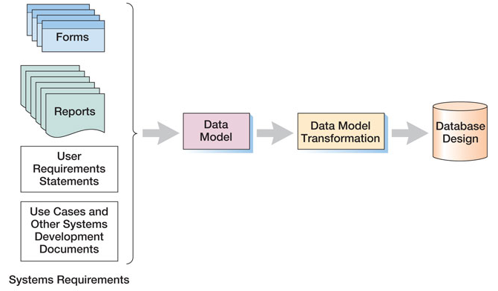
Database Design from New Systems Development
Entity-Relationship data modeling is covered in Chapter Five, and data model transformations to database designs are covered in Chapter Six

Slide 6
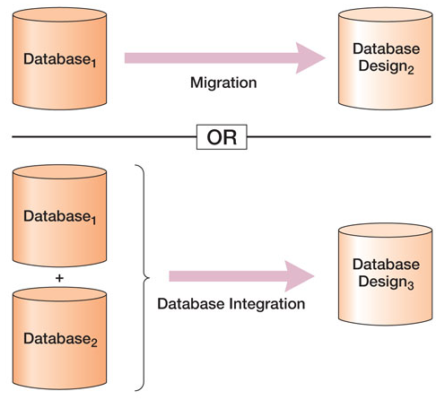
Database Design from Database Redesign
Database redesign is covered in Chapter Eight, after coverage of SQL in Chapter Seven

Slide 7
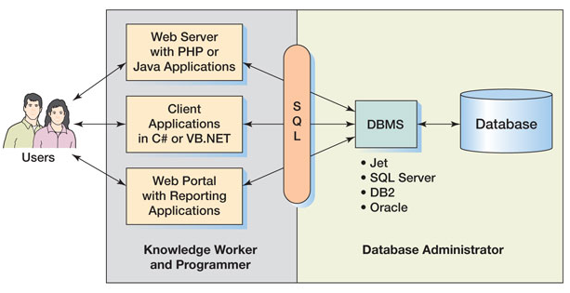
What You Need to Learn

Slide 8
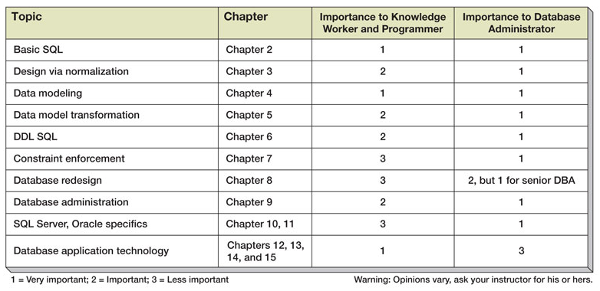
Knowledge Priorities

Slide 9
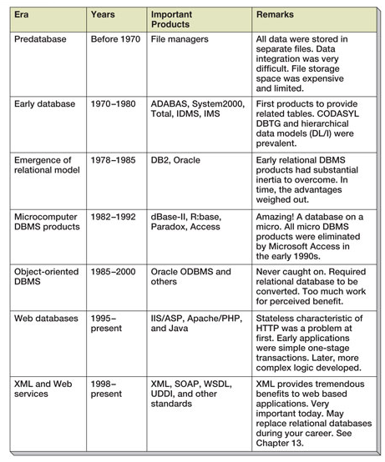
A Brief History of Database Processing

Slide 10
The Relational Database Model
The dominant database model is the relational database model – all current major DBMS products are based on it
Created by IBM engineer E. F. Codd in 1970
It was based on mathematics called relational algebra
This text examines and explains the relational database model

Slide 11
SE-222
Database Systems
End of Presentation:
Chapter One – Part Two

