Slide 1
SE-222
Database Systems
Chapter Two:
Introduction to
Structured Query Language
Part One

Slide 2
Structured Query Language
Structured Query Language (SQL) was developed by the IBM Corporation in the late 1970s.
SQL was endorsed as a United States national standard by the American National Standards Institute (ANSI) in 1992 [SQL-92].
A newer version [SQL3] exists and incorporates some object-oriented concepts, but is not widely used in commercial DBMS products.

Slide 3
SQL as a Data Sublanguage
SQL is not a full featured programming language as are C, C#, and Java.
SQL is a data sublanguage for creating and processing database data and metadata.
SQL is ubiquitous in enterprise-class DBMS products.
SQL programming is a critical skill.

Slide 4
SQL DDL and DML
SQL statements can be divided into two categories:
  Data definition language (DDL) statements
    Used for creating tables, relationships, and other structures.
    Covered in Chapter Seven.
  Data manipulation language (DML) statements.
    Used for queries and data modification
    Covered in this chapter (Chapter Two)

Slide 5
Cape Codd Outdoor Sports
Cape Codd Outdoor Sports is a fictitious company based on an actual outdoor retail equipment vendor.
Cape Codd Outdoor Sports:
  Has 15 retail stores in the United States and Canada.
  Has an on-line Internet store.
  Has a (postal) mail order department.
All retail sales recorded in an Oracle database.

Slide 6
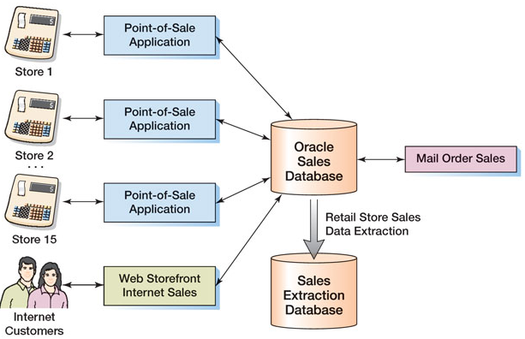
Cape Codd Retail Sales Structure

Slide 7
Cape Codd Retail Sales Data Extraction
The Cape Codd marketing department needs an analysis of in-store sales.
The entire database is not needed for this, only an extraction of retail sales data.
The data is extracted by the IS department from the operational database into a separate, off-line database for use by the marketing department.
Three tables are used: RETAIL_ORDER, ORDER_ITEM, and SKU_DATA (SKU = Stock Keeping Unit).
The extracted data is converted as necessary:
  Into a different DBMS → MS SQL Server
  Into different columns → OrderDate becomes OrderMonth and OrderYear

Slide 8
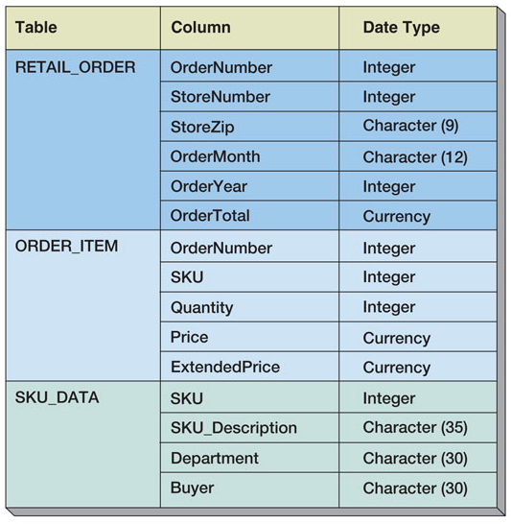
Extracted Retail Sales Data Format

Slide 9
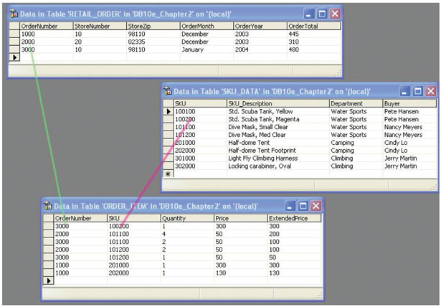
Retail Sales Extract Tables
[in MS SQL Server]

Slide 10
The SQL SELECT Statement
The fundamental framework for SQL query states is the SQL SELECT statement:
  SELECT {ColumnName(s)}
  FROM {TableName(s)}
  WHERE {Conditions}
All SQL statements end with a semi-colon (;).

Slide 11
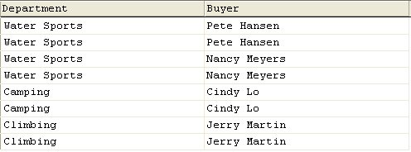
Specific Columns on One Table
SELECT Department, Buyer
FROM SKU_DATA;

Slide 12
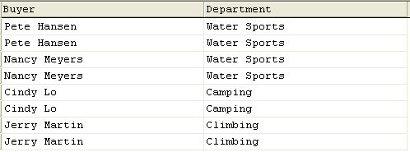
Specifying Column Order
SELECT Buyer, Department
FROM SKU_DATA;

Slide 13
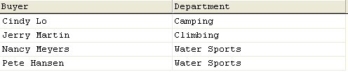
The DISTINCT Keyword
SELECT DISTINCT Buyer, Department
FROM SKU_DATA;

Slide 14
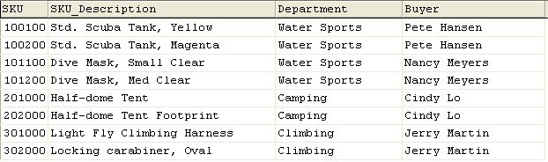
Selecting All Columns:
The Asterisk (*) Keyword
SELECT *
FROM SKU_DATA;

Slide 15
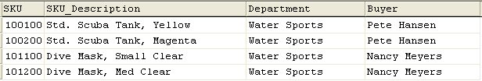
Specific Rows from One Table
SELECT *
FROM SKU_DATA
WHERE Department = 'Water Sports';
NOTE: SQL wants a plain ASCII single quote: ' NOT ‘ !

Slide 16

Specific Columns and Rows from One Table
SELECT SKU_Description, Buyer
FROM SKU_DATA
WHERE Department = 'Climbing';

Slide 17
SE-222
Database Systems
End of Presentation:
Chapter Two Part One

