Slide 1
CENG-303
Database Systems
Chapter Four:
Database Design
Using Normalization

Slide 2
Chapter Premise
We have received one or more tables of existing data
The data is to be stored in a new database
QUESTION: Should the data be stored as received, or should it be transformed for storage?

Slide 3
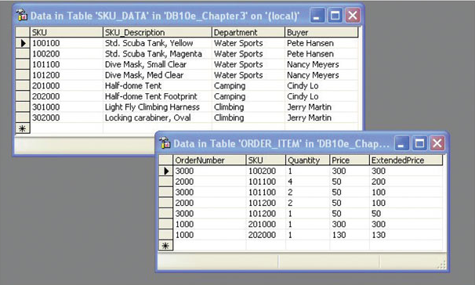
How Many Tables?
Should we store these two tables as they are, or should we combine them into one table in our new database?

Slide 4
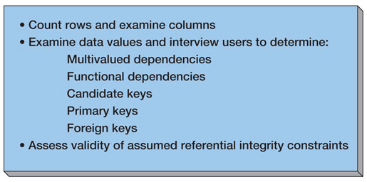
Assessing Table Structure

Slide 5
Counting Rows in a Table
To count the number of rows in a table use the SQL built-in function COUNT(*):
SELECT COUNT(*) AS NumRows
FROM SKU_DATA;

Slide 6
Examining the Columns
To determine the number and type of columns in a table, use an SQL SELECT statement
To limit the number of rows retreived, use the SQL TOP {NumberOfRows} keyword:
SELECT TOP (10) *
FROM SKU_DATA;

Slide 7
Checking Validity of Assumed Referential Integrity Constraints
Given two tables with an assumed foreign key constraint:
SKU_DATA (SKU, SKU_Description, Department, Buyer)
BUYER (BuyerName, Department)
Where SKU_DATA.Buyer must exist in BUYER.BuyerName

Slide 8
Checking Validity of Assumed Referential Integrity Constraints
To find any foreign key values that violate the foreign key constraint:
Any Answer?

Slide 9
Checking Validity of Assumed Referential Integrity Constraints
To find any foreign key values that violate the foreign key constraint:
SELECT Buyer
FROM SKU_DATA
WHERE Buyer NOT IN
(SELECT Buyer
FROM SKU_DATA, BUYER
WHERE SKU_DATA.BUYER =
BUYER.BuyerName;

Slide 10
Type of Database
Updateable database or read-only database?
If updateable database, we normally want tables in BCNF (OLTP)
If read-only database, we may not use BCNF tables (OLAP)

Slide 11
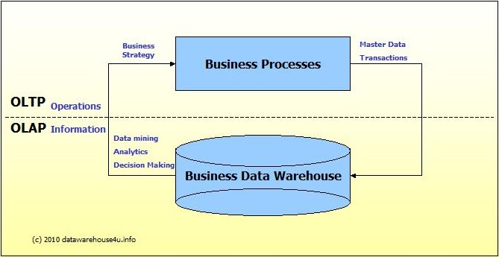
OLTP vs. OLAP
We can divide IT systems into transactional (OLTP) and analytical (OLAP).
In general we can assume that OLTP systems provide source data to data warehouses, whereas OLAP systems help to analyze it.
NORMALIZATION
Disk Access Speed
JOIN
CPU Speed
DE-NORMALIZATION

Slide 12
OLTP vs. OLAP
OLTP (On-line Transaction Processing) is characterized by a large number of short on-line transactions (INSERT, UPDATE, DELETE). The main emphasis for OLTP systems is put on very fast query processing, maintaining data integrity in multi-access environments and an effectiveness measured by number of transactions per second. In OLTP database there is detailed and current data, and schema used to store transactional databases is the entity model (usually 3NF).
OLAP (On-line Analytical Processing) is characterized by relatively low volume of transactions. Queries are often very complex and involve aggregations. For OLAP systems a response time is an effectiveness measure. OLAP applications are widely used by Data Mining techniques. In OLAP database there is aggregated, historical data, stored in multi-dimensional schemas (usually star schema).

Slide 13
Designing
Updateable Databases

Slide 14
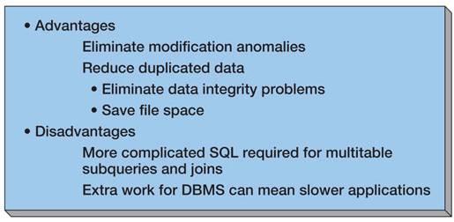
Normalization:
Advantages and Disadvantages

Slide 15
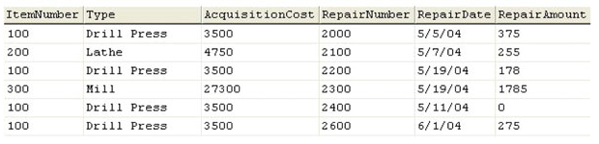
Non-Normalized Table:
EQUIPMENT_REPAIR
QUESTION: Which item is mostly repaired?

Slide 16
Non-Normalized Table:
EQUIPMENT_REPAIR
QUESTION: Which item is mostly repaired?
To answer this in normalized DB, we have to make JOINs.
But, here there is no need. Because table is de-normalized. (OLAP)

Slide 17
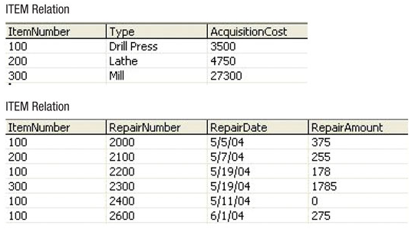
Normalized Tables:
ITEM and REPAIR

Slide 18
Copying Data to New Tables
To copy data from one table to another, use the SQL command INSERT INTO TableName command:
INSERT INTO ITEM
SELECT DISTINCT ItemNumber, Type,
AcquisitionCost
FROM EQUIPMENT_REPAIR;
INSERT INTO REPAIR
SELECT ItemNumber, RepairNumber,
RepairDate, RepairAmmount
FROM EQUIPMENT_REPAIR;

Slide 19
Choosing Not to Use BCNF
BCNF is used to control anomalies from functional dependencies
There are times when BCNF is not desirable
The classic example is ZIP codes:
  ZIP codes almost never change
  Any anomalies are likely to be caught by normal business practices
  Not having to use SQL to join data in two tables will speed up application processing

Slide 20
Multivaled Dependencies
Anomalies from multivalued dependencies are very problematic
Always place the columns of a multivalued dependency into a separate table (4NF)

Slide 21
Designing
Read-Only Databases

Slide 22
Read-Only Databases
Read-only databases are non-operational databases using data extracted from operational databases
They are used for querying, reporting and data mining applications
They are never updated (in the operational database sense – they may have new data imported form time-to-time)

Slide 23
Denormalization
For read-only databases, normalization is seldom an advantage
  Application processing speed is more important
Denormalization is the joining of data in normalized tables prior to storing the data
The data is then stored in non-normalized tables

Slide 24
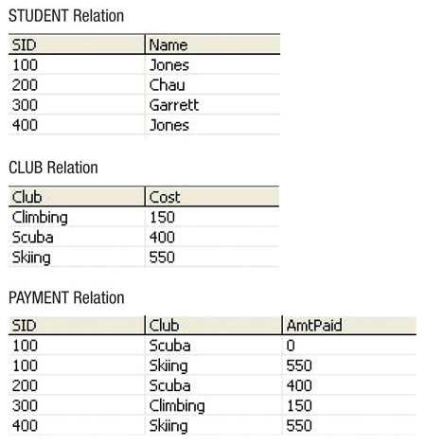
Normalized Tables

Slide 25
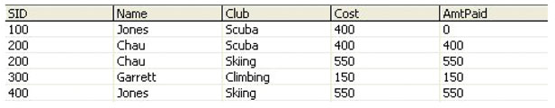
Denormalizing the Data
INSERT INTO PAYMENT_DATA
SELECT STUDENT.SID, Name, CLUB.Club,
Cost, AmtPaid
FROM STUDENT, PAYMENT, CLUB
WHERE STUDENT.SID = PAYMENT.SID
AND PAYMENT.Club = CLUB.Club;

Slide 26
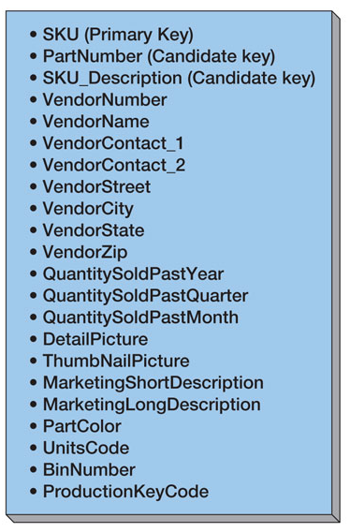
Customized Tables
Read-only databases are often designed with many copies of the same data, but with each copy customized for a specific application
Consider the PRODUCT table:

Slide 27
Customized Tables
PRODUCT_PURCHASING (SKU, SKU_Description, VendorNumber, VendorName, VendorContact_1, VendorContact_2, VendorStreet, VendorCity, VendorState, VendorZip)
PRODUCT_USAGE (SKU, SKU_Description, QuantitySoldPastYear, QuantitySoldPastQuarter, QuantitySoldPastMonth)
PRODUCT_WEB (SKU, DetailPicture, ThumbnailPicture, MarketingShortDescription, MarketingLongDescription, PartColor)
PRODUCT_INVENTORY (SKU, PartNumber, SKU_Description, UnitsCode, BinNumber, ProductionKeyCode)

Slide 28
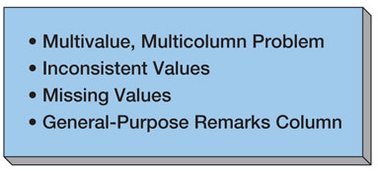
Common Design Problems

Slide 29
The Multivalue, Multicolumn Problem
The multivalue, multicolumn problem occurs when multiple values of an attribute are stored in more that one column:
EMPLOYEE (EmpNumber, Name, Email, Auto1_LicenseNumber, Auto2_LicenseNumber, Auto3_LicenseNumber)
This is another form of a multivalued dependency
Solution: Like the 4NF solution for multivalued dependencies, use a separate table to store the multiple values

Slide 30
Inconsistent Values
Inconsistent values occur when different users or different data sources use slightly different forms of the same data value:
  Different codings:
    SKU_Description = 'Corn, Large Can'
    SKU_Description = 'Can, Corn, Large'
    SKU_Description = 'Large Can Corn‘
  Different spellings:
    Coffee, Cofee, Coffeee

Slide 31
Inconsistent Values
Particularly problematic are primary or foreign key values
To detect:
  Use referential integrity check already discussed for checking keys
  Use the SQL GROUP BY clause on suspected columns
SELECT SKU_Description, COUNT(*) AS NameCount
FROM SKU_DATA
GROUP BY SKU_Description;

Slide 32
Missing Values
A missing value or null value is a value that has never been provided

Slide 33
Null Values
Null values are ambiguous:
  May indicate that a value is inappropriate:
    DateOfLastChildbirth is inappropriate for a male
  May indicate that a value is appropriate but unknown
    DateOfLastChildbirth is appropriate for a female, but may be unknown
  May indicate that a value is appropriate and known, but has never been entered:
    DateOfLastChildbirth is appropriate for a female, and may be known but no one has recorded it in the database

Slide 34
Checking for Null Values
Use the SQL keyword IS NULL to check for null values:
SELECT COUNT(*) AS QuantityNullCount
FROM ORDER_ITEM
WHERE Quantity IS NULL;

Slide 35
The General-Purpose Remarks Column
A general-purpose remarks column is a column with a name such as:
  Remarks
  Comments
  Notes
It often contains important data stored in an inconsistent, verbal and verbose way
  A typical use is to store data on a customer’s interests.
Such a column may:
  Be used inconsistently
  Hold multiple data items

Slide 36
CENG-303
Database Processing
End of Presentation:
Chapter Four

